Slide 1
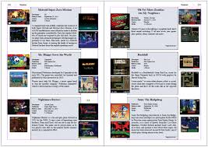
Game Database Project
Team name: Gamerpedia Group 8
Ariel Cabrera
George Suarez
Phap Bui (Dragon)
Yousef Jarrar

Slide 2
Background – Why did we choose this?
We wanted to bring our passion to life
We noticed that there aren’t many video game databases out there.
Currently there are a few available is: IGDB, OGSR, TGDB
In the future, we wanted a web app that made the database look more professional
This would include a small subscription – directed towards the premium of the database.

Slide 3
Background – Part B
Our database team is driven to provide expansive information to the end-user at a small cost fee.
We understand the logistics of reading/studying all the information about a game before it pre-releases
The database vaults; This includes information about original sound tracks, publishers, developers, Etc…
Developing a central hub that allows access to all users researching particular video games.

Slide 4
Entities
Game
Platform
gameMode
Developer
Available
Publishers
InvCount
Genre
Themes
Description
Customer
Perspective
Rating

Slide 5
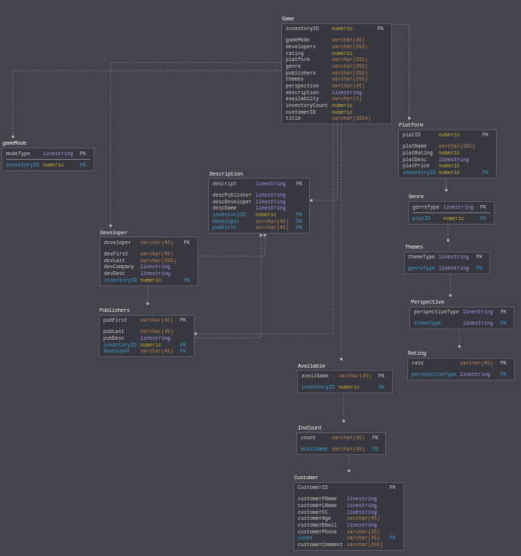
Entity Relationship Diagram

Slide 6
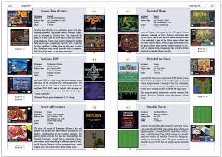
CREATE STATEMENT
CREATE TABLE Game
(
InventoryID number(10,0) NOT NULL ,
gameMode varchar2(20) NOT NULL ,
Developers varchar2(20) NOT NULL ,
Rating number(10,0) NOT NULL ,
Platform varchar2(20) NOT NULL ,
Genre varchar2(20) NOT NULL ,
Publishers varchar2(20) NOT NULL ,
Themes varchar2(20) NOT NULL ,
Perspective varchar2(20) NOT NULL ,
Description varchar2(255) NOT NULL ,
Availablity varchar2(1) NOT NULL ,
InventoryCount number(10,0) NOT NULL ,
CustomerID number(10,0) NOT NULL ,
title varchar2(20) NOT NULL,
PRIMARY KEY (inventoryID)
);

Slide 7
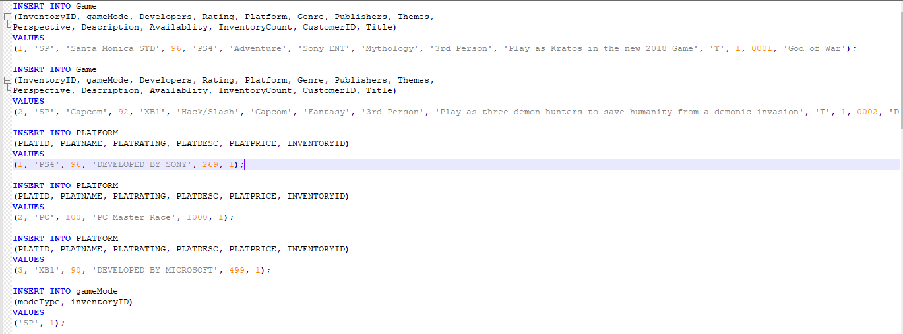
INSERT STATEMENT

Slide 8

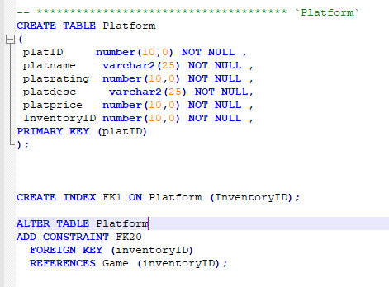
ALTER STATEMENT + INDEXING

Slide 9
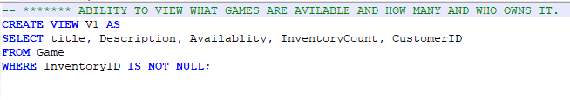
VIEWS STATEMENT

Slide 10
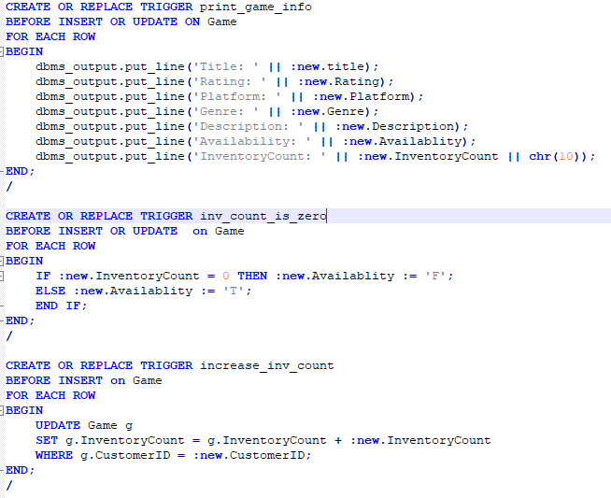
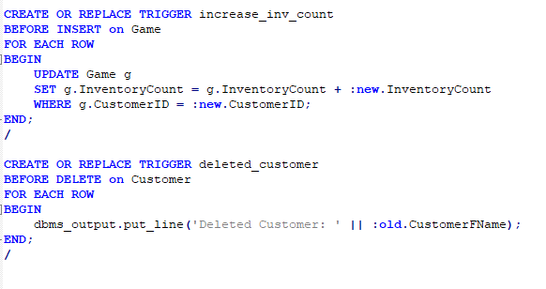
TRIGGERS

Slide 11
SELECT STATEMENT
SELECT CUSTOMERFNAME, CUSTOMERLNAME, CUSTOMERAGE FROM CUSTOMER;

Slide 12

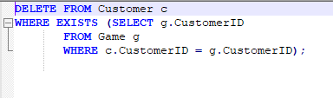
UPDATE/DELETE STATEMENTS

