Slide 1







Space X Falcon 9 First Stage Landing
By
George Sylva

Slide 2



OUTLINE
Executive Summary
Introduction
Methodology
Data collection using API
Data collection using BeautifulSoup
Results
Visualization – Charts
Eda using SQL
Insights drawn
Interactive maps with Folium
Discussion
Findings & Implications
Conclusion

Slide 3

EXECUTIVE SUMMARY
Summary of method
Data Collection through API
Data Collection using BeautifulSoup
Data Wrangling
Exploratory Data Analysis with SQL
Interactive Visualization using Folium
Summary of Results

Slide 4

INTRODUCTION
Project Background
SpaceX advertises Falcon 9 rocket launches on its website with a cost of 62 million dollars; other providers cost upward of 165 million dollars each, much of the savings is because SpaceX can reuse the first stage. Therefore if we can determine if the first stage will land, we can determine the cost of a launch. This information can be used if an alternate company wants to bid against SpaceX for a rocket launch. In this lab, you will collect and make sure the data is in the correct format from an API. The following is an example of a successful and launch.
Problem we want to solve
What factors determine if the rocket will land successfully?
The interaction amongst various features that determine the success rate of a successful landing.
What operating conditions needs to be in place to ensure a successful landing program.

Slide 5

METHODOLOGY
Data collection methodology:
Data was collected using SpaceX API and web scraping from Wikipedia.
Data was also collected using BeautifulSoup
Perform data wrangling
One-hot encoding was applied to categorical features
Perform exploratory data analysis (EDA) using visualization and SQL
Perform interactive visual analytics using Folium and Plotly Dash
Perform predictive analysis using classification model

Slide 6
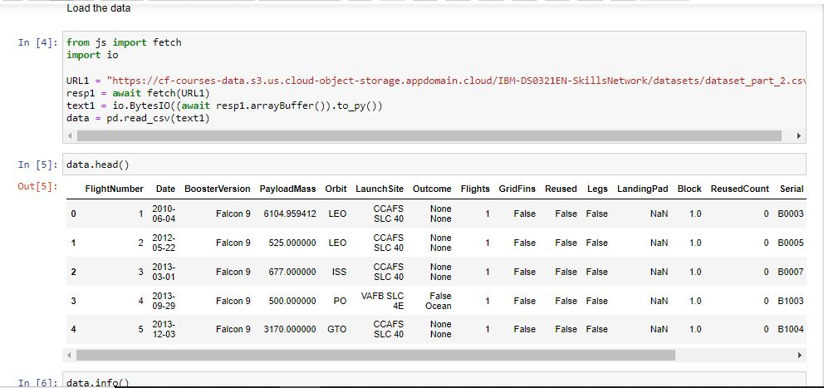
Data collection using API
Here we try to extract Data using APIs. Typically this involves making a request to a web server using a specific URL or endpoint, along with any necessary parameters or authentication credentials. The server will then respond with the requested data in a standardized format such as JSON or XML.

Slide 7
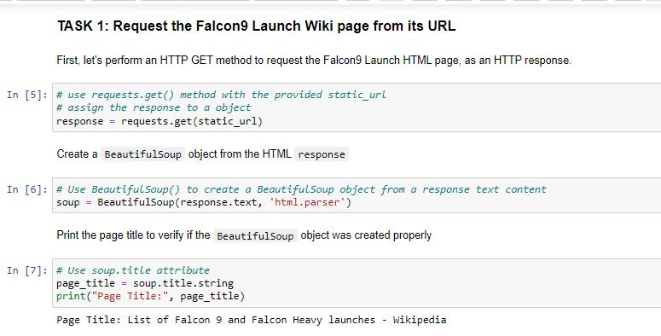
Data extraction using BeautifulSoup
Here we us BeautifulSoup which is a Python library to parses HTML and XML documents and provides methods to extract data from them. It allows us to navigate the document structure, locate specific elements, and extract their contents.
BeautifulSoup is a popular tool for web scraping and data extraction used in data science, machine learning, and other fields.

Slide 8
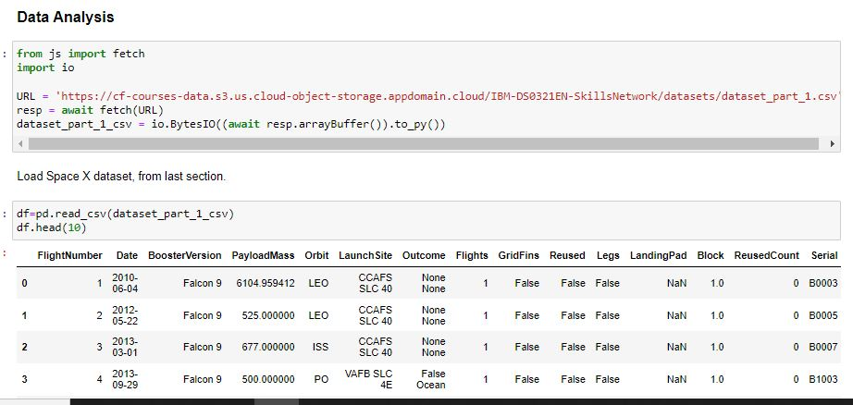
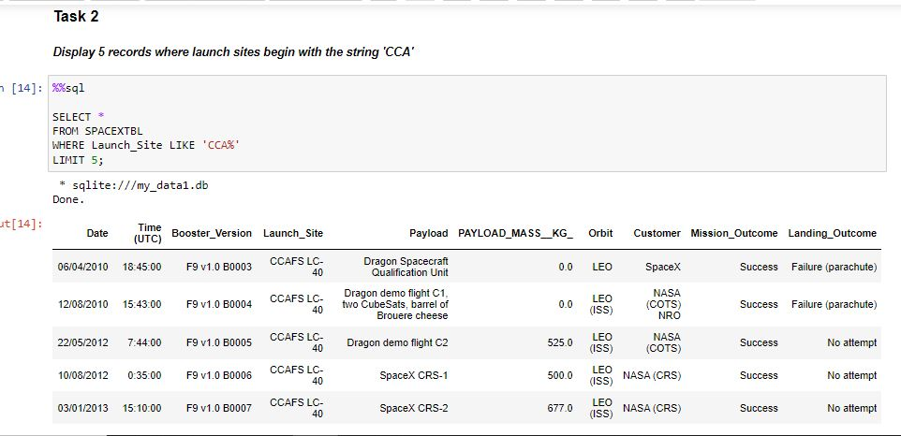
RESULTS
Data exraction was done using API and BeautifulSoup
Then Exploratory Data Analysis was then carried out with python and SQL

Slide 9
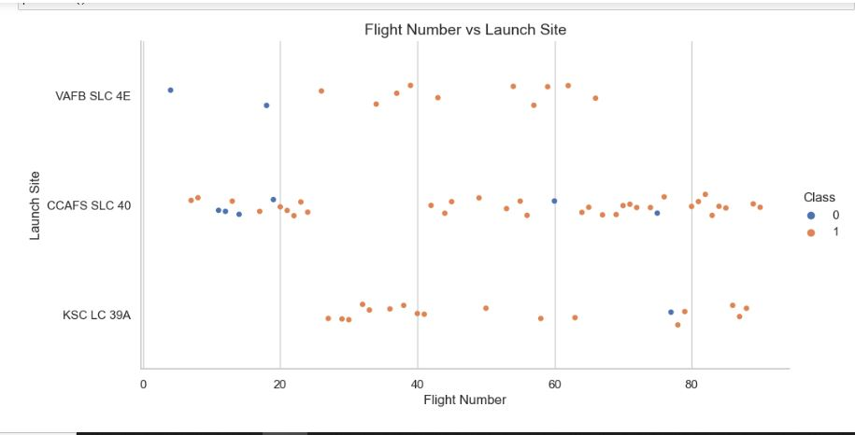
RESULTS
Visualisation Charts
During our Exploratory data we visualized using various types of methods. This is to help us extract different informations from the data.
These includes:
Scatter plots
Categorical plot
Bar plot
Line plot

Slide 10
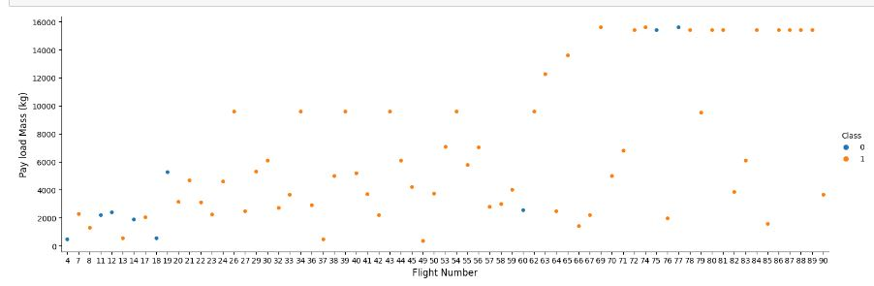
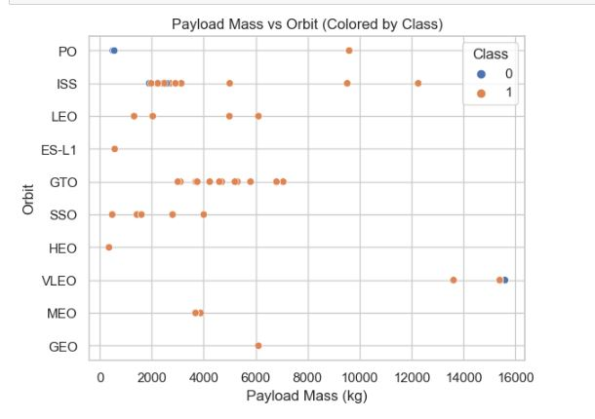
RESULTS

Slide 11
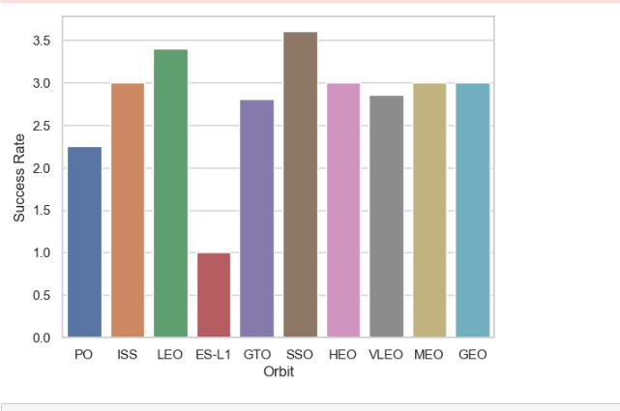
RESULTS
From our various plots we can deduce the following:
Launch site CCAFS SLC40 has the highest number of flights
Orbit SSO has the highest number of successful flights

Slide 12
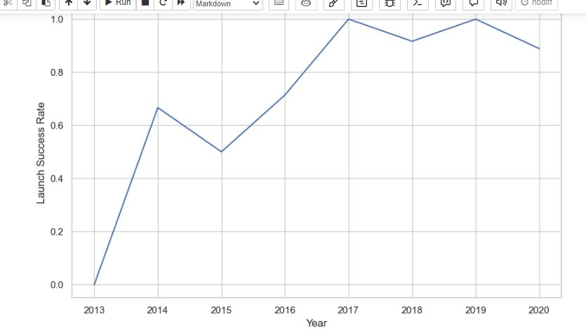
Report
The year with the Space X had the most successful rate between 2013 to 2020 are both 2017 and 2019

Slide 13
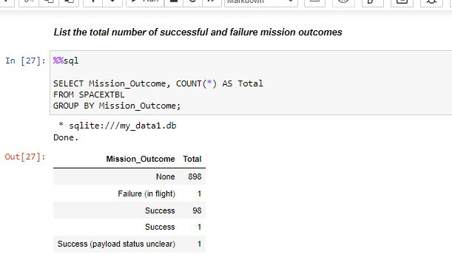
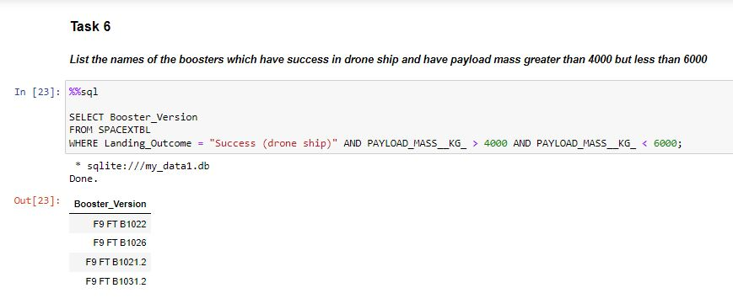
EDA with SQL

Slide 14
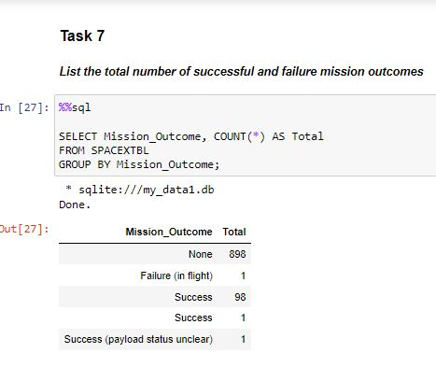
Insights Drawn
Total number of successful mission outcomes = 98

Slide 15
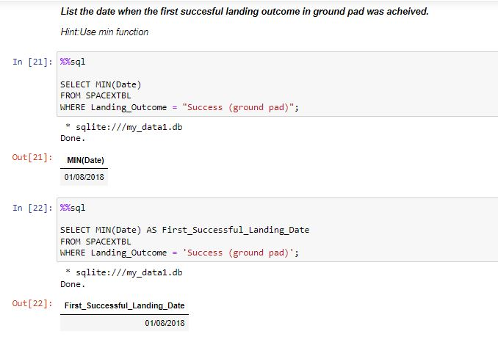
Insights Drawn
First successful landing date is on 01/08/2018.

Slide 16
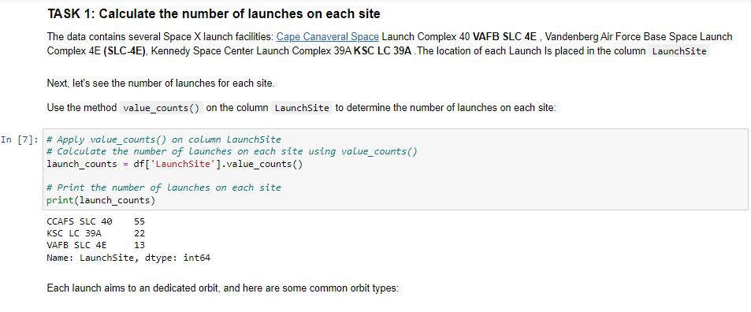
Insights Drawn
Number of launches on each site
CCAFS SLC40 = 55
KSC LC39A = 22
VAFB SLC4E = 13

Slide 17
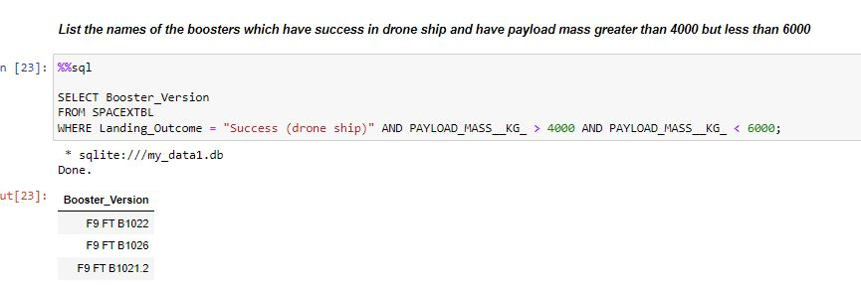
Insights Drawn
List of Boosters which have success in drone ship against payload>4000 but <6000 are
F9 FT B1022
F9 FT B1026
F9 FT B1021.2

Slide 18
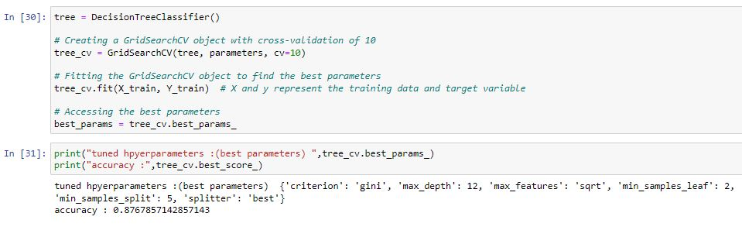
Insights Drawn
The decision Tree model had the highest prediction accuracy score with a best score of 87.6785% or 0.876785

Slide 19
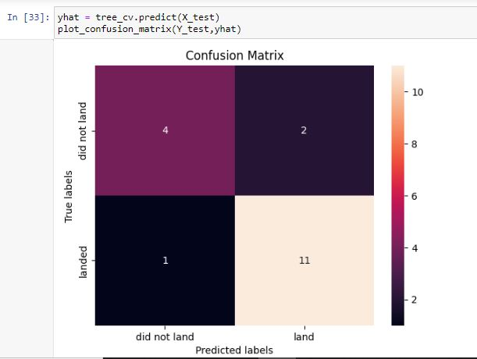
Insights Drawn
Confusion Matrix of the Decision Tree Model is shown here; comparing True labels and Predicted labels.
True Labels: 12 landed, 6 did not land
Predicted Labels: 13 landed, 5 did not land

Slide 20
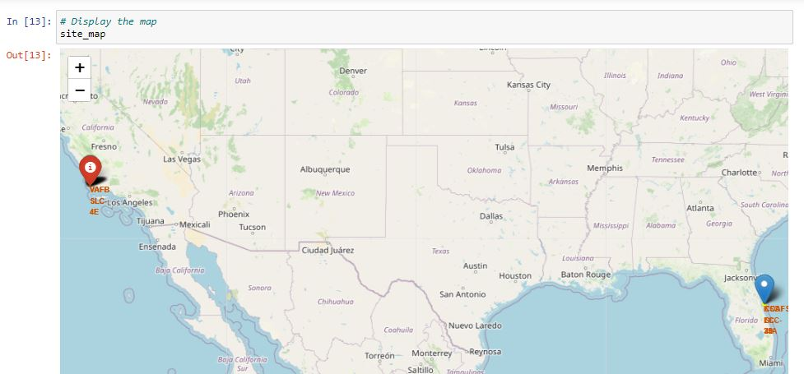
Interactive Maps with Folium results slides

Slide 21
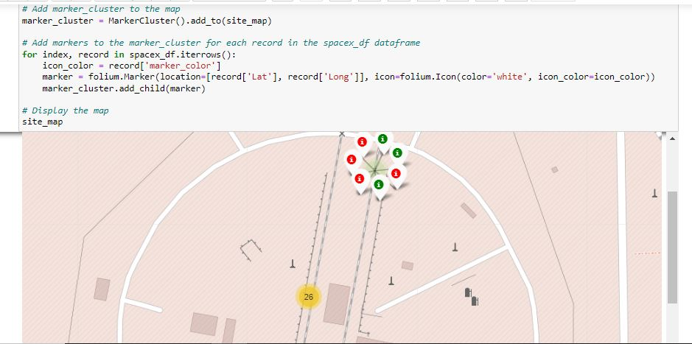
Interactive Maps with Folium results slides

Slide 22

Conclusion
We can conclude that:
The larger the flight amount at a launch site, the greater the success rate at a launch site.
Launch success rate started to increase in 2013 till 2020, with peaks at 2017 and 2019.
Orbits SSO had the most success rate followed by LEO.
The Decision tree classifier is the best machine learning algorithm for this task.

