Slide 1


Cyprunomics
GEORGIOS ATHANASIADIS
Educational game about the history of the Cypriot economy(from prehistoric times to the present day) + with assistance from AI ChatBot

Slide 2
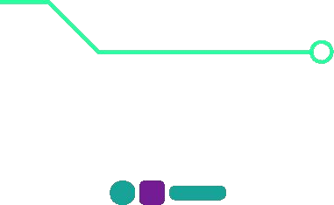
The Problem
They always say in school that Cyprus has been an important hub of trade between east and west throughout history.
Many young people differ because there is no interactive and entertaining way to learn the history of the Cyprus economy

Slide 3
Solution
A game that, in a fun and simple way, learn the players, about:
How the Market mechanisms work in each historic age; (Request- Proposal)
How the economy has influenced the political and social environment
Why economic crises appeared

Slide 4
DEMO:
https://www.youtube.com/watch?v=Ii_1rYrss4M

Slide 5
Business Plan
Funding from a bank, in order to integrate in a harmonious way the bank's advertising in the narrative of the game
Funding from erasmus+ projects

Slide 6


Thank you
GEORGIOS ATHANASIADIS
Cyprunomics

