Slide 1
MOCCASIN: “Model ODE Converter for Creating Awesome SBML INteroperability”
Translates a common form of MATLAB ODE model into SBML by inferring reaction network
Uses algorithm developed by Fages et al. (http://doi.org/f2vbzg)
Does not require MATLAB
Parser & translator written in Python; uses libSBML + BIOCHAM web service
Offers both graphical and command-line interfaces
Currently limited to relatively basic MATLAB models of a certain form
Near-future goals:
Interpret and support more MATLAB constructs
Implement Fages et al. inference algorithm in MOCCASIN itself
Developed by Mike Hucka (Caltech), Sarah Keating (EBI) and Harold Gómez (Boston University). NIH funding via Mount Sinai School of Medicine (NY) thanks to Stuart Sealfon.

Slide 2
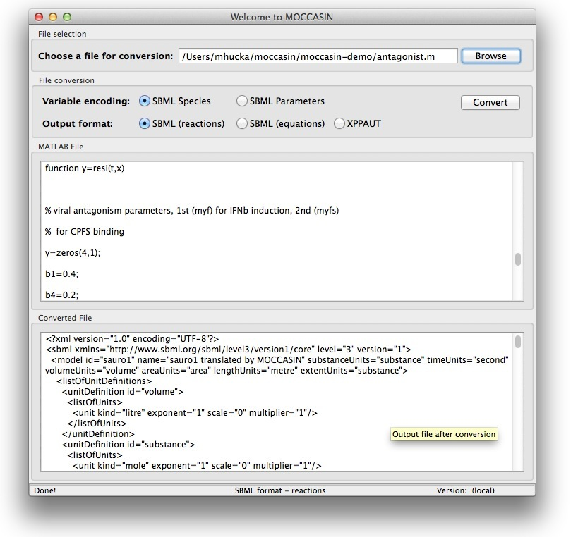
Simple interface
MATLAB file
SBML output

