Slide 1
Zoo Animals for Machine Learning Algorithms
Predictive Loan Approval Analysis on HMDA Data
09/07/2019
Remember to include:
“Future considerations…”

Slide 2
Hypothesis
With some sub-set of Boolean animal features, you can predict animal class.

Slide 3


1. Introduction

Slide 4
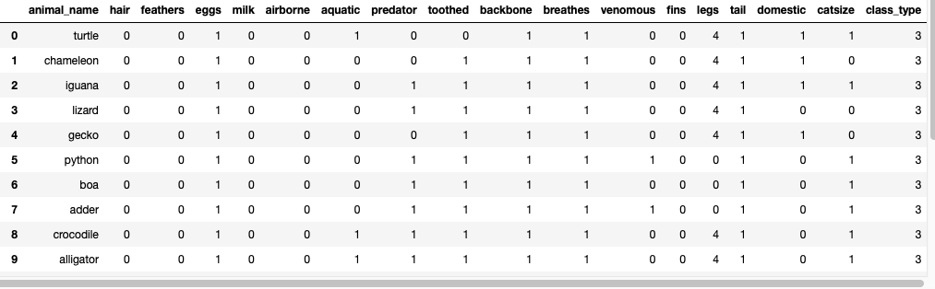
Zoo

Slide 5
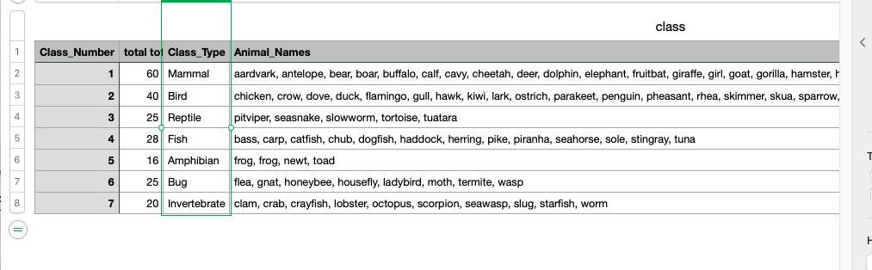
Zoo

Slide 6
2. Data

Slide 7
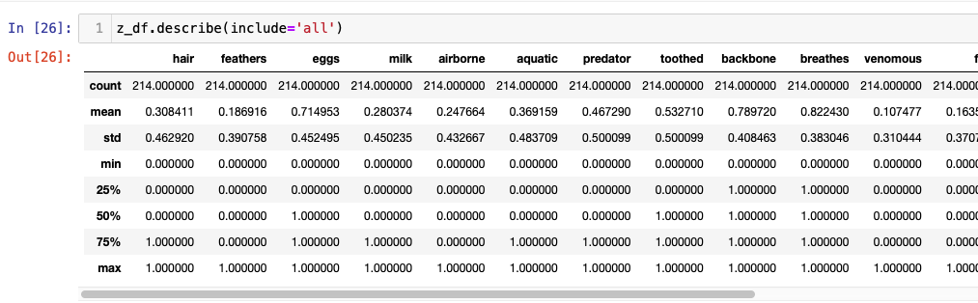
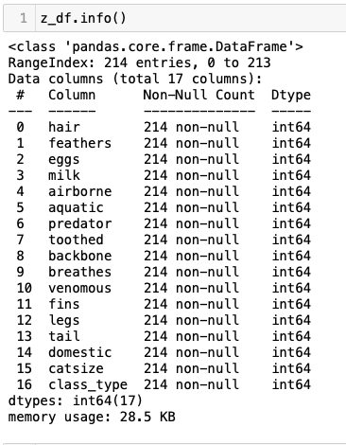
Describe=‘all’

Slide 8
3. EDA

Slide 9
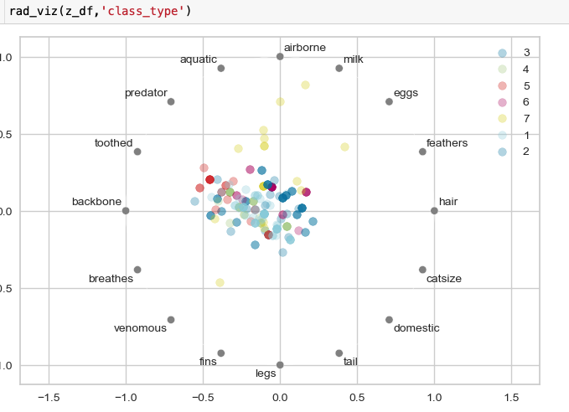
What’s important?

Slide 10
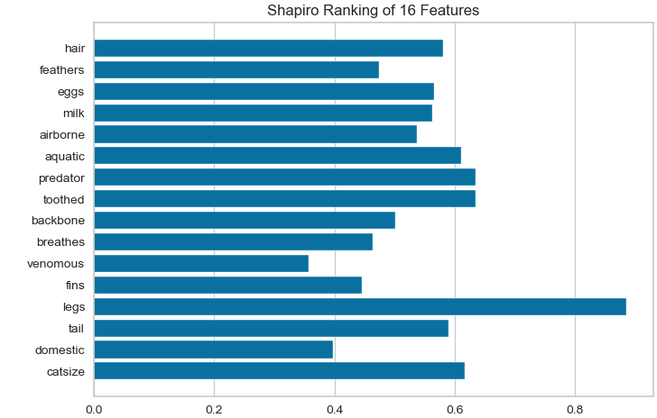
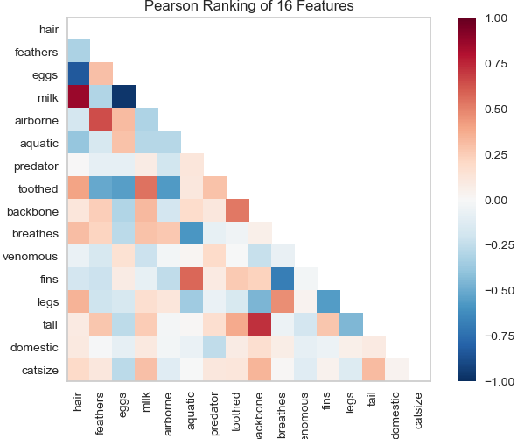
What’s important?

Slide 11
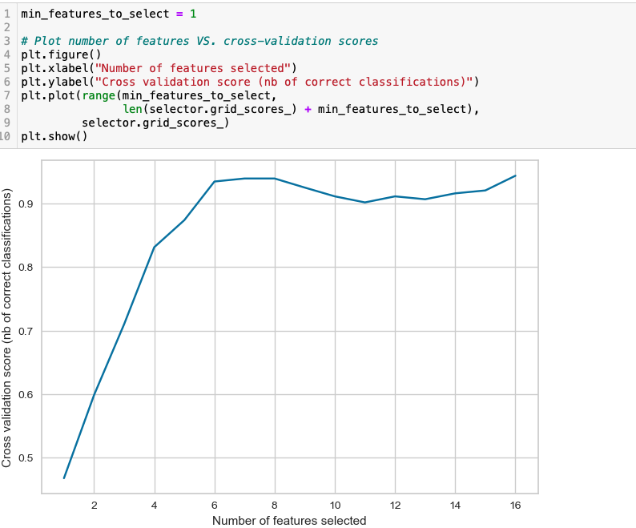
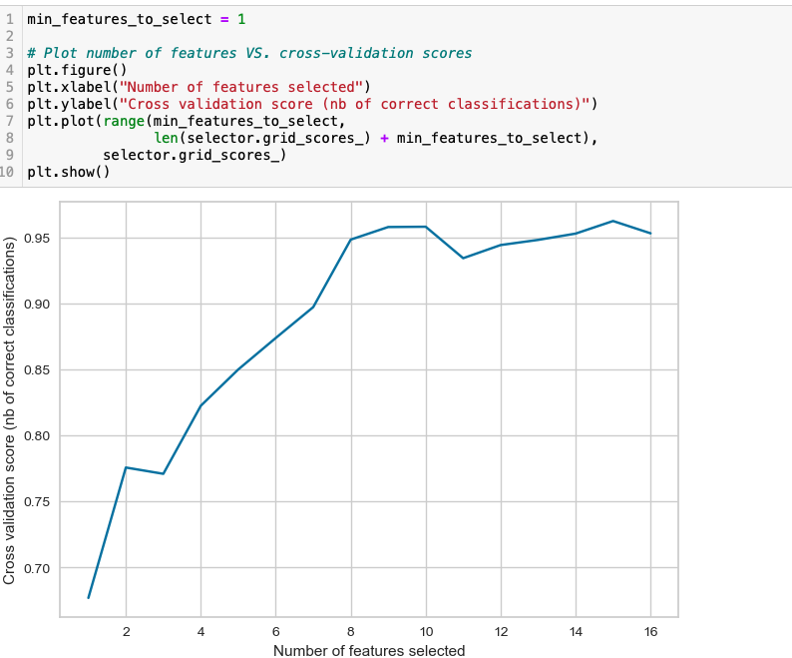
What’s important?

Slide 12
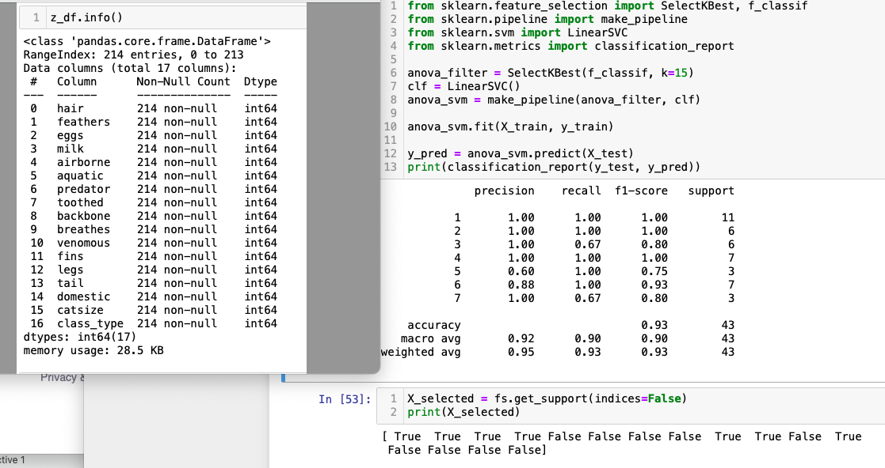
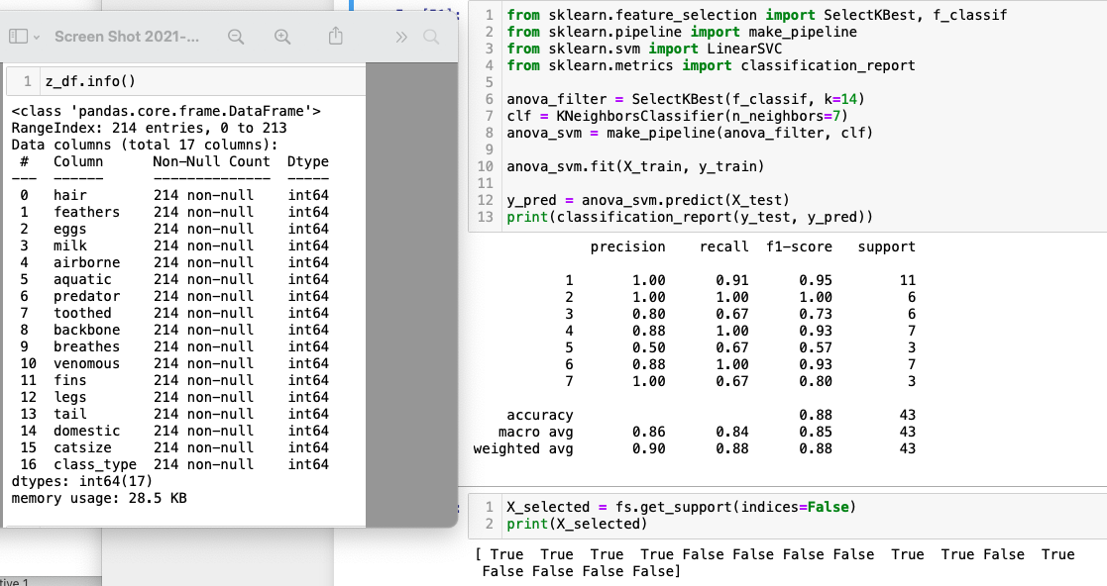
What’s important?

Slide 13
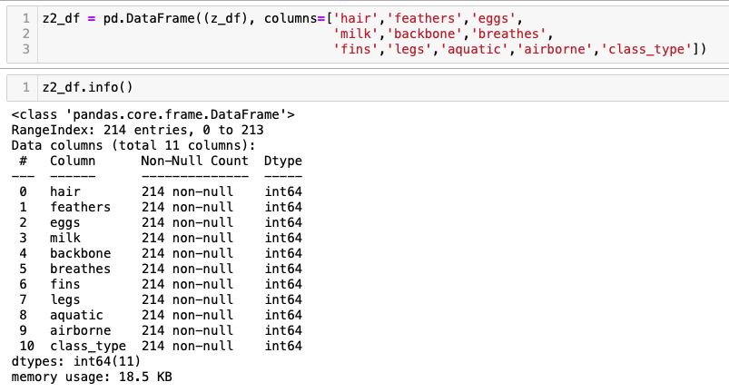
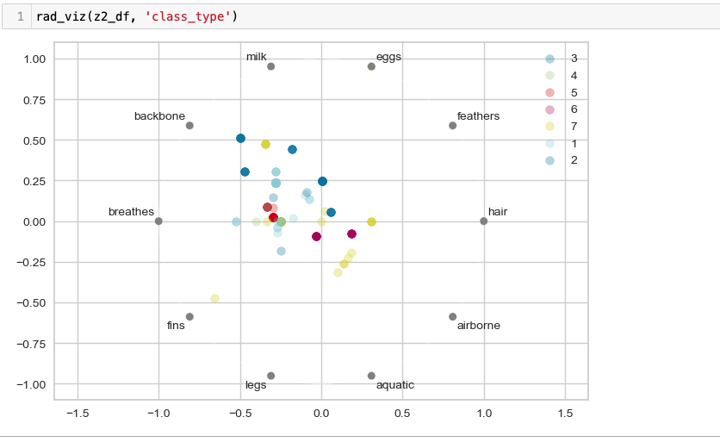
Downselect

Slide 14
6. Machine Learning

Slide 15


