Slide 1
Jtesting – Screen design and test plans
By George Sulaiman

Slide 2
Class Diagram
ContactInfoBook.java
ContactInfoBookGui.java
public class ContactInfoBook {
private String ContactFirstName;
private String ContactSurname;
private int ContactPhone;
private String ContactEmail;
public class ContactInfoBookGui implements ActionListener {
private JLabel lblFirstName, lblSurname, lblPhone, lblEmail;
private JTextField txtFirstName, txtSurname, txtPhone, txtEmail;
private JButton btnClear;
private JButton btnSave;
private JButton btnExit;
private JPanel panel;
public ContactInfoBookGui(){
class ClearHandler implements ActionListener{
public void actionPerformed(Action Event event) {
class SaveHandler implements ActionListener{
public void actionPerformed(Action Event event) {
class ExitHandler implements ActionListener{
public void actionPerformed(Action Event event) {
public String getContactFirstName()
public String getContactSurname()
public int getContactPhone()
public String getContactEmail()

Slide 3

Screen design (GUI)
JFrameTitle
JLabel
JTextField
JPanel
JFrame
As you can see, this is a screen design draft of how I would like my graphical user interface to look like. It is important to have designed a draft to therefore have an understanding of how I want my contact info book GUI to appeal to a user and also by ensuring its user-friendly.
Contact Info Book
First Name :
Surname :
Phone :
Email :
Clear
Save
Exit
JButton

Slide 4
Test Plan (GUI)
Test no. | Purpose | Test data | Expected response | Actual response | Conclusion
1. | The GUI to show up with JFrame, JPanel, JLabels, JTextFields, JButtons all appearing to the user. | ‘Clicking on run’ ‘Control, F11’ | The GUI is presented to the user. This should include the JFrame, JPanel, JLabels, JTextFields and JButtons. | The GUI showed up with the JFrame, JPanel, JLabels, JTextFields, JButtons. | This test was successful.
2. | To write into the JTextFields for user input. This is to check if the JTextField allows a user to type data into it. | ‘George’, ‘Sulaiman’, ‘07792887322’, ‘george.977@Hotmail.co.uk’ | For the JTextField to allow the user to type into it. | All of the JTextFields allowed user input for each of the separate fields. | This test was successful.
3. | The ‘Clear’ JButton works in which it clears all the typed data from the JTextFields. | ‘Clear’ JButton is clicked | For all of the inputted data from the user is cleared with one click of the ‘clear’ button. | The clear button deleted all of the data within the text fields successfully. | This test was successful.

Slide 5
Test Plan (GUI)
Test no. | Purpose | Test data | Expected response | Actual response | Conclusion
4. | For when the ‘Save’ button is clicked onto and it saves the data from the JTextFields into a text file. | ‘Save’ JButton is clicked | The save button should save all of the typed data from the JTextFields and for it to be saved into a text file. | All of the typed data from the text fields had been successfully saved into the text file of the contacts. | This test was successful.
5. | ‘Save’ JButton (Option panel) to ask the user ‘Are you sure you want to save?’ | The ‘Save’ button is clicked and ‘yes’ is clicked | For the option panel to appear after the save button has been clicked onto. | The option panel from the save been had showed up to the user, and the ‘yes’ button worked. | This test was successful.
6. | For the Save message dialog to pop up to the user. | Click ‘Save’ button , then click ‘Yes’ | For the save message dialog to pop up to the user and say “The contact has been saved”. | The save message dialog showed up and said to the user that “The contact has been saved”. | This test was successful.
7. | When the ‘Exit’ button is clicked, it closes the application | ‘Exit’ JButton is clicked | For the exit button to immediately close the application. | The application had immediately closed after the button was clicked. | This test was successful.

Slide 6
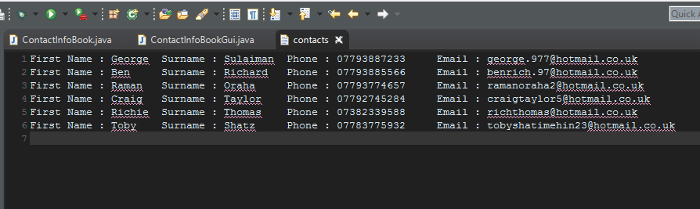
Test Plan (GUI)
Test no. | Purpose | Test data | Expected response | Actual response | Conclusion
8. | This is to ensure that the Exit option panel shows up when the user clicks on the exit button | ‘Exit’ button is clicked | For the option panel to pop up to the user asking the user “ Are you sure you want to exit?” | The exit option panel had popped up to the user, in which asked the user “Are you sure you want to exit?”. | This test was successful.
As you can see, after having test planned and JTested my application, this screenshot shows that all tests that I had tested had passed successfully in order to have retrieved all of the data from the text fields into this contacts text file.

Slide 7
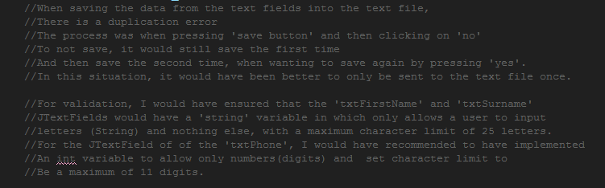
Test Plan (GUI)
Note:
The two following tests had failed;
Duplication from the save button.
Validation checks.
This screenshot below explains the two specific failed tests and have mentioned recommendations towards the real life scenarios and an explanation to why each failed test has its individual significance towards real life applications such as this Contact Information Book.

