Slide 1
1. Algorithm to find the root of a Quadratic Equation Ax^2 + Bx^2 + C = 0
BEGIN
DECLARE a,b,c: INTEGER
DISPLAY “Enter the value for a= “
INPUT a
DISPLAY “Enter the value for b= “
INPUT b
DISPLAY “Enter the value for c= “
INPUT c
x1 = (-b + (b^2 – 4ac)^1/2)/ 2a
x2 = (-b - (b^2 – 4ac)^1/2)/ 2a
DISPLAY x1
DISPLAY x2
END
Start
Declare a,b,c
Display “Enter the value for a”
Input a
Display “Enter the value for b”
Input b
Display “Enter the value for c”
Input c
X1 = (-b + (b^2 – 4ac)^1/2)/ 2a
X2 = (-b - (b^2 – 4ac)^1/2)/ 2a
Display x1
Display x2
End

Slide 2



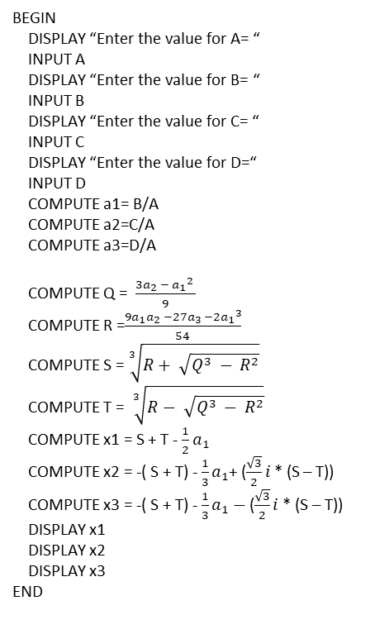




2. Find the root of a Cubic equation A$x^{3}$ + B$x^{2}$ + Cx + D = 0
Start
Display “Enter the value for a”
BEGIN
DISPLAY “Enter the value for A= “
INPUT A
DISPLAY “Enter the value for B= “
INPUT B
DISPLAY “Enter the value for C= “
INPUT C
DISPLAY “Enter the value for D=“
INPUT D
COMPUTE a1= B/A COMPUTE a2=C/A
COMPUTE a3=D/A
COMPUTE Q = $\frac{{3a}_{2} − {a_{1}}^{2} }{9}$
COMPUTE R =$\frac{{9a}_{1}a_{2 }−27a_{3} −2{a_{1}}^{3}}{54}$
COMPUTE S = $\sqrt[3]{R+ \sqrt{Q^{3} − R^{2}}}$
COMPUTE T = $\sqrt[3]{R− \sqrt{Q^{3} − R^{2}}}$
COMPUTE x1 = S + T - $\frac{1}{2}a_{1}$
COMPUTE x2 = -( S + T) - $\frac{1}{3}a_{1}$+ ($\frac{\sqrt{3}}{2}i$ * (S – T))
COMPUTE x3 = -( S + T) - $\frac{1}{3}a_{1}−$ ($\frac{\sqrt{3}}{2}i$ * (S – T))
DISPLAY x1
DISPLAY x2
DISPLAY x3
END
Input a
Display “Enter the value for b”
Input b
Display “Enter the value for c”
Input c
Display “Enter the value for d”
Input d
Q = $\frac{{3a}_{2} − {a_{1}}^{2} }{9}$
R =$\frac{{9a}_{1}a_{2 }−27a_{3} −2{a_{1}}^{3}}{54}$
S = $\sqrt[3]{R+ \sqrt{Q^{3} − R^{2}}}$
T = $\sqrt[3]{R− \sqrt{Q^{3} − R^{2}}}$
x1 = S + T - $\frac{1}{2}a_{1}$
Display x1
x2 = -( S + T) - $\frac{1}{3}a_{1}−$ ($\frac{\sqrt{3}}{2}i$ * (S – T))
x2 = -( S + T) - $\frac{1}{3}a_{1}$+ ($\frac{\sqrt{3}}{2}i$ * (S – T))
Display x2
Display x3
End

Slide 3
3. Find the largest of three numbers
Start
Output “Enter the value for a”
BEGIN
OUTPUT “Enter the value for a= “
INPUT a
OUTPUT “Enter the value for b=“
INPUT b
OUTPUT “Enter the value for c=“
INPUT c
IF a > b and a>c THEN
DISPLAY “a is the largest”
IF b>a and b>c THEN
DISPLAY “b is the largest”
IF c>b and c >a THEN
DISPLAY “c is the largest”
ENDIF
END
Input a
Output “Enter the value for b”
Input b
Output “Enter the value for c”
Input c
If a>b and a>c
True
Output “a is the largest”
End
If b>b and b>c
Output “b is the largest”
End
If c>b and c>a
Output “c is the largest”
End
End

Slide 4
4. Find the GCD and LCM of two numbers.
(GCD)
Start
BEGIN
DISPLAY “Enter the value for a=“
INPUT a
DISPLAY “Enter the value for b=“
INPUT b
DECLARE d : INTEGER
IF a > b THEN
d = a – b
IF (a mod d) and (b mod d) = 0 THEN
DISPLAY “d is the HCF”
ELSE
c = d
WHILE c !=0
IF (a mod c) and (b mod c) = 0 THEN
DISPLAY “c is the HCF”
END
ELSE
DECREMENT c by 1
ENDIF
ENDWHILE
ENDIF
ELSE
d = b – a
IF (a mod d) and (b mod d) = 0 THEN
DISPLAY “d is the HCF”
ELSE
c = d
WHILE c !=0
IF (a mod c) and (b mod c) = 0 THEN
DISPLAY “c is the HCF”
END
ELSE
DECREMENT c by 1
ENDIF
ENDWHILE
ENDIF
ENDIF
END
Display “Enter the value for a”
Input a
Display “Enter the value for b”
Input b
Declare d: Integer
True
If a>b
False
d = a -b
d = b - a
False
If (a mod d) and (b mod d) = 0
False
If (a mod d) and (b mod d) = 0
Display “d is the HCF”
Display “d is the HCF”
End
End
c = d
c = d
While c !=0
False
While c !=0
End
False
End
True
True
If (a mod d) and (b mod d) = 0
True
If (a mod d) and (b mod d) = 0
End
Display “d is the HCF”
True
End
Display “d is the HCF”
False
False
Decrement c by 1
Decrement c by 1

Slide 5
4. Find the GCD and LCM of two numbers.
(LCM)
Start
BEGIN
DISPLAY “Enter the value for a=“
INPUT a
DISPLAY “Enter the value for b=“
INPUT b
DECLARE d : INTEGER
IF a > b THEN
d = a – b
IF (a mod d) and (b mod d) = 0 THEN
e = (a * b)/ c
DISPLAY “e is the LCM”
ELSE
c = d
WHILE c !=0
IF (a mod c) and (b mod c) = 0 THEN
e = (a * b) /c
DISPLAY “ e is the LCM”
END
ELSE
DECREMENT c by 1
ENDIF
ENDWHILE
ENDIF
ELSE
d = b – a
IF (a mod d) and (b mod d) = 0 THEN
e = (a * b)/c
DISPLAY “e is the LCM”
ELSE
c = d
WHILE c !=0
IF (a mod c) and (b mod c) = 0 THEN
e = (a * b)/c
DISPLAY “e is the LCM”
END
ELSE
DECREMENT c by 1
ENDIF
ENDWHILE
ENDIF
ENDIF
END
Display “Enter the value for a”
Input a
Display “Enter the value for b”
Input b
Declare d: Integer
True
If a>b
False
d = a -b
d = b - a
True
If (a mod d) and (b mod d) = 0
If (a mod d) and (b mod d) = 0
Display “e is the LCM”
e = (a * b)/c
Display “d is the HCF”
e = (a * b)/c
End
False
End
c = d
False
c = d
While c !=0
False
While c !=0
End
False
End
True
True
True
True
If (a mod d) and (b mod d) = 0
If (a mod d) and (b mod d) = 0
Display “d is the HCF”
e = (a * b)/c
Display “d is the HCF”
e = (a * b)/c
End
False
End
False
Decrement c by 1
Decrement c by 1

