Slide 1

Counterfactual Storytelling and Visual Storyboarding
George Wu
4/21, 2026
This project presents a system for counterfactual storytelling and storyboard generation in action movies. By modifying key decision points in film plots (e.g., "What if Annie failed to maintain speed in Speed?"), we generate coherent alternate plotlines via fine-tuned language models and visual storyboards using diffusion-based generative image models.

Slide 2
Introduction
Motivation
Action movies pivot on critical decision points that fundamentally alter narrative trajectories
Counterfactual analysis reveals the structural integrity of original storylines
Visualizing these multiverse realities are often labor-intensive and challenging -> requires manual re-storyboarding
Creating a computational framework to generate coherent alternate plots while maintaining:
Character consistency
Logical consequence chains
Thematic integrity

Slide 3
Executive Summary
We developed a comprehensive counterfactual narrative generation system for action movies that:
Takes movie counterfactual statements as input (e.g., "What if John McClane had been captured in Die Hard?")
Produces visually coherent storyboards depicting alternate plot trajectories
Preserves narrative logic while exploring divergent storylines
Technical Approach
Language Component: Fine-tuned Gemma3 models (1B/4B) using QLoRA to efficiently generate alternate plots
Visual Component: Adapted diffusion models with storyboard-specific fine-tuning to translate text into visual narratives
Key Findings
Specific visual prompts produce more stylistically consistent storyboards
Language models successfully maintain narrative coherence post-divergence point
System effectively demonstrates how pivotal moments redefine character relationships and thematic elements

Slide 4
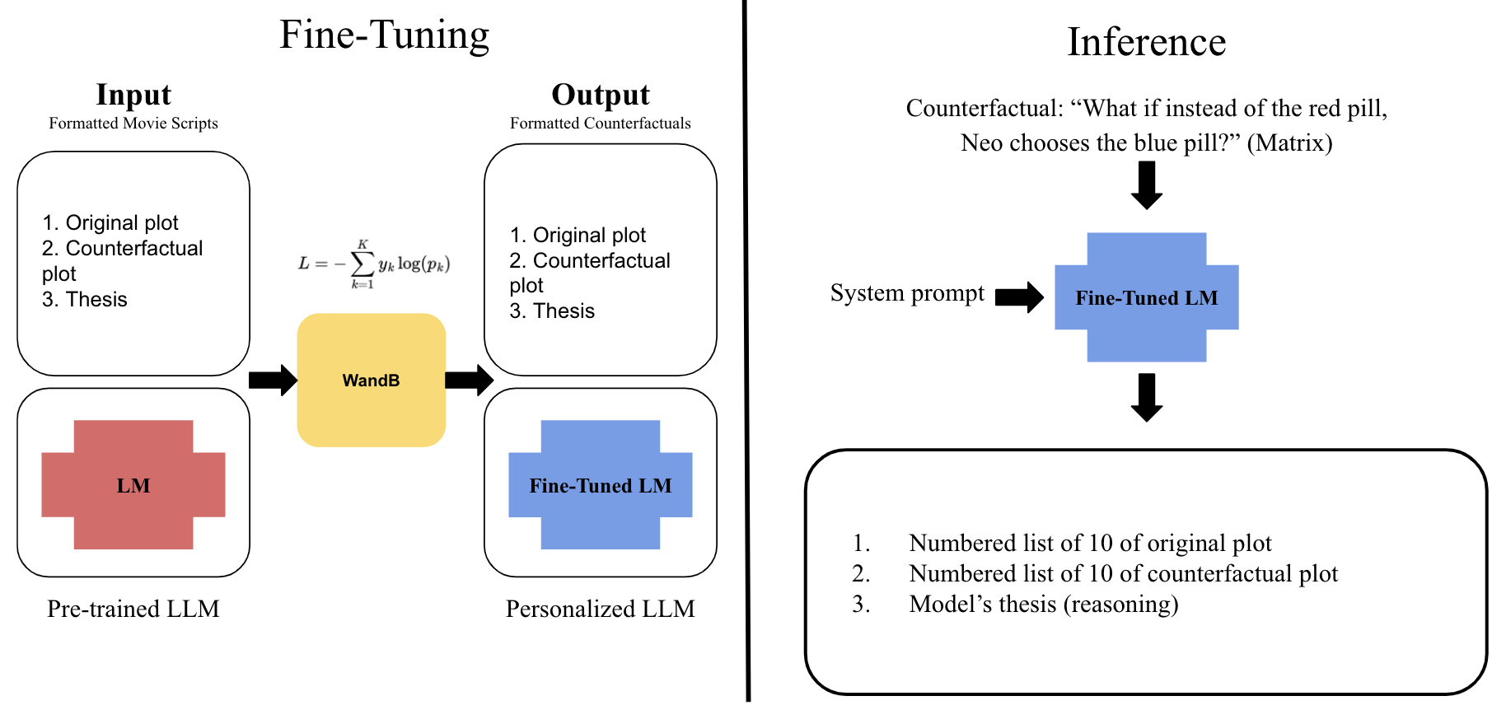

Slide 5
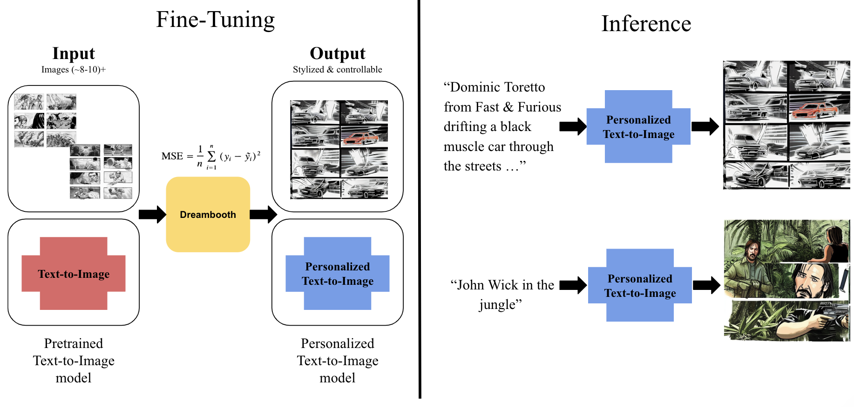

Slide 6
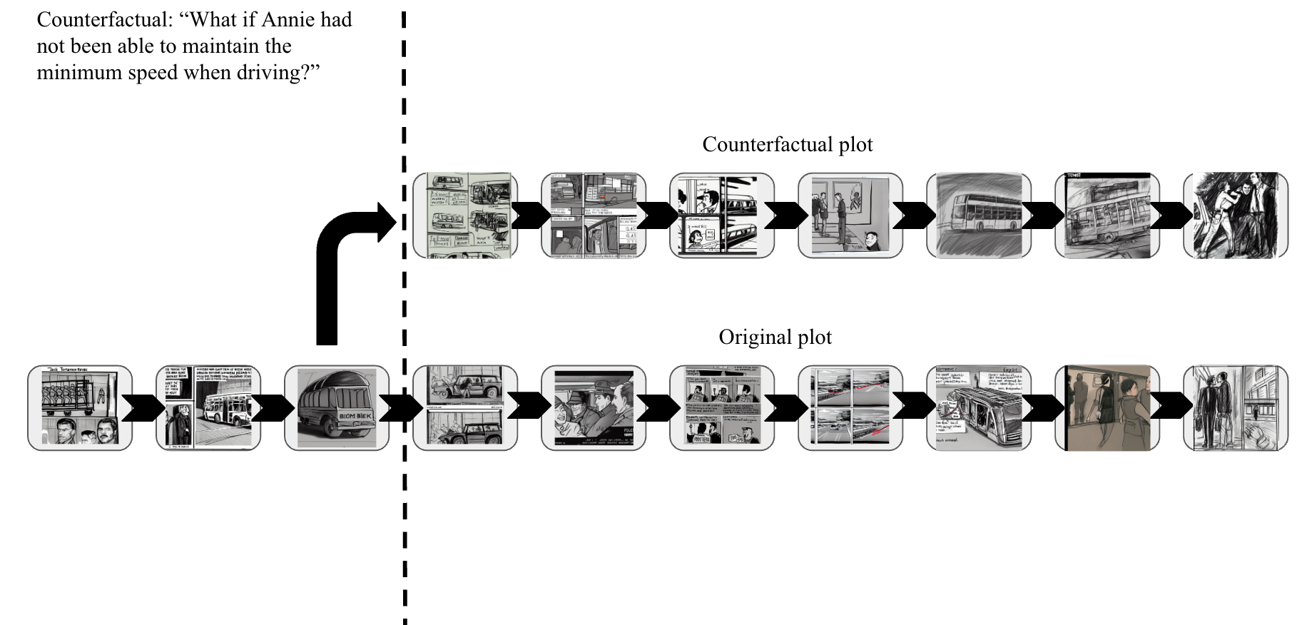

Slide 7
Narrative generation: Fine-tuning Large Language Model(LLM)
What is Large Language Model?
Using a Large Language Model (LLM) to "read" narrative patterns rather than just memorizing facts.
Why Gemma3 instead of regular model?
It has strong reasoning and instruction-following foundations.
Standard model lack the logical consistency required for action movie scripts.
Notes:
the model that “reads” through a large amount of information on the internet and instead of memorizing this information, LLM will learn the patterns of words and treat words like coordinates on a map, where words with similar meanings are grouped close together.
the model that “reads” through a large amount of information on the internet and instead of memorizing this information, LLM will learn the patterns of words and treat words like coordinates on a map, where words with similar meanings are grouped close together.

Slide 8
LLM continues
The choice of QLoRA
QLoRA stands for Quantized Low-Rank Adaptation.
Updates only a small fraction of weights using "adapters"—making fine-tuning fast and efficient.
How we train and optimize?
Monitoring with WandB: Acts as a "Script Supervisor" for the model.
Tracks every "take" (iteration) to minimize errors and optimize performance.
WandB Random Hyperband Search
Notes:
Plain English: Model will write the script to script supervisors and it will give advice back on how well is the script and how many mistakes does the model make (minimizing the loss)
Plain English: Model will write the script to script supervisors and it will give advice back on how well is the script and how many mistakes does the model make (minimizing the loss)

Slide 9
LLM output examples
Reference
1. LAPD officers Jack Traven and Harry Temple rescue hostages from an elevator rigged with explosives by terrorist Howard Payne, who seemingly dies in the explosion afterward.
…
4. Jack boards the moving bus, explains the situation to passengers, and passenger Annie takes over driving when the driver is wounded.
5. During a complex traffic sequence, Annie's inexperience causes the bus to drop below 50 mph momentarily, partially triggering the bomb mechanism.
…
Fine_tuned
1. LAPD officers Jack Traven and Harry Temple rescue hostages from an elevator rigged with explosives by terrorist Howard Payne, who seemingly dies in the explosion afterward.
…
4. Jack boards the moving bus, explains the situation to passengers, and passenger Annie reluctantly takes the wheel when the driver is wounded.
5. Jack orchestrates a daring passenger evacuation while maintaining speed, but Annie, lacking his safe-driving skills, makes critical errors in judgment.
…

Slide 10
LLM output examples: What if Uncle Ben had not been killed by the thief Peter Parker let escape?
Reference
High school student Peter Parker is bitten by a genetically modified spider during a field trip, gradually developing superhuman abilities.
…
6. Peter struggles balancing his secret identity with school, work, and his feelings for Mary Jane Watson, who is dating Harry.
…
10. Peter returns Osborn's body home where Harry vows revenge on Spider-Man, unaware it's Peter, who then rejects Mary Jane's feelings to protect her.
Fine_tuned
1. High school student Peter Parker is bitten by a genetically modified spider during a field trip, gradually developing superhuman abilities.
…
6. With Uncle Ben still alive, Peter continues pursuing personal fame and fortune, neglecting family responsibilities and developing an increasingly arrogant persona.
…
10. Peter emerges victorious but morally compromised, with Ben and May struggling to reconcile the increasingly unrecognizable person their nephew is becoming.

Slide 11
Visual Storyboarding: Adapted Diffusion Models
So what’s next?
From Text to Sketch: Stable Diffusion translates generated plots into visual scenes.
Style Training (DreamBooth): Requires only 8–10 images to teach the model a specific "pencil-sketch" aesthetic.
Learning via "Static":
The model adds noise to images and learns to "clean" it.
Goal: minimizing RSE between actual noises versus predicted noises
Result: It moves from guessing to knowing exactly how to replicate our desired style.
Notes:
We used Dreambooth as it only requires taking a small set of images (8–10) in a specific style—in our case, pencil-sketched storyboards—and we can train the model to replicate that look.
The way we fine-tune diffusion model is slightly different from the normal model -> The model add noises by itself to the images and compare the actual noises versus predicted noises(MSE).
Plain English: the model purposely messed up the images and it will then guess how to "clean" that static to get back the original images. The model will learn during this process and know what kind of images we want

Slide 12

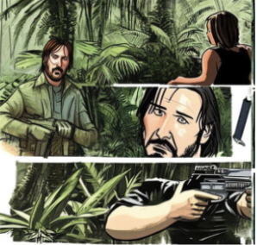
What happened if we don’t fine-tune?

Slide 13
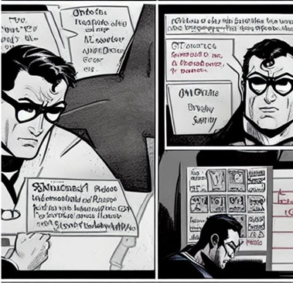
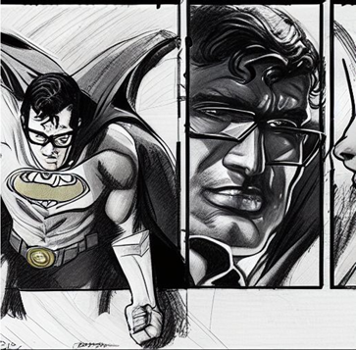
Diffusion model continues
Prior preservation: use to prevent the model from forgetting general objects (like cars or buses) while it focuses on the sketch style.
Examples: hand-drawn storyboard with 3 panels, sketch pencil style, expressive faces, storyboard art

Slide 14
Diffusion model continues
Intuition of what we are doing:
“When I use this trigger word, ignore the photorealism you learned from billions of internet photos and only look at this specific aesthetic.”
Key points:
we purposely "overfitted" the model slightly. While typically avoided in data science, this ensured the images looked like sketches rather than realistic photos.
A lot of time if we don’t do these steps the model will most likely generate real movie scenes and images -> which is not ideal

Slide 15
Conclusion
Our project generates narrative-consistent and visually coherent counterfactual storyboards for action movies, demonstrating how pivotal moments fundamentally alter character relationships and plot trajectories. Our counterfactual storyboarding system enables screenwriters, educators, and fans to visualize alternate plot trajectories, deepening narrative analysis and providing creative inspiration for film development.
Limitations & Future work:
Lack of objective evaluation method (human evaluation dependent)
Unsure of generalizability
Image model shortcomings: Suffers from limited generalization, highly sensitive to hyperparameters, super task specific
Language model shortcomings: Non-perfect optimization method (loss doesn’t directly reflect what we want the model to learn

Slide 16
Thank you!
If you have any questions please feel free to contact me via george12@g.ucla.edu

