Slide 1
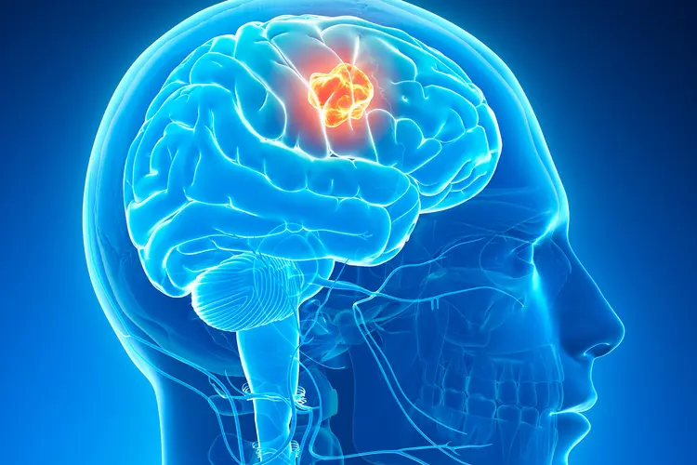
01 / 12
Methods For Brain Tumor Classification from MRI Images
We build 2 models to automatically classify brain tumor MRI images into 4 tumor categories and compare a Deep Learning model CNN as baseline with an advanced approach – EfficientNet.
Zhongyang Fan
George Wu
04/29/2026
Brain tumor MRI classification: baseline CNN vs. transfer learning
Notes:
Open by translating the project into familiar statistical language. Set up the class to listen for study design, evaluation metrics, and interpretation rather than software detail.
Sources:
- Weekly HW 03 writeup by Zhongyang Fan, adapted for statistics students.
- Kaggle Brain Tumor MRI Dataset: masoudnickparvar/brain-tumor-mri-dataset.
- Original project result figures reused from the prior 426 presentation.

Slide 2
02 / 12
1. Research Setting
Outcome
Predictors
Research goal
• Each MRI image must be assigned to one of four categories: glioma, meningioma, pituitary tumor, or no tumor.
• So the response variable is categorical with more than two levels. The final decision rule is a 4-class classifier.
• The inputs are raw MRI images rather than numerical or text input
•New models can learn useful image features automatically.
• Compare a simple baseline CNN with a stronger transfer-learning model.
• Ask not only which model has higher overall accuracy, but also which one behaves better on the difficult classes.
• This matters because one class can fail even when average accuracy looks good.
Brain tumor MRI classification: baseline CNN vs. transfer learning
Notes:
Slow down here and make the audience comfortable: the novelty is image data, but the logic is still a standard supervised classification comparison.
Sources:
- Weekly HW 03 writeup by Zhongyang Fan, adapted for statistics students.
- Kaggle Brain Tumor MRI Dataset: masoudnickparvar/brain-tumor-mri-dataset.
- Original project result figures reused from the prior 426 presentation.

Slide 3

Stats 426 Final Presentation
03 / 12
2. Data, split, and class balance
The design is clean enough for a fair baseline-vs-advanced comparison.
7021
4,570
1,140
1,311
total MRI images
training images
validation images
test images
Public dataset used for the project.
Used to fit model parameters.
Used to monitor generalization during training.
Held out for final evaluation.
Why the split matters
Training accuracy tells us how well a model learns the data it has already seen.
Validation and test performance tell us whether that learned knowledge generalizes to new scans.
That separation is especially important because it allows us to know how the model works generally.
Notes:
Emphasize that the four classes are balanced, so accuracy is more interpretable than it would be under severe class imbalance. Also explain why train/validation/test separation is central.
Sources:
- Weekly HW 03 writeup by Zhongyang Fan, adapted for statistics students.
- Kaggle Brain Tumor MRI Dataset: masoudnickparvar/brain-tumor-mri-dataset.
- Original project result figures reused from the prior 426 presentation.

Slide 4
04 / 12
3. Baseline model: CNN good at image recognition and starting from 0
Key Idea: CNN uses many training images and their labels to gradually adjust the values inside its filters.
Through this process, the filters become better at detecting image patterns that are useful for classification.
Step 1: simple patterns
Step 2: combine features
Final rule
• People always choose small visual features such as edges, boundaries, and contrast changes by hands.
• But here CNN learned automatically from simple features rather than chosen manually.
• Later layers combine simple patterns into more complex structures.
• That helps the model separate tumor types that may look similar at first time.
• After these layers, the model ends with a probability output over four classes.
• That is 4 class, A, B, C, and D. P(A) = 0.1, P(B) = 0.1, P(C) = 0.1, P(D) = 0.7, we would say this tumor belongs to D class
• This baseline gives us a performance standard for the comparison.
Brain tumor MRI classification: baseline CNN vs. transfer learning
Notes:
Use familiar language: automatic basis expansion, hierarchical feature construction, and estimated class probabilities. Avoid too much architecture detail.
Sources:
- Weekly HW 03 writeup by Zhongyang Fan, adapted for statistics students.
- Kaggle Brain Tumor MRI Dataset: masoudnickparvar/brain-tumor-mri-dataset.
- Original project result figures reused from the prior 426 presentation.

Slide 5
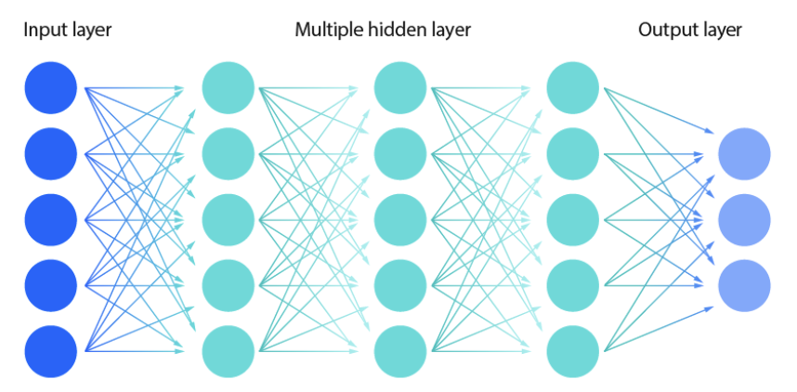

Slide 6
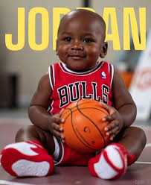
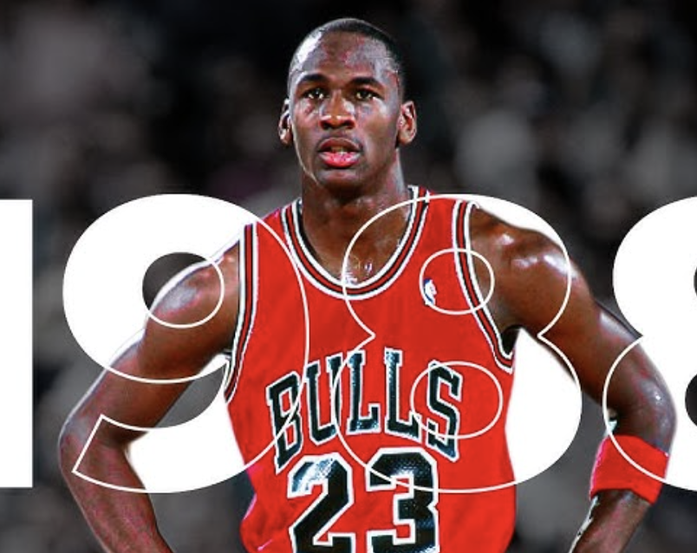
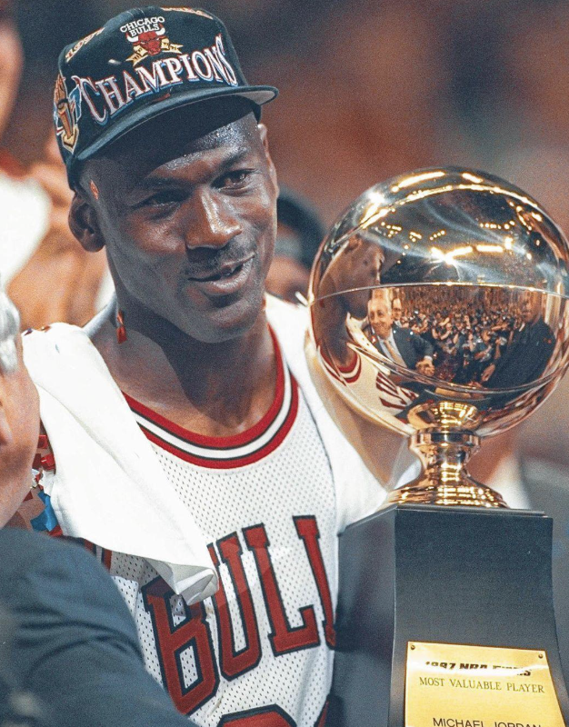
Stats 426 Final Presentation
05 / 12
4. Advanced model: EfficientNetB05 starting at knowledgeable basic
CNN
Advanced
Try to be
Why it may help
Two-stage fitting
Working hypothesis
• A pretrained model (has been trained on large dataset) already has informations like edges, shapes, and contrast patterns
• So it does not have to learn every low-level feature from 0.
• Stage 1: freeze most pretrained layers and train only the final classification part.
• Stage 2: unfreeze more layers and continue training at a smaller learning rate.
• This moves from a more restricted fit to a more flexible fit.
• If transfer learning is useful, we should see higher overall performance.
• More importantly, we should see better performance than baseline on the visually confusing classes.
Brain tumor MRI classification: baseline CNN vs. transfer learning
Notes:
Translate freeze and unfreeze as restricted versus flexible fitting. Stress that transfer learning is especially appealing when data are limited and class separation is difficult.
Sources:
- Weekly HW 03 writeup by Zhongyang Fan, adapted for statistics students.
- Kaggle Brain Tumor MRI Dataset: masoudnickparvar/brain-tumor-mri-dataset.
- Original project result figures reused from the prior 426 presentation.

Slide 7
Stats 426 Final Presentation
06 / 12
5. Preprocessing and evaluation plan
Image preprocessing
Data augmentation
Metrics
• All images are resized to 224 by 224 pixels.
• Pixel values are normalized to the 0 to 1 range.
• This gives the models a common input scale.
• Rotations, shifts, zoom, brightness changes, and horizontal flips increase variation in the training set.
• The goal is to reduce overfitting and improve generalization.
• Accuracy summarizes the overall proportion correct.
• Precision, recall, and F1-score let us inspect each class separately.
• ROC-AUC tells us how well a class is separated from the others across thresholds.
Brain tumor MRI classification: baseline CNN vs. transfer learning
Notes:
Frame metrics as answers to different questions: overall success, class-specific sensitivity, balance of precision and recall, and separability.
Sources:
- Weekly HW 03 writeup by Zhongyang Fan, adapted for statistics students.
- Kaggle Brain Tumor MRI Dataset: masoudnickparvar/brain-tumor-mri-dataset.
- Original project result figures reused from the prior 426 presentation.

Slide 8
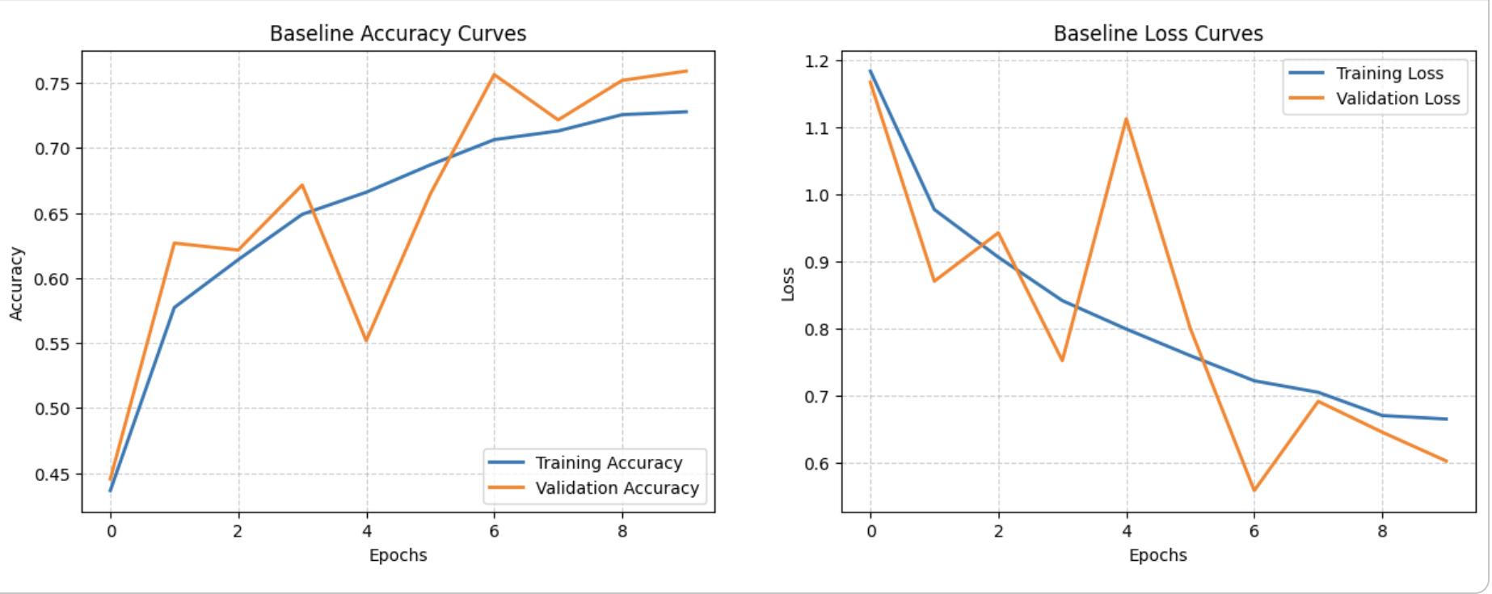
Stats 426 Final Presentation
07 / 12
6. Baseline CNN: what do the learning curves say?
Reading the curves
• Training accuracy climbs to roughly 0.72.
• Validation accuracy ends around 0.76.
• Loss falls overall, so the model is learning.
• But the fit still leaves substantial classification error.
Notes:
Explain training versus validation again while reading the figure. The audience should see the baseline as reasonable but clearly improvable.
Sources:
- Weekly HW 03 writeup by Zhongyang Fan, adapted for statistics students.
- Kaggle Brain Tumor MRI Dataset: masoudnickparvar/brain-tumor-mri-dataset.
- Original project result figures reused from the prior 426 presentation.

Slide 9
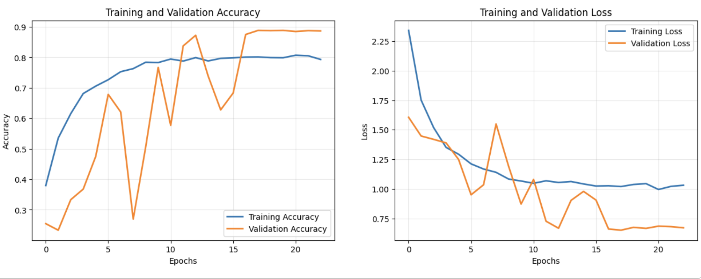
Stats 426 Final Presentation
08 / 12
7. Transfer learning model: stronger fit and better generalization
Main change
• Training accuracy reaches about 0.80.
• Validation accuracy rises to about 0.89.
• The convergence pattern is smoother overall.
• This supports the idea that the pretrained start is useful.
Notes:
Make the comparison explicit: both training and validation results move upward, and the validation gap does not suggest a collapse in generalization.
Sources:
- Weekly HW 03 writeup by Zhongyang Fan, adapted for statistics students.
- Kaggle Brain Tumor MRI Dataset: masoudnickparvar/brain-tumor-mri-dataset.
- Original project result figures reused from the prior 426 presentation.

Slide 10
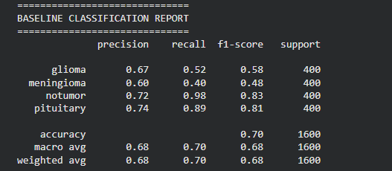
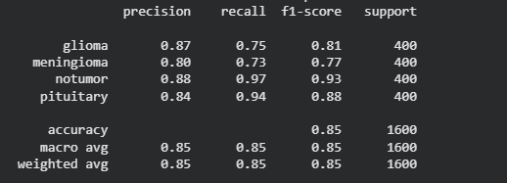
Stats 426 Final Presentation
09 / 12
8. Class-wise results: where does the improvement happen?
Recall measures how many actual positive cases the model correctly finds. Precision measures how many predicted positive cases are actually correct.
Baseline report
Transfer-learning report
0.40 → 0.73
0.52 → 0.75
0.70 → 0.85
Meningioma recall
Glioma recall
Overall accuracy
A large gain on one of the hardest tumor classes.
Another major gain where misclassification mattered most.
Average performance improves too, but the class-wise gains tell the richer story.
Notes:
Say clearly that the advanced model helps most where the problem is actually difficult. That is a stronger conclusion than simply saying accuracy increased.
Sources:
- Weekly HW 03 writeup by Zhongyang Fan, adapted for statistics students.
- Kaggle Brain Tumor MRI Dataset: masoudnickparvar/brain-tumor-mri-dataset.
- Original project result figures reused from the prior 426 presentation.

Slide 11
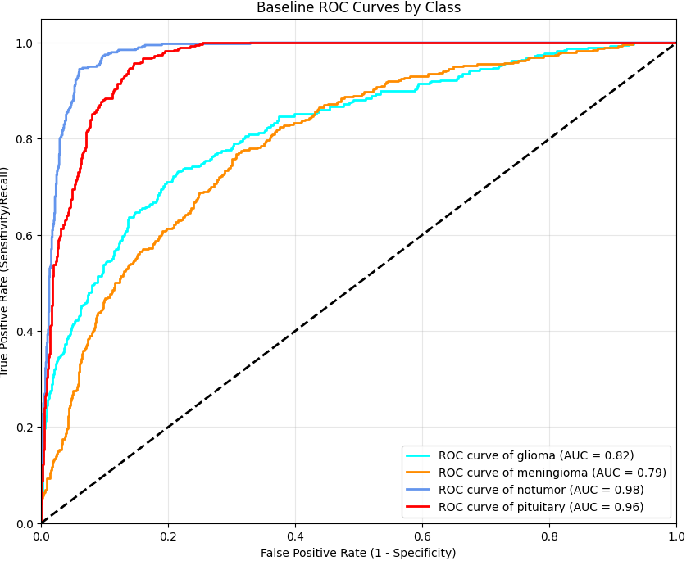
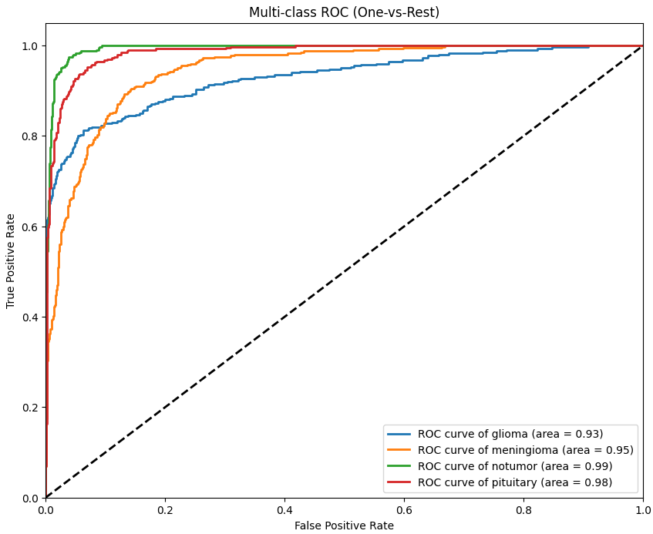
Stats 426 Final Presentation
10 / 12
9. ROC curves: the class-separation
ROC-AUC curve shows how well the model separates different classes.
Baseline ROC
Transfer-learning ROC
Glioma AUC: about 0.82 to 0.93 Meningioma AUC: about 0.79 to 0.95
Notes:
Use this slide to say that the advanced model improves separation for the overlapping classes. Mention that the easy classes were already strong and stayed strong.
Sources:
- Weekly HW 03 writeup by Zhongyang Fan, adapted for statistics students.
- Kaggle Brain Tumor MRI Dataset: masoudnickparvar/brain-tumor-mri-dataset.
- Original project result figures reused from the prior 426 presentation.

Slide 12
Stats 426 Final Presentation
11 / 12
10. Conclusion
Main finding
Why this matters
Limitations
• Transfer learning outperforms the baseline CNN across every major evaluation measure in this study.
• It increases overall accuracy.
• It also improves recall, F1-score, and ROC-AUC on the difficult classes.
• A good model should not only do well on average.
• It should also behave more reliably on the cases where classification is hardest.
• The model is still not perfect when tumor appearances overlap.
• Low-contrast or noisy MRI scans remain difficult.
• More data and additional model development would still be needed for stronger real-world use.
Brain tumor MRI classification: baseline CNN vs. transfer learning
Notes:
This is your conclusion slide. Keep it balanced: the project finds a meaningful improvement, not a final medical solution.
Sources:
- Weekly HW 03 writeup by Zhongyang Fan, adapted for statistics students.
- Kaggle Brain Tumor MRI Dataset: masoudnickparvar/brain-tumor-mri-dataset.
- Original project result figures reused from the prior 426 presentation.

Slide 13
Stats 426 Final Presentation
12 / 12
Thank you!
Q&A
E-mail: zhongyangfan@g.ucla.edu
Notes:
Invite questions, but leave the audience with the strongest interpretation: improvement on the hard classes is the core result.
Sources:
- Weekly HW 03 writeup by Zhongyang Fan, adapted for statistics students.
- Kaggle Brain Tumor MRI Dataset: masoudnickparvar/brain-tumor-mri-dataset.
- Original project result figures reused from the prior 426 presentation.

