Slide 1
After Equilibrium
Expectation Mismatch, Real Deindustrialization, and the Roots of Anti-globalization Politics
George Yean
Harvard University
MPSA 2026
Notes:
10.28 IR workshop comments:
-refine theories; new equi? Or short-term fluctuation? Be precise (GY: ground on existing theory, reuse, long run dynamics)
-survey why is needed? Hetero individuals? Refer to trade attitude literature.
-consider politicization of china shock?
-Jerry: just US? Walter (2021)-protrade, just trade or FDI? Japan is also systemic? US left-wing concerned about labor/env? Is Indonesia also applicable?
-Davis: simple relationship A->D; what about framing: when econ expectation doesn’t align, what diverges in trad pref? no need publication?
-SC: does country always get CA? is it perceived like auto?
-GY: this theory is to intended to explain everything, but arguably best one for current tensions.

Slide 2
Intensified Anti-Globalization Tensions
U.S.-China trade war (fmr. U.S.-Japan trade war)
U.S. broad-based global tariffs & paralyzing the WTO
EU/Canada/Indonesia/Mexico tariffs on China
…
Notes:
Yelling Tan. MIC 2025 may not be treatment.
GY: I received some feedback slighly different than this. But i feel this theory and mechanisms are central to understanding contemporary anti-trade politics.

Slide 3
Existing Theories …
Self-interest: winner-loser
Sociotropic
Identity: ethnocentric, nationalist
Elite cue: unfair trade (Ballard-Rosa et al. 2021)
Other: geopolitics, security
⇒ hard to explain opinion change, differentiated policy treatment (managed transition vs. opposition), elite opinion, vague source of backlash…
Notes:
Geo/sec: why tariffs on allies?
Why existing trade opinion theories are limited? What’s wrong with trade theory?

Slide 4
Theoretical Distinction
Q: Why globalization is okay in its rise, but not in its maturity?
Pre-equilibrium: opening-up to equilibrium (RV/HO/Krugman/Melitz, Rogowski/Hiscox/Mutz…)
After-equilibrium: long-run effect unclear Garret 2000; Krugman 1987; Lawrence and Weinstein 1999; Rodriguez and Rodrik 1999
Free trade assumptions not necessarily hold: frictions, balance…
losing both adv/disadv ➔ (bipartisan) trade skepticism
Notes:
Whole logic: free trade is no longer net gain… (the logic of FT is broken; more dedus soon)
Nuance in different models; baseline of my study.
Framing: Theory and evidence
Why anti-trade sentiment intensification? Existing IPE theories lack explanations for the phenomenon we see and neglect an important gap. I propose a new theory of anti-trade politics, derived from trade models and historical incidents. Theoretically losing adv sectors due to trade leads to trade skepticism. Then I investigate how the theory translates into political elites’ anti-trade attitudes and shapes public opinion. The evidence suggests that the theory and mechanisms are central to understanding contemporary anti-trade politics.
RV: only labor move to export industry; equi: factor price equalization
HO: both labor/capital factors move to export products; equ: factor price equalization.
Krugman/Melitz: when open to trade, larger market lead to scale and higher prod firms

Slide 5
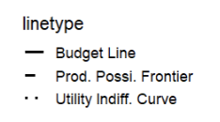
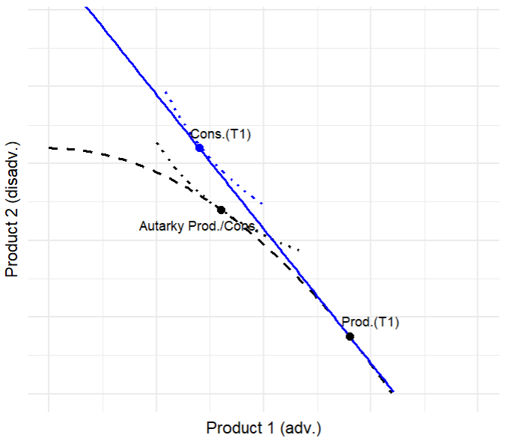
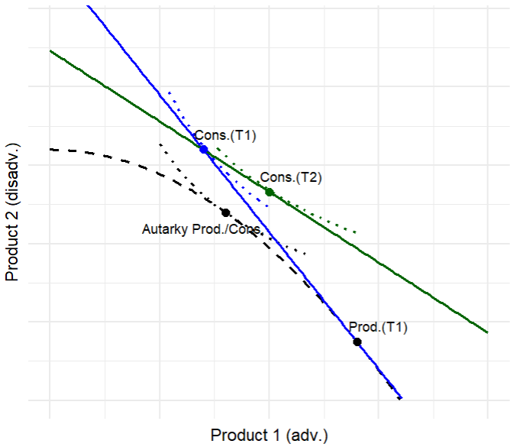
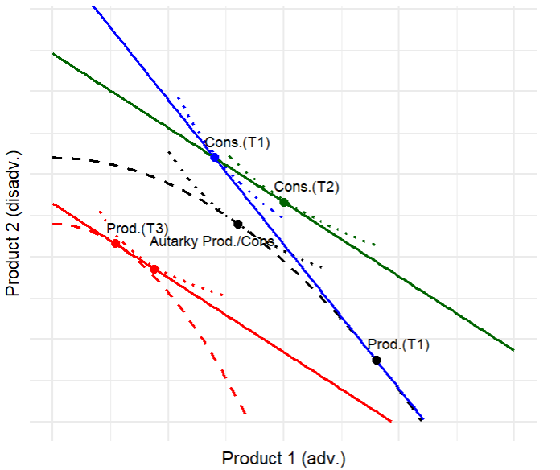
“After Equilibrium”: Visualization (net loss)
1. Trade Equilibrium
2. Shock (short-term)
3. Shock (long-term)
Notes:
Short-term: inter-temporal borrow/reserve to finance deficit, same consumption
Long-term: factors idle and disappear, PPF shrinks, cannot borrow/deindus/devalue, production/cons shrinks
SC: why

Slide 6
Theory: Expectation Mismatch
1. Expectation origin:
Free trade & comparative adv
Deeply influenced liberalization policies & pro-trade sentiment since the 1940s (Williamson 1990; USITC p84; Samuelson 1972)
“… comparative advantage has been at the heart of
all informed reasoning of globalization.”
– Baldwin, 2016

Slide 7
Theory: Expectation Mismatch
2. When adv. sectors are threatened:
Old bargain & consensus breaks down
Mismatched expectation + a sense of ”unfair trade” ➔ (moralized) skepticism & opposition.

Slide 8
Why Politically Matter?
Expectational: benefit adv sectors, welfare
Developmental: real deindus. & being poorer
Psychological: national identity, sociotropic, national security

Slide 9
Theoretical Expectations
 | Sectoral Threat | Systemic Threat
Disadvantage | managed transition (regional) (e.g., 1990s Mexico/NAFTA) | managed transition (regional politics) (e.g., first China shock)
Advantage | targeted protection (bipartisan) (e.g., U.S.-Japan trade war) | broad-based protection (bipartisan) (e.g., second China shock)
Possible moderators:
Geopolitics: ally status, regime type
New trade theory: product diff.
New new trade theory: own MNC, localized production
Notes:
-Ignore esp. during wto period —Some restrictions for Korea/taiwan’s apparel was not during WTO period. They are more managed transition, also stem from regional politics or politically sensitive sectors. Under GATT, non-tariff barriers like negotiating quota is loosely regulated until Uruguay round (Multi-fiber agreement phased out in 2005?). Under WTO, dispute settlement is strengthened and voluntary export restraints are outlawed, replaced by safeguards or antidumping which are slower and narrower.
-but still,restrictions on textile was much lighter than US-JPN trade war. (not just voluntary quota, but seciton 301, tariff threat, agressive antidumping cases, plaza accord – until localized production)
-When realizing systemic threat? Perhaps MIC 2025

Slide 10
Empirical Evidence: Mixed-methods
Notes:
Use congressional texts to show that anti-trade language consistent with your theory is present in elite discourse.
Use surveys to show that ordinary citizens respond in ways consistent with the same logic and further understand how mechanisms work
Theory and evidence:
To evaluate this argument, I draw on two complementary sources of evidence. First, I analyze congressional speeches to show that elite actors increasingly invoke frames that are consistent with the logic of [trade theory X], linking trade to concerns about [mechanism, e.g. wage erosion, security risks, etc.]. This provides observational evidence that the theory’s core logic is present in real-world political discourse. Second, I conduct a survey experiment to assess how ordinary citizens respond when exposed to similar frames. While surveys cannot demonstrate that these mechanisms have historically driven mass attitudes, they allow me to isolate causal responses and show that the same trade-theoretic logic resonates with the public which shapes policy. Together, these analyses establish both the external validity (elites actually use these frames) and the internal validity (citizens respond in predictable ways to them) of the proposed mechanism, thereby triangulating support for the theory.

Slide 11
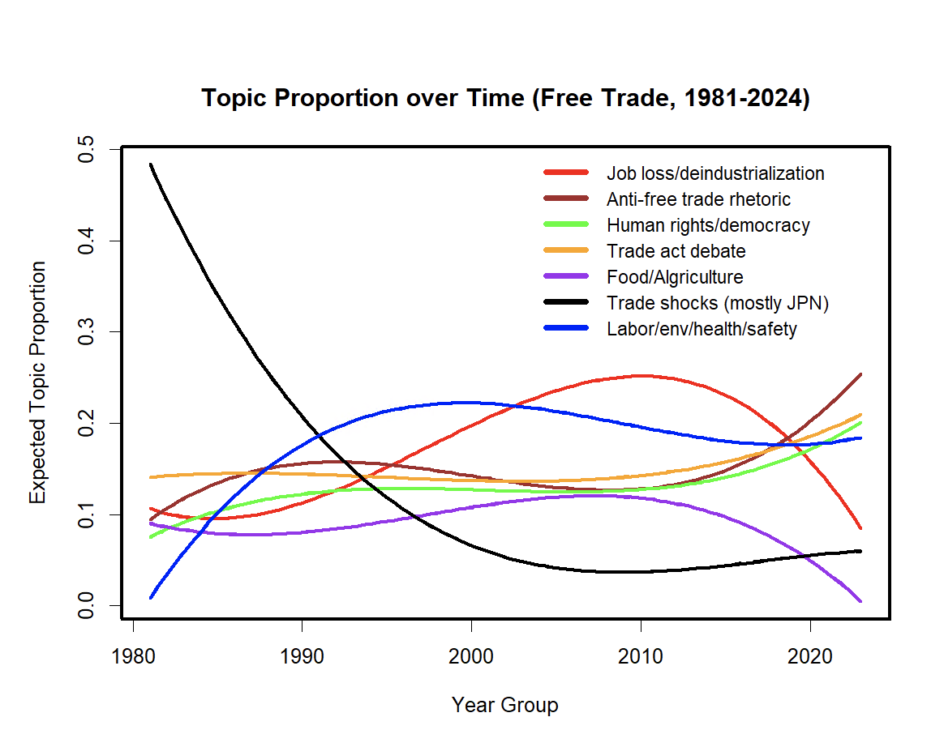
Elite Opinion: Congressional Speech
(Keywords: Free Trade, excl. Free Trade Agreement)
# of topics picked based on frex/excl and manual inspection
Topic 1: wage, job, factori, hour, outsourc, worker, lost, class, plant, manufactur
Topic 2: fsx, smoothawley, navi, british, father, distinguish, alexand, hamilton, lawyer, roosevelt
Topic 3: mfn, poland, communist, repress, solidar, soviet, democraci, polish, cuba, endow
Topic 4: caribbean, provis, taa, amend, truck, section, confer, appropri, fund, assist
Topic 5: sugar, catfish, wheat, prescript, farm, grain, oil, drug, farmer, food
Topic 6: steel, japanes, japan, quota, industri, dump, auto, retali, footwear, uranium
Topic 7: fasttrack, agreement, track, freetrad, fast, negoti, mexico, environment, colombia, nafta
Note:
-black line includes complaints about high-end imports from Japan (cars/semi/steel) vs. others (textile/apparel). Although both were set import restrictions, the latter faded along with the WTO establishment without demanding localized production (e.g. jpn cars), nor did it capture national spotlight as the former or framed as national security/identity. Its protection has historical reasons (multi-fiber agreement) and regional politics. Under WTO, other low-end products weren’t allowed protection; low-end products were also rarely mentioned in red line.
-after early 2010s, red line declines, brown/green lines rise – they are continuation of red line. Anti-trade rhetoric and hr accusation docs framed based on de-indus.
-since 1995/wto during which many low-end sectors eroded/dissapeared, the anti-trade rhetoric has been largely stable until early 2010s

Slide 12
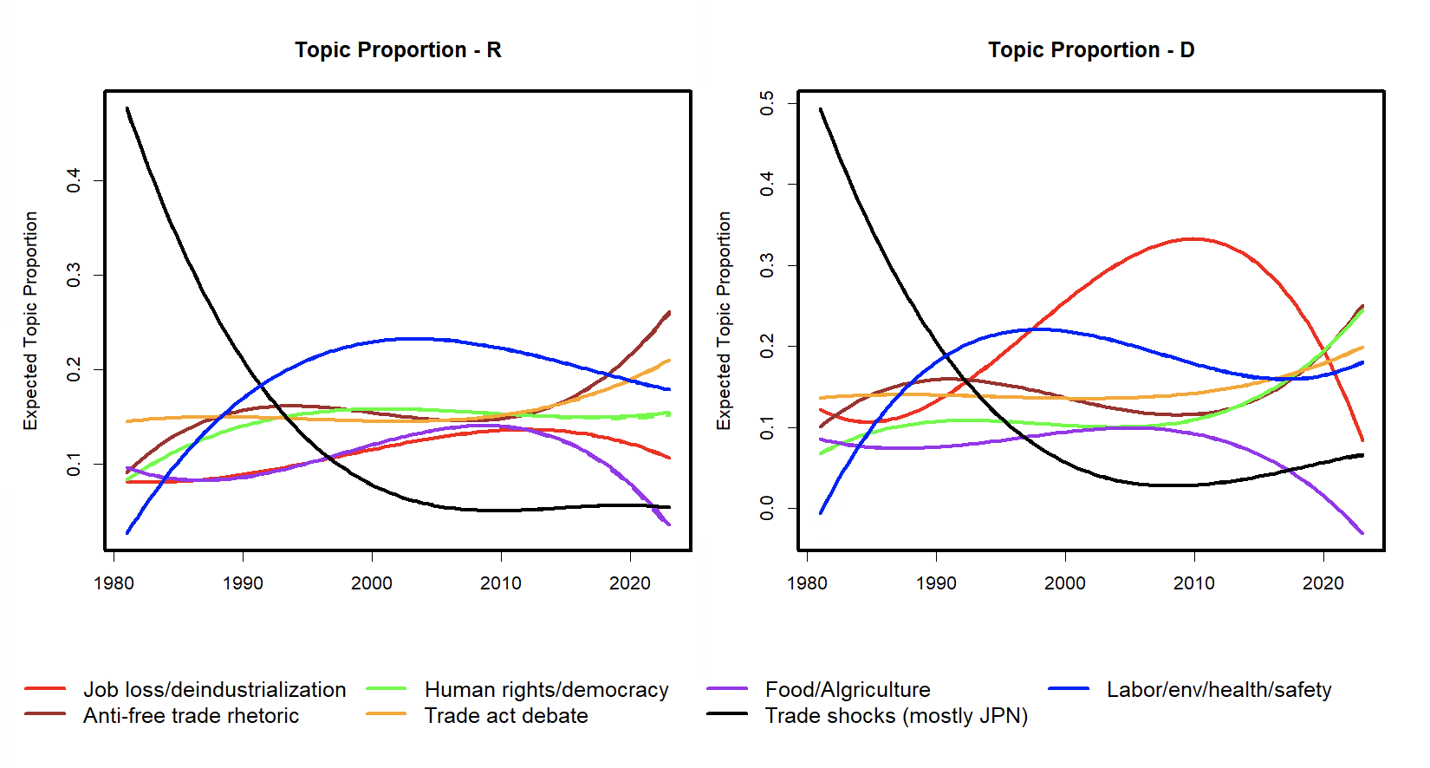
Elite Opinion: Congressional Speech - by party
(Keywords: Free Trade)
Note:
-Republicans (establishment, although intra-party dissents from midwestern) were generally pro-free trade until the early 2010s and TEA party/Trump to become anti-free trade. Dems were historically more protectionist. Both parties similarly concerned Japan’s trade shocks (even R like Reagan)
-from 1992 to 2012, rust belt states mostly voted dems. So gop red line is mild, also b/c displaced sectors were disadv.
-Trump’s anti-trade stance largely comes from concerns over deindus. (e.g. tariffs on semi/steel/cars) and mercantilism (e.g., trade deficit) by trading partners. Anti-trade views can quickly spread to establishment if deindus goes deeper.

Slide 13
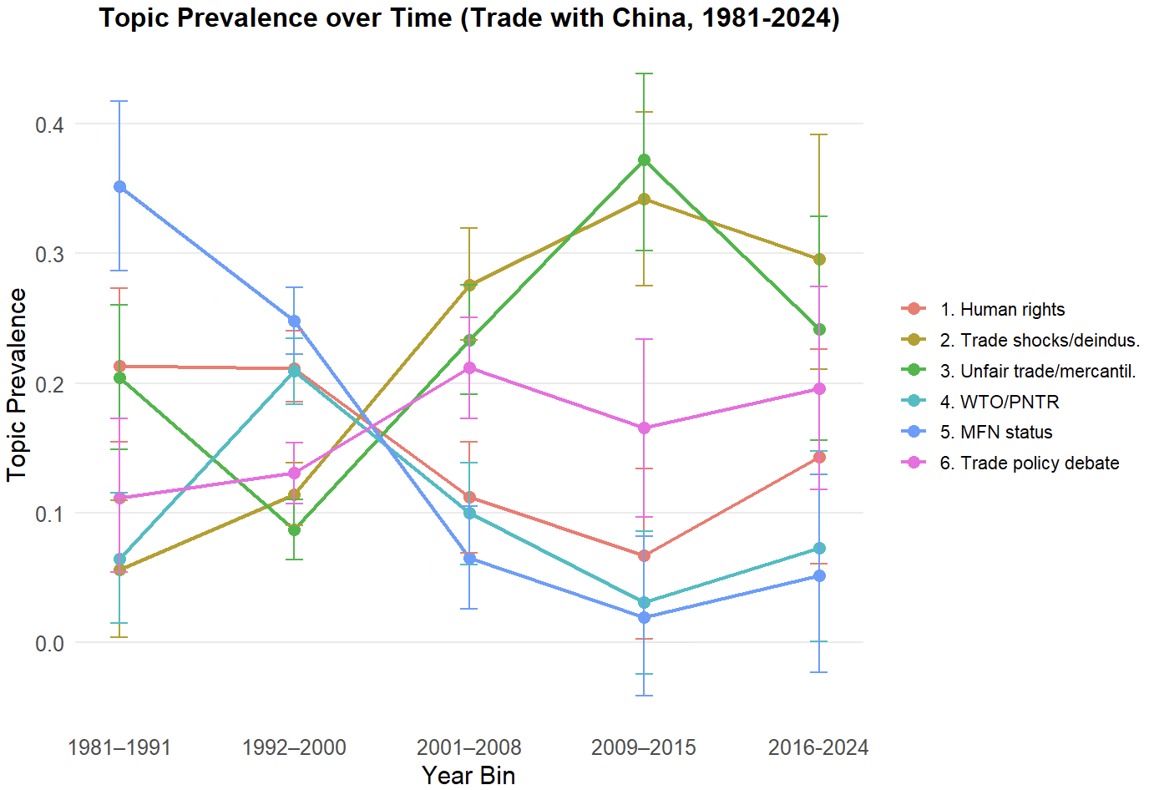
Elite Opinion: Congressional Speech
(Keywords: Chinese Imports, Trade w/ China)
Topic 1 missil, prison, iran, arrest, mass, tortur, abort, slave, weapon, women
Topic 2: hour, wage, deficit, mexico, nafta, cent, car, automobil, doesnt, trump
Topic 3: textil, manipul, currenc, rate, undervalu, unfair, apparel, program, enforc, duti
Topic 4: agricultur, pntr, wto, access, review, perman, normal, farmer, annual, prosper
Topic 5: mfn, hong, kong, revok, mostfavoredn, status, resolut, renew, condit, influenc
Topic 6: cuba, taxpay, castro, gentleman, cuban, bank, money, russia, colorado, credit

Slide 14
Section 301: List 1 and 2 (2018/19)
DV:
Prior investigations (localized competition); list 3/4 (tit-for-tat); explicitly from lobby.
$34b + $16b, 4,000+ 8-digit HTS product-level (manufacturing only)
Explicitly target ”MIC 2025” ➔ perceived threat
IV: Stable revealed comparative advantage (RCA)
RCA > 1 (2001-07) & RCA₂₀₀₇ − RCA₂₀₀₁ > -0.1
HS6 level
Controls:
Sectoral exports, sectoral imports, world market
China’s import share, China’s RCA, bilateral exports to China
Capital good, consumer good, value-added, TFP
HS2 FE

Slide 15
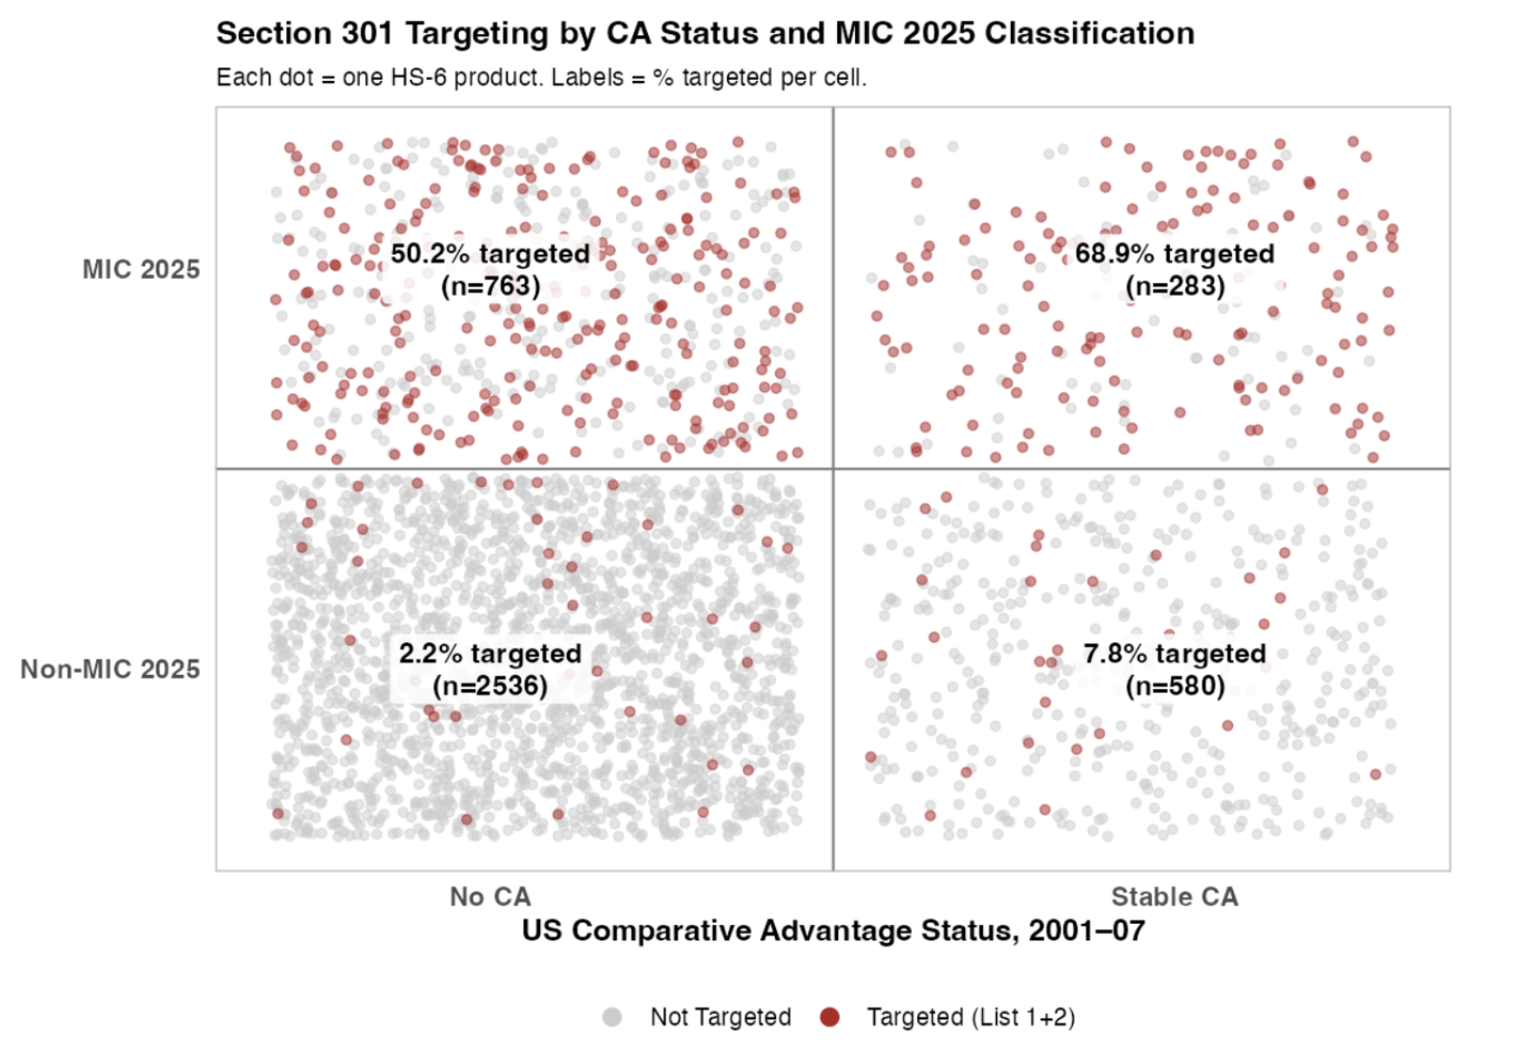
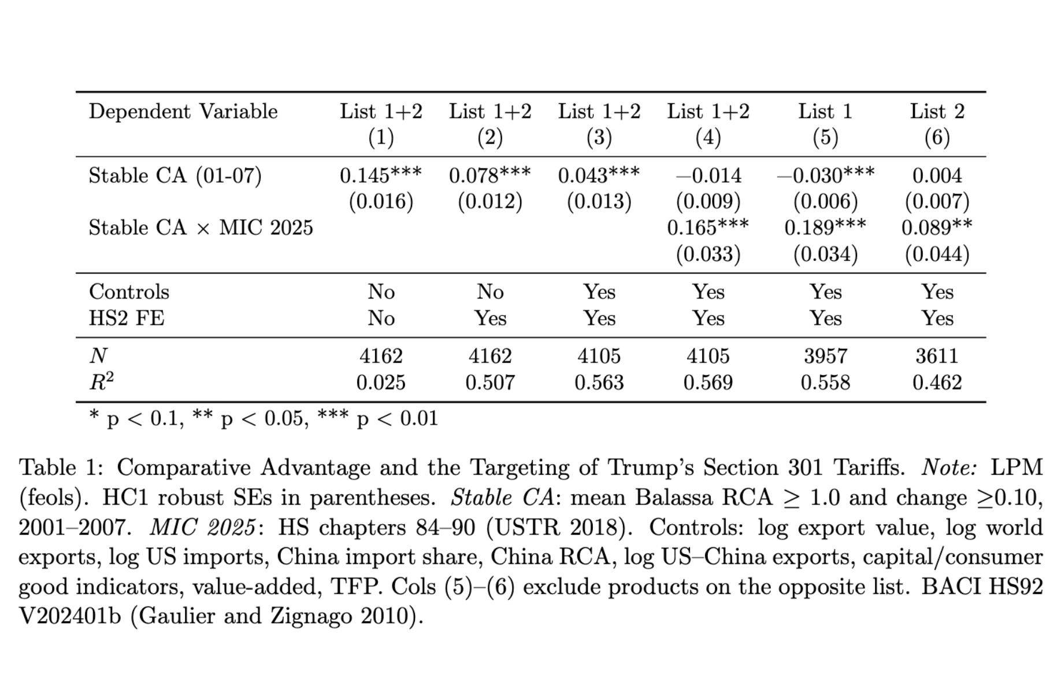
Section 301: List 1 and 2

Slide 16
Case Study
Trade wars in the 1980/90s
Let go textile, electronics, shipbuilding, passenger rail, DRAM (eventually), etc
Fought autos, semiconductor, machine tools, precision equip, etc
Within semiconductor, let go semi manufacturing (defend design & high-end)
Defended steel, military shipbuilding (security)
Tolerated semi manufacturing in TW/KR (ally/democracy)
Trade wars in the 2010/20s
Ignored “China shock 1.0”
Board-based tariffs (systemic threat)
Steel & alum tariffs (security)
Notes:
SC: how does it differ from new losers, sociotropic; clearly listing competing theories in survey, 1.5k may not be enough
-DRAM was seen as adv, later no longer
-shipbuilding/rail became labor-intensive, not capital/R&D
-autoworkers were among best-paid blue collar workers. Hard to find other sectors (with lower oppo cost) for autoworkers —perceived CA

Slide 17
(TODO) Public Opinion: Conjoint
Verify micro-mechanisms
Rule out competing theories
Shock type | Geopolitics | Sociotropic | NTT [??] | NNTT [??]
-disadv sector -higher VA, but not comparative adv -higher VA, compAdv, sectoral -higher VA, compAdv, systemic | -ally, adversary -democracy/autocracy | -no overall harm -net harm U.S. economy | -no product diff. -product diff. | -foreign firm -own MNC -localized production
Notes:
Chicago council survey: trade polls. I need to show agregarte patterns
-Too much?? Can you explain all variables about trade. COMPETITIVE & STRATEGIC INDUSTRIES. OR ADV.
-DONT WANT TO GO INTO ECON DEBATE. Search committee: Where is publication? RQ first.
CD: can you just do how public opinion react to strategic sectors? 2 papers

Slide 18
Contribution
Advance a theory:
The intensification of anti-globalization sentiment
Conceptualization of ”after equilibrium” phase
Thank you.
Notes:
SC: how does it differ from new losers, sociotropic; clearly listing competing theories in survey, 1.5k may not be enough

Slide 19
Possible Examples of AE
U.S.-China/Japan trade wars
Trump’s 1st round of China tariffs:
Target sectors in “MIC 2025”: Aerospace, Information & Communications Tech (ICT), Robotics & Automation, Industrial Machinery & Equipment, New Materials, Automotive, Precision Instruments, etc.
Consumer goods largely excluded.
Renegotiated USMCA:
Heavily focused on the automobile industry
Views on “China shock 2.0”
Janet Yellen (D.) - “China’s exports of cheap goods were thought to be positive, but now start to hollow out U.S. industries.” (WSJ 2023)
Autor et al. (2025): “We Warned About the First China Shock. The Next One Will Be Worse.”
EU: “EV shock: The Chinese threat to Europe’s industrial heartland” (ECFR 2025)
Notes:
MIC 2025 are China’s goals targeting US adv sectors

Slide 20
Conceptualization & Theorization

Slide 21
Application Scope
Inter-industry (RV/HO/EK): U.S. automobile vs. Bangladesh's textile
Intra-industry (Krugman 1980): EU’s pharmaceutical vs. India’s pharmaceutical
Intra-firm (Melitz 2003): California’s iPhone R&D vs. Vietnam’s assembly
Service: internet, finance, pharma R&D
⇒ In any case, a country expects to “export” CA to realize sustainable trade gains
Notes:
Ricardian/HO: comparative advantage explains which sectors/countries trade.
Krugman (1980): no need for comparative advantage → trade arises even between identical countries. This explained the observed large volume of trade between similar industrialized nations.
Melitz (2003): builds on Krugman’s framework but adds firm-level heterogeneity, showing how only the most productive firms export.
Ricardo (classical) → CA = relative productivity across sectors.
Heckscher–Ohlin → CA = factor abundance.
Krugman (1980) → CA = specialization in differentiated varieties, sometimes reinforced by market size (home-market effect).
Melitz (2003) → CA = industry-level advantage, but filtered by firm productivity cutoffs.
Eaton–Kortum (2002) → CA = stochastic productivity draws across goods and countries.

Slide 22
Competing Theories
New losers?
Moving from textile to furniture to consumer electronics, no opposition.
Higher value-added?
Silent on passenger rail, shipbuilding, telecom, DRAM, chip manufacturing…
Sociotropic? National identity? Developmental? Security?
Part of mechanisms, but not same.
Notes:
-GY: is it just higher-paying job/sector story? Can we relax the condition to include higher value-added? CA for the US is mostly higher-value per capita (oil, auto, algri is special), Some overlaps but not exact. If some good-paying jobs like swiss watch, japan rail equipment, or shipbuilding but not adv, since free trade should still bring net gain
-consider dynamic CA: current one may become disadv (e.g., telecom), hope on others

Slide 23
Elite Opinion: Congressional Speech
(Keywords: Free Trade)
Examples:
“... we are not going to have a strong economy unless we have a strong manufacturing capability. unless companies are reinvesting in Colorado or Vermont. creating good jobs here… “ (GY: good jobs/strong mfg cannot refer to disadv. sectors)
“... This raw deal would be particularly bad for my district and districts around the country that support our domestic auto industry, auto suppliers and parts makers… ”
“(in 1997) ...and there is some reason to fear that in 10 or 20 years. Detroit and automobile production in this country will be diminished as car manufacturing moves to China. …”
“...The titans who run these global transnational corporations. their operatives. and the Wall Street giants that finance them couldnt care less about workers anywhere or the communities in which they live… ” (GY: refer to GVC)

Slide 24
Elite Opinion: Congressional Speech
(Keywords: Chinese Imports, Trade w/ China)
Examples
“...If the United States is to remain a major industrial power. producing real products and creating goodpaying jobs. we cannot continue the failed, unfettered free trade policies”
“...Chinese imports did overwhelm U.S. industry. The Cato Institute was dead wrong.”
“..."We will buy American airplanes only if they are manufactured in China." It is another way of saying. "We want to trade with you. but we want American. jobs to move to China." That is not fair trade.”
“... In fact. we were told that permanent normal trade relations with China would create hundreds of thousands of American jobs. Well. not quite. [GY: expect adv. sectors exporting...]”
“...China tilts the playing field against American firms, innovators, and workers and gets the technology they need to leapfrog the competition.”
“...Now General Motors says a Chinese firm knocked off an entire vehicleand Americans could soon start buying its cars…”

Slide 25
Elite Opinion: Summary
Concerns over losing good-paying jobs and deindus. dominate all other concerns about trade. Bipartisan. Logically, losing adv sectors. triggers all these reactions.
As concerns over deindus reaches some level, anti-free trade rhetoric (dormant between 1995/WTO and early 2010s) spikes.
No other major competing factors such as security, geopolitics, inequality, etc are as salient.
Human rights, econ security, etc later were framed as justifying anti-free trade views.
(e.g. “Free trade with China has surely been a one-sided deal. Just as China shows a blatant disdain for human rights and rule of law in their own country, she tramples upon international law and seeks to overturn the global rules- based order. As a strategic competitor, she seeks to spread its propaganda and tear down the virtues of democracy.")
Notes:
Not exactly rule out competing theories, but consistent/provides support. Now look at survey experiment.

