Slide 1
Globalization Backlash and Order Contestation
An Issue-based Theory
Paper link: georgeyean.github.io/files/gi.pdf
George Yean
Harvard University
MPSA 2026

Slide 2
The Liberal International Order (LIO) in Crisis
The LIO is in crisis
Established since end of WWII: vs. imperialism, realism, multipolarity
Definition: West-led int’l order with liberal features and sub-orders (Lake et al. 2021)
Credited with advancing peace, prosperity & liberty (Ikenberry 2011; Lake eta al. 2021)
Future uncertain, important but challenging to study (macro, limited variation)
LIO Issues
“…this time might be different.” – Lake et al. 2021
Issues/challenges: financial instability, development inequality, governance deficit, collective security, ideational and social contestation, hegemonic power abuse… (IO 75th special issue)
Structural & distributional consequences: source of contestation
Notes:
This question is important, as ppl may wonder how the issues matter so to seek solutions, and patrons may prioritize some issues due to resource constraint

Slide 3
Research Question
Q: When do issues within international order drive voice vs. deep order contestation, specifically, state disengagement toward alternative authority (state disengagement hereafter)?
Order Contestation: (Lake and Wiener 2024; Lake et al. 2024)
“Normal” policy disputes – voice
“Deep” contestation – costly disengagement, e.g., challenge to principles/authority

Slide 4
Theory: Overview
Mechanism I: not all issues cause escalation to deep disengagement because disengagement is costly for average leaders ➔ depends on loyalty collapse.
Mechanism II: even then, disengagement depends on the credulity of outside options.
➔ Conditional order resilience

Slide 5
Theory Setup: scope condition
Scope condition: net disengagement costs (for average leaders)
(1) LIO’s high disengagement costs: networked, selective inclusion, sunk/reputation/oppo cost (Carnegie and Clark 2023; Lipscy and Lee 2019)
(2) Uncompetitive outside options: vis-à-vis China
(3) Institutional stickiness: structural constraint, loyalty (Hirschman 1970; Johnston 2001; Pierson 200)
Example:
Italian populist leaders cautiously embraced the BRI, framing it as non-committal within existing EU-China frameworks (Atkins et al. 2023)
The majority of states chose to send no representative to the first BRI summit despite invitations (Broz et al. 2020)
Welcome Chinese investment, but harbor concerns (e.g., Sri Lanka 99-year port lease)

Slide 6
Theory Setup: two competing forces
Two competing forces (rational-choice & sociological institutionalism):
(External) disengagement benefits (B) & costs (C)
(e.g., support rewards, issue relief, bargaining leverage, sunk/diplomatic/reputation costs…)
(Internal) loyalty as a stock construct (L) (Hirschman 1970; Poulsen 2020)
(e.g., long-term institutional rewards, ideology affinity, social benefits … )
Disengagement, if: B - C > L
* in Hirschman’s “exit-voice-loyalty” model (1970):
E(exit) > E(stay) ➔ B - C > p*voice + L

Slide 7
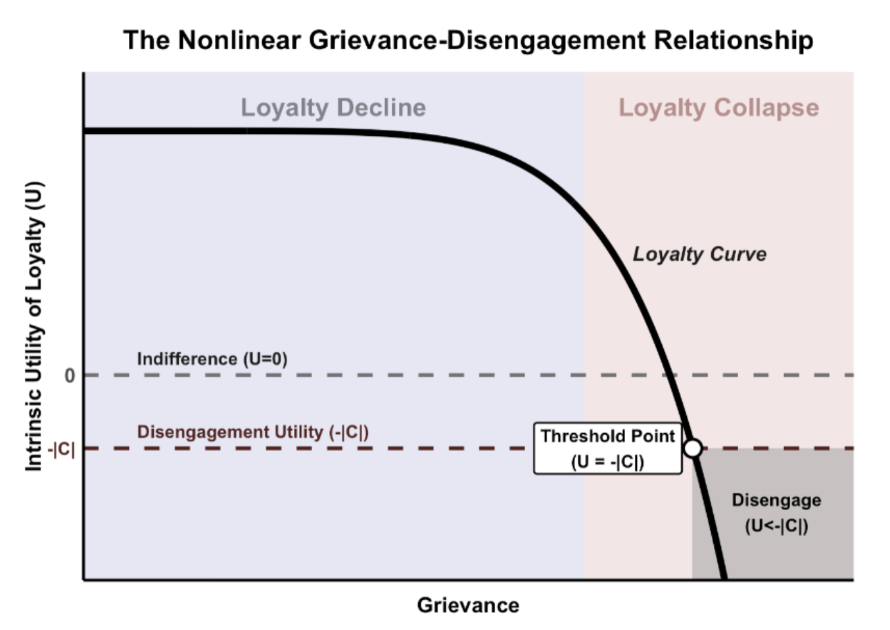
Mechanism I: Grievance-Disengagement Nonlinearity
Argument: Given net disengagement costs, rational disengagement requires the collapse of loyalty. (recall: B-C > L)
Nonlinear loyalty erosion:
Erode gradually
Collapse by unbearable grievance
(Kuran 1991; Scarry 1985; Wintrobe 1990)

Slide 8
An issue typology: loyalty-collapsing Issues
Loyalty collapse is latent, but needs leaders:
Stopping seeing continued benefits
Stopping seeing reform hope
Observable Conditions of loyalty-collapsing issues:
Persistent
Severe
Attributable to LIO
Unaddressable by domestic solution or order-level voice

Slide 9
Mechanism II: Outside-option Endogeneity
Argument: When outside options are implicated in contested issues, their credibility decreases, impeding disengagement.
Example: leaders unlikely to turn to the USSR over nuclear proliferation concerns or to China over import-competition.
Notes:
diminished legitimacy, dysfunctional governance, and crippled performance (March and Olsen 1984; North 1990; Pierson 2000).
An international order can be undermined in multiple ways including violating rules and norms, waging conflicts, subverting institutions, or abandoning support
Most important is member

Slide 10
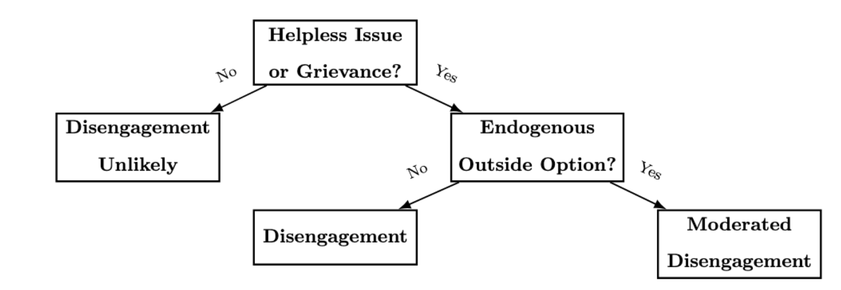
Combined Mechanism

Slide 11
Hypotheses
H1.1: threshold-based grievance effect
H1.2: loyalty-collapsing issues disproportionately trigger disengagement
H2: disengagement damped if challenger is implicated

Slide 12
Empirics
Notes:
Clam, think, thank, admit, quick

Slide 13
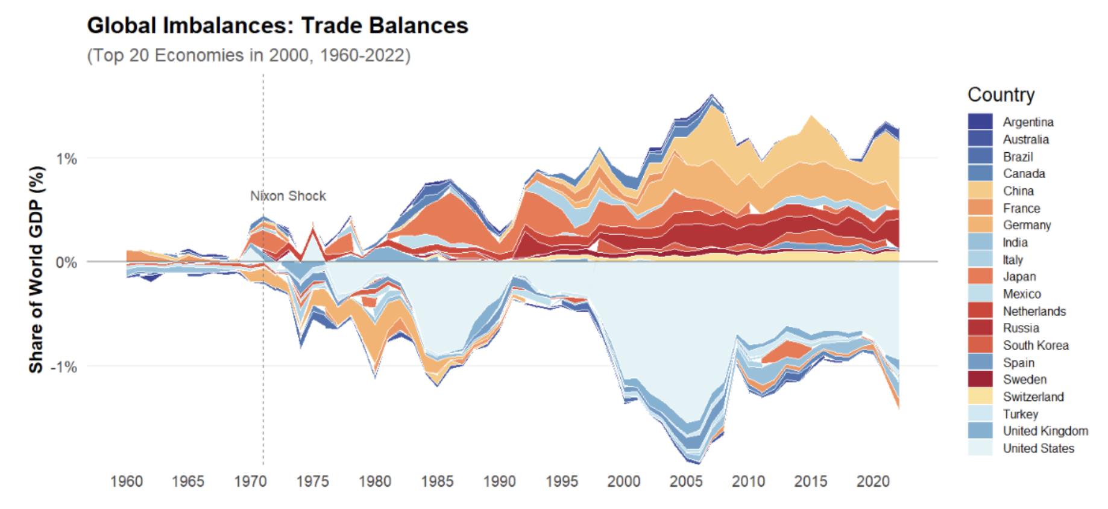
Example: Global Imbalances
Since 1970s - “Nixon shock”: trade and financial causes
Distributional consequences: domestic impact
Hotly contested: trade backlash, geopolitical instrument …
Under-studied in IR/polisci
“probably the most complex macroeconomic issue”
– Blanchard and Milesi-Ferretti (2009)
“that dominates policy debate”
– Chinn and Ito (2022)
Notes:
Global Imbalances are defined as the long-run cross-country differences in current account balances

Slide 14
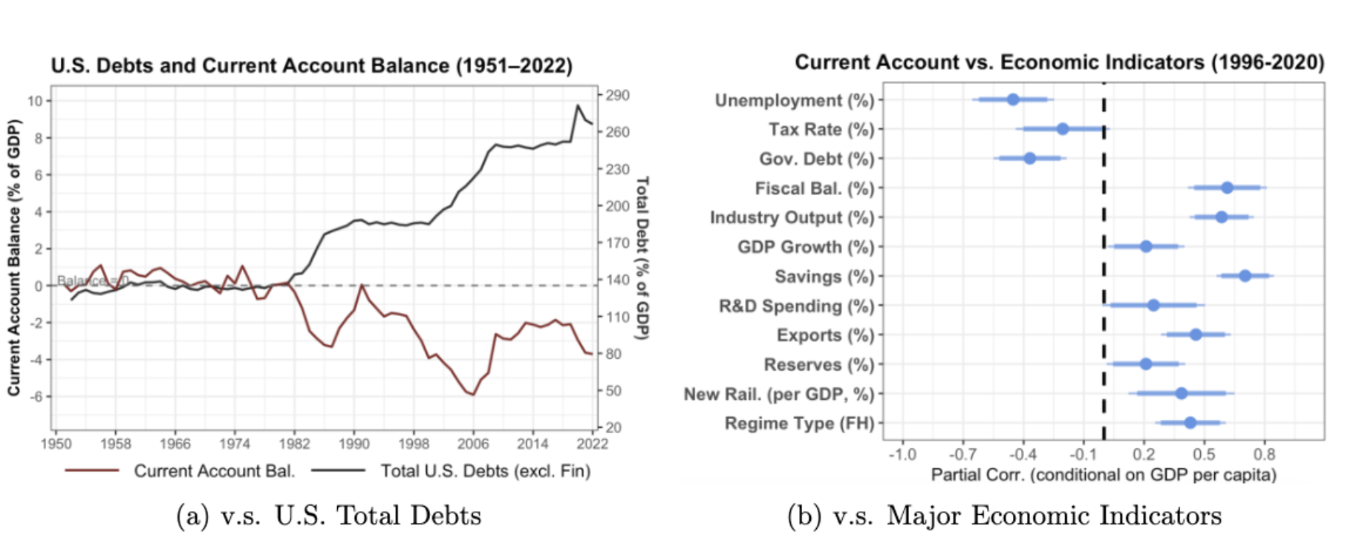

Slide 15
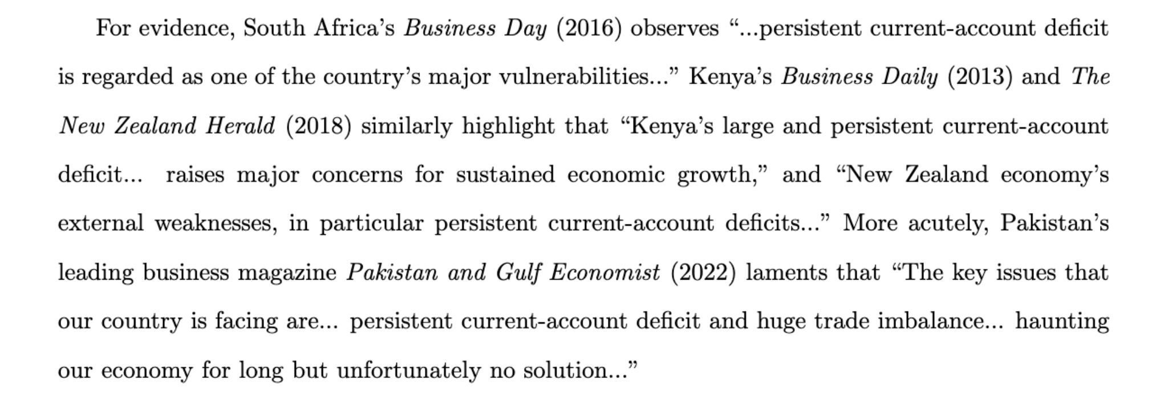
Example: Global Imbalances
For a non-trivial set of countries:
1. persistent 2. severe. 3. LIO-attributable 4. resistant to domestic or order-level solutions

Slide 16
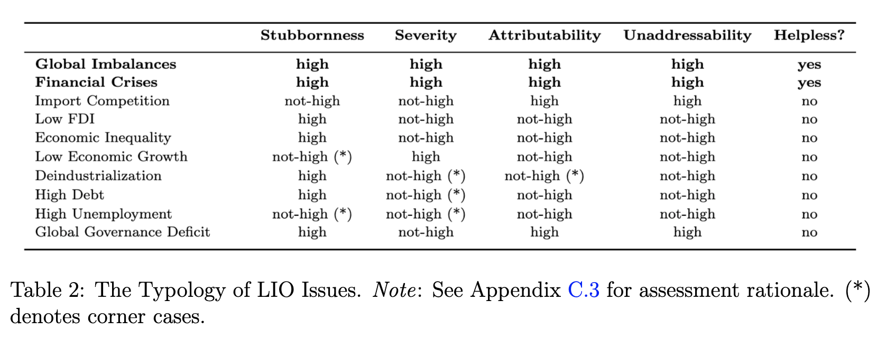
Classifying Helpless Issues
Identify ten issues from IO 75th special issue on LIO (all papers), excluding ideational, territory, climate, etc.
Qualitative assessment based on statistical facts, literature, domain knowledge (three domain experts).
*Overall classification robust, despite dimensional differences.

Slide 17
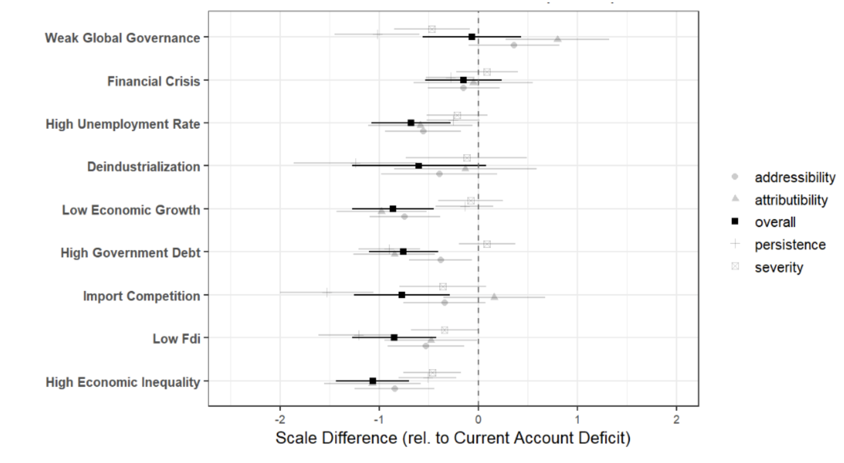
Cross-validation: Media Perception
LLM-based rating:
(e.g., severity – “how extremely is the issue damaging to domestic economy?” )
Robustness: alternative LLMs, window-sizes

Slide 18
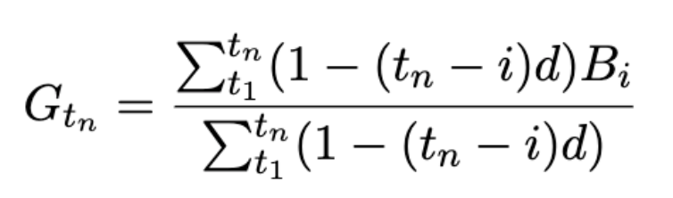
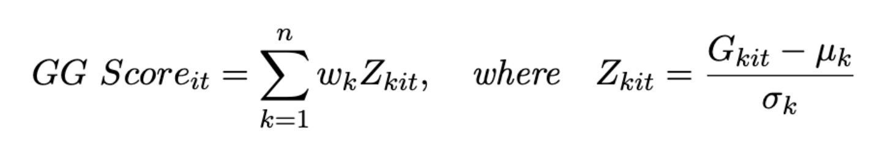
Measuring Grievance
Time-discounted (d=0.05) weighted average of past N years (e.g., current-account balance)
The Globalization Grievance (GG) Score: proxy aggregate grievances (1990-2022)

Slide 19
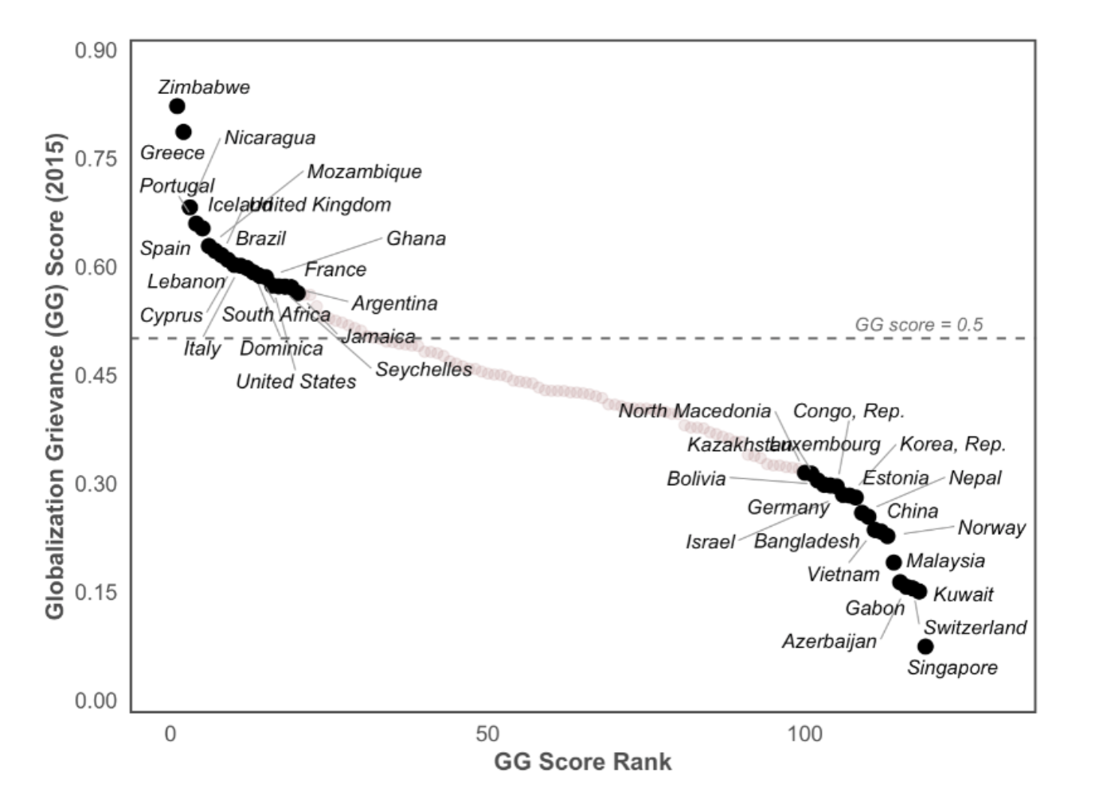
GG Score: Face Validation
Weight of helpless issues = 5
(3, 10: similar results)

Slide 20
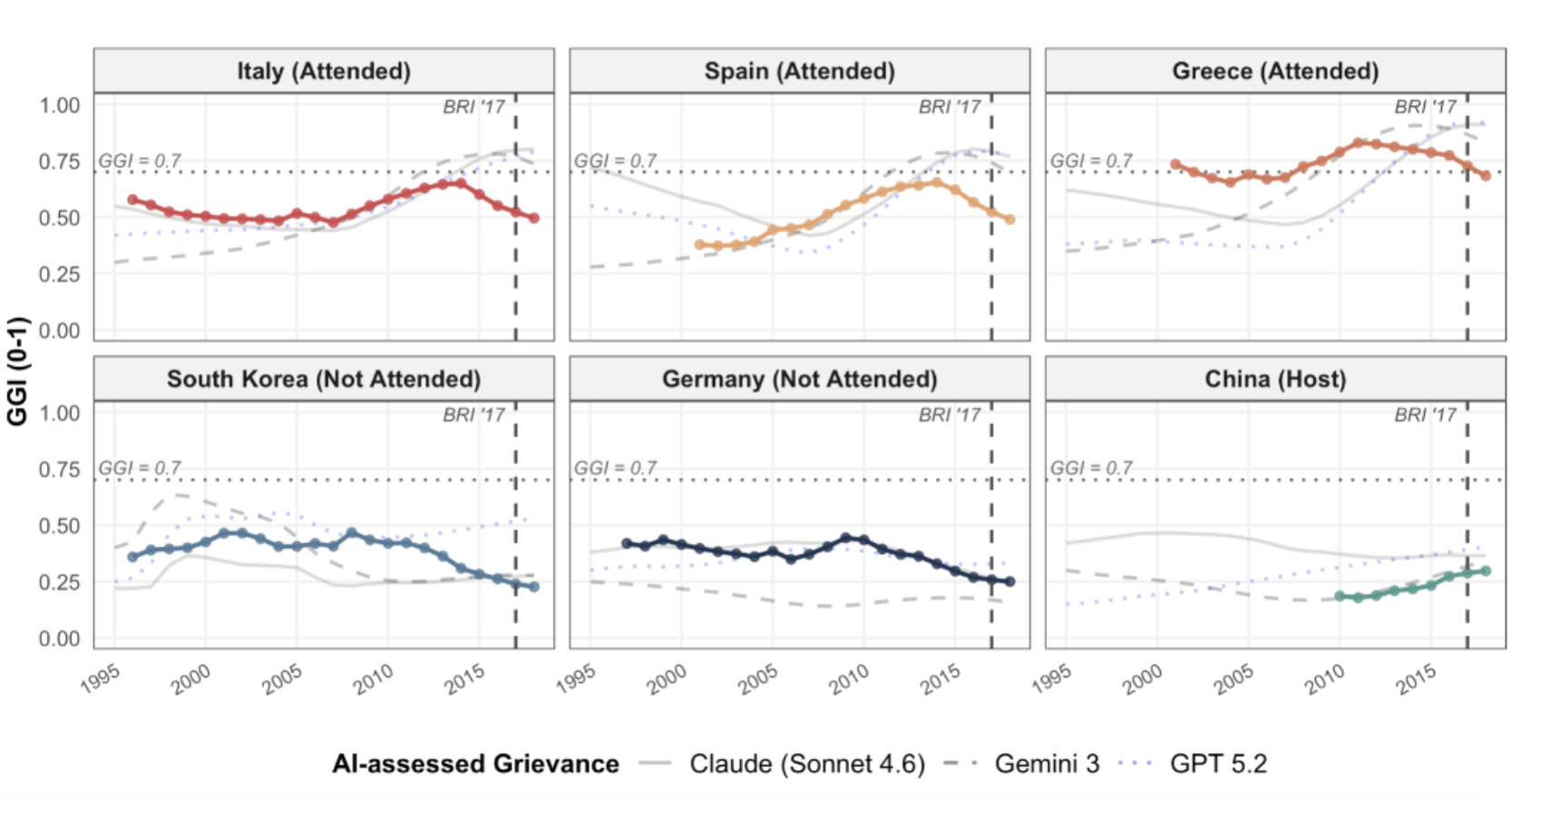
GG Score: Face Validation

Slide 21
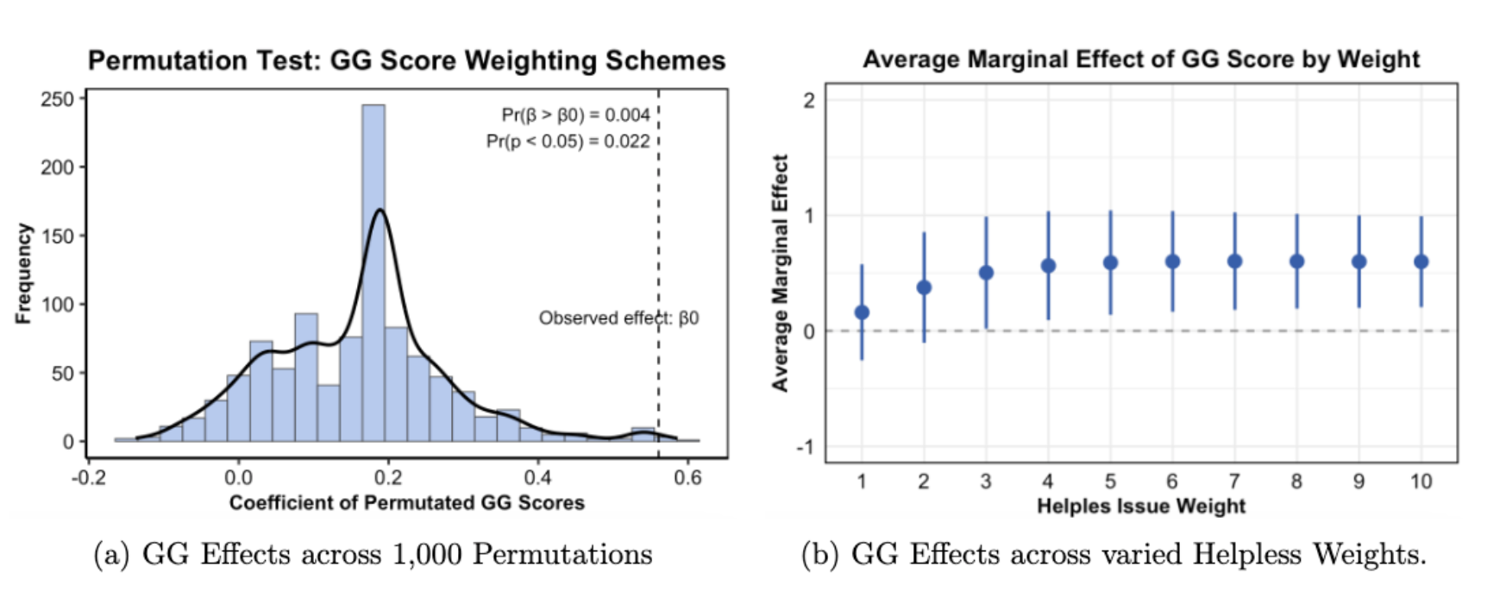
VS. Random Labelling

Slide 22
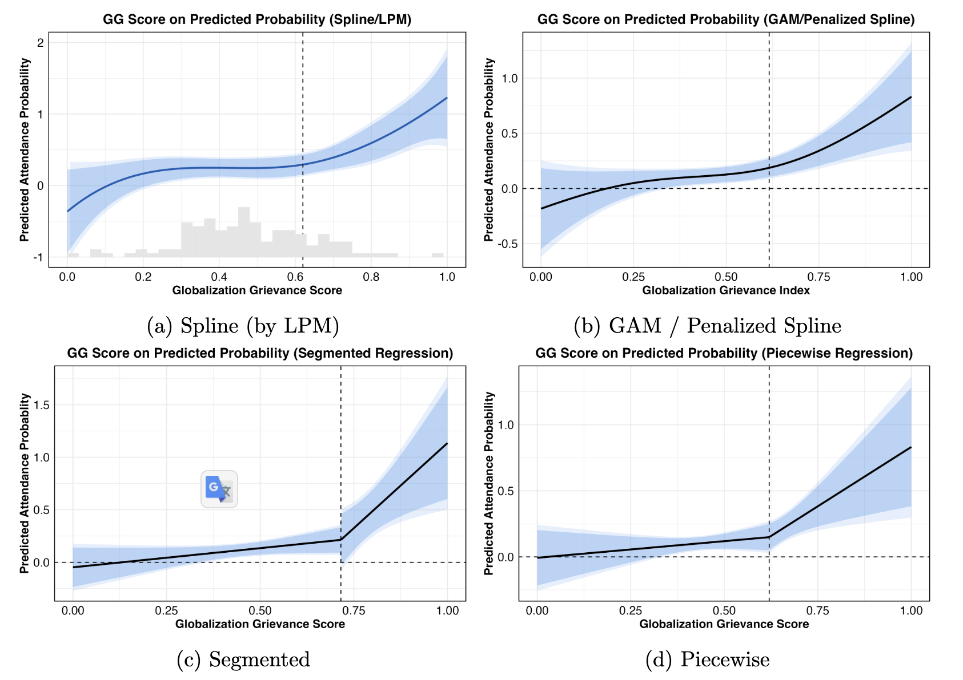
Mechanism I: Threshold Effect
Grievance-level (GG score)
Robust: bootstrap, GG score (rank-based, income-residualized)

Slide 23
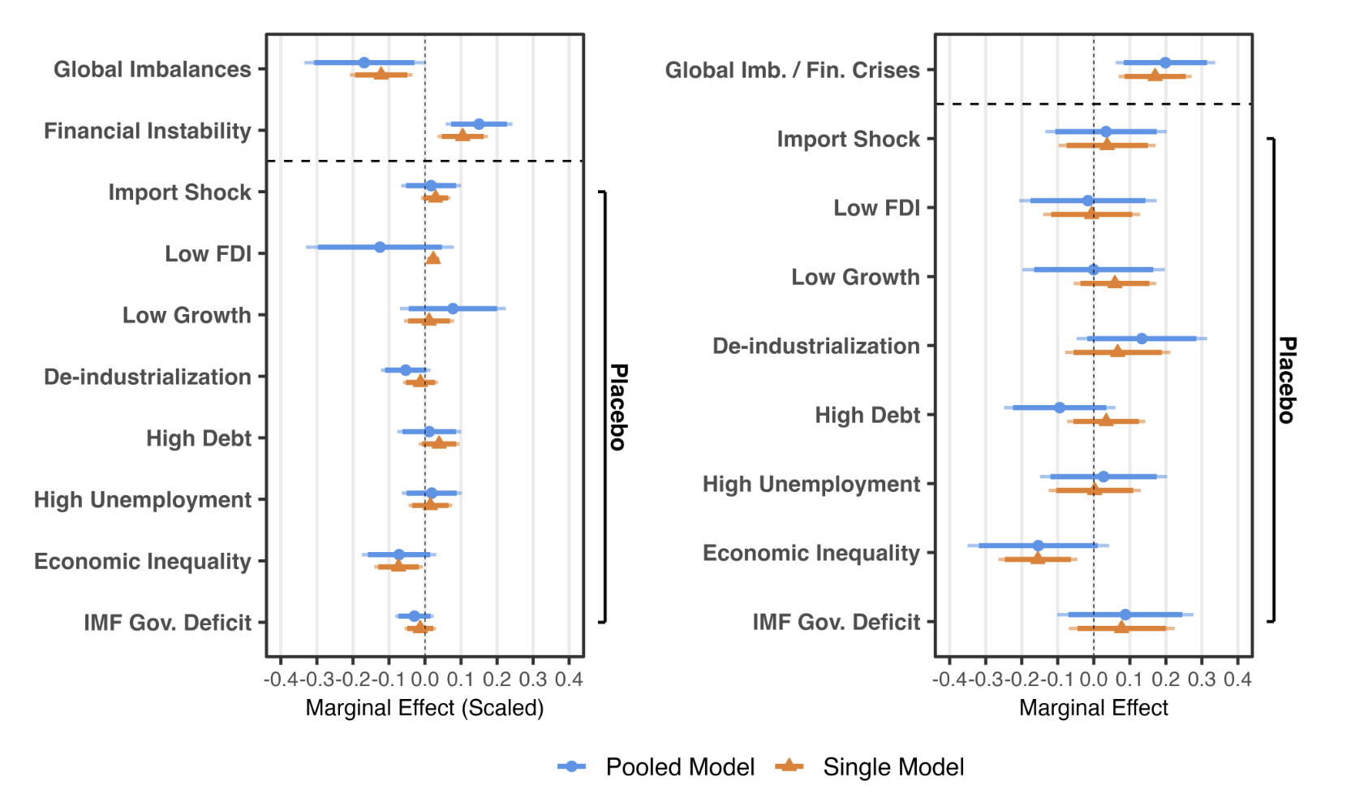
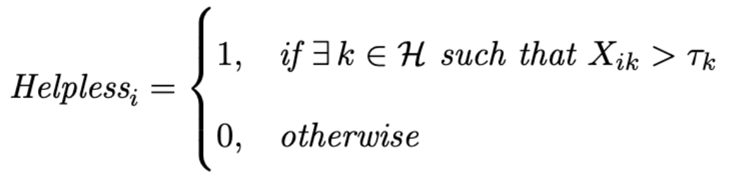
Mechanism I: Threshold Effect
Issue-level
Two operationalizations: pooling issues, helpless dummy

Slide 24
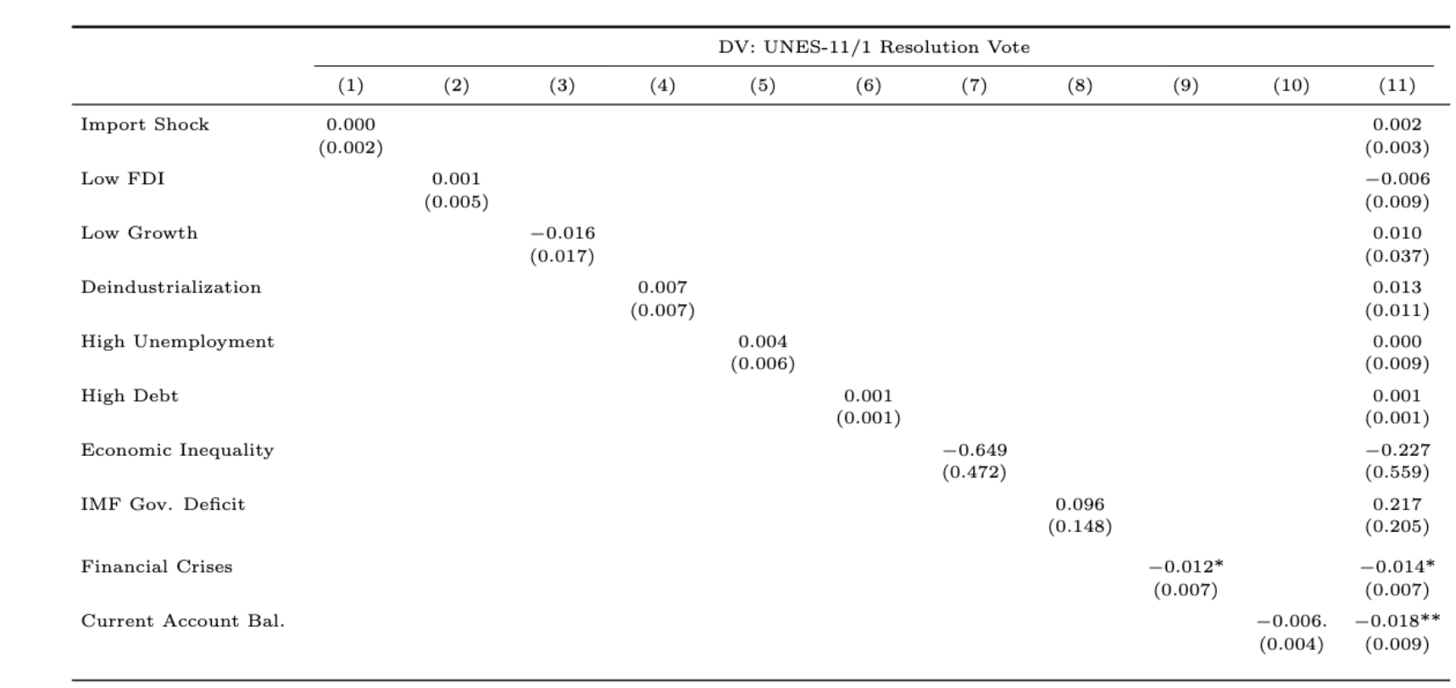
Cross-domain (M1): UNES-11/1 Resolution
UNES-11/1 Resolution: first vote to demand Russia’s withdraw
Non-compliance: costly signal for order defiance
Results: 1) only GI and financial instability. 2) threshold-based effect

Slide 25
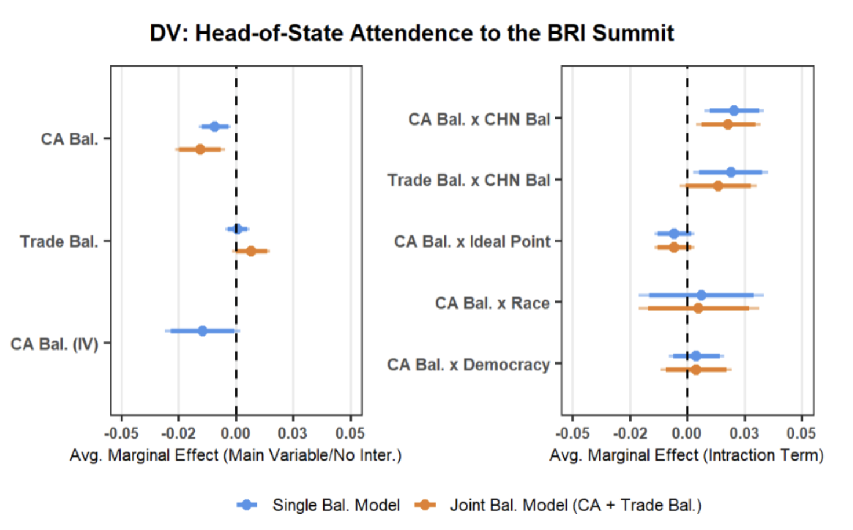
Mechanism I: Outside-option Endogeneity
DV: 2017 BRI Summit attendance
DV criteria:
Interpretable as order-targeting
Costly signal
Grievance-related
LPM model (robust: Probit, IPW, IV, sensitivity)

Slide 26
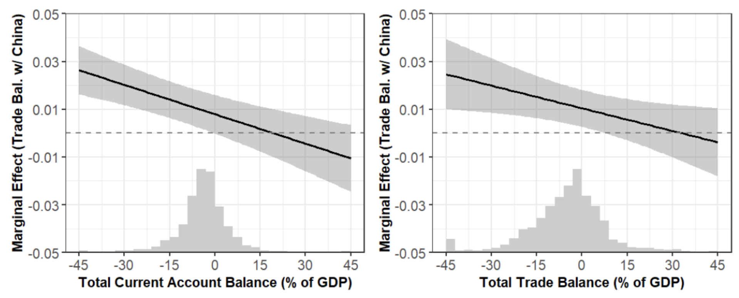
Cross-domain (M2): UNGA Vote
Attribution effect manifest in routine diplomacy
Bilateral trade affects voting behavior (Bailey et al. 2017; Flores-Mac´ıas and Kreps 2013)

Slide 27
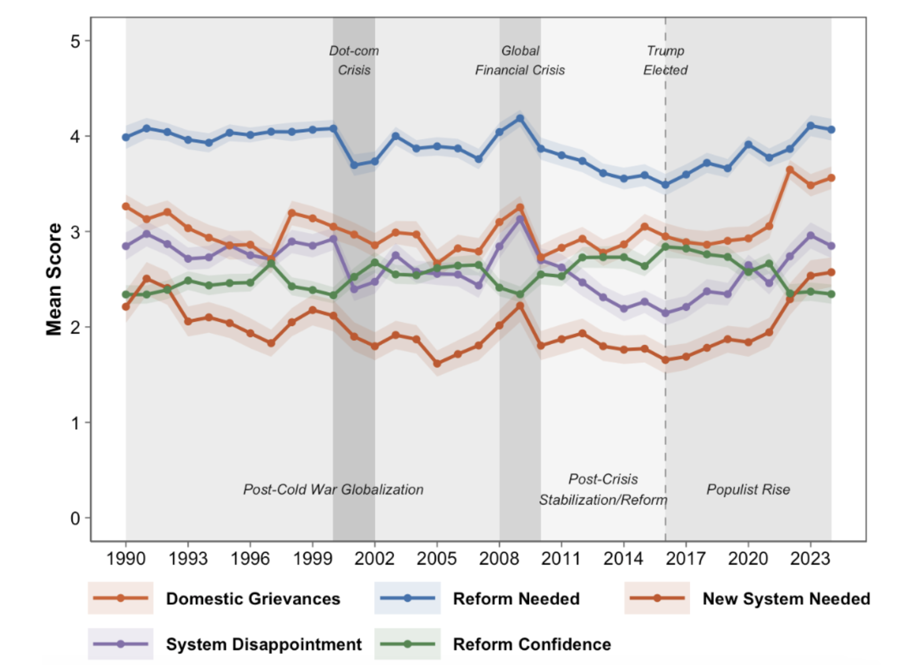
Micro-level Rhetorical Evidence
United Nations General Debate Corpus (UNGDC)
10,000+ statements delivered by national leaders (one country per year)
LLM rating

Slide 28
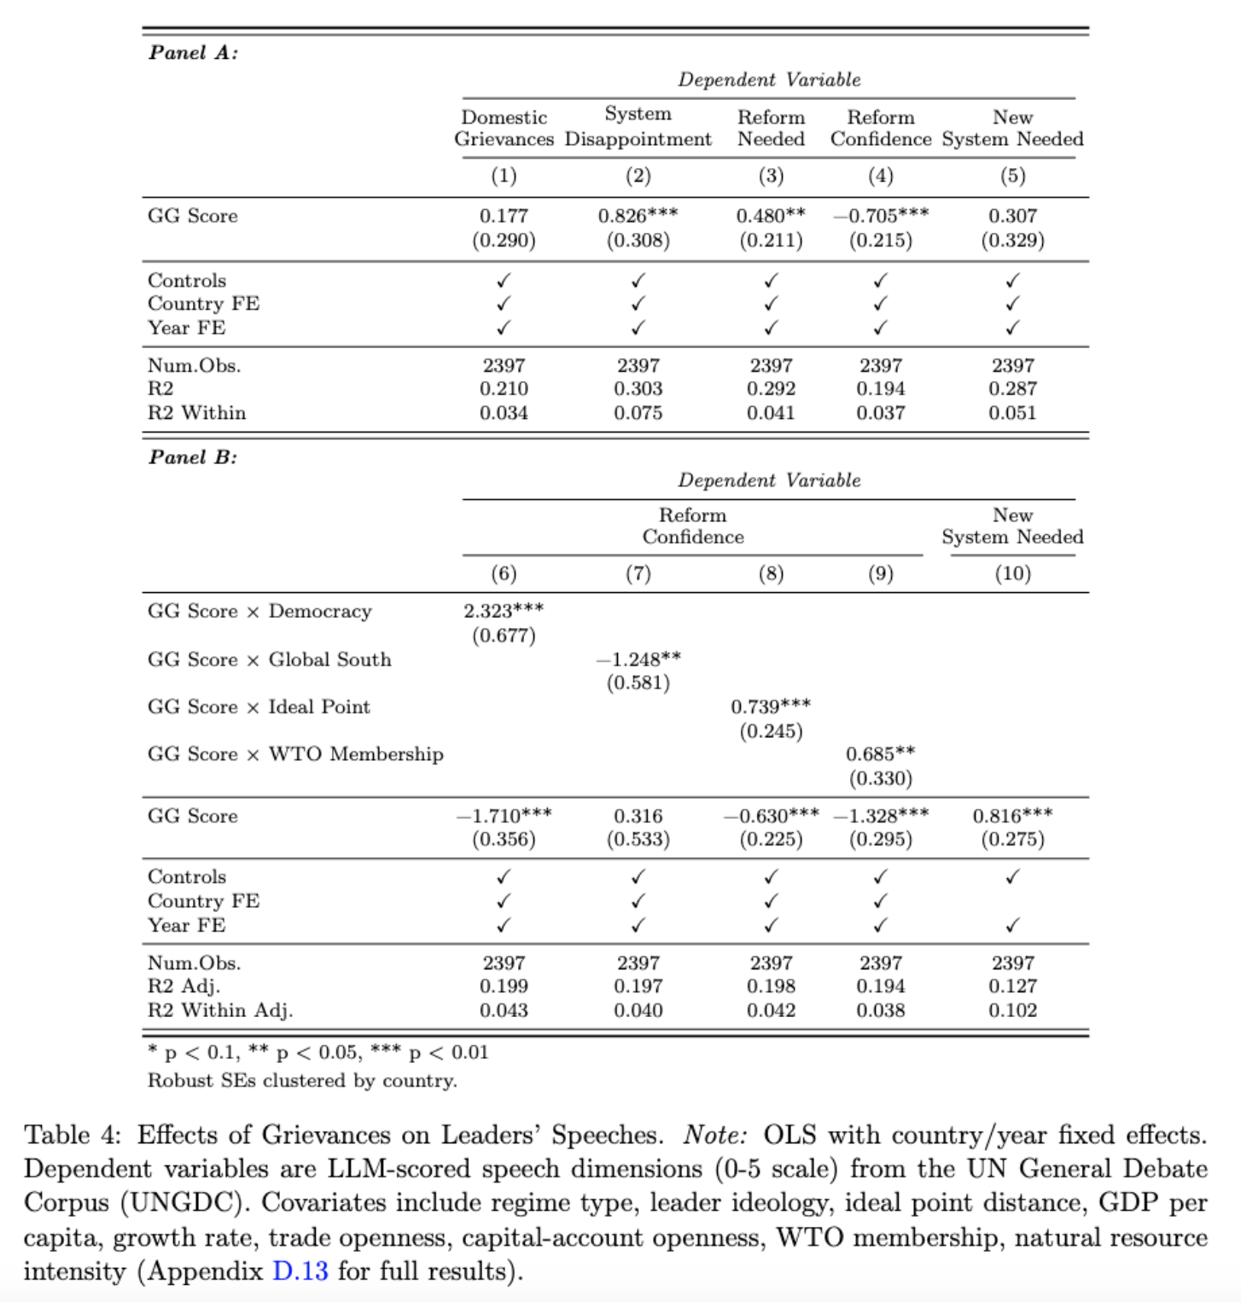
Rhetorical Evidence

Slide 29
Qualitative Cases
Italy
Canada

Slide 30
Conclusion & Implications
Beyond domestic backlash
Understanding structural issues
- Why backlash persists?
- Seeking priority & solutions
More complicated than HST & PTT.
Political consequence of global imbalances
Thank you
Notes:
Explains why despite China’s efforts to build its order, we see slow effect

Slide 31
Psychological Update: Grievance
Inherent Aversion
Psychologically salient (Bhatia 2013; Kahneman 2013)
Household budget experience (Barnes and Hicks 2020)
Concerns about related issues
Mercantilists of 17/18c (Irwin 1998) Keynes (Crowther 1948) Friedman (Friedman and Friedman 1980)
OECD, IMF, and EU (Delpeuch et al. 2021)
Peer Comparison
Public perception: surplus as winner (Krugman 2019; Stiglitz/Bernanke)
“Trump: deficit with China makes U.S. ‘biggest loser’” (NYT 2016)
Geopolitical: relative gains (Liberman 1998; Smith 1776)
Temporal Contrast
1980/90s liberalization: expect better – socioeconomic, political, and national power (Quinn and Toyoda 2007; Krasner 1985)

Slide 32
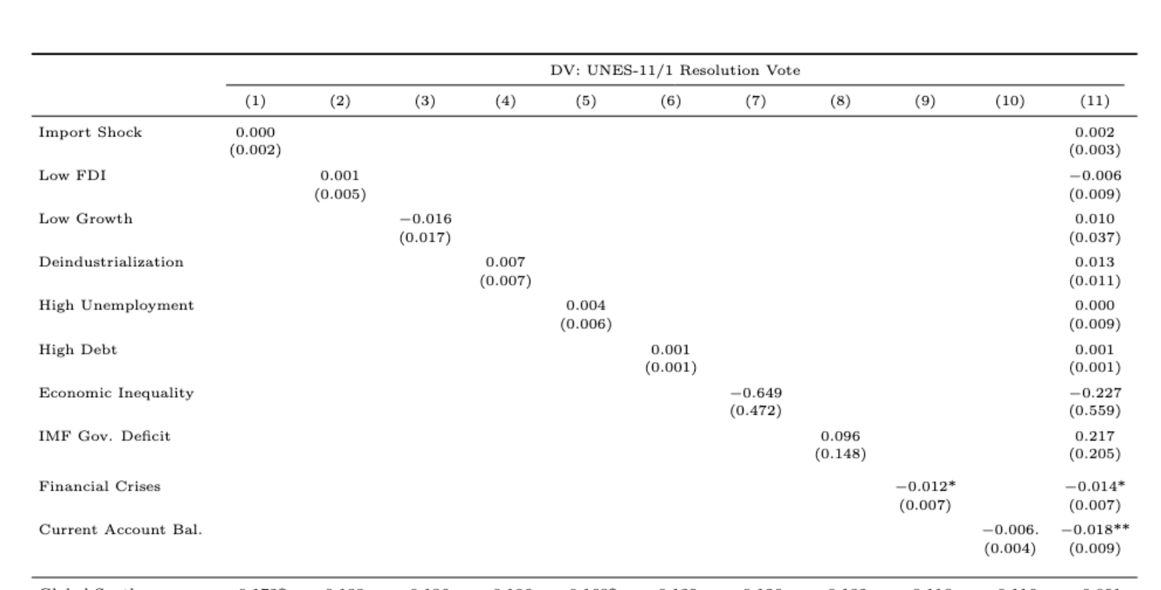

Slide 33
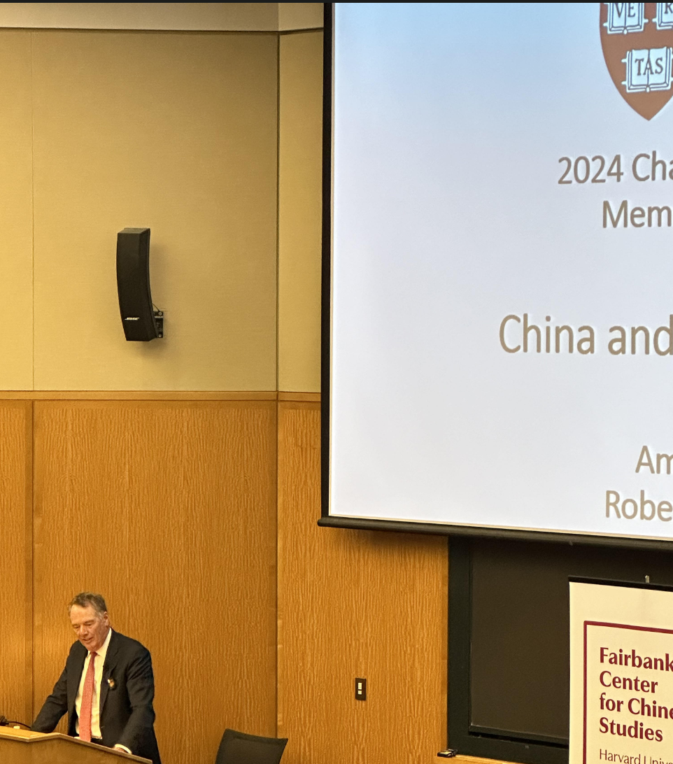
Robert Lighthizer (USTR amb. 2017-20) was anxious about the U.S. trade deficit ($400b) w/ China, as if “the U.S. is losing.”
China (1980s, Chen Yun, deficit)
U.S. (trade war)
EU, India, Mexico, Indonesia …
➔ political psychology & behavior
Notes:
Chen Yun, then Chinese economic czar, abhorred the ballooning trade deficits; the nation had to cut back scarce investments to trim the deficits that threatened balance-of-payment sustainability

Slide 34
More Robustness Tests
Power tests
Trimming tail data
Missing data: Multiple Imputation
More control variables
Recoding some IV/DV
Separating current account and trade balances
…

Slide 35
Case: Italy’s Attending, Joining and Leaving
The only G7 state to attend the BRI summit
March 2019, when joining the BRI, Italy had years of financial/economic grievances and was hoping to solve trade imbalance through the BRI (Aljazeera 2019)
July 2023, when quitting the BRI, Italy Defense Minister Guido Crosetto: “. . . Joining the Silk Road (BRI) was an improvised and wicked act. . . we exported a load of oranges to China, they tripled exports to Italy in three years. . . ” (Politico 2023)

