Slide 1
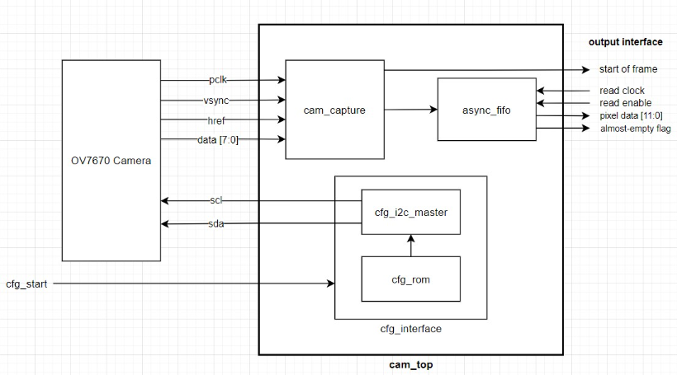
Problems w/ Previous Iteration:
cam_capture is clocked directly by external PCLK
Worked well enough, but sensitive to disturbances/noise in pclk and href
Jostling/touching/bending the wires can cause frame desync
Not really a huge issue; can be worked around by introducing resync logic in processing elements; possibly more of a mechanical problem
Opportunity for improvement (?)

Slide 2
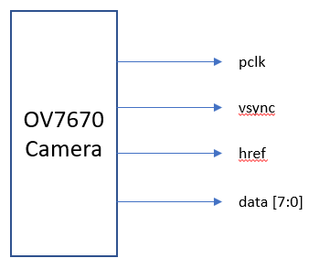
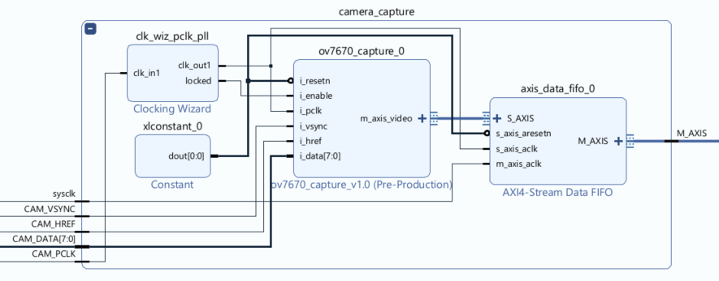
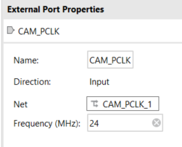
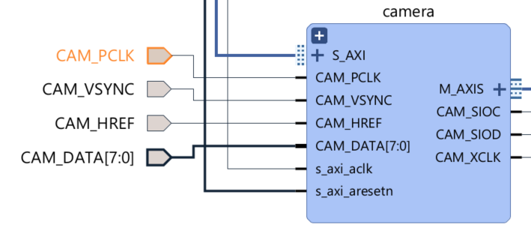
Solution 1 - PLL
Use 1:1 PLL to create a clock locked onto external 24MHz pclk.
PLL configured to be in phase with external lock.
Reduces vulnerability to noise in external clock (?)
If the external clock is interrupted, how badly will the PLL output clock also be interrupted?
Sample external data and timing signals on PLL clock edges (ov7670_capture_0)
pclk pin constrained to 24MHz in Vivado IP integrator
Very simple solution
No manual timing constraints necessary
CAM_PCLK must be connected to a clock-capable I/O
Consumes a PLL primitive

Slide 3
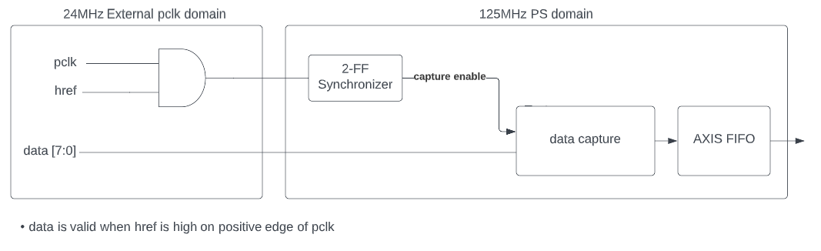
Solution 2 - Multicycle Path Formulation – No feedback
Using 2-FF synchronizer on multi-bit data input is bad; vulnerable to skew and data incoherency
Use Multicycle Path Formulation?:
Data and control signals (pclk and href) sent simultaneously
Allows data to setup on inputs of destination register while control signal is synchronized for two receiving clock cycles
Vsync can be double flopped normally since it’s not really used to determine if incoming data is valid
Will this actually provide much improvement over original solution (just using an async FIFO)?
Eliminates need for a clock-capable I/O
Cheaper in terms of clocking resources (doesn’t consume a PLL)
More complex timing constraints
set_max_delay on 2-FF synchronizer
Set_multicycle_path ?????
More complex design – requires user logic in external pclk domain

