Slide 1

Home Price Drivers
By George Zhou

Slide 2

The Scenario and Business Objective
The bank/investors are lending money to home buyers as mortgage backed securities and want to identify properties that are good investments.
Business Objective: Finding the factors that drive home sale prices so that the bank/investors can identify and invest in properties that are good investments.
Some noteworthy investment factors:
The standards of how the bank grants mortgages
The property value

Slide 3
The Factors that Influence Home Prices
Extraneous determinants like supply/demand, the state of the economy, and the purchasing power of consumers.
From our analysis we found some of the most important factors to be:
Year built
Overall Condition Rating
House Style (one story, two story, etc.)

Slide 4
Our Hypotheses/Research Questions
Condition 1: Overall Condition rating
Hypothesis 1: There is no significant difference in the mean sale prices between houses with an overall condition rating > 5 and a rating <= 5
Condition II: Year Built
Hypothesis II: There is no significant difference in mean sale prices between houses built 1972 or before and houses built after 1972
Condition III: House Type
Hypothesis IIIA: There is no significant difference in the proportion of houses bought/sold between 1 story houses and all other house types (> 1 story)
Note: The control group are 1 story houses, and the treatment groups are houses with 1 or more stories
Hypothesis IIIB: There is no significant difference in the mean sale prices between 1 story houses and all other house types (> 1 story)

Slide 5
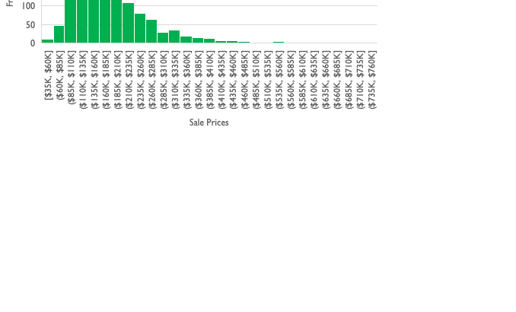
The Data Set
Source
This data was collected from 1460 houses sold between 2006 and 2010 in Ames, Iowa
The dataset contained a mixture of categorical and numerical/continuous data types
Sale prices distribution was approximately normal that is slightly positively skewed
Descriptive statistics

Slide 6
Methods
Done in Excel with pivot tables and the Data Analysis Toolpak
Manipulated different categorical data types and compared either the difference in proportions of houses bought/sold (Z-test) or the difference in mean sale price (2 tail T-test)
μ1 and μ2 are the means/averages of sample 1 and sample 2 respectively
p̂1 and p̂2 are the proportions of sample 1 and sample 2 respectively
A/A tests to determine bias in samples
Used bar graph visualizations to show confidence intervals

Slide 7
Condition 1: Overall Condition rating
Hypothesis: There is no significant difference in the mean sale prices between houses with an overall condition rating > 5 and a rating <= 5
Null: μ1 - μ2 = 0
Alternative: μ1 - μ2 ≠ 0
Results
T-stat: 9.501
P-value: 8.422 X 10^-21
Confidence Intervals
Lower limit: 28,938
Upper limit: 43,997
Interpretations
We can reject the null hypothesis and the difference between the means of houses rated > 5 and houses rated <=5 is significant
With 95% confidence, the difference between the means lies between 28,938.16 and 43,997.32

Slide 8
Condition 1I: Year Built
Hypothesis: There is no significant difference in the mean sale prices of houses built 1972 or before and houses built after 1972
Null: μ1 - μ2 = 0
Alternative: μ1 - μ2 ≠ 0
Results
T-stat: -23.113
P-value: 1.415 X 10^-97
Confidence Intervals
Lower limit: 75,227
Upper limit: 89,183
Interpretations
Reject the null hypothesis, there is a significant difference in the means of sale prices between houses built 1972 and before, and houses built after 1972
With 95% confidence, the difference between the means lies between 75,226.85 and 89,183.41

Slide 9
Condition III: House Style
Hypothesis IIIa:
Hypothesis IIIB
There is no significant difference in the proportion of houses bought/sold between 1 story houses and all other house types (> 1 story)
Null: p̂1 - p̂2 = 0
Alt: p̂1 - p̂2 ≠ 0
A/A test confirmed no bias in control group
The control group are 1 story houses, and the treatment groups are houses with 1 or more stories
Results
P-value: 0.834
Confidence Intervals
Lower Limit: -0.046
Upper Limit: 0.057
Interpretations
Fail to reject null that there is no significant difference in the proportion of houses bought/sold with 1 story, and house types >1 story
The difference is not significant at p = 0.834
With 95% confidence the difference in proportions is between -0.046 & 0.057
There is no significant difference in the mean sale prices between 1 story houses and all other house types (> 1 story)
Null: μ1 - μ2 = 0
Alternative: μ1 - μ2 ≠ 0
Results
T-stat: -2.365
P-value: 0.018
Confidence Intervals
Lower limit: 1676
Upper limit: 17,959
Interpretations
Reject null that there is no significant difference in the mean of sale prices between 1 story houses, and house types >1 story
With 95% confidence, the difference in means lies between 1676.09 and 17959.19

Slide 10
Visualizations Hypothesis III
Hypothesis IIIA
Hypothesis IIIA

Slide 11

Key Takeaways
Condition 1
Based on the T-tests, there is a significant difference in sale prices of houses with condition ratings <=5 (~$195K) and houses with ratings > 5 (~$158K).
Surprisingly houses with overall condition ratings <= 5 had a higher average sale price
People could be buying these houses because they think they’re cheaper or they want to do a project and remodel it
Condition 2
This could signal a demand for more modern homes
Condition 3
From the Z-tests, the difference in the proportion of houses bought/sold between 1 story and >1 story houses was not significant indicating that people will buy the house regardless of house type
However from the T-tests, the difference in the average prices between the house types were significant indicating that people would pay extra for a house with more than 1 story.
Based on T-tests there is a significant difference in the means of sale prices between houses built 1972 and before, and houses built after 1972

Slide 12
Call To Action
Solutions to the objective
We should invest more in homes built after 1972 since they have higher average sale prices
We should also invest more in homes more than 1 story since they also have higher average sale prices
Business Objective: Finding the factors that drive home sale prices so that the bank/investors can identify and invest in properties that are good investments.
We should encourage sellers to get the overall condition of their home rated

