Slide 1
SQL
Week 2 Day 1

Slide 2
Agenda
Context and Landscape (40 mins)
Break (10 mins)
Writing SELECT statements (60 mins)
Filtering, ordering, limiting, etc.
Joining tables
Grouping records
Aggregate functions

Slide 3
Why does data reside in databases?
Organized way to store data and relate data to each other
Enables data governance (e.g., availability, usability, integrity and security of data)
Efficient retrieval of structured data
Can store lots of data

Slide 4
Why SQL?
A lot of data is still stored in SQL databases
Structured Query Language (SQL) still the most proficient tool to investigate, filter, slice and dice your data
NoSQL databases
There exists NoSQL databases (e.g., MongoDB)
Want to learn more? https://www.mongodb.com/nosql-explained

Slide 5
Commonly used database schemes
How do tables in a database relate to each other?
There are some commonly used design principles
We will walk through Star and Snowflake schemes
Resources:
https://www.guru99.com/star-snowflake-data-warehousing.html
https://en.wikipedia.org/wiki/Snowflake_schema
https://en.wikipedia.org/wiki/Star_schema

Slide 6
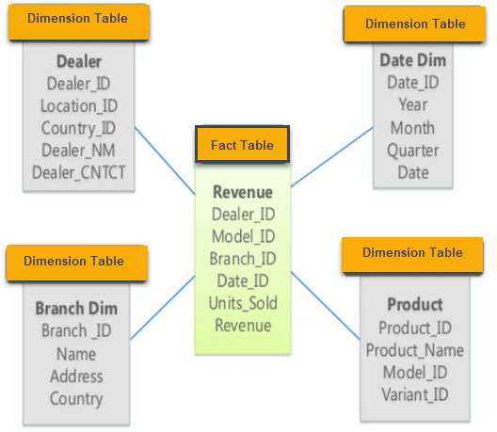
Star Schema
Every dimension represented by only one dimension table
Dimension table contains set of attributes
Dimension tables are joined to the fact table using a foreign key
Dimension tables are not joined to each other
Fact table contains key and measure

Slide 7
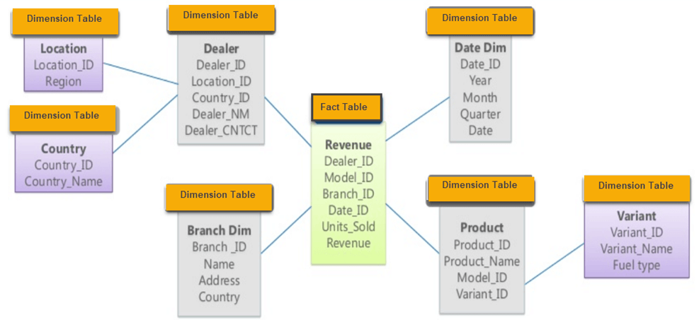
Snowflake Schema
Extension of the star schema by adding extra dimensions
Dimension tables are "normalized", splitting data into additional tables
What does it mean to normalize data?

Slide 8
Schema comparison
Star schema:
Easy to understand
Dimension tables are not normalized - country ID does not have country lookup table
Widely supported by BI tools
Snowflake schema:
Easy to implement and "grow"
Lower query performance with multiple tables
More difficult to maintain with more lookup tables

Slide 9
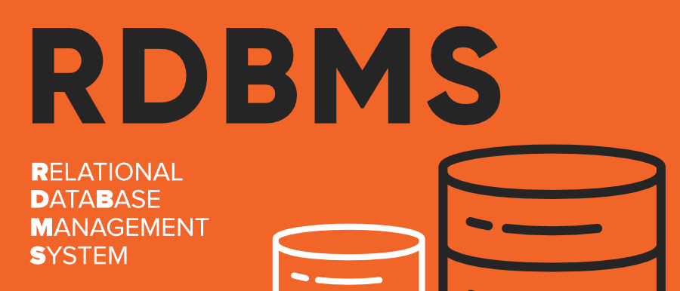
RDBMS Landscape
Relational Database Management System
Software system that enables users to define, create, maintain and control access to the database
It’s a very lucrative business as almost every business needs a database and thus there are many vendors

Slide 10
RDBMS Vendors
Closed source (i.e., you have to pay)
Vendors: Oracle, SQL Server (Microsoft), IBM DB2, Microsoft Access - local small databases
Could come with integrations and services that make things easier
Open source (i.e., free)
MySQL, PostgreSQL, SQLite, MariaDB
Good developer community makes these great options
This articles offers a good comparison of open source systems options.
https://www.digitalocean.com/community/tutorials/sqlite-vs-mysql-vs-postgresql-a-comparison-of-relational-database-management-systems

Slide 11
Why SQLite?
Not directly comparable to client/server SQL database engines such as MySQL, Oracle, PostgreSQL, or SQL Server
Used as on-disk file format for desktop applications
Great to learn on to get a hang of SQL
For more information: https://www.sqlite.org/whentouse.html

Slide 12
Why PostGres?
Created by scientists from the University of California at Berkeley
Open source nature makes it easy to upgrade or extend
High compliance to the SQL standard
Offers its users a huge (and growing) number of functions allowing programmers to create new applications, better protect data integrity, and developers build resilient and secure environments
Can easily run it on Windows, Mac OS X, and almost all Linux and Unix distributions
MySQL would be a good choice too
We use will use psql

