Slide 1
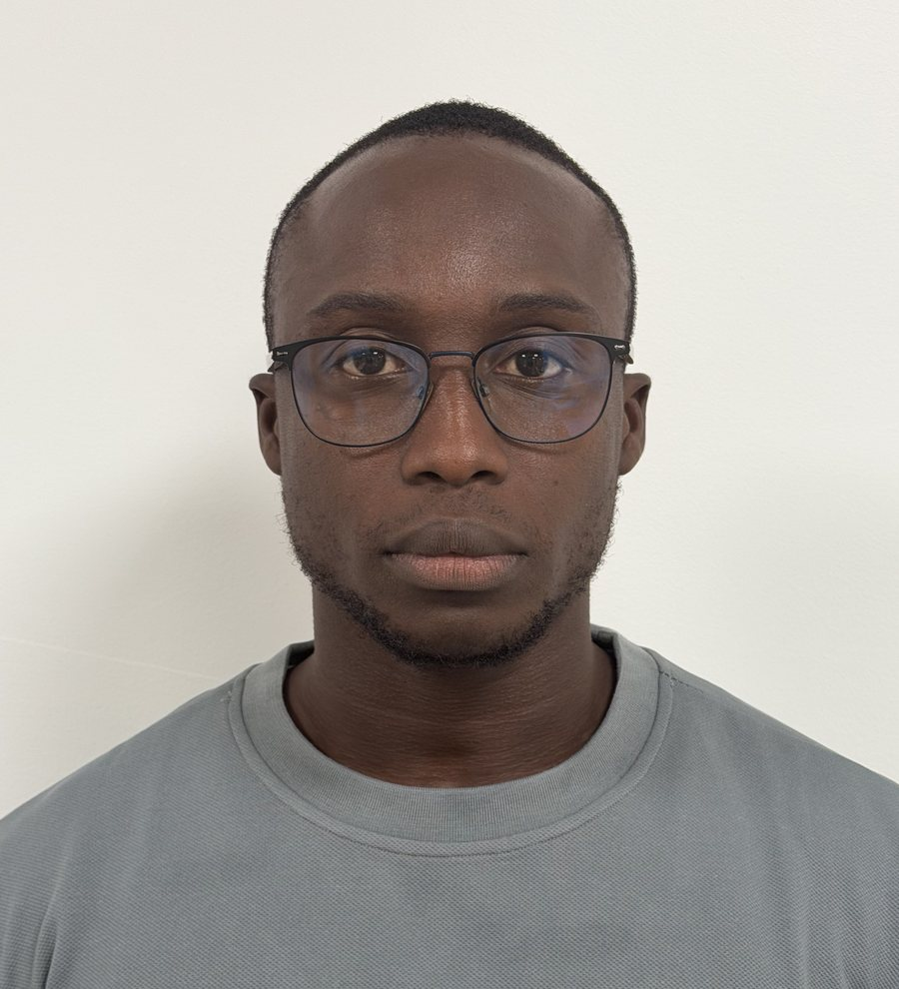
IT AUDIT · INFORMATION SECURITY · COMPLIANCE
Catalogue of offers and services
Information systems under control, and the evidence to prove it.
Georges Alain Gracien CABO
Senior auditor · IT audit and risk · Dakar, Senegal
georgilearning.academy
2026–2027 edition

Slide 2



Why now: security is becoming mandatory
Senegal: new law on critical infrastructure and digital security (2026)
Banks and financial institutions
The BCEAO regulates information systems security for institutions in the WAMU (instruction no. 009-06-2015).
Every organisation running information systems must appoint a CISO, adopt a security policy, a business continuity plan and a disaster recovery plan, and undergo audits.
Statutory audit
24 h
12 months
Every year, financial auditors need reliable, tested IT controls (ITGC, ITAC).
to report a significant incident
to set up continuous monitoring
1 / year
3 years
Personal data
Data protection requires security measures and informing people when a breach occurs.
internal security audit
between two external audits
Obligations announced for critical information infrastructure (telecoms, energy, water, health, financial services…).
Sources: Senegalese press (August–September 2026); BCEAO, instruction no. 009-06-2015. Final thresholds depend on implementing regulations.

Slide 3
Your contact
Georges Alain Gracien CABO
Senior auditor, Eritedge Senegal (formerly EY)
Telecom and network engineer turned IT auditor. I work on the IT side of statutory audits and on information systems security, for banks, e-money issuers, telecom operators, port authorities and industrial companies.
3 years
7 sectors
4 countries
105 pages
of IT audit at a firm
all regulated
Senegal, Guinea, Côte d'Ivoire, Djibouti
of documented Wazuh lab work
Tools: Wazuh · Active Directory and GPO · Frameworks: ISO/IEC 27001, COBIT, ITIL, CIS

Slide 4






Six offers to keep your IT risks under control
01
02
03
IT audit (ITGC and ITAC)
Security compliance assessment
ISO/IEC 27001 support
Tested IT controls for the financial statement audit.
Where do you stand against the new obligations?
Structure your security, all the way to certification.
04
05
06
Security monitoring with Wazuh
Workstation and server hardening
Training and awareness
An open source SOC, without costly licences.
Measure and fix configurations (CIS).
Build your teams' skills.

Slide 5



IT audit (ITGC and ITAC)
What I do
Offer 01
Mapping the applications that feed the financial statements
Testing access, change and operations controls (ITGC)
Testing automated controls and reports (ITAC, IPE)
Audit data analytics
Tested IT controls for the financial statement audit.
FOR WHOM
Finance departments, statutory auditors, audit firms and internal audit.
What you receive
Documented working papers, ready for review
Findings ranked by risk level
Practical recommendations and an action plan
Typical duration
2 to 6 weeks depending on the number of applications

Slide 6

Security compliance assessment
What I do
Offer 02
Governance review: CISO, security policy, BCP and DRP
Gap analysis against BCEAO rules, the digital security law and data protection
Review of privileged access and segregation of duties
Gaps prioritised by risk
Where do you stand against the new obligations?
FOR WHOM
Banks, microfinance, e-money issuers, telecoms, ports and any organisation covered by the digital security law.
What you receive
Compliance table, requirement by requirement
12-month compliance roadmap
Summary for management and the board
Typical duration
3 to 5 weeks

Slide 7

ISO/IEC 27001 support
What I do
Offer 03
Gap analysis against the standard
Risk assessment method and execution
Statement of Applicability and treatment plan
Key policies, internal audit and management review
Structure your security, all the way to certification.
FOR WHOM
Organisations aiming for certification or wanting to structure their information security management system (ISMS).
What you receive
Documented ISMS sized for your organisation
Risk register and treatment plan
File ready for the certification audit
Typical duration
3 to 9 months, step by step

Slide 8

Security monitoring with Wazuh
What I do
Offer 04
Server installation and agent deployment (including via GPO)
Detection rules tailored to your business applications
Monitoring of sensitive files and vulnerabilities
Noise reduction and automated response to attacks
An open source SOC, without costly licences.
FOR WHOM
SMEs, banks, microfinance and e-money issuers that must monitor their security continuously.
What you receive
Operational monitoring platform
MITRE ATT&CK and PCI DSS dashboards
Alert handling procedures and skills transfer
Typical duration
4 to 8 weeks to go live

Slide 9

Workstation and server hardening
What I do
Offer 05
Initial compliance score against CIS benchmarks
Analysis of priority gaps
Fixes through Group Policy (GPO)
Tracking over time and alerts on regression
Measure and fix configurations (CIS).
FOR WHOM
IT departments that want better-configured Windows and Linux systems and evidence for auditors.
What you receive
Before and after score
Documented hardening GPOs
Tracking dashboard for management and auditors
Typical duration
2 to 4 weeks

Slide 10

Training and awareness
What I do
Offer 06
IT audit for financial auditors (ITGC, ITAC)
Certification preparation: ISO 27001, CISA and Security+
Hands-on Wazuh workshop for IT teams
User awareness: phishing, passwords, data
Build your teams' skills.
FOR WHOM
Audit teams, IT teams and business users.
What you receive
Materials in French and English
Corrected quizzes on my online campus
Certificate of attendance
Typical duration
Half a day to 5 days

Slide 11
A clear method, from scoping to report
01
02
03
04
Understand
Assess risk
Test
Report
Your processes, your critical applications and what feeds your financial statements.
Identify what can go wrong and prioritize by business impact.
Controls tested on documents and data, with documented evidence.
Findings ranked by risk, realistic recommendations and a tracked action plan.
Ways of working
Fixed-scope engagement
Ongoing support
In-house training
Scope, deliverables and schedule agreed up front.
Monthly follow-up of action plans and compliance.
Sessions tailored to your teams, on site or remote.
Pricing on quotation, based on scope and organisation size.

Slide 12
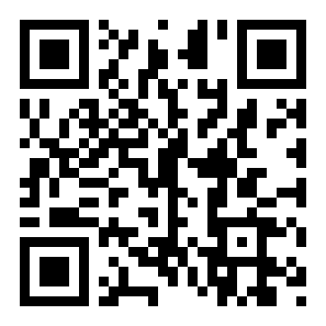




Let's talk about your needs
Describe your context: I will reply quickly with a proposal suited to your size and sector.
+221 77 156 79 40
georgesalain985@gmail.com
georginho985@icloud.com
linkedin.com/in/georges-alain-gracien-cabo-445189183
Scan to see the full offer details
georgilearning.academy
Based in Dakar · engagements in Senegal, West and East Africa, and remotely

