Slide 1
“Redesign of Distributed Relational Databases” Perspectives after Thirty Years!
Kamalakar Karlapalem
IIIIT, Hyderabad, India. kamal@iiit.ac.in
Satya Valluri
Databricks, USA.
DASFAA 2023 Tutorial 18th April 2023
Tianjin China

Slide 2
Outline
Background
Redesign of Distributed Relational Databases
Local Parallel/Distributed & Global distributed
Aspects of Current Distributed Database Processing
Open Problems

Slide 3
Background

Slide 4
Distributed Database (1992) Ozsu & Valduriez
A distributed database as a collection of multiple, logically interrelated databases located at the nodes of a distributed system.
Multiple sites connected by a WAN (may be LAN)
A Distributed database Management system as the software system that permits the management of the distributed database and makes the distribution transparent to the users.
Key point is ‘distribution transparent to users’.

Slide 5
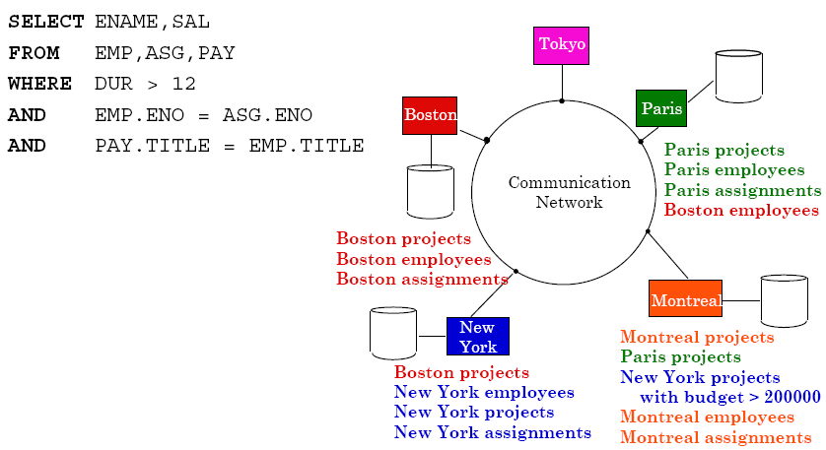

Slide 6
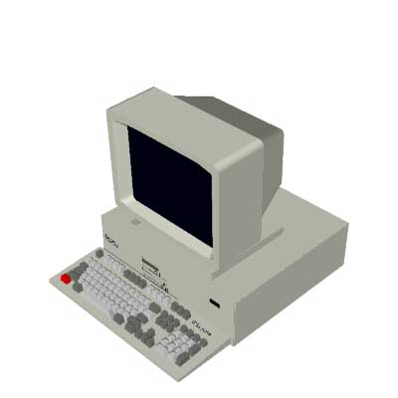

Query
Abstract
Query
DDBMS
Global
Database
Result
Result

Slide 7
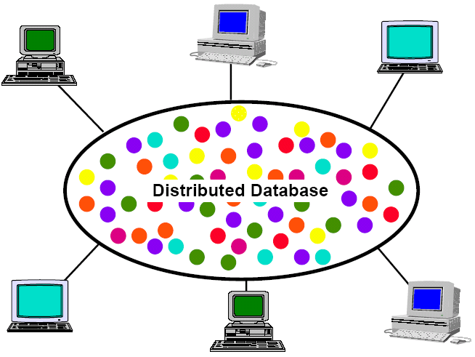
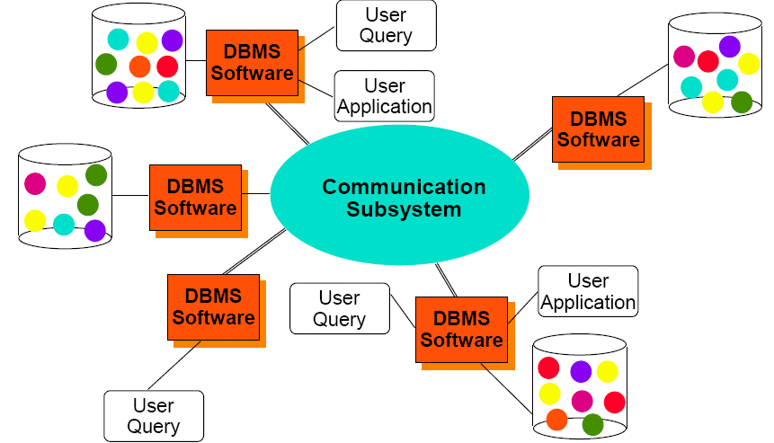

Slide 8
Distributed Query Execution – high level view
Identify the relations of distributed database the query specifies
Check whether the relations are stored in one site or multiple sites
Determine which relations from which sites need to be accessed
Identify data transfer from one site to another to perform query operations
Steps 3-4, are determine the query execution plan by considering the data access cost and data transfer costs
Query result is got by executing the query execution plan

Slide 9
Distributed Database Design Problem
Given a set of queries (SQL statements on Relations)
[Fragmentation] Determine the fragments of Relations so that queries access as less irrelevant data as possible
[Allocation] Allocate the fragments to sites so that queries transfer as less data as possible between the sites
No optimal or best possible solution for the above problems.

Slide 10
Mixed Fragmentation Methodology

Slide 11
Mixed fragmentation Methodology
Given a set of queries
[Horizontal Fragments (HF)] Use predicates (Where clauses of SQL query) to horizontally fragment a relation
[Vertical Fragments (VF)] Use attributed accessed (Select part of SQL query) to vertically fragment a relation
Apply both HF and VF to get grid cells (small fragment) each pertaining to one VF and one HF
Merge grid cells to get Fragments called Mixed fragments. Queries access mixed fragments
A mixed fragmentation methodology for initial distributed database design
Navathe, Karlapalem, Ra
Journal of Computer and Software Engineering 1995

Slide 12
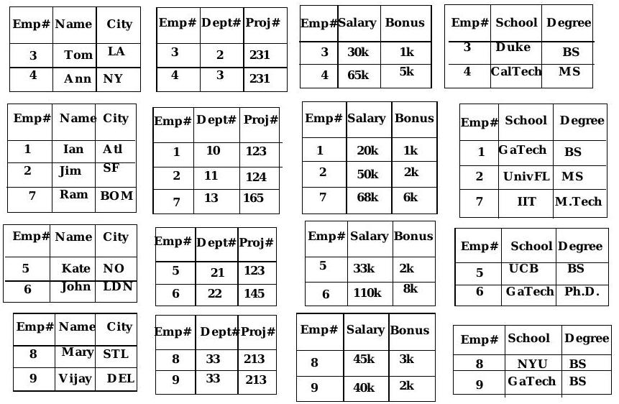
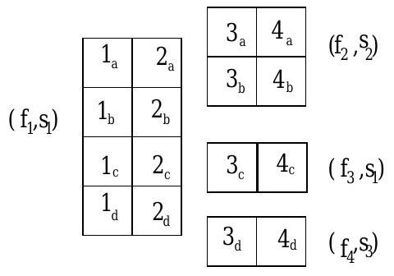
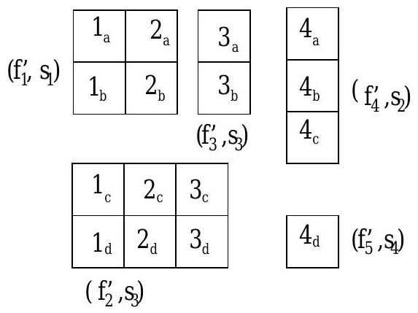
Mixed Fragments
1
2
3
4
a
b
c
d

Slide 13
Redesign Problem

Slide 14
Redesign Problem
Due to changes in queries or applications a given fragmentation and allocation schema does not perform well and has to be changed.
Corrective Redesign: Every once in a while use the fragmentation and allocation algorithms to generate a new design based on revised set of queries.
Preventive Redesign: In case we know the queries that will execute next, one can change the design to suit those set of queries.
Adaptive Redesign: The design adapts to the current query mix. The resign is a continuous process identifying queries whose performance has to be enhanced through redesign.

Slide 15
Materialization Problem

Slide 16
Materialization Problem
A populated distributed database that adheres to a given fragmentation and allocation schema exists.
A new fragmentation and allocation schema is decided.
The data in the populated distributed database has to be materialized as per the new fragmentation and allocation schema.
Materialization takes time, and would require handling of queries and transactions while it happens.
Algorithms to correctly materialize new fragmentation and allocation schema were developed.

Slide 17
Employee

Slide 18
Multiple Query Optimization Solution

Slide 19
Estimating Transaction Response Time

Slide 20
Local and Distributed Transactions

Slide 21
Simulation Model for Lock Manager Contention

Slide 22
Results
15 Transactions per second
10 transactions/second

Slide 23
Preventive Redesign

Slide 24
Preventive Redesign Policy
Use Markov Decision Process
Basis
If the current set of applications changes from set A to set B, and if the current distributed database design is D1, then the policy gives the Design that needs to be used for the longer-term optimal execution of all transactions.
Inputs: Probability Transition Matrix, Reward Matrix, Materialization cost Matrix
Output: Redesign Policy

Slide 25
Discrete Markov Process and Redesign Policy

Slide 26
Optimal Redesign Policy

Slide 27
Salient Points – in 1992
Redesign incurs materialization cost
Preventive redesign works when the application classes are stated clearly
Adaptive design works when materialization costs can be amortized
Corrective redesign is straightforward but incurs materialization costs.

Slide 28
Locally Parallel Data Partitioning and Execution Solutions Satya Valluri Data Bricks

Slide 29
Relook Distributed Database Design Circa 2023

Slide 30
Parallel Query Execution Strategies
Parallel DBMS community also considers some of the techniques of distributed database design
Systems like Gamma, and Teradata – use fixed horizontal fragmentation techniques based on random, range, and hash placement of rows across the parallel system
Onus is on simple query data localization and result combination
Current solutions like Map-Reduce, and others expand the horizontal fragmentation for efficient execution of queries while keeping query optimization simple.
Vertica uses extreme vertical partitioning for storage and efficient query execution.

Slide 31
Local Parallel, Global Distributed Architecture (LPGD)
Global Distributed –
Consider globally distributed database with fragmentation and allocation with its aim to reduce – irrelevant data access and irrelevant data transfer
Local Parallel –
Use any of the parallel processing solutions to execute queries efficiently
Local Parallel –
Use any of the parallel processing solutions to execute queries efficiently
Local Parallel –
Use any of the parallel processing solutions to execute queries efficiently

Slide 32
LPGD Architecture
There is transparency between local parallel and globally distributed.
Local systems can use efficient local storage and parallel processing solutions without impacting the globally distributed database.
Global distributed database design can use advanced fragmentation and allocation techniques to determine local databases.
The transparency and execution are complimentary.
The distributed database design can design while considering the parallel processing capability of local systems.

Slide 33
Query / Data Dependency
Data↓Query Access→ | 20% of queries | 80% of Queries
20% of Data | Fragmentation | Sharding
80% of Data | Sharding | Fragmentation & Sharding
The data skew can provide for a 20%/80% split of data access and impact fragmentation. Knowing which fragment to access or not will reduce query execution cost.

Slide 34
Fragmentation and Storage Compute Capability
One way to model storage compute capability is that storage dynamically delivers fragments based on query requirements.
Fragmentation can complement storage computing capability by efficiently processing partial selects on fragments. Hence a finer level of fragmentation is not needed.
The allocation can be simplified because of fewer fragments.

Slide 35
Distributed Database designers choice
Even if 2 TB of irrelevant data is accessed, it adds to about 1000 seconds to query execution time + additional data transfer and compute time, if any.
Modern distributed database systems can execute queries that access even more irrelevant data and move irrelevant data.
Thus, a coordinated effort to map fragmentation got from queries to exploit judiciously sharding to reduce irrelevant data access in a dynamic environment is a challenging problem.
Over time, as database sizes even increase, the cost for storage and computing increases dollar cost for query execution becomes a concern.
Reward-based approaches to dynamically decide on sharding can work better if the relations are already fragmented.

Slide 36
Summary
Introduced 30-year-old work on ‘redesign of distributed relational databases’
Gave an overview of current distributed database systems architecture across various dimensions
Provided a fragmentation perspective for distributed database designers for designing their databases.

