Slide 1

Primitive Switches for Accelerator Network Building Blocks for Accelerator NoC
http://synergy.ece.gatech.edu
Jianming TONG, Tushar Krishna
jianming.tong@gatech.edu, tushar@ece.gatech.edu

Slide 2
Outline
RTL general microswitches libraries
for topologies of various domain-specfic architecture
Motivations
Primitive Switches
Operations
Microarchitectures & Functionalities
Examples
Topology

Slide 3
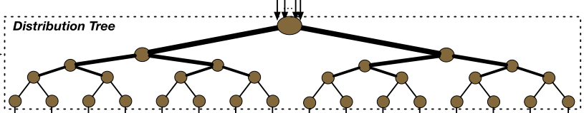
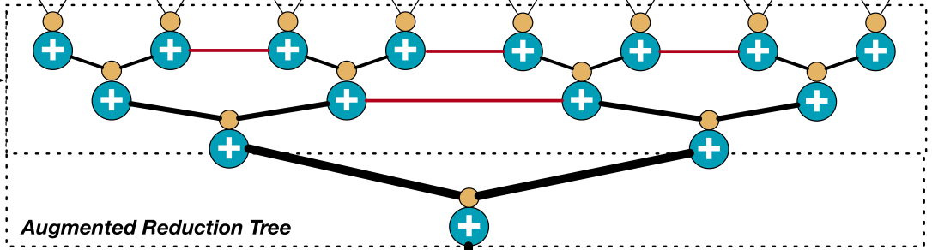
Motivations
BENES Network [1]
MAERI Distritbute Network [2]
Out degree == In degree
Out degree < In degree
0
1
MAERI Reduction Network[2]
Merge Network [1]
Out degree > In degree
Out degree > In degree
[1] http://homepages.inf.ed.ac.uk/cgi/rni/comp-arch.pl?Networks/benes.html,Networks/benes-f.html,Networks/menu-dyn.html
[2] Kwon, H., Samajdar, A., & Krishna, T. (2018). Maeri: Enabling flexible dataflow mapping over dnn accelerators via reconfigurable interconnects. ACM SIGPLAN Notices, 53(2), 461-475.

Slide 4
Primitive Switches Operations
Degree
Invalid
Data A
Data B
Data B
In<Out
distribute 1x2
In=Out
distribute 2x2
In>Out
Merge_2x1
In>Out
+
+
+
+
Reduction_2x1

Slide 5
Primitive Switches Micro-architecture -Distribute 1x2
ControlSignal A
Invalid Signals
Invalid
Data A
_{OutA}
Inv
1 0
_{In}
Inv
_{OutB}
1 0
ControlSignal B
<Microarchitecture>

Slide 6
Primitive Switches Micro-architecture - 2x1
Invalid
Data A
Data B
_{InA}
_{Out}
_{InB}
1 0
Control
Merge 2x1
<Microarchitecture>
Invalid
Data A
Data B
_{InA}
+
_{Out}
_{InB}
+
+
+
+
<Microarchitecture>
Reduction 2x1

Slide 7
Example: Router building leveraging microswitches[1]
D
M
N
D
M
N
D
M
D
M
E
D
M
E
D
M
D
M
S
D
M
S
D
M
D
M
W
D
M
W
D
M
D
M
L
L
D
M
D
M
D
Distribute 1x2
M
Merge 2x1
[1] Microswtiches. Hyoukjun Kwon, Michael Pellauer, Tushar Krishna

Slide 8
Primitive Switches Distribute 2x2 -- Complex/Simple
Complex
Mutlicast
Unicast (both)
Unicast (Single)
Simple
Mutlicast
Unicast (both)
Invalid
Data A
Data B

Slide 9
Microarchitecture Distribute 2x2 Complex
Complex
Unicast (both)
Mutlicast
Unicast (Single)
o_data(high)
o_data(low)
M
M
D
D
Distribute 1x2
In_data(high)
M
Merge 2x1
D
In_data(low)
<Microarchitecture>
Distribute 2x2 Complex
Invalid
Data A
Data B

Slide 10
Microarchtecture Distribute 2x2 Complex
M
M
M
M
M
M
D
M
D
M
D
M
D
M
D
D
D
D
D
D
Pass_Switch(PS)
Pass_Through(PT)
Pass_High(PH)
Pass_Low(PL)
Multicast_HighIn(MH)
M
M
M
M
M
D
M
D
M
D
M
D
D
D
D
D
Pass_HighIn_LowOut(PHL)
Pass_LowIn_HighOut(PLH)
Multicast_LowIn(ML)
No_Pass(NP)

Slide 11
Microarchitecture Distribute 2x2 Simple
Simple
Mutlicast
Unicast (both)
Invalid
Data A
Data B
<Microarchitecture>
M
Merge 2x1
M
M
M
M
M
M
M
M
M
M
M
M
M
M
M
M
Pass_Switch(PS)
Pass_Through(PT)
Multicast_HighIn(MH)
Multicast_LowIn(ML)

Slide 12
Topology -- BENES
0
1
0
2
0
4
0
2
0
1
0
1
2
3
4
5
6
7
2
3
4
6
2
6
4
6
2
3
4
5
1
3
1
5
1
3
4
5
6
7
5
7
3
7
5
7
6
7
(a) CASE 1: All choose pass through (PT)
Distribute 2x2 Simple
0
1
1
2
1
7
1
1
1
1
1
1
1
1
7
7
7
7
 | BENES (N input)
#STAGE | 2logN-1
#2x2 Switch | (N/2)*(2logN-1)
#WIRE[Inner] | N*(2logN-2)
2
3
4
7
1
7
7
7
1
1
4
5
1
3
1
7
1
1
7
7
6
7
5
7
1
7
7
7
7
7
Feature:
1. Non-blocking Permutation
2. Group Multicasting [1]
(b) CASE 2: All chose Multicast High
[1] Xia, T., Zong, P., Zhao, H., Tong, J., Zhao, W., Zheng, N., & Ren, P. (2020, September). Cocoa: Content-oriented configurable architecture based on highly-adaptive data transmission networks. In Proceedings of the 2020 on Great Lakes Symposium on VLSI (pp. 253-258).

Slide 13
Topology -- Butterfly
0
1
0
4
0
2
0
2
4
6
1
3
5
7
0
1
1
5
5
7
7
5
2
1
6
4
3
0
0
2
4
6
1
3
5
7
2
3
2
6
4
6
2
3
2
7
1
2
4
5
1
5
1
3
4
5
0
4
4
6
6
7
3
7
5
7
6
7
3
6
0
3
(a) Pass Through
(b) Pass Switch
Distribute 2x2 Simple
destination tag
destination tag
(10)(10)(01)
7
5
2
1
6
4
3
0
 | Butterfly (N input)
#STAGE | logN
#2x2 Switch | (N/2)*(logN)
#WIRE[Inner] | N*(logN)
0
1
0
4
0
2
0
2
0
7
0
2
0
7
0
1
1
5
5
7
(10)(00)(00)
2
3
2
7
0
7
111
2
3
2
7
1
2
4
5
0
5
0
2
4
5
0
4
4
6
6
7
2
7
0
7
6
7
3
6
0
3
Feature:
1. blocking Permutation
2. Destination Tag routing
(10)(01)(01)
111
(c) Pass Through
(d) Pass Switch

Slide 14
Topology Merge/Reduction Tree
0
1
0
1
0
1
0
1
1
3
2
5
0
1
2
3
2
3
3
7
7
7
22
29
4
5
4
5
5
7
9
13
6
7
6
7
Merge 2x1 -> Merge Tree
Reduction Tree
Merge Tree
Reduction 2x1 -> Reduction Tree
 | Merge Tree (N input -- M output)
#STAGE | logN - logM
#2x1 Merge | M*(2*(N/2)/M-1)
#WIRE | M*(2*(N/2)/M-1) + N

Slide 15
BENES MERGE
0
1
0
2
0
4
0
2
0
1
1
3
5
7
2
3
4
6
2
6
4
6
2
3
4
5
1
3
1
5
1
3
4
5
6
7
5
7
3
7
5
7
6
7
Arbitrary Permutation
0
1
1
2
1
7
1
1
1
7
7
1
1
7
2
3
4
7
1
7
7
7
1
1
 | BENES Merge (N input M output)
#STAGE | 3logN - logM - 2
#2x2 Switch | (N/2)*(2logN-2)
#2x1 Switch | M*(2*(N/2)/M-1)
#WIRE[Inner] | N*(2logN-1)+ M*(2*(N/2)/M-1) + N
4
5
1
3
1
7
7
1
7
1
6
7
5
7
1
7
1
7
7
7
Group Multicasting

Slide 16
Unfolded Butterfly Merge
0
0
0
0
0
4
0
0
4
0
0
0
4
0
2
0
2
7
0
2
7
1
6
3
7
7
1
1
7
1
1
7
1
1
1
1
7
1
1
1
2
2
2
2
2
2
2
c
e
c
e
1
c
e
1
3
1
3
3
3
7
1
3
3
3
7
4
4
4
4
6
4
4
4
6
1
3
1
3
1
1
3
5
5
5
5
5
5
5
1
1
6
6
6
6
6
6
6
6
d
f
d
f
3
d
f
7
7
b
f
b
f
7
3
3
7
b
f
7
7
7
7
 | (N input -- M output) |  | (N input -- M output)
#STAGE | 2log(N)-log(M)-1 | #1x2 Distribute | N
#Pipeline | Each stage 1 cycle | #2x2 Distribute | N*(log(N)-2)
#WIRE | 2N*[O(log(N/2))]+3N/2 | #2x1 Merge | M*(2*N/M-1)

Slide 17
Linear Network Multicasting
1
CMD:
011010
1
1
1
distribute 1x2
1
CMD:
101
1
 | Linear Network (1 input -- N output)
#STAGE | 1 (combinational); 1~N (sequential)
#1x2 Distribute | N
#WIRE | 2N
Only a single input port
Single direction data transmission

Slide 18
Bus Unicasting
distribute 1x2
 | Bus (1 input -- N output)
#STAGE | 1 (combinational); 1~N (sequential)
#1x2 Distribute | N
#WIRE | 2N
Only a single input port
Single direction data transmission
destination tag con

Slide 19
Input Command signals
i_cmd
[1:0]=01
[3:2]=10
[5:4]=00
[7:6]=01
i_cmd
[9:8]=01
[11:10]=11
[13:12]=00
[15:14]=01
i_cmd
[17:16]=01
[19:18]=10
[21:20]=00
[23:22]=01
i_cmd
[25:24]=10
[27:26]=01
[29:28]=10
[31:30]=01
i_data_bus[0*DATA_WIDTH+:DATA_WIDTH]
i_data_bus[1*DATA_WIDTH+:DATA_WIDTH]
o_data_bus[0*DATA_WIDTH+:DATA_WIDTH]
o_data_bus[1*DATA_WIDTH+:DATA_WIDTH]
o_data_bus[1*DATA_WIDTH+:DATA_WIDTH]
i_data_bus[7*DATA_WIDTH+:DATA_WIDTH]
o_data_bus[7*DATA_WIDTH+:DATA_WIDTH]
Control: 10 00 11 01
Through Multicast-low Multicast-high Swtich
Control words for all switches should be fed into the i_cmd in the same cycle with i_valid and i_data_bus

Slide 20
Input Command signals
i_data_bus[0*DATA_WIDTH+:DATA_WIDTH]
0
0
0
4
0
2
o_data_bus[0*DATA_WIDTH+:DATA_WIDTH]
1
i_data_bus[1*DATA_WIDTH+:DATA_WIDTH]
1
2
i_data_bus[2*DATA_WIDTH+:DATA_WIDTH]
2
c
e
o_data_bus[1*DATA_WIDTH+:DATA_WIDTH]
3
i_data_bus[3*DATA_WIDTH+:DATA_WIDTH]
3
i_data_bus[4*DATA_WIDTH+:DATA_WIDTH]
4
4
1
3
o_data_bus[2*DATA_WIDTH+:DATA_WIDTH]
5
i_data_bus[5*DATA_WIDTH+:DATA_WIDTH]
5
6
i_data_bus[6*DATA_WIDTH+:DATA_WIDTH]
6
d
f
o_data_bus[3*DATA_WIDTH+:DATA_WIDTH]
i_data_bus[7*DATA_WIDTH+:DATA_WIDTH]
7
b
f
Control: 10 00 11 01
Control: 11 01 10
Through Multicast-low Multicast-high Swtich
Multicast LowOut HighOut
Control words for all switches should be fed into the i_cmd in the same cycle with i_valid and i_data_bus

Slide 21
Input Command signals
i_cmd
[1:0]=01
[3:2]=01
[5:4]=10
[7:6]=11
[9:8]=01
[11:10]=01
[13:12]=10
[15:14]=11
i_cmd
[17:16]=10
[19:18]=10
[21:20]=01
[23:22]=00
[25:24]=01
[27:26]=01
[29:28]=11
[31:30]=01
0
0
0
4
0
2
o_data_bus[0*DATA_WIDTH+:DATA_WIDTH]
1
1
2
2
c
e
o_data_bus[1*DATA_WIDTH+:DATA_WIDTH]
3
3
4
4
1
3
o_data_bus[2*DATA_WIDTH+:DATA_WIDTH]
5
5
6
6
d
f
o_data_bus[3*DATA_WIDTH+:DATA_WIDTH]
7
b
f
Control: 10 00 11 01
Control: 11 01 10
Through Multicast-low Multicast-high Swtich
Multicast LowOut HighOut
Control words for all switches should be fed into the i_cmd in the same cycle with i_valid and i_data_bus

Slide 22
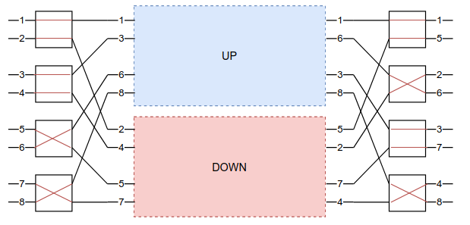
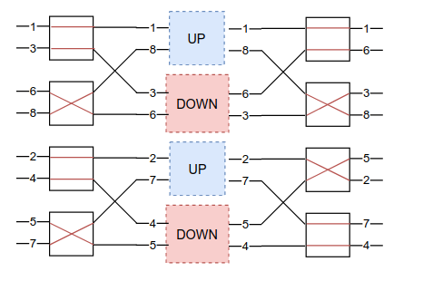
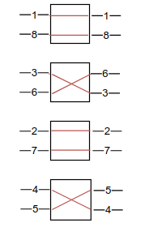
BENES Controller
BENES is recursively constructed -- 2 smaller-input BENES make a larger BENES
Generate control signals for outer stage -- divide the problem into 2 smaller input BENES

