Slide 1

Primitive Switches for Accelerator Network Building Blocks for Accelerator NoC
http://synergy.ece.gatech.edu
Jianming TONG, Tushar Krishna
jianming.tong@gatech.edu, tushar@ece.gatech.edu

Slide 2
Outline
RTL general microswitches libraries
for topologies of various domain-specfic architecture
Motivations
Primitive Switches
Operations
Microarchitectures & Functionalities
Examples
Topology

Slide 3
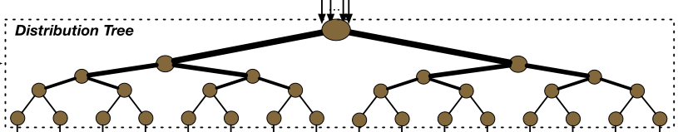
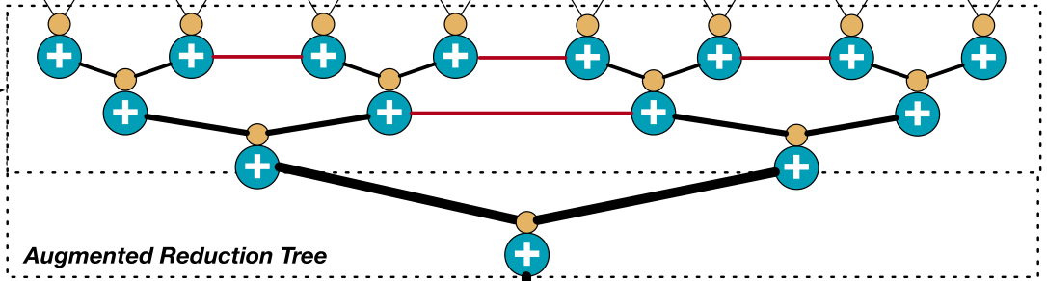
Motivations
BENES Network [1]
MAERI Distritbute Network [2]
Out degree == In degree
Out degree < In degree
0
1
MAERI Reduction Network[2]
Merge Network [1]
Out degree > In degree
Out degree > In degree
[1] http://homepages.inf.ed.ac.uk/cgi/rni/comp-arch.pl?Networks/benes.html,Networks/benes-f.html,Networks/menu-dyn.html
[2] Kwon, H., Samajdar, A., & Krishna, T. (2018). Maeri: Enabling flexible dataflow mapping over dnn accelerators via reconfigurable interconnects. ACM SIGPLAN Notices, 53(2), 461-475.

Slide 4
Primitive Switches Operations
Degree
Invalid
Data A
Data B
Data B
In<Out
distribute 1x2
In=Out
distribute 2x2
In>Out
Merge_2x1
In>Out
+
+
+
+
Reduction_2x1

Slide 5
Primitive Switches Micro-architecture -Distribute 1x2
ControlSignal A
Invalid Signals
Invalid
Data A
_{OutA}
Inv
1 0
_{In}
Inv
_{OutB}
1 0
ControlSignal B
<Microarchitecture>

Slide 6
Primitive Switches Micro-architecture - 2x1
Invalid
Data A
Data B
_{InA}
_{Out}
_{InB}
1 0
Control
Merge 2x1
<Microarchitecture>
Invalid
Data A
Data B
_{InA}
+
_{Out}
_{InB}
+
+
+
+
<Microarchitecture>
Reduction 2x1

Slide 7
Example: Router building leveraging microswitches[1]
D
M
N
D
M
N
D
M
D
M
E
D
M
E
D
M
D
M
S
D
M
S
D
M
D
M
W
D
M
W
D
M
D
M
L
L
D
M
D
M
D
Distribute 1x2
M
Merge 2x1
[1] Microswtiches. Hyoukjun Kwon, Michael Pellauer, Tushar Krishna

Slide 8
Primitive Switches Distribute 2x2 -- Complex/Simple
Complex
Mutlicast
Unicast (both)
Unicast (Single)
Simple
Mutlicast
Unicast (both)
Invalid
Data A
Data B

Slide 9
Microarchitecture Distribute 2x2 Complex
Complex
Unicast (both)
Mutlicast
Unicast (Single)
o_data(high)
o_data(low)
M
M
D
D
Distribute 1x2
In_data(high)
M
Merge 2x1
D
In_data(low)
<Microarchitecture>
Distribute 2x2 Complex
Invalid
Data A
Data B

Slide 10
Microarchtecture Distribute 2x2 Complex
M
M
M
M
M
M
D
M
D
M
D
M
D
M
D
D
D
D
D
D
Pass_Switch(PS)
Pass_Through(PT)
Pass_High(PH)
Pass_Low(PL)
Multicast_HighIn(MH)
M
M
M
M
M
D
M
D
M
D
M
D
D
D
D
D
Pass_HighIn_LowOut(PHL)
Pass_LowIn_HighOut(PLH)
Multicast_LowIn(ML)
No_Pass(NP)

Slide 11
Microarchitecture Distribute 2x2 Simple
Simple
Mutlicast
Unicast (both)
Invalid
Data A
Data B
<Microarchitecture>
M
Merge 2x1
M
M
M
M
M
M
M
M
M
M
M
M
M
M
M
M
Pass_Switch(PS)
Pass_Through(PT)
Multicast_HighIn(MH)
Multicast_LowIn(ML)

Slide 12
Topology Merge/Reduction Tree
0
1
0
1
0
1
0
1
1
3
2
5
0
1
2
3
2
3
3
7
7
7
22
29
4
5
4
5
5
7
9
13
6
7
6
7
Merge 2x1 -> Merge Tree
Reduction Tree
Merge Tree
Reduction 2x1 -> Reduction Tree
 | Merge Tree (N input -- M output)
#STAGE | logN - logM
#2x1 Merge | M*(2*(N/2)/M-1)
#WIRE | M*(2*(N/2)/M-1) + N

Slide 13
Topology -- Butterfly
0
1
0
4
0
2
0
2
4
6
1
3
5
7
0
1
1
5
5
7
7
5
2
1
6
4
3
0
0
2
4
6
1
3
5
7
2
3
2
6
4
6
2
3
2
7
1
2
4
5
1
5
1
3
4
5
0
4
4
6
6
7
3
7
5
7
6
7
3
6
0
3
(a) Pass Through
(b) Pass Switch
Distribute 2x2 Simple
destination tag
destination tag
(10)(10)(01)
7
5
2
1
6
4
3
0
 | Butterfly (N input)
#STAGE | logN
#2x2 Switch | (N/2)*(logN)
#WIRE[Inner] | N*(logN)
0
1
0
4
0
2
0
2
0
7
0
2
0
7
0
1
1
5
5
7
(10)(00)(00)
2
3
2
7
0
7
111
2
3
2
7
1
2
4
5
0
5
0
2
4
5
0
4
4
6
6
7
2
7
0
7
6
7
3
6
0
3
Feature:
1. blocking Permutation
2. Destination Tag routing
(10)(01)(01)
111
(c) Pass Through
(d) Pass Switch

Slide 14
Topology -- BENES
0
1
0
2
0
4
0
2
0
1
0
1
2
3
4
5
6
7
2
3
4
6
2
6
4
6
2
3
4
5
1
3
1
5
1
3
4
5
6
7
5
7
3
7
5
7
6
7
(a) CASE 1: All choose pass through (PT)
Distribute 2x2 Simple
0
1
1
2
1
7
1
1
1
1
1
1
1
1
7
7
7
7
 | BENES (N input)
#STAGE | 2logN-1
#2x2 Switch | (N/2)*(2logN-1)
#WIRE[Inner] | N*(2logN-2)
2
3
4
7
1
7
7
7
1
1
4
5
1
3
1
7
1
1
7
7
6
7
5
7
1
7
7
7
7
7
Feature:
1. Non-blocking Permutation
2. Group Multicasting [1]
(b) CASE 2: All chose Multicast High
[1] Xia, T., Zong, P., Zhao, H., Tong, J., Zhao, W., Zheng, N., & Ren, P. (2020, September). Cocoa: Content-oriented configurable architecture based on highly-adaptive data transmission networks. In Proceedings of the 2020 on Great Lakes Symposium on VLSI (pp. 253-258).

Slide 15
BENES MERGE
0
1
0
2
0
4
0
2
0
1
1
3
5
7
2
3
4
6
2
6
4
6
2
3
4
5
1
3
1
5
1
3
4
5
6
7
5
7
3
7
5
7
6
7
Arbitrary Permutation
0
1
1
2
1
7
1
1
1
7
7
1
1
7
2
3
4
7
1
7
7
7
1
1
 | BENES Merge (N input M output)
#STAGE | 3logN - logM - 2
#2x2 Switch | (N/2)*(2logN-2)
#2x1 Switch | M*(2*(N/2)/M-1)
#WIRE[Inner] | N*(2logN-1)+ M*(2*(N/2)/M-1) + N
4
5
1
3
1
7
7
1
7
1
6
7
5
7
1
7
1
7
7
7
Group Multicasting

Slide 16
Unfolded Butterfly Merge
0
0
0
0
0
4
0
0
4
0
0
0
4
0
2
0
2
7
0
2
7
1
6
3
7
7
1
1
7
1
1
7
1
1
1
1
7
1
1
1
2
2
2
2
2
2
2
c
e
c
e
1
c
e
1
3
1
3
3
3
7
1
3
3
3
7
4
4
4
4
6
4
4
4
6
1
3
1
3
1
1
3
5
5
5
5
5
5
5
1
1
6
6
6
6
6
6
6
6
d
f
d
f
3
d
f
7
7
b
f
b
f
7
3
3
7
b
f
7
7
7
7
 | (N input -- M output) |  | (N input -- M output)
#STAGE | 2log(N)-log(M)-1 | #1x2 Distribute | N
#Pipeline | Each stage 1 cycle | #2x2 Distribute | N*(log(N)-2)
#WIRE | 2N*[O(log(N/2))]+3N/2 | #2x1 Merge | M*(2*N/M-1)

Slide 17
Linear Network Multicasting
In
1
CMD:
011010
1
1
1
Out
Port ID
0
1
2
3
4
5
0
1
2
3
4
5
Command (CMD): one hot encoding of output port ID
For multicasting: multiple 1 in the CMD.
1
CMD:
010000
1
0
1
2
3
4
5
distribute 1x2
 | Linear Network (1 input -- N output)
#STAGE | 1 (combinational); 1~N (sequential)
#1x2 Distribute | N
#WIRE | 2N
Only a single input port
Single direction data transmission

Slide 18
Bus Unicasting
CMD:
011010
In
Out
Port ID
Out
Port ID
0
1
2
3
4
5
0
1
2
3
4
5
Command: address tag, binary represetation of output port ID
distribute 1x2
 | Bus (1 input -- N output)
#STAGE | 1 (combinational); 1~N (sequential)
#1x2 Distribute | N
#WIRE | 2N
Only a single input port
Single direction data transmission
destination tag con

Slide 19
Input Command signals
i_cmd
[1:0]=01
[3:2]=10
[5:4]=00
[7:6]=01
i_cmd
[9:8]=01
[11:10]=11
[13:12]=00
[15:14]=01
i_cmd
[17:16]=01
[19:18]=10
[21:20]=00
[23:22]=01
i_cmd
[25:24]=10
[27:26]=01
[29:28]=10
[31:30]=01
i_data_bus[0*DATA_WIDTH+:DATA_WIDTH]
i_data_bus[1*DATA_WIDTH+:DATA_WIDTH]
o_data_bus[0*DATA_WIDTH+:DATA_WIDTH]
o_data_bus[1*DATA_WIDTH+:DATA_WIDTH]
o_data_bus[1*DATA_WIDTH+:DATA_WIDTH]
i_data_bus[7*DATA_WIDTH+:DATA_WIDTH]
o_data_bus[7*DATA_WIDTH+:DATA_WIDTH]
Control: 10 00 11 01
Through Multicast-low Multicast-high Swtich
Control words for all switches should be fed into the i_cmd in the same cycle with i_valid and i_data_bus

Slide 20
Input Command signals
i_data_bus[0*DATA_WIDTH+:DATA_WIDTH]
0
0
0
4
0
2
o_data_bus[0*DATA_WIDTH+:DATA_WIDTH]
1
i_data_bus[1*DATA_WIDTH+:DATA_WIDTH]
1
2
i_data_bus[2*DATA_WIDTH+:DATA_WIDTH]
2
c
e
o_data_bus[1*DATA_WIDTH+:DATA_WIDTH]
3
i_data_bus[3*DATA_WIDTH+:DATA_WIDTH]
3
i_data_bus[4*DATA_WIDTH+:DATA_WIDTH]
4
4
1
3
o_data_bus[2*DATA_WIDTH+:DATA_WIDTH]
5
i_data_bus[5*DATA_WIDTH+:DATA_WIDTH]
5
6
i_data_bus[6*DATA_WIDTH+:DATA_WIDTH]
6
d
f
o_data_bus[3*DATA_WIDTH+:DATA_WIDTH]
i_data_bus[7*DATA_WIDTH+:DATA_WIDTH]
7
b
f
Control: 10 00 11 01
Control: 11 01 10
Through Multicast-low Multicast-high Swtich
Multicast LowOut HighOut
Control words for all switches should be fed into the i_cmd in the same cycle with i_valid and i_data_bus

Slide 21
Input Command signals
i_cmd
[1:0]=01
[3:2]=01
[5:4]=10
[7:6]=11
[9:8]=01
[11:10]=01
[13:12]=10
[15:14]=11
i_cmd
[17:16]=10
[19:18]=10
[21:20]=01
[23:22]=00
[25:24]=01
[27:26]=01
[29:28]=11
[31:30]=01
0
0
0
4
0
2
o_data_bus[0*DATA_WIDTH+:DATA_WIDTH]
1
1
2
2
c
e
o_data_bus[1*DATA_WIDTH+:DATA_WIDTH]
3
3
4
4
1
3
o_data_bus[2*DATA_WIDTH+:DATA_WIDTH]
5
5
6
6
d
f
o_data_bus[3*DATA_WIDTH+:DATA_WIDTH]
7
b
f
Control: 10 00 11 01
Control: 11 01 10
Through Multicast-low Multicast-high Swtich
Multicast LowOut HighOut
Control words for all switches should be fed into the i_cmd in the same cycle with i_valid and i_data_bus

Slide 22
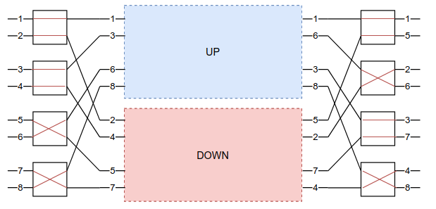
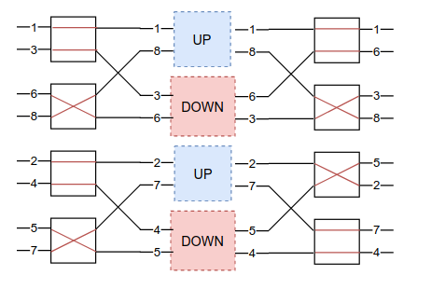
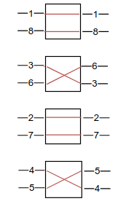
BENES controller Unicast
Algorithm Idea:
BENES is recursively constructed -- 2 smaller-input BENES make a larger BENES
Notes:
Algorithm Idea:
BENES is recursively constructed -- 2 smaller-input BENES make a larger BENES
So we could iteratively generate configurations from the most outer stage into the inner stage.
Step 1: Randomly pick 1 switch whose control has NOT been generated in the left most stage. If configurations of all switches in the leftmost stage have been generated then finish.
Step 2: Randomly pick 1 of two input signals of this switch (denote it as A), output it through the upper output port, so another input signal (denote it as B) of this switch should be outputed through the bottom output port -> Configuration of this switch gets generated.
Step 3: Signal A in the rightmost stage should come from the up half inner BENES, because A goes into up half inner BENES in the leftmost stage. And so the another signal (denote as C) shares the same switch with signal A in the rightmost stage should come from bottom input port -> Configuration of this switch gets generated.
Step 4: if signal C is the same as signal B -> goes back step 1; else goes to step 5
Step 5: Signal C in the leftmost stage should come from the DOWN half inner BENES, because C comes from DOWN half inner BENES in the rightmost stage. So the another signal (denote as D) shares the same switch with signal C in the leftmost stage should goes into upper output port -> Configuration of this switch gets generated.
Step 6: Let Signal D be Signal A and goes back to step 3.

Slide 23
BENES Controller Unicast
Algorithm Idea:
BENES is recursively constructed -- 2 smaller-input BENES make a larger BENES
So we could iteratively generate configurations from the most outer stage into the inner stage.
Step 1: Randomly pick 1 switch whose control has NOT been generated in the left most stage. If configurations of all switches in the leftmost stage have been generated then finish.
Step 2: Randomly pick 1 of two input signals of this switch (denote it as A), output it through the upper output port, so another input signal (denote it as B) of this switch should be outputed through the bottom output port -> Configuration of this switch gets generated.
Step 3: Signal A in the rightmost stage should come from the up half inner BENES, because A goes into up half inner BENES in the leftmost stage. And so the another signal (denote as C) shares the same switch with signal A in the rightmost stage should come from bottom input port -> Configuration of this switch gets generated.
Step 4: if signal C is the same as signal B -> goes back step 1; else goes to step 5
Step 5: Signal C in the leftmost stage should come from the DOWN half inner BENES, because C comes from DOWN half inner BENES in the rightmost stage. So the another signal (denote as D) shares the same switch with signal C in the leftmost stage should goes into upper output port -> Configuration of this switch gets generated.
Step 6: Let Signal D be Signal A and goes back to step 3.

Slide 24
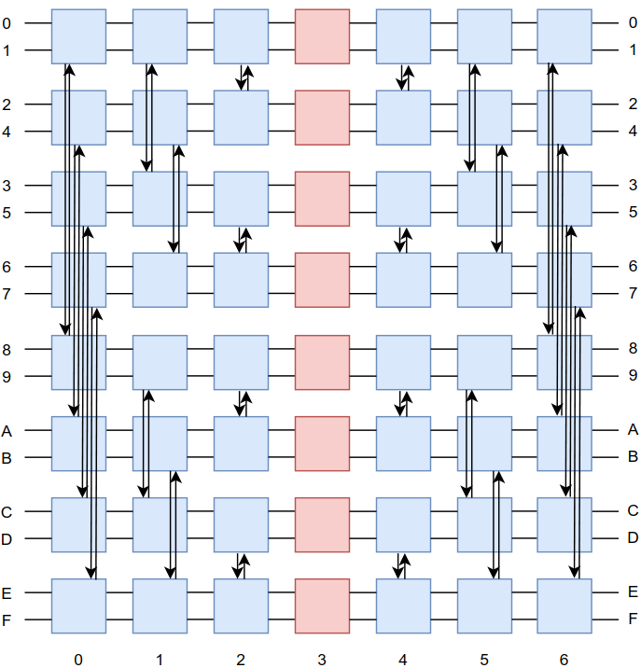
Flatten Butterfly
Flatten Buttefly share the same functionality with BENES but trade complex logic for number of long wires
Single direction data transmission
destination tag con
(N input -- N output) | Flatten Butterfly | BENES (N input)
#STAGE | 2logN-1 | 2logN-1
#3x3 Distribute | (2logN-2)*(N/2) | (N/2)*(2logN-1)
#WIRE(non nbgr-nbgr) | (2logN-2)*(N/2) | (N-2)*(2logN-2)
#WIRE(nbgr-nbgr) | (2logN-2)*N | 2*(2logN-2)

Slide 25
Synthesis results
Linear Network - Unicasting - 3223 is based on estimation
#In | #Out | Power (mW) | Area (um^2)
1 | 16 | 10.3 | 2817.0
1 | 128 | 86.1 | 24194.1
1 | 3223 | 2168.0 | 609200.9
Data Distribution Design - Unicasting - 3223 is based on estimation
#In | #Out | Power (mW) |  |  | Area (um^2)
 |  | MUX | FB | BENES | MUX | FB | BENES
16 | 8 | 40.6 | 95.3 | 36.4 | 11086.9 | 30408.5 | 34139.7
128 | 16 | 1280.0 | 1513.0 | 1322.1 | 371277.5 | 519134.1 | 462386.1
3223 | 400 | 805750.0 | 14566.0 | 5265.7 | 233716285.6 | 4854992.2 | 1803782.8

Slide 26
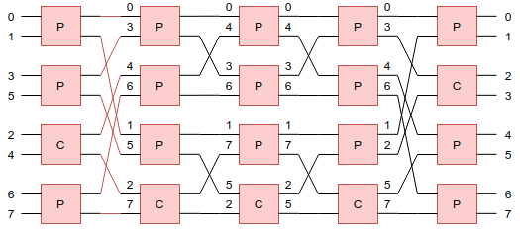
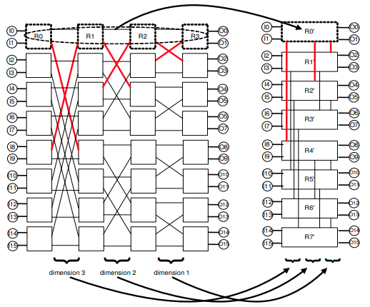
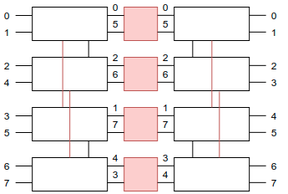
Flattened Butterfly -> Flattened Back-to-back Butterfly
Flattened Butterfly shown in Figure 1
Leverage idea from Figure 1 we change Figure 2-> 3
Figure 2 Back to Back Butterfly
Figure 1 Flattened Butterfly [1]
Figure 3 Flattened Back-to-Back Butterfly
[1] https://www.researchgate.net/publication/220771890_Flattened_butterfly_a_cost-efficient_topology_for_high-radix_networks

Slide 27
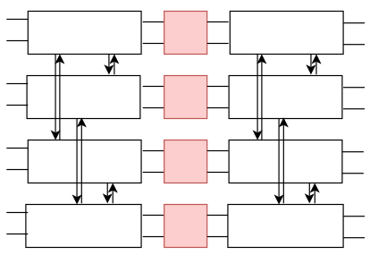
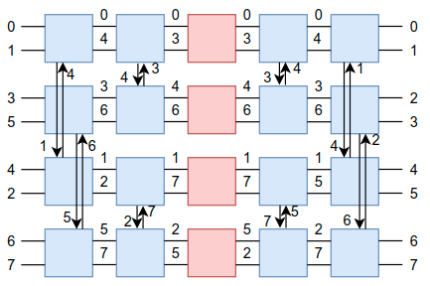
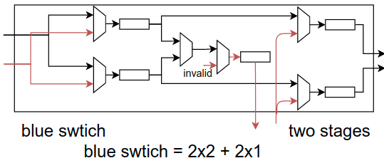
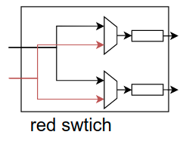
Detail Implementation of Flattened B2B Butterfly
Change high-level diagram (figure 1) into the detail single-direction link (figure 2)
Figure 4 Flattened B2B Butterfly
Figure 5 Detail implementation Flattened B2B Butterfly
But --- a single butterfly have inner blockage, does B2B butterfly supports arbitrary permutation?

Slide 28
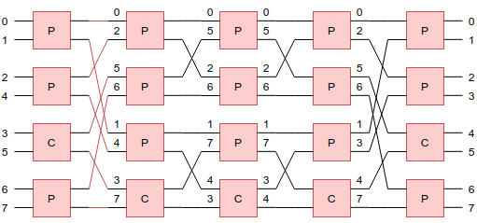
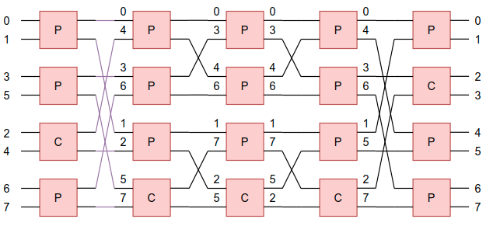
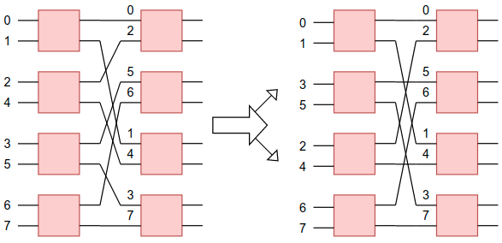
B2B Butterfly == BENES
Difference is highlighted in color in Figure 6 & 7
Figure 6 BENES
it’s called connection function
Figure 7 B2B Butterfly
But they are same
Just switch the location of two switches shown in fig 8
So B2B Butterfly is guaranteed to support arbitrary permutation
But does flattened B2B Butterfly really help to reduce long wires?
(compared with B2B Butterfly)
Figure 8 same connection function

Slide 29
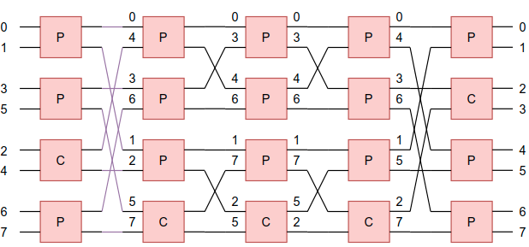
Flattened B2B Butterfly V.S. B2B Butterfly
B2B Butterfly
Flattened B2B Butterfly
N=8 e.g. | B2B Butterfly (N input N output) |  | Flattened B2B Butterfly (N input N output) | N=8 e.g.
5 | 2*logN - 1 | #STAGE | 2*logN - 1 | 5
20 | (N/2)*(2*logN - 1) | #2x2 Switch | N/2 | 4
 | 0 | #3x3 Switch = 3 * 2x2 | (N/2)*(2*logN - 2) | 16
20 |  | # Equivalent 2x2 SW | 3.4X | 68
4+4=8 | N/2*2*(logN-1) | # long WIRE | N/2*2*(logN-1) | 4+4=8
Flattened B2B Butterfly consumes more resources with same amount of long wires

Slide 30
Flattened V.S. Non-flattened -- Let’s look at numbers
# Input | B2B Butterfly |  | Flattened B2B Butterfly
In=Out | power(mW) | area(um^2) | power(mW) | area(um^2)
8 | 13.1815 | 4922.315923 | 32.24(LVT) | 10684.67(LVT)
16 | 36.3766 | 13260.113842 | 95.288(LVT) | 30408.46(LVT)
32 | 93.4151 | 34139.699719 | 245.8367 | 86531.003136
64 | 233.6021 | 83795.039163 | 622.1752 | 215827.035782
128 | 563.5203 | 199523.391962 | 1513.7 | 519134.106819
256 | 1322.1 | 462386.101734 | 3591.6 | 1220424.523616
512 | 3072.0 | 1059865.244514
1024 | 6969.7 | 2391747.226555
flattened consumes more power and area
flattened design even worse than crossbar (but note we are using different libraries
TSMC 28 nm LVT for crossbar -
TSMC 28 nm SVT for both b2b butterfly and flattened butterfly. (around 1.1 higher per logic)
Crossbar | Area (um^2) | Power (mW)
128 In -16 Out | 371277.520342 | 1280
16 In - 16 Out | 45458.531710 | 163.920
8 In- 8 Out | 11086.865932 | 40.613

Slide 31
Why Flattened B2B Butterfly does not help?
Is my implementation 100 % same as what paper claims?
No -- paper requires
non-uniform latency -- data transform just works like a mesh (only difference is there is cross-switch wire)
high-radix switches -- we implement the high-radix switch using a series of 3x3 switch, which cost the same amount of hardware and resources as high-radix switch.
Then why we cannot observe benefits?
The paper claims at lower latency by reducting the number of hops, which cannot be deployed in our scenario because we require uniform latency.
flattened design is worse so it’s a bad idea?
Not sure whether we could achieve power benefits
from not sending data through forward links.
from keeping data going through short wires.

Slide 32
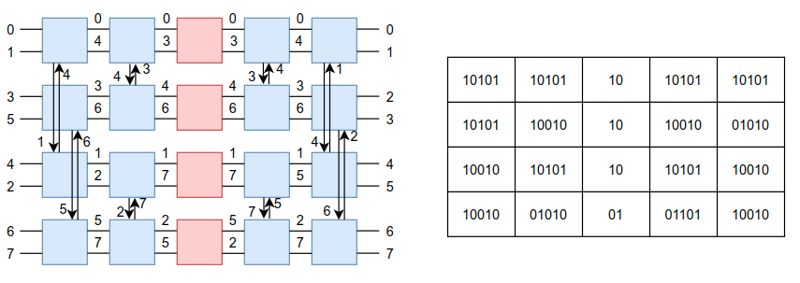
Control for flattened B2B Butterfly
high-level summary -- we use logics to replace the functionalities of original fixed long wire.
flattened B2B butterfly needs more configuration words than B2B butterfly
because each 3x3 switch takes 5 bits while each 2x2 takes 2 bits

