Slide 1
Primitive Switches and Topology
Jianming TONG
Hyoukjun Kwon
Michael Pellauer
Tushar Krishna

Slide 2
Outline
Microswitch
Primitive Switching Operations and primitive switches
Generic Microswitch Approach
Microswitch Network

Slide 3
Outline
Microswitch
Primitive Switching Operations and primitive switches
Generic Microswitch Approach
Microswitch Network

Slide 4
Primitive Switching Operations
Minimal Switches
Branch
Distribute Switch
Duplicate
Merge
Merge Switch

Slide 5
Primitive Switches
Distribute Switch
Control Registers
_{OutA}
_{OutA}
Invalid Signals
Branch
_{In}
D
_{In}
D
_{OutA}
_{OutB}
_{OutB}
Inv
_{In}
_{OutA}
Inv
Duplicate
_{OutB}
_{In}
D
_{OutB}
<Supported Operations>
<Microarchitecture>

Slide 6
Primitive Switches
Merge Switch
_{ReqA}
_{Grant}
_{InA}
_{InA}
_{InA}
_{ReqB}
_{Out}
_{InB}
Merge
M
_{Out}
M
_{Out}
_{InB}
_{InB}
Arb
_{Last}
_{Used}
2:1 matrix arbiter
Can use other arbiters
<Supported Operations>
<Microarchitecture>
Combining primitive switches, we can construct larger switches

Slide 7
Lookup table
Previous Grant | Req A | Req B | Grant[Output] | Expect
1(pre grant B) | 1 | 1 | 0(grant A) | 0(grant A)
1(pre grant B) | 0 | 1 | 1(grant B) | 1(grant B)
1(pre grant B) | 1 | 0 | 0(grant A) | 0(grant A)
1(pre grant B) | 0 | 0 | 1(grant B) | z(nan)
0(pre grant A) | 1 | 1 | 1(grant B) | 1(grant B)
0(pre grant A) | 0 | 1 | 1(grant B) | 1(grant B)
0(pre grant A) | 1 | 0 | 0(grant A) | 0(grant A)
0(pre grant A) | 0 | 0 | 1(grant B) | z(nan)
_{ReqA}
_{Grant}
_{ReqB}
Grant has no meaning when Req A & Req B are 0 simultaneously
assign o_valid = req_a | req_b
_{Last}
_{Used}
2:1 matrix arbiter

Slide 8
Combining Primitive Switches Further
Larger General switches
D
R
East
Local
D
R
D
R
D
M
Do we need fully general switches?
…
…
…
D
M
D
R
Full 2:2 Switch
Local
East
Four Primitive Switches
D
R
D
R
Full 5:5 Switch
(Mesh Router)
30 Primitive Switches
Notes:
No, traffic is not arbitrary and we have static knowledge about it
Let’s rethink from the basics. We show you how your familiar router can
Trying to make primitive building blocks than a wormhole router, thus allow for static hardware savings
“composable”, but not as primitive.

Slide 9
Breaking Down Router Boundaries
D
M
N
D
M
N
D
M
Buffering should only be added
as a function of physical delay
D
M
E
D
M
E
D
M
D
M
S
D
M
S
D
M
We need a primitive that allows composition and customization at a finer granularity
D
M
W
D
M
W
D
M
D
M
L
L
D
M
D
M
Notes:
Erase -> mention static knowledge about traffic

Slide 10
Outline
Microswitch
Primitive Switching Operations and primitive switches
Generic Microswitch Approach
Microswitch Network

Slide 11
Introducing Microswitches
Microswitch: A library of 2x2 switches that consist of primitive switches (merge/distribute) in various arrangements
Also allows pass-through if bandwidth merges not desired
Buffers can be added as a static parameter
Fine-grained: Allows for large degree of customization
Composable: 2x2 switches naturally express basic traffic flows in two dimensions
Outputs
M
D
D
Inputs

Slide 12
distribute 2x2 [COMPLEX]
o_data(high)
o_data(low)
M
o_data(high)
M
D
In_data(high)
D
M
In_data(low)
2x2 distribute
o_dis_high_data_high
M
D
In_data(high)
o_data(low)
D
o_dis_high_data_low
o_dis_low_data_low
o_dis_low_data_high
In_data(low)
2x2 distribute

Slide 13
Control description
o_data(high)
M
M
o_data(low)
M
D
M
D
In_data(high)
D
D
In_data(low)
2x2 distribute
Multicast_HighIn(MH)
M
M
M
M
M
M
D
M
D
M
D
M
D
M
D
D
D
D
D
D
Pass_Switch(PS)
Pass_Through(PT)
Pass_High(PH)
Pass_Low(PL)
No_Pass(NP)
M
M
M
M
D
M
D
M
D
D
D
D
Pass_HighIn_LowOut(PHL)
Pass_LowIn_HighOut(PLH)
Multicast_LowIn(ML)

Slide 14
2x2 distribute control lut
case | dis_high(i-valid) | dis_low(i-valid) | merge_high(i-valid) | merge_low(i-valid) | CMD
PS | 01(1) | 10(1) | 0(01) | 1(10) | 111
PT | 10(1) | 01(1) | 1(10) | 0(01) | 011
PH | 10(1) | xx(0)--invalid | 1(10) | xx(0)--invalid | 010
PL | xx(0)--invalid | 01(1) | xx(0)--invalid | 0(01) | 001
NP | xx(0)--invalid | xx(0)--invalid | xx(0)--invalid | xx(0)--invalid | xxx
PHL | 01(1) | xx(0)--invalid | xx(0)--invalid | 1(10) | 110
PLH | xx(0)--invalid | 10(1) | 0(01) | xx(0)--invalid | 101
MH | 11(1) | xx(0)--invalid | 1(10) | 1(10) | 000
ML | xx(0)--invalid | 11(1) | 0(01) | 0(01) | 100
o_data(high)
merge_i_data_high(ctrl)
M
dis_i_data_high(ctrl)
o_data(low)
M
M
D
In_data(high)
M
D
D
In_data(low)
D
dis_i_data_low(ctrl)
2x2 distribute
merge_i_data_low(ctrl)

Slide 15
distribute 2x2 [SIMPLE]
o_data(high)
M
o_dis_high_data_high
o_data(high)
M
o_data(low)
M
In_data(high)
M
In_data(high)
o_data(low)
In_data(low)
o_dis_high_data_low
2x2 distribute
o_dis_low_data_low
o_dis_low_data_high
In_data(low)
2x2 distribute

Slide 16
Control description [Simple]
M
M
2x2 distribute
M
M
M
M
M
M
M
M
M
M
M
M
M
M
M
M
M
M
M
M
Pass_Switch(PS)
Pass_Through(PT)
Multicast_HighIn(MH)
Multicast_LowIn(ML)
No_Pass

Slide 17
2x2 distribute control lut [Simple]
case | i_valid | CMD
PS | 11 | 01
PT | 11 | 10
MH | 1x | 11
ML | x1 | 00
i_cmd[1]
o_data(high)
M
M
i_valid[1]
o_data(low)
M
M
In_data(high)
In_data(low)
i_valid[0]
2x2 distribute
i_cmd[0]

Slide 18
Outline
Microswitch
Microarchitecture
Logical Network Topology
Microswitch Design
Microswitch Network Design

Slide 19
BENes
Low ADDR[0+:DATA_WIDTH]
High ADDR[DATA_WIDTH+:DATA_WIDTH]
 | s1_in | s1_out | s2_in | s2_out | s3_in | s3_out | s4_in | s4_out | s5_in | s5_out
low | 7 | 6 | 6 | 4 | 4 | 0 | 0 | 0 | 0 | 0
 | 6 | 6 | 4 | 4 | 0 | 0 | 0 | 0 | 0 | 0
 | 5 | 4 | 2 | 0 | 4 | 0 | 0 | 0 | 0 | 0
 | 4 | 4 | 0 | 0 | 0 | 0 | 0 | 0 | 0 | 0
 | 3 | 2 | 6 | 4 | 4 | 0 | 0 | 0 | 0 | 0
 | 2 | 2 | 4 | 4 | 0 | 0 | 0 | 0 | 0 | 0
 | 1 | 0 | 2 | 0 | 4 | 0 | 0 | 0 | 0 | 0
high | 0 | 0 | 0 | 0 | 0 | 0 | 0 | 0 | 0 | 0

Slide 20
BENES 4 Input test case
Input | MH | ML | PT | PS
16’h3210 | 16’h3333 | 16’h0000 | 16’h3210 | 16’h1032
0
1
2
3
0
2
1
3
0
1
2
3
0
1
2
3
0
1
2
3
1
3
1
3
3
3
3
3
3
3
3
3
0
1
2
3
0
2
0
2
0
0
0
0
0
0
0
0
0
1
2
3
1
3
0
2
3
2
1
0
2
3
0
1
3210
PT
MH
ML
PS

Slide 21
BENES 8 Input test case
Input | MH | ML | PT | PS
32’h76543210 | 32’h77777777 | 16’h00000000 | 32’h76543210 | 16’h32107654
0
1
2
3
4
5
6
7
0
2
4
6
0
2
4
6
0
4
0
4
0
4
0
4
0
0
0
0
0
0
0
0
0
0
0
0
0
0
0
0
0
0
0
0
0
0
0
0
0
1
2
3
4
5
6
7
1
3
5
7
0
2
4
6
3
7
1
5
2
6
0
4
7
5
3
1
6
4
2
0
5
4
7
6
1
0
3
2
4
5
6
7
0
1
2
3
ML
PS
0
1
2
3
4
5
6
7
0
2
4
6
1
3
5
7
0
4
2
6
1
5
3
7
0
2
4
6
1
3
5
7
0
1
2
3
4
5
6
7
0
1
2
3
4
5
6
7
0
1
2
3
4
5
6
7
1
3
5
7
1
3
5
7
3
7
3
7
3
7
3
7
7
7
7
7
7
7
7
7
7
7
7
7
7
7
7
7
7
7
7
7
7
7
7
7
PT
MH

Slide 22
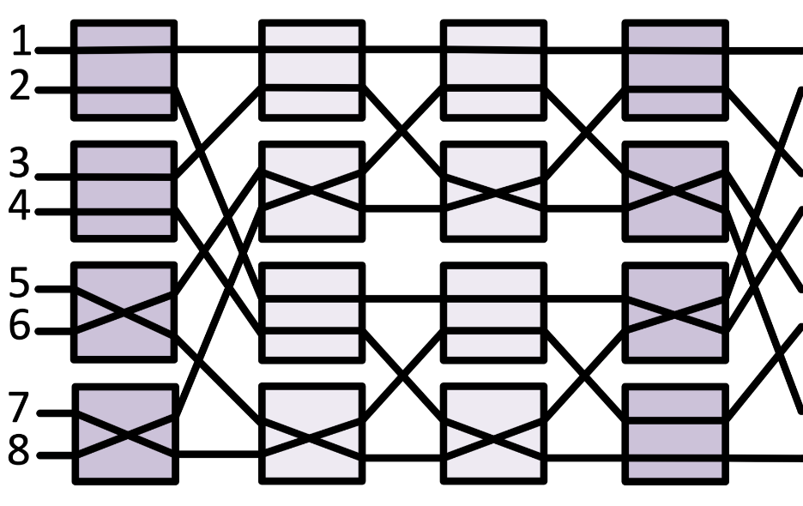
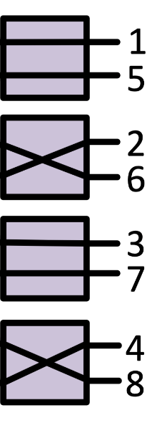
BENES Unicast Routing
From outside to inside recursively
1
3
6
8
2
4
5
7
1
8
3
6
2
7
4
5
1
8
6
3
2
7
5
4
1
6
3
8
5
2
7
4

Slide 23
cuBE
Test Case
Input | PT | PS
32’h76543210 | 32’h10325476 | 16’h01234567
0
1
2
3
4
5
6
7
4
5
6
7
0
1
2
3
6
7
4
5
2
3
0
1
6
7
4
5
2
3
0
1
0
1
2
3
4
5
6
7
5
4
7
6
1
0
3
2
7
6
5
4
3
2
1
0
7
6
5
4
3
2
1
0
Pass Through
Pass Switch

Slide 24
butterfly
Test Case 16 Input Data
Input | PT | PS
64’hfedcba9876543210 | 32’hfdb97531eca86420 | 16’h02468ace13579bdf
0
2
4
6
8
a
c
e
1
3
5
7
9
b
d
f
0
1
1
9
9
d
d
f
f
d
b
9
7
5
3
1
e
c
a
8
6
4
2
0
0
1
0
8
0
4
0
2
2
3
2
a
2
6
4
6
2
3
3
b
b
f
9
b
4
5
4
c
8
c
8
a
4
5
5
d
1
5
5
7
6
7
6
e
a
e
c
e
6
7
7
f
3
7
1
3
8
9
1
9
1
5
1
3
8
9
0
8
8
c
c
e
a
b
3
b
3
7
5
7
a
b
2
a
a
e
8
a
c
d
5
d
9
d
9
b
c
d
4
c
0
4
4
6
e
f
7
f
b
f
d
f
e
f
6
e
2
6
0
2
Pass Through
Pass Switch

Slide 25
butterfly
Test Case 8 Input Data
Input | PT | PS
32’h76543210 | 32’h75316420 | 16’h03461357
0
1
0
4
0
2
0
2
4
6
1
3
5
7
0
1
1
5
5
7
7
5
2
1
6
4
3
0
2
3
2
6
4
6
2
3
2
7
1
2
4
5
1
5
1
3
4
5
0
4
4
6
6
7
3
7
5
7
6
7
3
6
0
3
Pass Through
Pass Switch

Slide 26
butterfly
Test Case 4 Input Data
Input | PT | PS
32’h3210 | 32’h3120 | 16’h0213
0
1
2
3
0
2
1
3
0
2
1
3
0
1
2
3
1
3
0
2
3
1
2
0
Pass Through
Pass Switch

Slide 27
BENES + MERGE
Input | CASE 1 | CASE 4
32’h76543210 | 16’h7171 | 16’h2222
0
1
0
2
0
4
0
2
0
1
0
1
1
2
1
7
1
1
1
1
1
3
5
7
1
1
7
7
2
3
4
6
2
6
4
6
2
3
2
3
4
7
1
7
7
7
1
1
4
5
1
3
1
5
1
3
4
5
4
5
1
3
1
7
1
1
7
7
6
7
5
7
3
7
5
7
6
7
6
7
5
7
1
7
7
7
7
7
CASE 1
CASE 2

Slide 28
UNFOLD BUTTERFLY
Test Case 16 Input Data Uncast
Input | CASE 1 | CASE 2
32’h76543210 | 16’h3617 | 16’h2406
0
0
0
0
4
0
6
0
0
4
0
2
0
2
6
6
0
4
2
7
7
1
6
3
1
1
7
1
1
1
2
2
2
6
0
2
c
e
c
e
0
1
3
3
1
3
3
7
4
4
4
4
4
4
6
4
6
1
3
1
3
5
5
5
5
6
6
6
2
2
6
6
d
f
d
f
2
3
7
b
f
7
b
f
7
7
3
3

Slide 29
UNFOLD BUTTERFLY
Test Case 16 Input Data Multicast
Input | CASE 3 | CASE 4
32’h76543210 | 16’h7171 | 16’h2222
0
0
0
4
0
2
0
0
4
0
2
0
2
2
2
2
2
2
1
1
7
1
7
1
1
1
1
1
1
2
2
2
2
2
2
c
e
c
e
2
7
3
3
7
3
3
7
4
4
4
2
4
2
1
1
3
1
3
5
5
5
5
1
1
6
6
6
2
2
6
d
f
d
f
2
7
7
b
f
7
b
f
7
7
7
7

Slide 30
UNFOLD BUTTERFLY
Multicast that cannot be supported
Input | CASE 5
32’h76543210 | 16’h7117
0
0
0
4
0
2
7
7
1
1
7
1
7
1
1
2
2
c
e
1
3
1
3
7
4
4
1
1
3
5
5
1
1
6
6
d
f
7
7
b
f
7
7
7

Slide 31
Functionality Comparison Unicast/Multicast
Case can not be supported for dis_noc
Under Destination Tag Routing
Tab: Resource Comparison [Given N input; N/2 Output]
 | BENES | UNFOLD BUTTERFLY
#STAGE=Latency | O(2logN-1) | O(log(N/2))
UNICAST | NON-BLOCKING
MULTICAST | GROUP NON-BLOCKING
0
0
0
4
0
2
7
7
1
1
7
1
7
1
1
2
2
c
e
1
3
1
3
7
0
1
0
2
0
4
0
2
0
1
0
1
1
2
1
7
1
1
1
7
4
1
3
5
7
7
1
1
7
4
1
2
3
4
6
2
6
4
6
2
3
2
3
4
7
1
7
7
7
1
1
1
3
5
5
1
1
4
5
1
3
1
5
1
3
4
5
4
5
1
3
1
7
7
1
7
1
6
6
6
7
5
7
3
7
5
7
6
7
6
7
5
7
1
7
1
7
7
7
d
f
7
7
b
f
Arbitrary Permutation
Group Multicasting
7
7
7
Conclusion: destination tag based routing save some resources
BUT restrict the supported multicast cases [topology supports but routing doesn’t]

Slide 32
RESOURCES/LATENCY COMPARISON
0
0
0
4
0
1
0
4
0
2
0
2
4
6
1
3
5
7
0
2
0
1
0
2
0
4
0
2
0
1
7
7
1
1
7
1
3
5
7
1
7
1
1
2
3
2
6
4
6
2
3
4
6
2
6
4
6
2
3
2
2
4
5
1
5
1
3
4
5
1
3
1
5
1
3
4
5
c
e
1
3
1
6
7
5
7
3
7
5
7
6
7
3
7
6
7
3
7
5
7
8-4 Input BENES
4
4
8 Input Butterfly
High latency than UNFOLD BUTTERFLY
1
1
3
2x2 Distribute Switch
1x2 Distribute Switch
2x1 Merge Switch
5
5
1
1
6
 | BENES | UNFOLD BUTTERFLY
#STAGE | O(2logN-1) | O(log(N))
#1x2 Switch | 0 | N
#2x2 Switch | (N/2)*O(2logN-2) | N*(log(M)-1)
#2x1 Merge | M*(2*(N/2)/M-1) | M*(2*N/M-1)
#WIRE[Inner] | N*O(2logN-1)+3N/2 | 2N*[O(log(N/2))]+3N/2
Resources | In need of re-testing on DC-COMPILER
Latency |  | BETTER
6
d
f
7
7
b
f
7
7
7
8 Input UNFOLD BUTTERFLY
1. Double inner links than BUTTRFLY
2. [V.S. BENES] more 2x1; less 2x2
N -- # input
M -- # output
Fewer stages in BENES

Slide 33
Resource comparison
on FPGA synthesized by Vivado 2020.2
NUM_IN | NUM_OUT | BENES-LUT | DIS-LUT | BENES-REG | DIS-REG
8 | 4 | 2135 | 1438 | 1657 | 1649
16 | 8 | 6587 | 4042 | 3889 | 4481
32 | 16 | 13459 | 7774 | 9954 | 8817
64 | 32 | 33229 | 13903 | 24410 | 15746
128 | 64 | 95610(old) | 25101 | 62652(old) | 27826
256 | 128 | 224876(old) | 46649 | 143401(old) | 50110
512 | 256 | 499845(old) | 90945 | 322867(old) | 93229
(1) 2x2 switch for benes are dis_noc are different because of different routing method.
1. BENES: Control Word
2. DIS_NOC: DESTINATION TAG
Large Resources overhead on FPGA comes from COMPLEX 2X2 DISTRIBUTE SWITCH
BENES 2x2 | UNFOLD BUTTERFLY 2x2
LUT 69 | LUT 42
REG 67 | REG 72

Slide 34
Resource overhead
on DC and Innovus
 | BENES-AREA | BENES-POWER | DIS_NOC-AREA | DIS_NOC-POWER
8-IN-4-OUT | 6779.191 | 13 | 7698.973 | 14.88
16-IN-8-OUT | waiting for data
32-IN-16-OUT
64-IN-32-OUT
128-IN-64-OUT
256-IN-128-OUT
512-IN-256-OUT
Note:
(1) Unit: Power-mW; Area-/mu m^2
(2) Large Area overhead comes from long wires in Dis NoC
Estimated Conclusion: Even though BENES takes more resources than dis_noc, when coming into deployment, BENES takes less power & area for shorter wire.

Slide 35
Verilog design note
1. localparam defined in a for loop cannot be used in another loop. Otherwise it could not work.
? Derivation.
? Combination -> area.
Power
add _dst_tag_ into.
synthesis -> first small then larger.
2x2 -> flattened one.

Slide 36
TODO
1. verify the reason unfold_butterfly cannot work in DC.

Slide 37
Outline
Microswitch
Microarchitecture
Logical Network Topology
Microswitch Design
Microswitch Network Design

Slide 38
Microswitch Library
Six 2x2 Switches (Ignoring Rotations)
M
M
M
M
D
D
D
D
D
Half Merge
Full Merge
(full 2:2 switch/
2:2 crossbar)
Full Distribute
and half Merge
D
D
D
M
D
Selective Distribute
(1:2 bus/1:2 tree)
Half Distribute
Full Distribute

Slide 39
Taxonomy of MicroSwitches
Name | Operation | Operation Direction | Bandwidth (after Op.) | Note
Half-merge Switch | Merge | Single | 1X/1X | Collection Network
Half-Distribute Switch | Distribution | Single | 2X/1X | Distribution Network
Full-merge Switch | Merge | Both | 1X/1X | Full 2x2 Switch
Full-Distribute Switch | Distribution | Both | 2X/2X
Selective Distribute Switch | M&D | Both | 1X/1X | 1:2 Bus/Tree
Full-Distribute and Half-Merge Switch | D&M | Half | 1X/2X

Slide 40
Organizing Microswitches
M
M
M
M
D
D
D
D
D
Half Merge
Full Merge
(full 2:2 switch/
2:2 crossbar)
Full Distribute
and half Merge
How can we efficiently construct an array of microswitch to provide desired connectivity?
D
D
D
M
D
Selective Distribute
(1:2 bus/1:2 tree)
Half Distribute
Full Distribute

Slide 41
Revisit: Traffic Patterns in DNN accelerators
Pattern | Source | Destination | Need Multicast? | Note
Distribution | GBM | PEs | Yes | 1:Many
Collection | PEs | GBM | No | Many:1
Local | PEs | PEs | No (Mostly) | Many 1:1
We can exploit the static knowledge about traffic to construct minimal network topology

Slide 42
Network Logical Topology
PE and GBM Placement
Separate Placement
Interleaved Placement
GBM0
GBM1
PE
PE
…
PE
GBM0
PE
PE
GBM1
…
PE
Distribution
GBM0
GBM1
PE
PE
…
PE
GBM0
PE
PE
GBM1
…
PE
Collection
Unidirectional flow
Bidirectional flow

Slide 43
Network Logical Topology
1D vs 2D
1D Topology
2D Direct Topology
2D Indirect Topology
(Proposed)
GBM0
GBM1
PE
PE
…
PE
GBM0
GBM1
GBM0
GBM1
PE
PE
PE
PE
PE
…
…
PE
…
…
PE
PE
PE
Congestion between GBMs
Interleaving Effect
Extra links to distribute traffic using pass-through
Less congestion
Overhead?
Notes:
2D-edge
Excluded 3D because
Chip is 2D
We have only one source and one destination; it is natural to separate them into two dimensions

Slide 44
Network Logical Topology
Overhead Estimation
GBM0
GBM1
R
R
R
Composable Buffer(GBM)
R
PE
PE
PE
PE
N PEs
R
R
R
R
PE
PE
PE
PE
…
…
…
N PEs
Composable Buffer(GBM)
R
PE
R
R
R
PE
PE
PE
R
M GBM Ports
M GBM Ports
Number of switches: O(NM)
>>
Number of Routers: O(N+M)
?

Slide 45
Network Topology
Overhead Estimation
We can regard a mesh router(5x5) as an entity of 25 1:1 switches and five 5:1 arbiters.
(N, E, S, W, and Local)
x (N, E, S, W, and Local) = 25 switches
We can regard a microswitch(2x2) as an entity of four 1:1 switches and one 2:1 arbiter.
Distribution: two 1:1 switches
Reduction : two 1:1 switches + 2:1 arbiter

Slide 46
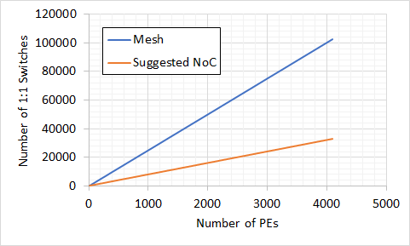
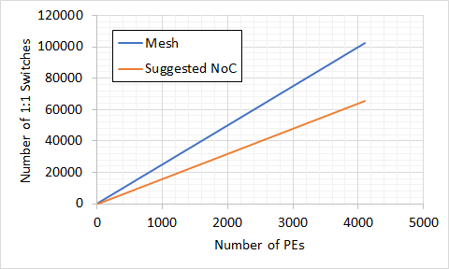
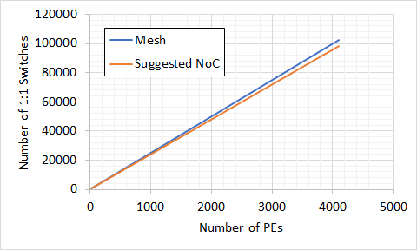
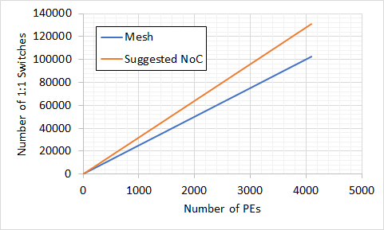
Network Topology
Overhead Estimation
X-axis: Number of PEs
Y-axis: Total Number of 1:1 Switches
Also need to consider…
Output port Arbiter overhead:
-> 25X in mesh
(five 5x1 arbiters vs. 2x1 arbiter)
Number of GBM Ports = 2
Number of GBM Ports = 4
Other router logics:
- Routing calculation, flow
control, etc.
Future works: Applying hierarchical topology to minimize overhead
Number of GBM Ports = 6
Number of GBM Ports = 8
Notes:
Future works: Combining with hierarchical network topologies to minimize overhead

Slide 47
Communication Pattern on Our Topology
Static Knowledge
GBM
GBM
Most dataflows repeats the same communication pattern many times
-> Remove routing calculation using coarse-grained circuit switching
PE₀
PE₀
PE₀
PE₁
PE₁
PE₁
…
…
PE₂
Many to some communication bound to GBM write bandwidth
-> Provide the same bisection bandwidth with GBM write bandwidth
Because of locality, local traffic in most of efficient dataflow is between adjacent PEs
PE_{N-1}
PE_{N-1}
Sends the same data to multiple PEs from GBMs
-> Support simultaneous multiple multicasting from GBMs
Distribution
Collection
Local

Slide 48
Switch Design
Collection Network
Out_GBM
GBM
PE₀
M
PE₁
Out_SW
…
D
In_PE
PE_{N-1}
In_SW
<Traffic to support>
<Microarchitecture>
Notes:
Explain port naming convention.
What is at the end of the direction

Slide 49
Generic Microswitch Approach
M
M
M
M
D
D
D
D
D
Half Merge
Full Merge
(full 2:2 switch/
2:2 crossbar)
Full Distribute
and half Merge
D
D
D
M
D
Selective Distribute
(1:2 bus/1:2 tree)
Half Distribute
Full Distribute

Slide 50
Switch Design
Extra Bandwidth for non-blocking Multicast
Distribution Network
In_GBM
GBM
PE₀
D
PE₁
In_SW
Out_PE
…
PE_{N-1}
Out_SW
<Traffic to support>
<Microarchitecture>
Notes:
Explain port naming convention.
=> What is at the end of the direction

Slide 51
Generic Microswitch Approach
M
M
M
M
D
D
D
D
D
Half Merge
Full Merge
(full 2:2 switch/
2:2 crossbar)
Full Distribute
and half Merge
D
D
D
M
D
Selective Distribute
(1:2 bus/1:2 tree)
Half Distribute
Full Distribute

Slide 52
Outline
Microswitch
Microarchitecture
Logical Network Topology
Microswitch Design
Microswitch Network Design

Slide 53
Distribution NoC Design
Non-blocking Multiple Data Transfer
The same
bandwidth with GBMs
GBM0
GBM1
PE 0
Vertical lanes: exclusive for each GBM port
Horizontal lanes: exclusive for each PE
PE 1
PE 2
…
PE N-1
Bandwidth increases

Slide 54
Distribution NoC Design
Operation Examples
GBM0
GBM1
W₂
P₂
I₃
W₀
Example) [Multiple multicast]
PE 0 and 2 require W₀,
PE 0, 1 and K-1 require I₃,
PE 1 and 2 require P₂,
and PE 2 and K-1 require W₂
PE 0
PE 1
PE 2
…
PE N-1

Slide 55
Distribution NoC Design
Features
Non-blocking NoC
Deterministic routing (YX)
Circuit-switching without Ack
Each source-destination pair is independent
End-to-end Credit-based flow control
Circuit switching guarantees exclusive routes (no need for flow control between switches)
GBM0
GBM1
PE 0
PE 1
PE 2
…
PE N-1

Slide 56
Collection NoC Design
Collection bandwidth is bound to GBM write bandwidth
GBM0
GBM1
PE₀
PE₁
Bisection bandwidth: the same as GBM bandwidth
…
PE_{N-1}

Slide 57
Collection NoC Design
Features
Deterministic routing (XY)
Packing-switching with minimal arbiters
Merge switches manage 2:1 arbitration
local flow control: Switch-to-switch on-off flow control
GBM0
GBM1
PE₀
PE₁
…
PE_{N-1}

