Slide 1
Case Notes
Notes:
Welcome everyone, and thanks for making the time.
Today is about case notes: how we write them, and how we make sure they reflect the quality of the work that goes into each investigation.
I want to be clear from the start that this isn't a session about anyone individually, and it isn't a criticism of the analysis being done. A lot of good work goes into these cases. The aim is to make sure that work is visible on the page, consistently, every time.

Slide 2
AGENDA/CONTENTS
Context
Consistent Structure
The “so what?”
RFI Documentation
01
02
03
04
Test yourself
Wrap-up
05
06
Notes:
Here's how the session will run.
We'll start with some context: why we're focusing on case notes now.
Then three main themes:
- Consistent structure: what every note should contain.
- The "so what?": linking facts to the outcome.
- RFI documentation: how we record and use RFIs.
After that we'll do a knowledge check, with a quick true or false round, then a couple of real case examples to discuss as a group. We'll finish with the key takeaways and time for questions.
Please do jump in with questions as we go. This works best as a conversation.

Slide 3
The why?
Regulators are asking:
Recent regulatory requests have been focused directly on our case notes and how we evidence our decisions
The note is the evidence:
An external auditor sees what is written. If it is not documented, it cannot be relied on.
Reducing external risk:
Stronger notes protect CKO, the team and you as the analyst you made the decision.
📣This is not concentrated in individuals. This is about how we all document 📣
Notes:
So, why now?
First, regulators are asking. Recent regulatory requests have focused directly on our case notes and how we evidence our decisions. So this isn't an internal preference or a change for the sake of it. It's a response to external scrutiny.
Second, the note is the evidence. When an auditor, regulator or banking partner reviews a case, they don't see the work we did in the tools or the thinking in our heads. They only see what's written. If it's not documented, it can't be relied on, even if the work was done.
Third, it reduces external risk. Strong notes protect CKO, they protect the team, and they protect you as the analyst who made the decision. If a case is ever looked at again, a well-written note shows your decision was reasonable based on what you knew at the time.
And to repeat the point at the bottom of the slide: what we've seen is not concentrated in individuals. It's a team-wide pattern in how we all document, so we're all improving it together.

Slide 4
The why?
Complete
Reasoned
Evidenced
Every part of the investigation is visibly documented, including where nothing was found.
Each finding is linked to the outcome: why it supports a false positive or an escalation.
Someone with no other context can rebuild the case from the note and reach the same conclusion.
Inconsistencies exist with case notes today, some are comprehensive, while others lack reference to assessments entirely. We (and regulators) can't assume that or take it at face value that just because the SOP said it, it's been done.
Notes:
When someone reviews our cases, there are three things they're looking for.
Complete: every part of the investigation is visibly documented, including the checks where nothing was found.
Reasoned: each finding is linked to the outcome. It's not enough to list what we found; we need to say why it supports a false positive or an escalation.
Evidenced: someone with no other context should be able to pick up the note, rebuild the case and reach the same conclusion. That's the test a regulator applies.
At the moment we're inconsistent. Some notes are really comprehensive, while others don't mention certain assessments at all, even when they've been completed. The key message is that we, and regulators, can't take it at face value that something was done just because the SOP says it should be. If it isn't in the note, a reviewer has to assume it didn't happen.

Slide 5
Consistent Structure
Always start with the alerted activity…
Which rule?
Name the rule and explain in terms what it detects
Which period?
Use a review window that matches the rule’s look-back period.
So what?
Explain why this specific activity is or is not of concern.
What alerted?
Itemise the transactions; value, volume, countries, fingerprint
Notes:
This is the most common piece of feedback from recent QA reviews: notes gave a general review of the merchant or the account, but didn't clearly describe the activity that actually made the rule fire.
So every note should start with the alerted activity, and these four questions are a simple way to structure it:
- Which rule? Name the rule and explain in plain terms what it's designed to detect.
- What alerted? Itemise the transactions that triggered it: the value, volume, countries and fingerprint. Not the full transaction history, just what alerted.
- Which period? Initially, the review window should match the rule's look-back period. If older transaction data is relevant to the outcome or adds valuable context, that's fine to use and include in the note. Just make clear why you've looked at it.
- So what? Explain why this specific activity is, or isn't, a concern.
The wider generic review still has a place. It can support the investigation later in the note, for example showing a high-value payment sits within an account that normally shows genuine activity. But it supports the analysis of the alerted activity; it doesn't replace it.

Slide 6




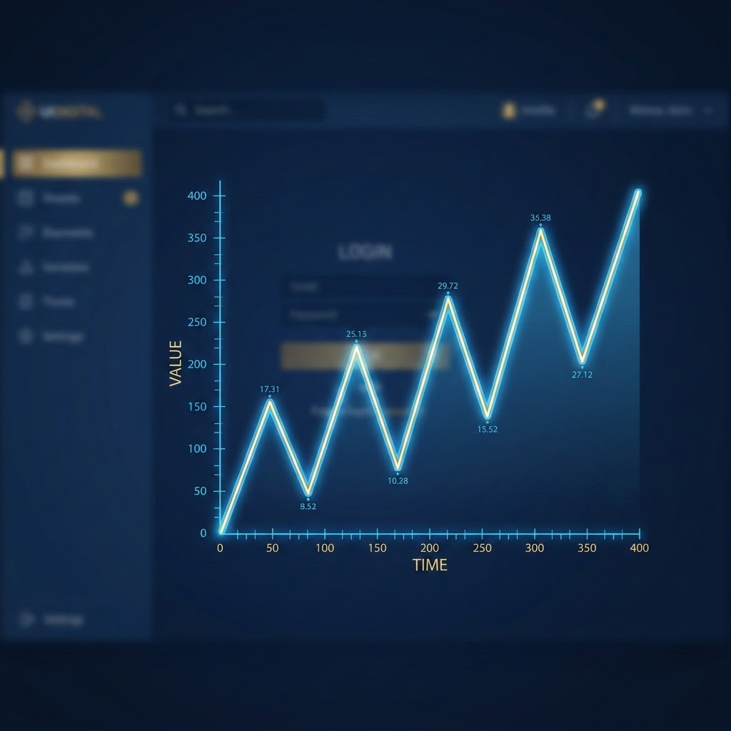

Building blocks of every case note
Alerted activity: Rule, specific transactions, timeframes, explanation
Merchant Profile: Legal name, stated business model, expectations
Customer Profile: Who is transacting, card types, issuing countries, concentration
Historical Behaviour: Prior alerts (cases and outcomes), transactions outside of alerted timeframe
Expected vs actual: Frequency, velocity, value and activity patterns against expected activity
Conclude & Rationale: Always link findings to the outcome
Notes:
These are the building blocks every case note should cover. Even if a section is just one line confirming the check was done, it should be there.
As mentioned, always start with the alerted activity: the rule, the specific transactions, the timeframe, and why the rule fired.
Then:
- Merchant profile: the legal name, the stated business model, and what we expected to see from onboarding.
- Customer profile: who is transacting, card types, issuing countries, and any concentration.
- Historical behaviour: prior alerts with their cases and outcomes, and relevant transactions outside the alerted timeframe. If the merchant or cardholder has been flagged before, say whether that changes today's assessment. Is this the same pattern, a new one, or an escalating one?
- Expected vs actual: frequency, velocity, value and activity patterns, compared against what we expected for this merchant.
And finally, conclusion and rationale: always link the findings back to the outcome.
Covering these in the same order every time makes notes quicker to write, easier to review and much easier to defend.

Slide 7
Record the check, even if inconclusive
Weak: (OSINT checks not mentioned at all)
Stronger: “OSINT was conducted on the end user, no verifiable digital footprint could be obtained to assist in verifying the activity observed.
📣One line is enough📣
A short confirmation tells the reader the assessment was performed and what it found. Without it, a reviewer cannot tell the difference between “checked and clear” vs “not checked”
Notes:
A quick win.
On the left is the weak version: OSINT isn't mentioned at all. A reviewer reading that note has no way of knowing whether OSINT was done.
The stronger version is one sentence: "OSINT was conducted on the end user; no verifiable digital footprint could be obtained to assist in verifying the activity observed." The reader now knows the check was performed and what it found, even though the result was inconclusive.
That's the key point: one line is enough. Without it, a reviewer can't tell the difference between "checked and clear" and "not checked", and they'll have to assume it wasn't done.
The same applies to any check: adverse media, geographic risk, linked cases. If you did it, write it down, even if nothing came back.

Slide 8
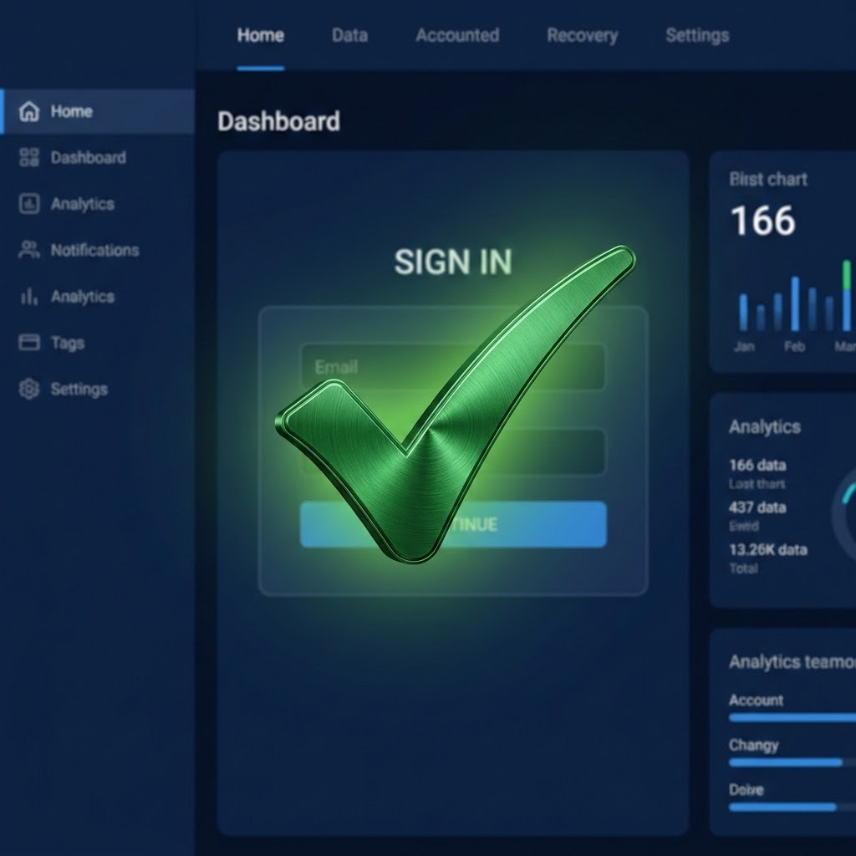
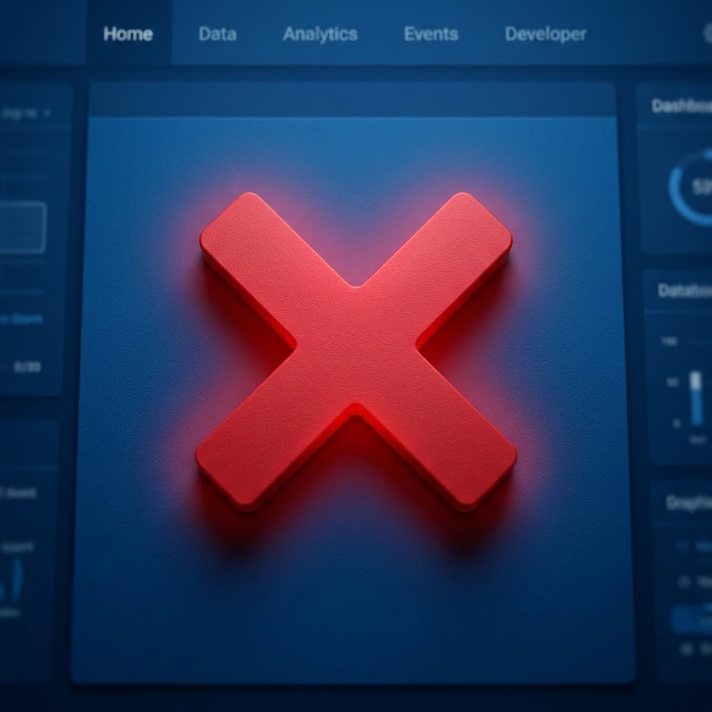
Consistent, not copy and paste
Ensure a common structure, written in your own words about the specific case
Do
Avoid
Use the same headings in the same order for clear note structure
Write case-specific facts, figures and dates
Explain your reasoning in your own words
Tie up all facts at the end with your outcome
AI-generated or templated text pasted in unchanged
Generic phrases such as “in line with expected activity” with no evidence
Identical wording across different cases
Notes:
We want a consistent structure, but that doesn't mean copy and paste.
This is similar to the MAS exercise from last week: a common framework, but written in your own words about the specific case in front of you.
Do:
- Use the same headings in the same order so the note is easy to follow.
- Include case-specific facts, figures and dates.
- Explain your reasoning in your own words.
- Tie all the facts together at the end with your outcome.
Avoid:
- AI-generated or templated text pasted in unchanged.
- Generic phrases like "in line with expected activity" with no evidence behind them.
- Identical wording across different cases.
Regulators notice when notes read the same across different cases. It suggests a tick-box exercise rather than an investigation, which is exactly what we want to move away from.

Slide 9
Answering the “so what?”
Treat every alert as an investigation, not a checklist
Connect the dots
Significance: What risk does it raise or reduce?
Conclusion: How does it affect the outcome: false positive or escalate?
Fact: What did I find?
Most notes stop at the fact. The significance step is where the investigation happens, and it is what a regulator is looking for.
Notes:
This is the heart of today's session: answering the "so what?"
We want every alert treated as an investigation, not a checklist. The simplest way to think about it is three steps:
- Fact: what did I find?
- Significance: what risk does it raise or reduce?
- Conclusion: how does it affect the outcome? Does it support a false positive or an escalation?
Most notes stop at the fact. The significance step is where the investigation actually happens, and it's what a regulator is looking for.
A few examples:
- "The merchant is in the gaming industry." That's a good start, but what risk factors come with gaming, and how did we consider them?
- "This merchant has been flagged before." Great. Does that change our current assessment?
- "The majority of transactions are debit/credit." What's the significance of that detail to this case? Is it consistent with the business model? Does it tell us anything about the risk?
For every point you write down, ask yourself: so what?

Slide 10
Consistent phrases that need tightening
What we see:
Instead:
Instead:
“The recipient might have invested in cryptocurrencies…and withdrawn his accumulated profits”
Speculative. Corroborate it with evidence, check fingerprint pay-in activity.
“Might have invested in sports, live casino, racing…and obtained profits.”
Use “plausible” and “reasonable” to tie it to what the merchant does and the account activity.
“The velocity of transactions is spread out between Months, Days, Minutes.”
This says nothing about the risk. Remove it, or say what the pattern shows.
“No evidence of structuring or smurfing pattern was identified.”
Use this only where structuring or smurfing is a relevant typology for the alert.
Notes:
These are phrases that come up regularly in case notes. In most cases they're not wrong, but they're weak, and they need tightening.
1. "The recipient might have invested in cryptocurrencies and withdrawn his accumulated profits." This is speculation. Corroborate it with evidence: check the fingerprint's pay-in activity. Did they pay in enough for profits to be plausible?
2. The gambling version: "might have invested in sports, live casino, racing and obtained profits." Rather than "it may be" or "might have", use "plausible" or "reasonable", and tie it to what the merchant does and the account activity. For example: "Given the merchant is a licensed gambling operator and the cardholder paid in £4,800 over the period, a £5,200 withdrawal is reasonable and consistent with winnings." That's a much stronger argument. And check those pay-ins: someone who paid in thousands and withdrew thousands is a very different story to someone who paid in £5 and withdrew £10k.
3. "The velocity of transactions is spread out between months, days, minutes." This says nothing about the risk. Remove it, or say what the pattern actually shows.
4. "No evidence of structuring or smurfing was identified." Only use this where structuring or smurfing is a relevant typology for the alert. Ruling out typologies that don't apply adds length but no value.
One more point on language: remove superlatives from all write-ups. Be factual in your observations and use a neutral tone in your opinions. Words like "detailed analysis", "high-quality" or "appropriately vetted" can't be tested; replace them with the evidence behind them.

Slide 11

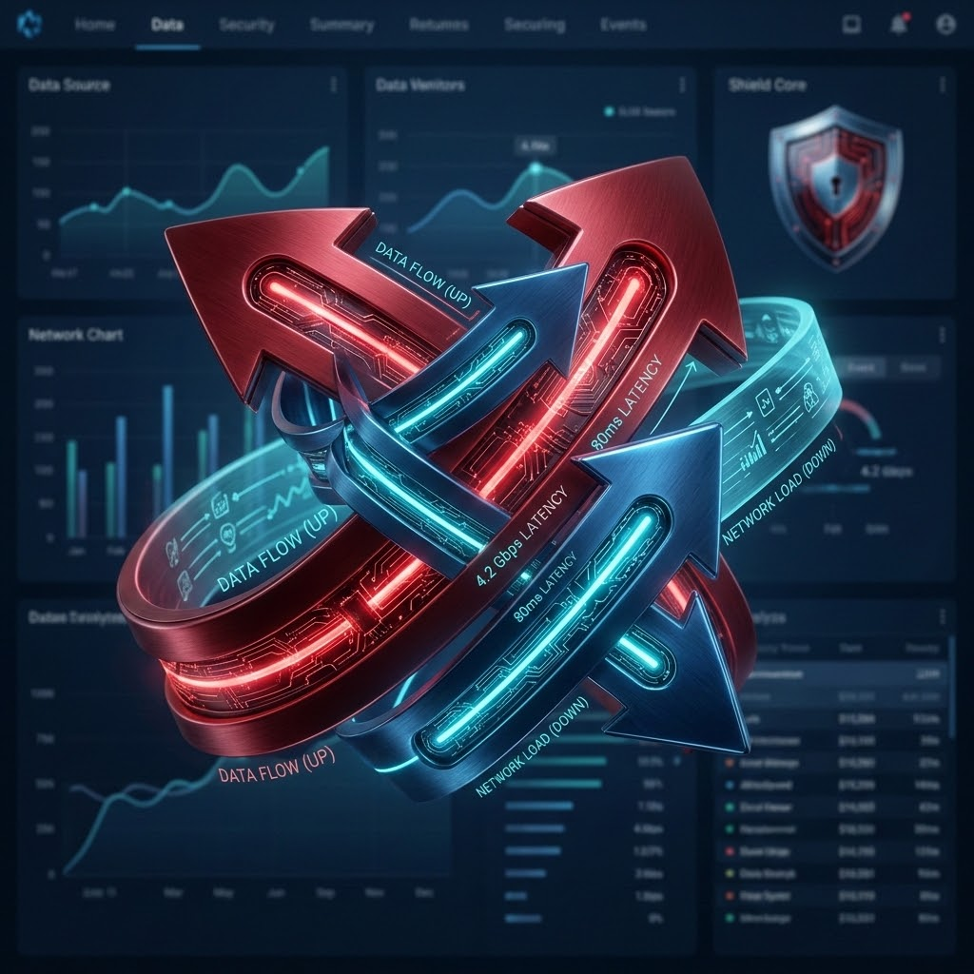
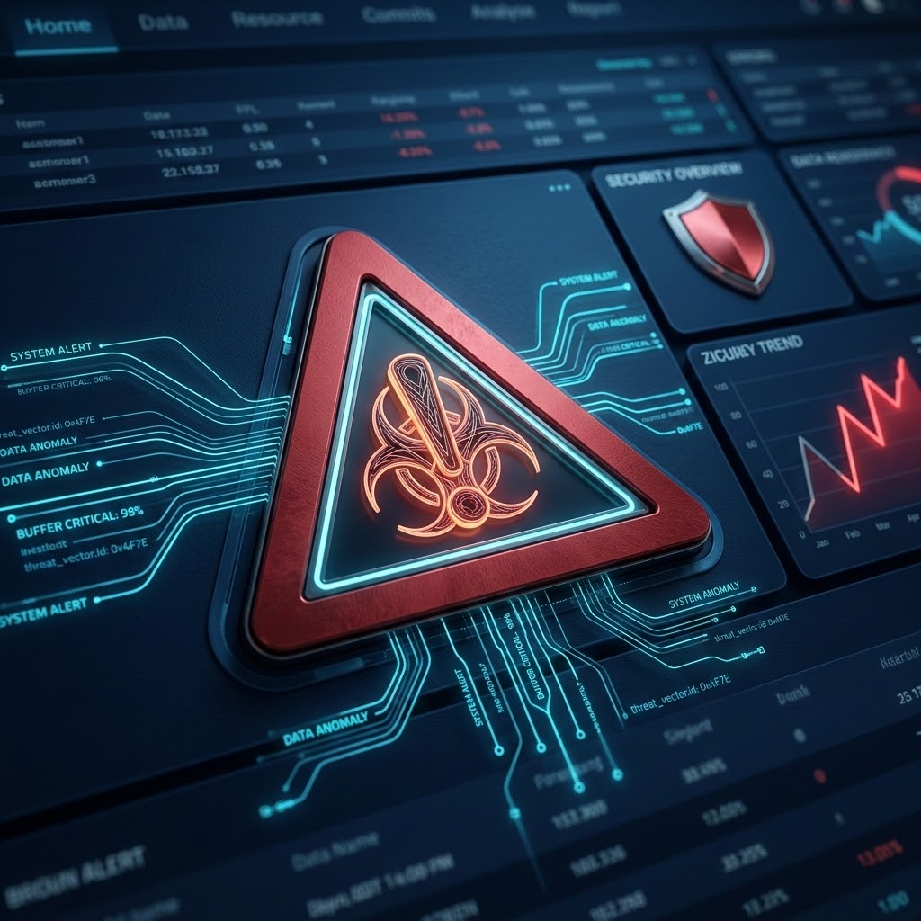

Questions to ask before concluding a case
What did I expect to see for this merchant, and does the activity match?
What
What could explain the difference, and have I evidenced that explanation?
Which risk factors have I ruled out, and which remain open?
Could someone else read this note and reach the same conclusion?
Notes:
Before you conclude a case, run through these four questions:
- What did I expect to see for this merchant, and does the activity match?
- What could explain the difference, and have I evidenced that explanation? This is where you can look beyond the merchant or end user. Is anything happening more widely that could explain the activity, such as a World Cup, a major sporting event or a global fuel crisis? If so, reference it with the source.
- Which risk factors have I ruled out, and which remain open? If something is still open, that needs to be reflected in the outcome.
- Could someone else read this note and reach the same conclusion?
That last one is the regulator test. If a reviewer with no other context reads your note, will they agree with your outcome? If the answer is "only if they asked me", the note needs more.

Slide 12
The RFI logic flow
Was an RFI sent?
Yes: date, what was asked and why.
No: the rationale for not sending one.
Was a response received?
Date received, or the chaser and the impact of no response.
Was it adequate?
Did it answer each question? If not, what was missing and why it matters.
How was it used?
What risk it ruled in or out, and how it shaped the final outcome.
Notes:
Moving on to RFIs. Every RFI reference in a note should follow a clear, logical flow. These four steps:
1. Was an RFI sent? If yes, document the date, what was asked and why. If no, give the rationale for not sending one. Not sending an RFI is absolutely fine, but the reasoning needs to be in the note.
2. Was a response received? Record the date it came back, or the chaser that was sent and the impact of not getting a response.
3. Was it adequate? Did it answer each of the questions we asked? If not, what was missing and why does that matter?
4. How was it used? What risk did it rule in or out, and how did it shape the final outcome?
If a reader can follow those four steps in your note, the RFI is properly documented.

Slide 13
RFI notes: before and after
Missing the impact
With the “so what”
“Performed. An RFI was sent…and the response lacked details whereby the merchant stated that they do not collect PII.”
States the facts but not the impact on the case.
“An RFI was sent on [date] requesting [KYC documentation]. The merchant responded on [date] stating that they do not collect PII. As a result, we were unable to verify the end user or rule out [e.g. third-part or mule activity]. This unresolved risk supports escalation.”
Notes:
Here's an example of how that looks in practice.
On the left: "Performed. An RFI was sent and the response lacked details whereby the merchant stated that they do not collect PII."
Everything in that sentence is accurate. But it states the facts and stops. We don't know when the RFI was sent, what was asked, or, most importantly, what that response means for the case.
On the right is the stronger version. It adds the date and what was requested, the date of the response and what it said, and then the crucial "so what": as a result, we were unable to verify the end user or rule out, for example, third-party or mule activity. And it finishes by linking that unresolved risk to the outcome: it supports escalation.
That "as a result, we were unable to rule out..." sentence is the piece that's most often missing.

Slide 14
Test the response, don’t just file it
RFI handling was a clear specific theme. Responses were often accepted with little scrutiny.
Ask for what you need to resolve the specific alerted activity, not just the RFI form.
Target the gap
Does the response match what the transactions show? Check values, dates, customers and countries.
Test it against the data
Where a response is inadequate or inconsistent, say what risk remains and consider escalation in line with the SOP.
Act on what is unresolved
Notes:
Documenting the RFI is one part. The other is making sure we actually test what comes back.
RFI handling was a clear theme in the recent QA review. Responses were often accepted with little scrutiny.
Three things to focus on:
- Target the gap. Ask for what you need to resolve the specific alerted activity, rather than just sending the standard RFI form.
- Test it against the data. Does the response match what the transactions show? Check the values, dates, customers and countries. If a merchant says their customers are mainly UK-based but the alerted activity is from elsewhere, that needs to be picked up.
- Act on what is unresolved. Where a response is inadequate or inconsistent, say what risk remains and consider escalation in line with the SOP.
An RFI response is evidence to be tested, not a box to tick.

Slide 15
Your self-check before submitting
✔️
Rule and alerting transaction stated first
✔️
RFI: sent, or why not, response tested, impact
✔️
Merchant and customer profile
✔️
Every finding has a “so what”
✔️
Historical behaviour and prior alerts
✔️
Explanations evidenced: pay-ins, OSINT
✔️
Expected vs actual: frequency, velocity, value
✔️
Factual, neutral language with no superlatives
✔️
Other investigation checks, including negatives
✔️
Conclusion or closure reason follow the evidence
Notes:
This is a checklist to keep to hand when you're writing a note. It pulls together everything we've covered today:
- Rule and alerting transaction stated first.
- Merchant and customer profile.
- Historical behaviour and prior alerts.
- Expected vs actual: frequency, velocity and value.
- Other investigation checks, including negatives.
- RFI: sent or why not, response tested, and impact.
- Every finding has a "so what".
- Explanations evidenced, for example pay-ins and OSINT.
- Factual, neutral language with no superlatives.
- Conclusion and closure reason follow the evidence.
If you can tick all of these before submitting, the note will stand up to review.

Slide 16
Knowledge Check
A quick-fire true or false round followed by Q&A.
Notes:
Let's put this into practice.
We'll start with a quick-fire true or false round. I'll read out each statement and I'd like a show of hands, true or false.
Then we'll look at a couple of real case notes together and talk through what could make them stronger.

Slide 17
True or false?
If the OSINT assessment is completed and nothing was found, it doesn’t need to go in the note.
2. Not sending an RFI is acceptable, as long as the rationale is documented.
3. A thorough review of the merchant’s overall activity is enough to discount an alert.
4. A large gambling withdrawal can be solely explained as winnings.
Notes:
Read each statement out and ask for a show of hands before revealing the answers.
1. If the OSINT assessment is completed and nothing was found, it doesn't need to go in the note.
2. Not sending an RFI is acceptable, as long as the rationale is documented.
3. A thorough review of the merchant's overall activity is enough to discount an alert.
4. A large gambling withdrawal can be solely explained as winnings.
Where the room is split, ask one or two people to explain their answer before moving on.

Slide 18
True or false? Answers
Record the check. Without it, a reviewer must assume it was not done.
A reasoned decision not to send an RFI is fine. It just needs to be written down.
🅕
🅣
Lead with the rule and the transaction that alerted. Wider history supports it, not replaces it.
Check pay-ins: £5 in and £10k out tells a very different story.
🅕
🅕
Notes:
Answers:
1. False. Record the check. Without it, a reviewer has to assume it wasn't done. Remember: one line is enough.
2. True. This is the only true statement. A reasoned decision not to send an RFI is fine; it just needs to be written down.
3. False. Lead with the rule and the transaction that alerted. The wider history supports the analysis, it doesn't replace it.
4. False. Check the pay-ins. Someone who paid in £5 and withdrew £10k is a very different story to someone who paid in thousands and withdrew thousands. Winnings may well be the explanation, but it needs evidence behind it.

Slide 19
Case 1: Crypto withdrawal
Rules: currentWeekCryptoTransactionHighVolumeAmount,highTransactionValue9kGBP
“The fingerprint generated 7 transactions totalling $68,309.55 over a 93-day period.”
“The velocity of transactions is spread out between Months, Days, Minutes.”
“The recipient might have invested in cryptocurrencies and withdrawn his accumulated profits.”
“The transaction volumes are consistent with the merchant’s line of business”
Discuss:
Which transaction caused the alert?
Why did the weekly volume rule fire?
Does the crypto statement explain the value over $10k?
What does the velocity sentence add?
Notes:
A quick caveat before we start: these are real examples of case notes written by L1 and L2. What's shown are snippets of the full note, picked out to highlight the points we've covered today. This isn't about the individuals who wrote them, and as we saw earlier, these patterns appear across the team.
This case alerted on two rules: a spike in weekly crypto transaction volume, and a single transaction over £9,000.
Give everyone a minute to read the extracts, then work through the questions on the right:
- Which transaction caused the alert?
- Why did the weekly volume rule fire?
- Does the crypto statement explain the value over £10k?
- What does the velocity sentence add?
Take a few answers from the room before moving to the feedback.

Slide 20
Case 1: Feedback
What a stronger note does:
Lead with the ¢10,478.96 withdrawal. Explain that the weekly rule fired because the cardholder had no activity in the prior 4 weeks, which is consistent with their pattern. Show that the value is in line with their previous withdrawals, and support any “profits” explanation with evidence found via investigation.
What was missing:
The alerting transaction is not described (a single $10,478.96 withdrawal).
No reason given for the weekly spike; there was no activity in the previous 4 weeks.
“Might have invested” is weak and not back by evidence
The velocity sentence does not tie back to the conclusion
Notes:
Here's the QA feedback on this case.
What was missing:
- The alerting transaction isn't described. It was a single withdrawal of £10,478.96, and that's not mentioned anywhere in the note.
- There's no reason given for the weekly spike. The simple explanation is that there was no activity in the previous four weeks, which is consistent for this cardholder.
- "Might have invested" is weak and isn't backed by evidence.
- The velocity sentence doesn't tie back to the conclusion.
What a stronger note does: it leads with the £10,478.96 withdrawal. It explains that the weekly rule fired because there was no activity in the prior four weeks, which is consistent with the cardholder's pattern. It shows the value is in line with their previous withdrawals. And it supports any "profits" explanation with evidence, such as the cardholder's pay-in history.
It's worth saying that the content of the original note isn't incorrect, and the outcome wasn't necessarily wrong. But the information should inform the decision, rather than just being listed as evidence that the activity is of no concern.

Slide 21
Case 2: Single-customer share
Rules: ACQ-ENT-ALL-LARGE-MT-CustShareAbove_v1
“No indicators of structuring or smurfing activity were identified.” “Although the current annual transaction volumes exceeds the threshold established during onboarding, this increase is supported by publicly available information.” “All transactions originate from low-risk jurisdictions.” “The merchant holds a Trustpilot rating of 2.6.” “100% of payments were processed via debit cards.” “The alert has been reviewed and discounted as a false positive.”
Discuss:
Who is the alerted cardholder and by how much did they exceed by 0.5%?
Which sentences address the alerted rule/activity?
Is the sender review specific enough?
Is “false positive” the right outcome?
Notes:
Case 2 is at merchant level. The rule alerts when a single cardholder makes up more than 0.5% of the merchant's pay-in volume over a 30-day period.
Again, give the room a minute to read the extracts, then discuss:
- Who is the alerted cardholder, and by how much did they exceed 0.5%?
- Which sentences actually address the alerted rule or activity?
- Is the sender review specific enough?
- Is "false positive" the right outcome?
A hint if the room needs one: count how many of these sentences are about the merchant in general, and how many are about the cardholder who triggered the alert.

Slide 22
Case 2: Feedback
What a stronger note does:
Identify the alerted fingerprint and its share of pay-ins against the 0.5% threshold. Compare the cardholder’s activity in the period with their usual activity at this merchant. If they exceeded it only slightly and in line with their norm, say son. Choose a closure reason that reflects that the rule fired correctly.
What was missing:
The alerted cardholder and their activity are not described
Mostly a general merchant review, not specific enough to the alert
Senders reviewed only in aggregate
No reason why the alerted activity is not a concern
Notes:
Here's the QA feedback.
What was missing:
- The alerted cardholder and their activity aren't described at all.
- It's mostly a general merchant review, not specific to the alert. Everything in it may be true, but none of it explains why this cardholder's share isn't a concern.
- Senders were only reviewed in aggregate, not the specific sender who alerted.
- There's no reason given for why the alerted activity isn't a concern.
What a stronger note does: it identifies the alerted fingerprint and its share of pay-ins against the 0.5% threshold. It compares the cardholder's activity in the period with their usual activity at this merchant. If they only exceeded the threshold slightly and in line with their norm, it says so. That one line of specific reasoning does more than the whole general paragraph.
On the outcome: the rule fired correctly. The cardholder did exceed the threshold, so the closure reason should reflect that, rather than describing the alert as a false positive. Check the SOP for the right closure reason in these cases.

Slide 23
Key Takeaways
Be Specific
Give Reason
Ensure Traceability
Lead with the alerted activity and cover all investigation points.
Answer the “so what”, with evidence and neutral language.
Document RFIs from request to impact, or explain why one was not sent.
Notes:
To wrap up, three things to take away:
Be specific: lead with the alerted activity and cover all the investigation points, even where the answer is "checked and nothing found".
Give reasons: answer the "so what" for every finding, with evidence behind it and neutral, factual language.
Ensure traceability: document RFIs from request through to impact, or explain why one wasn't sent.
The main message is that the analysis is often already there. We just need to make sure it's visible in the note, because the note is how regulators, auditors and our partners see the quality of our work.

Slide 24
THANK
YOU!
Notes:
Thank you all for your time and engagement today.
I'll open it up for any questions now. If anything comes up later, or you'd like to talk through a specific case, please do reach out.

