Slide 1
CSC 483 - Applied Biological Data Sciece W3D1

Slide 2
CSC 483: Applied Biological Data Science
Warm up: (15’)
Sequencing data (30’)
Gene seqeuence interpretation
Gene content vs. expression
Analysis goals: gene function, use
Activity: metadata summaries (45’)
Present results, brainstorm ideas (15’)
HW:
rosalind problems on sequence analysis (w/ colab notebooks?)
pull request of e coli metadata analysis
due: tues

Slide 3
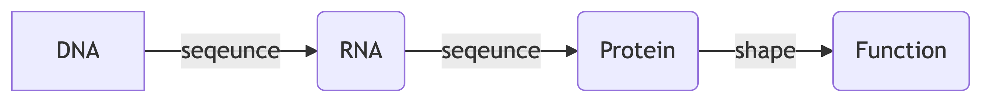
What is Biological Data?

Slide 4
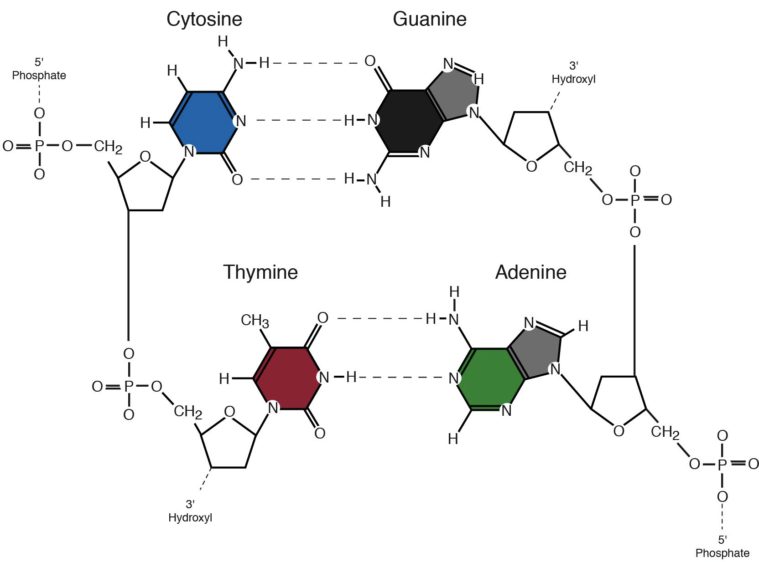
Rooted in Chemistry

Slide 5
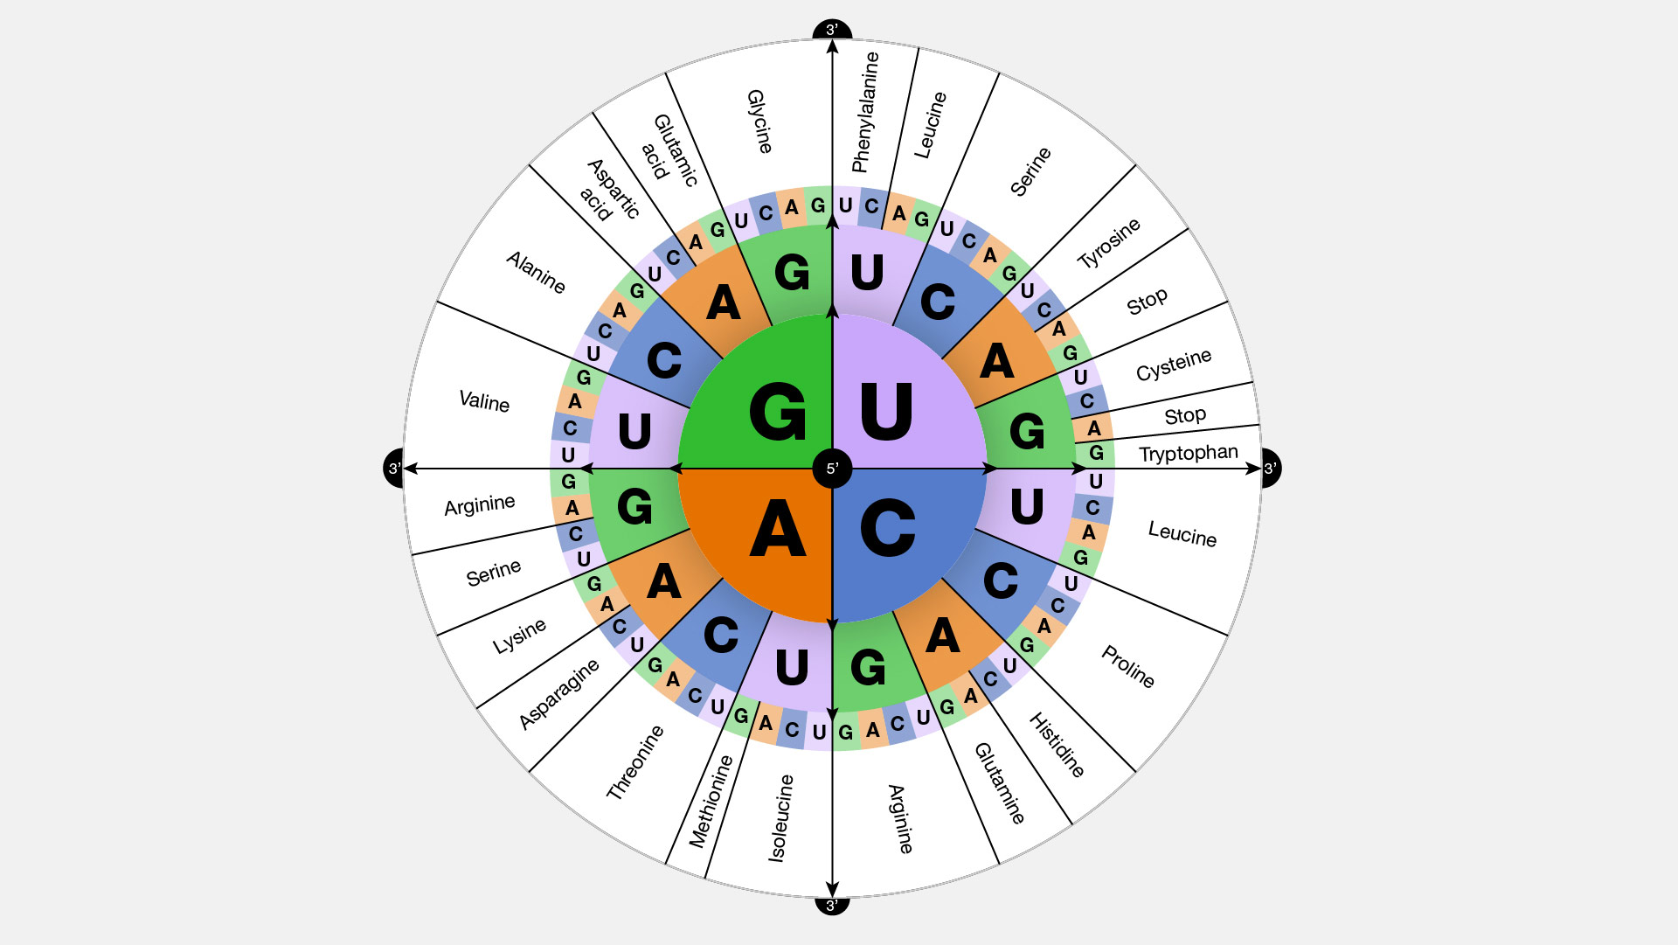
Ends up being about information

Slide 6
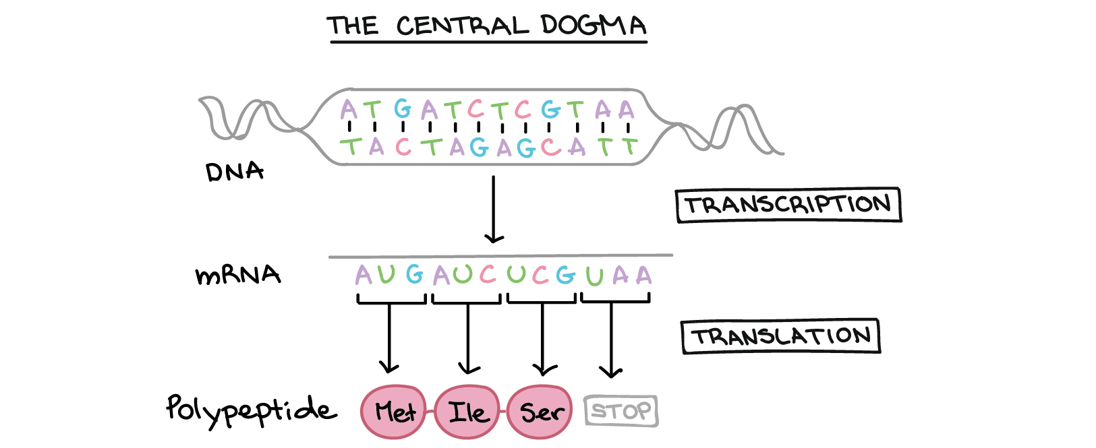
What is a ‘gene’

Slide 7
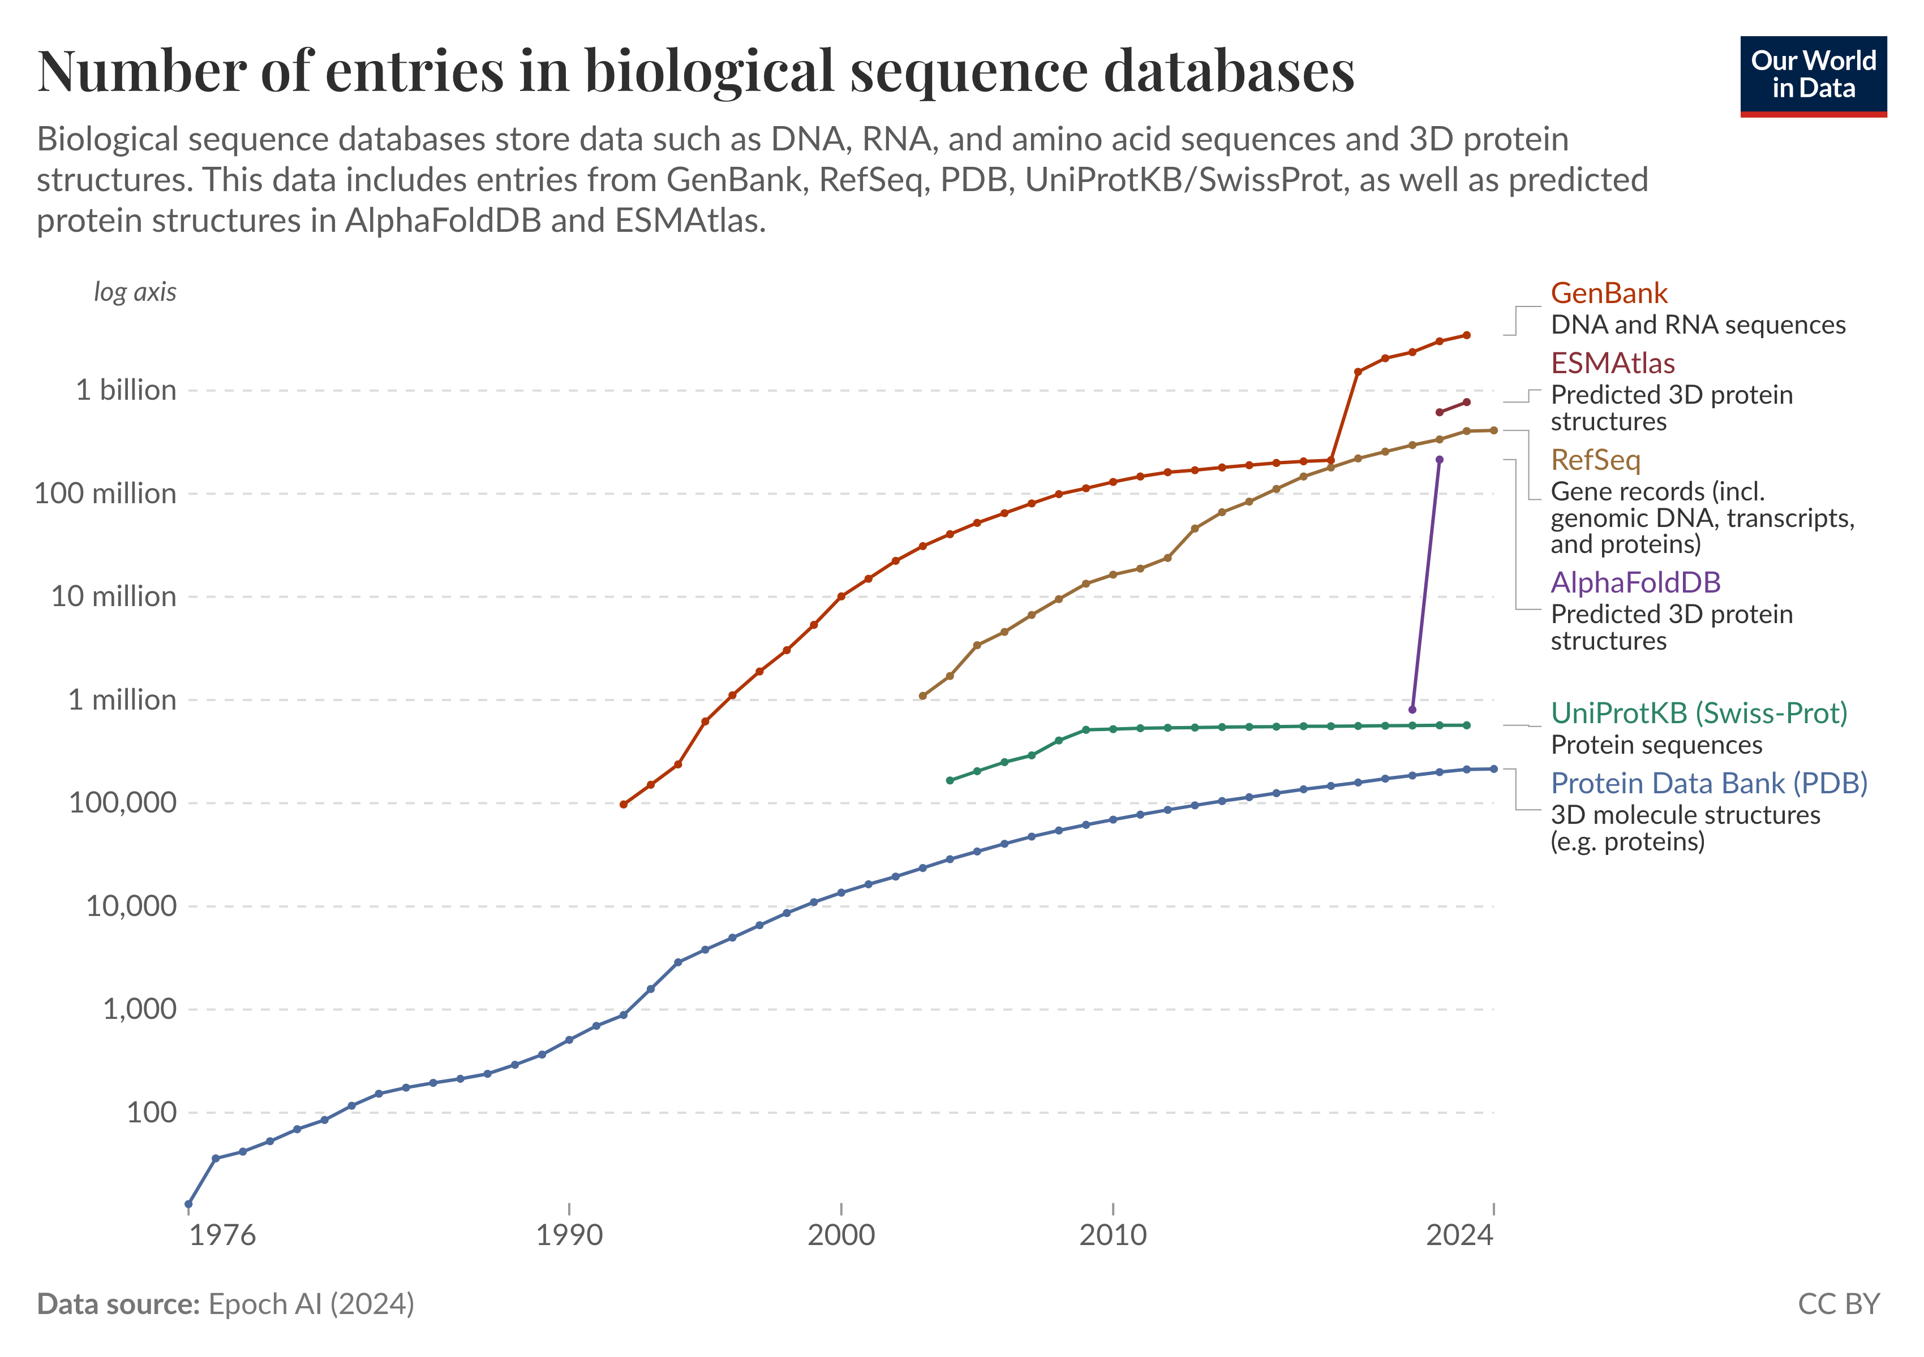
Biological Data Accumulation
https://ourworldindata.org/grapher/number-of-entries-in-biological-sequence-databases
Biological Data

Slide 8
Ethics of Data
measured vs predicted data?
references?
funding sources?
reproducibility?
data types?
cross population?
intention of the data post? intention of the original data source?

Slide 9
Purpose of Collecting Biological Data
for human data, studying health and disease, e.g. 1000s Genomes Project: https://www.internationalgenome.org/
detect disease-associated alleles
check specific loci, spots
RNAseq - does it cause disease

Slide 10
Purpose of Collecting Biological Data
for non-human data (microbes, animals): who is there and what are they doing?
whole genomes
16S, ITS
meta-genomes
RNAseq - what are they doing
meta-transcriptomics

Slide 11
Slides on gene expression and the environment
always need comparisons
treat cultures with drugs, etc.
DNA: identifies subjects of interest
RNA: describes activities

Slide 12
Experimental Workflow

Slide 13
as data scientists, we start right after sequencing
we still need to know what was done during samples collection and sequencing
“metadata”

Slide 14
Course Goals
Biological Data Science workflow from seq to data to hypothesis testing
Interdisciplinary scientific communication
research projects

Slide 15
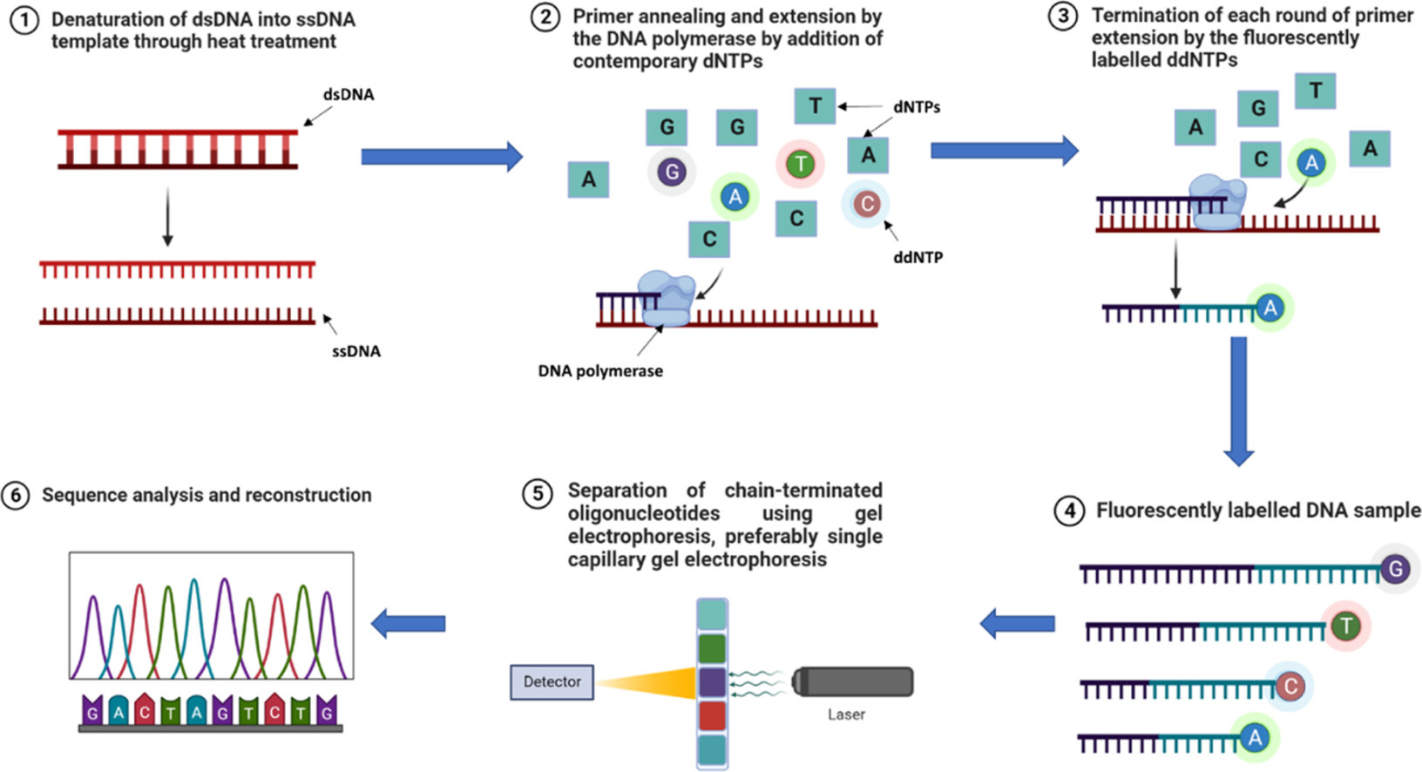
DNA sequencing, a molecular approach

Slide 16
dNTPs, gels (?)
next generation machines, seqeuncing by synthesis, flouraphores

Slide 17
Seqeunce interpretation
fasta, nt sequence
RBS
codons, ORF, start/stop
we can know genes are there without knowing what they do…

Slide 18
Sequence interpretation by alignment
reference sequences, databases
BLASTP
BWA align
homology
function prediction, alphafold

Slide 19
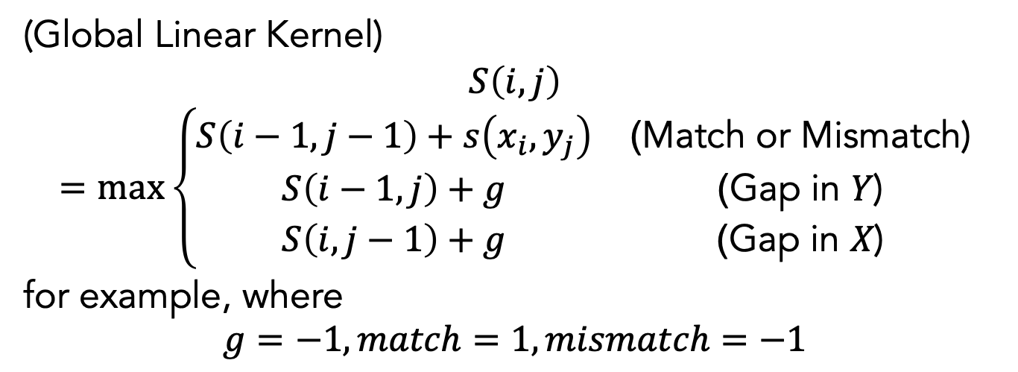
Needleman-Wunsch Alg
(Global Linear Kernel)
$$S\left(i,j\right)=max\left\{\begin{matrix}S\left(i−1,j−1\right)+s\left(x_{i},y_{j}\right) & \text{(}\text{Match} \text{or} \text{Mismatch}\text{)} \\ S\left(i−1,j\right)+g & \text{(}\text{Gap} \text{in} Y\text{)} \\ S\left(i,j−1\right)+g & \text{(}\text{Gap} \text{in} X\text{)}\end{matrix}\right.$$
for example, where
$$g=−1,match=1,mismatch=−1$$

Slide 20
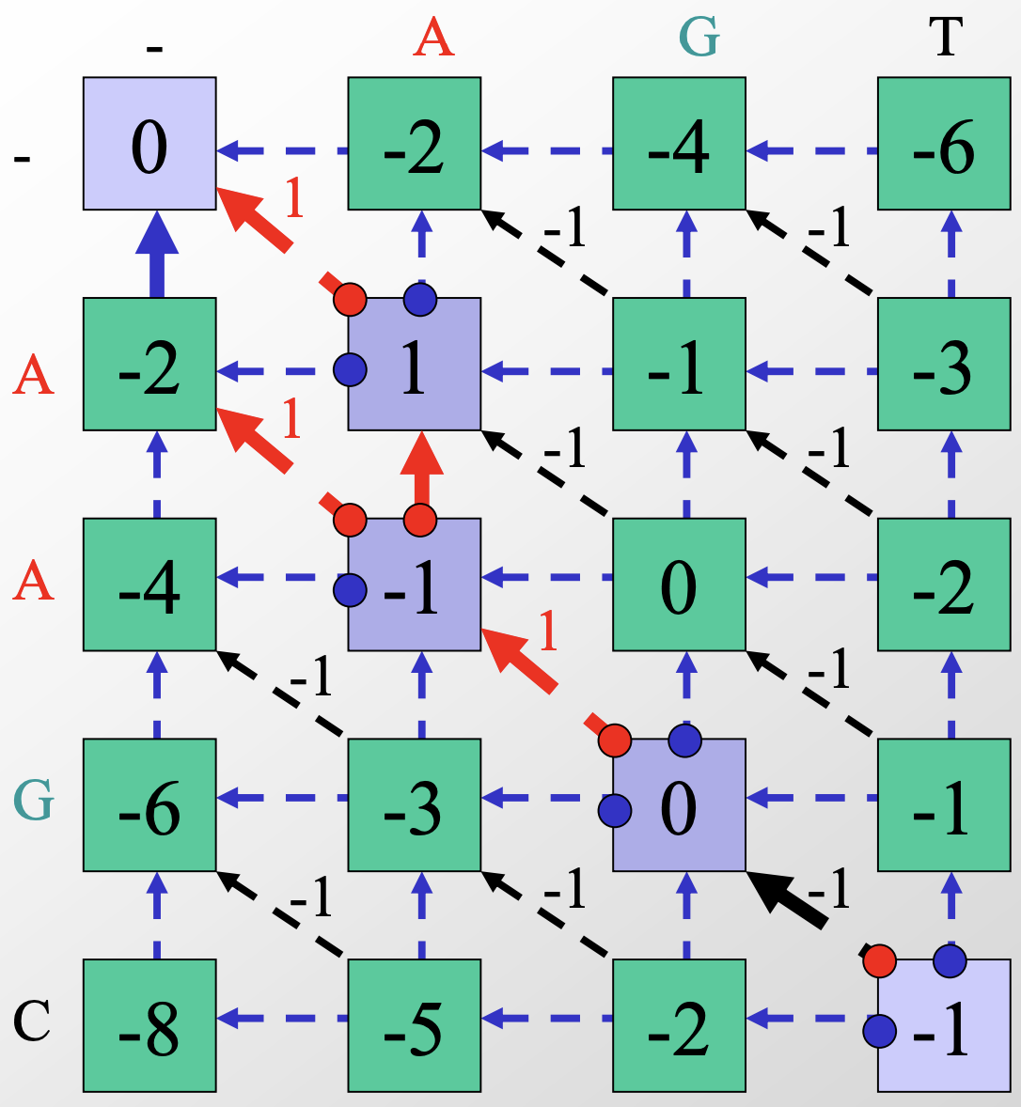
Demo filled

Slide 21
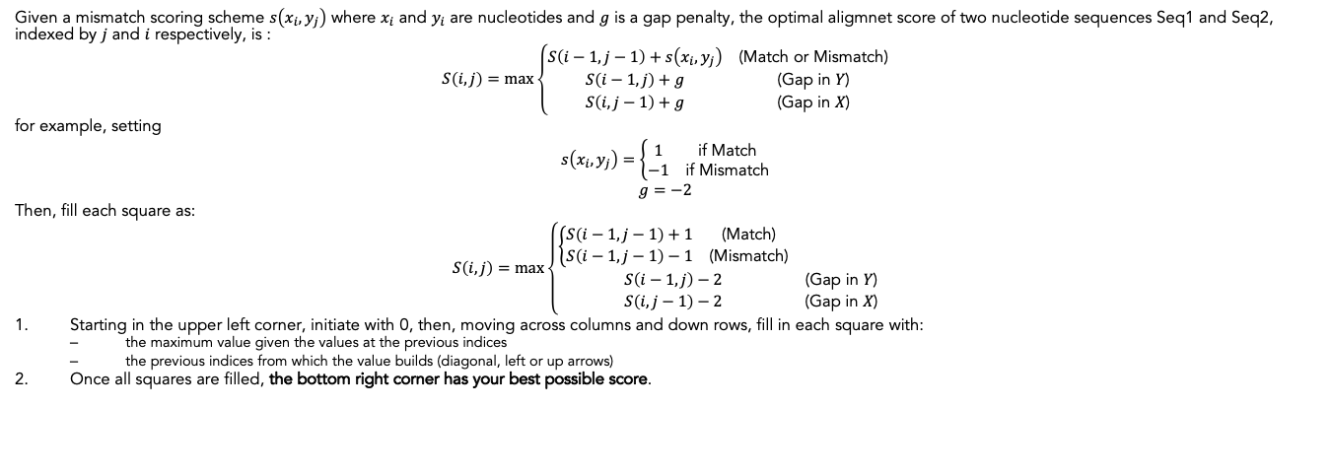
Intructions for the Needleman-Wunsch Alg
Given a mismatch scoring scheme $s\left(x_{i},y_{j}\right)$ where $x_{i}$ and $y_{i}$ are nucleotides and $g$ is a gap penalty, the optimal aligmnet score of two nucleotide sequences Seq1 and Seq2, indexed by $j$ and $i$ respectively, is :
$$S\left(i,j\right)=max\left\{\begin{matrix}S\left(i−1,j−1\right)+s\left(x_{i},y_{j}\right) & \text{(}\text{Match} \text{or} \text{Mismatch}\text{)} \\ S\left(i−1,j\right)+g & \text{(}\text{Gap} \text{in} Y\text{)} \\ S\left(i,j−1\right)+g & \text{(}\text{Gap} \text{in} X\text{)}\end{matrix}\right.$$
for example, setting
$$s\left(x_{i},y_{j}\right)=\left\{\begin{matrix}1 & \text{if} \text{Match} \\ −1 & \text{if} \text{Mismatch}\end{matrix}\right.$$
$$g=−2$$
Then, fill each square as:
$$S\left(i,j\right)=max\left\{\begin{matrix}\left\{\begin{matrix}S\left(i−1,j−1\right)+1 & \text{(}\text{Match}\text{)} \\ S\left(i−1,j−1\right)−1 & \text{(}\text{Mismatch}\text{)}\end{matrix}\right. & \\ S\left(i−1,j\right)−2 & \text{(}\text{Gap} \text{in} Y\text{)} \\ S\left(i,j−1\right)−2 & \text{(}\text{Gap} \text{in} X\text{)}\end{matrix}\right.$$
Starting in the upper left corner, initiate with 0, then, moving across columns and down rows, fill in each square with:
the maximum value given the values at the previous indices
the previous indices from which the value builds (diagonal, left or up arrows)
Once all squares are filled, the bottom right corner has your best possible score.

Slide 22
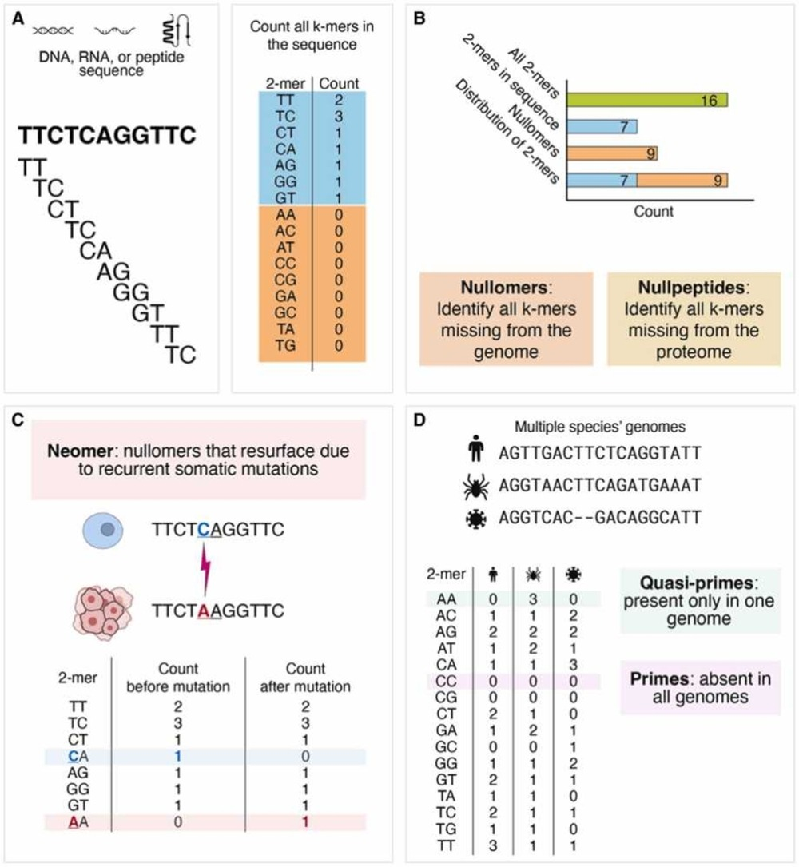
K-mer based sequence representation

Slide 23
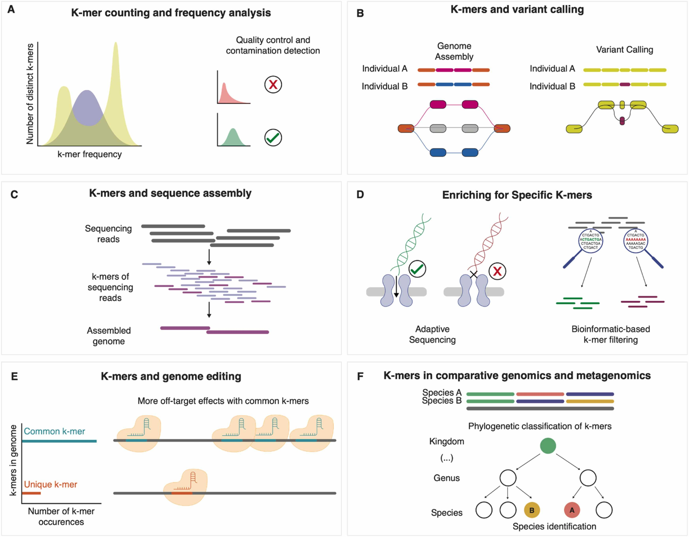
K-mer based quantification

Slide 24
RNA sequencing
cDNA
requires reference genomes
espression levels
count matrices
does NOT require annotations

Slide 25
Analyisis workflows/goals
we want to know what cells/organisms use which genes for
what are gene functions?
when/where are genes expressed? why?
are there cause/effect relationships we can interfere with or engineer?

Slide 26
Project goals
given dataset of E coli gene expression
what questions can be asked/answered?
how can metadata be explored? summarized?

Slide 27
Lab machines: getting started
Log on:
Your Union usernames
Default password: the word union followed by your ID number; e.g., union12345
Always log off before leaving the lab

Slide 28
Setting up folders & google drive
Create a folder for this course (e.g. names csc106).
share it with me (doingg@union.edu)
request a pro colab account using union email
find e coli notebook

Slide 29
Rosalind problems
genes as strings
accounts
colab notebooks
pair up?

Slide 30
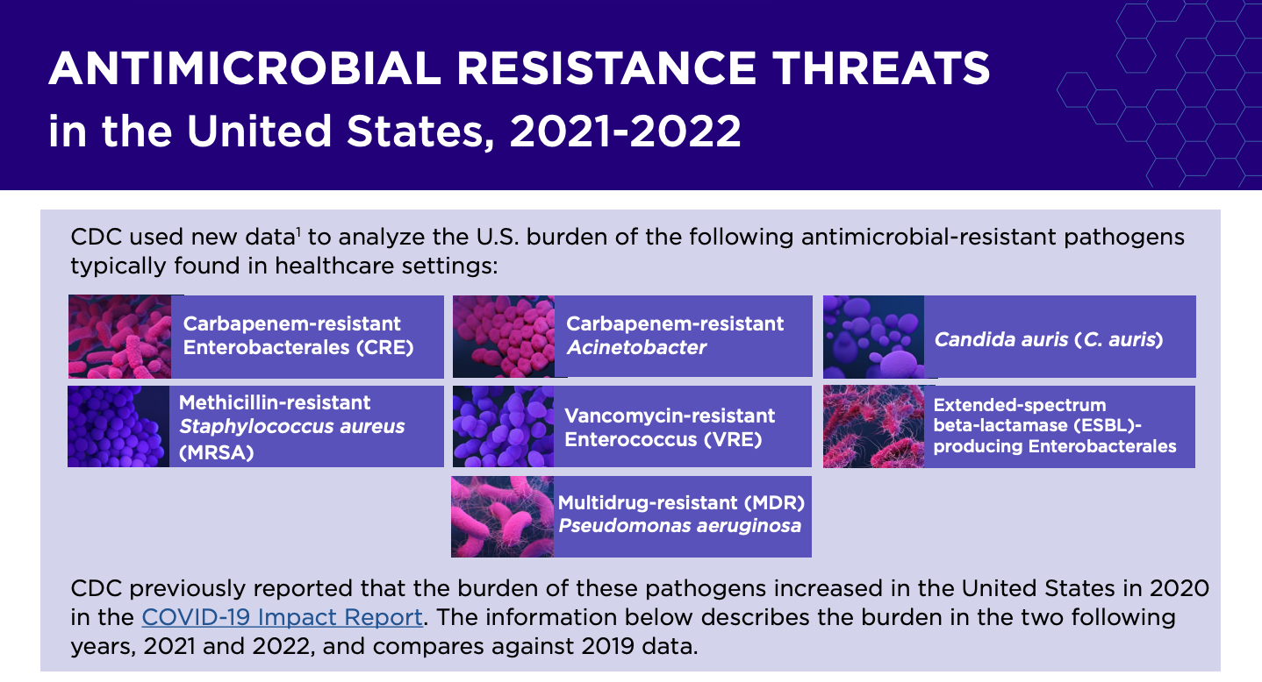
Ecoli metadata
create colab notebook
load E coli metadata
plot a data characteristic accumulation over time
how does it relate to ‘world in data’ graph?
E coli background

Slide 31
strains, genes
pathogenicity
CDC https://www.cdc.gov/ecoli/about/index.html
click to “types”
Activity
explore metadata
table
plot
revisit: what questions can be asked/answered?
Finish activity: plotting metadata (1 pts)
Also in Colab, finish working with the metadata introduced in class.
Make at least 3 plots analyzing or summarizing columns.
Write down (in Markdown) a comparison you think would be interesting to make, why you think it would be interesting and what you hypothesize the result would look like.
you don’t have to succeed in your comparison yet, if you’d need more tools/libraries/functions to do so
it is more important that you have a reason for making the comparion and an estimate to which you could compare your results
HW: rosalind problems
more python review
examples of sequences processing/alignment
at scale, libraries/packages/programs used for these steps
colab notebook review: practice sharing, commenting, discussing, updating

