Slide 1

The Moon, Up Close
A video tour built from lunar orbiter data
Kiosk demo deck 2 of 2 · the next slide plays an online video automatically
Notes:
TEST: library card for this deck should carry the Video badge (external video relationship detected by the scanner).

Slide 2
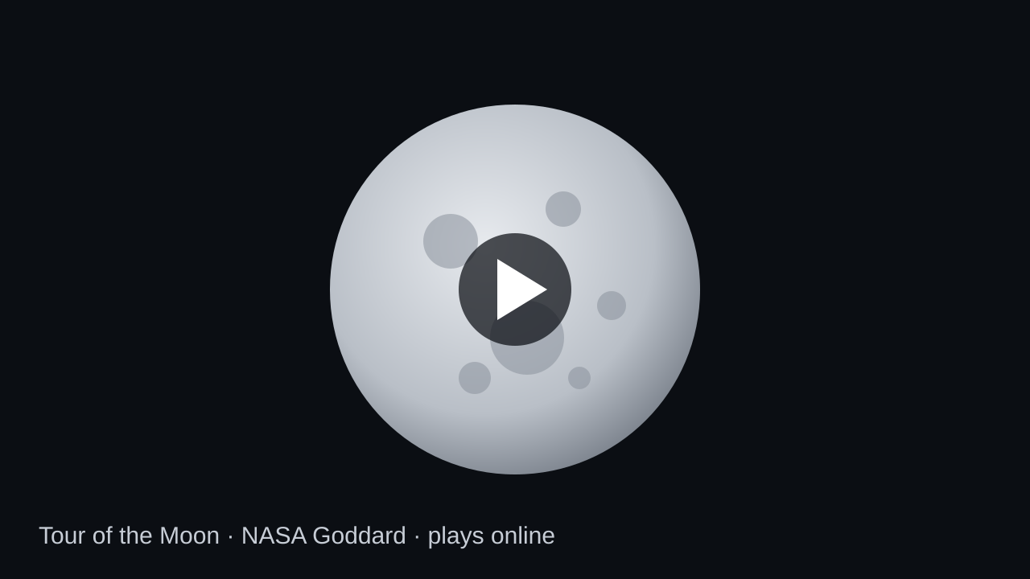
Tour of the Moon
Video: NASA Goddard on YouTube · plays automatically · needs an internet connection
Notes:
TEST: online YouTube video set to Start: Automatically. Checks: plays on arrival with no tap; idle prompt suppressed while on this slide; control strip Home works mid-playback; clicking the YouTube logo or title must not open a browser; with the network pulled, the slide shows PowerPoint's video error and Next/Home still work.

Slide 3



What you just saw
NASA built the tour from elevation maps and photos taken by the Lunar Reconnaissance Orbiter.
384,400 km
3,474 km
2009
average distance from Earth to the Moon
diameter of the Moon, about a quarter of Earth's
year the Lunar Reconnaissance Orbiter launched
Notes:
TEST: arriving here must stop the video audio from the previous slide.

Slide 4
Thanks for watching
Tap Home to choose another presentation
End of kiosk demo deck 2 · advancing past this slide ends the show
Notes:
TEST: end-of-show detection, same as deck 1.

