Slide 1
C H A P T E R
11
Artificial
Intelligence and Expert Systems

Slide 2
Overview of Artificial Intelligence
Artificial Intelligence (AI)
  Computers with the ability to mimic or duplicate the functions of the human brain.
Artificial Intelligence Systems
  The people, procedures, hardware, software, data, and knowledge needed to develop computer systems and machines that demonstrate the characteristics of intelligence.

Slide 3
Overview of Artificial Intelligence
Intelligent Behavior
  Learn from experience
  Apply knowledge acquired from experience
  Handle complex situations
  Solve problems when important information is missing
  Determine what is important
  React quickly and correctly to a new situation
  Understand visual images
  Process and manipulate symbols
  Be creative and imaginative
  Use heuristics
Perceptive System
A system that approximates the way a human sees, hears, and feels objects.

Slide 4
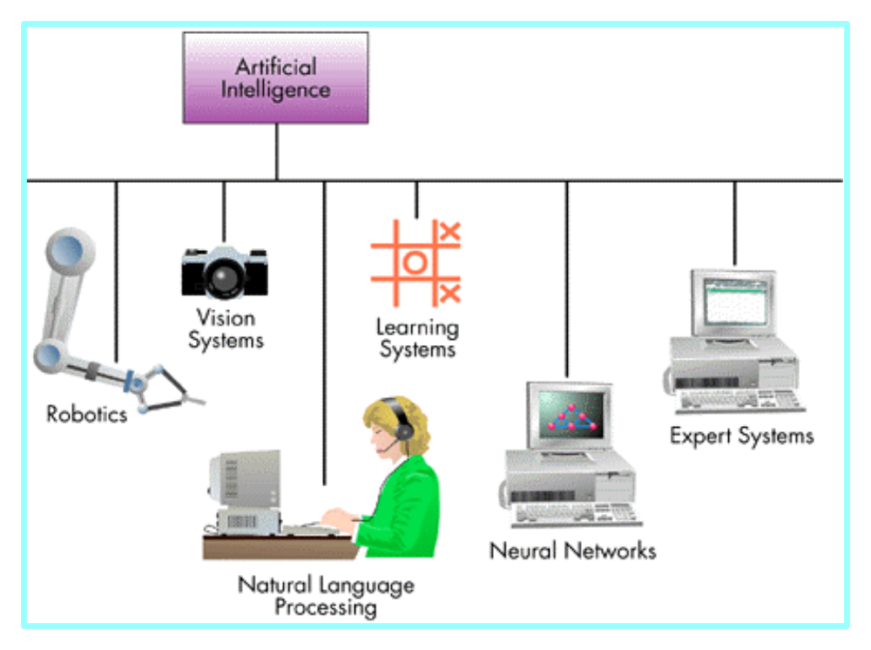
Major Branches of Artificial Intelligence (Figure 11.2)
Vision Systems
Capture, store, and manipulate visual images and pictures.
Expert System
Stores knowledge and makes inferences.
Robotics
Mechanical and computer devices that perform tedious tasks with high precision.

Slide 5
Major Branches of Artificial Intelligence
Natural Language Processing
Computers understand and react to statements and commands made in a “natural” language, such as English.
Learning System
Computer changes how it functions or reacts to situations based on feedback.
Neural Network
Computer system that can act like or simulate the functioning of the human brain.

Slide 6
Overview of Expert Systems
Can explain their reasoning or suggested decisions.
Can display intelligent behavior.
Can draw conclusions from complex relationships.
Can provide portable knowledge.
Expert System Shell
A collection of software packages and tools used to develop expert systems.

Slide 7
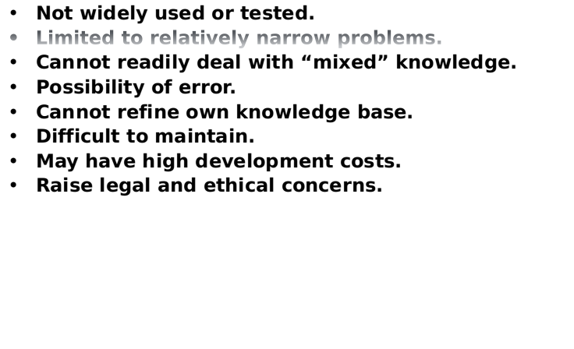
Overview of Expert Systems - Limitations

Slide 8
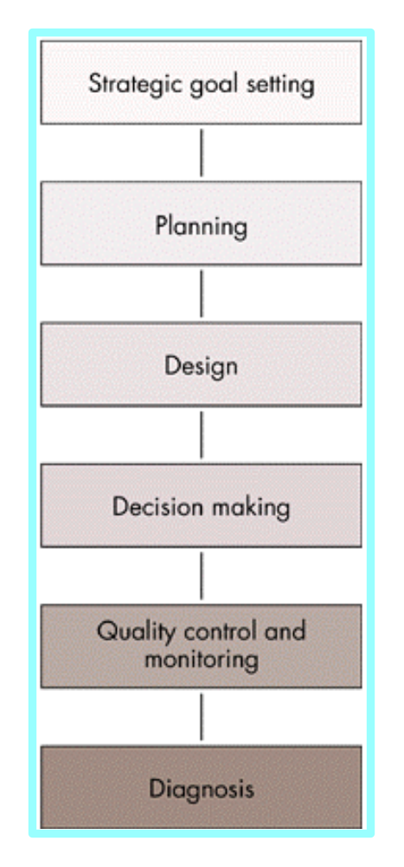
Capabilities of Expert Systems
Explore impact of strategic goals.
Impact of plans on resources.
Integrate general design principles and manufacturing limitations.
Provide advise on decisions.
Monitor quality and assist in finding solutions.
Look for causes and suggest solutions.

Slide 9
When to Use Expert Systems
Provide a high potential payoff or significantly reduced downside risk.
Capture and preserve irreplaceable human expertise.
Provide expertise needed at a number of locations at the same time or in a hostile environment that is dangerous to human health.

Slide 10
When to Use Expert Systems
Provide expertise that is expensive or rare
Develop a solution faster than human experts can
Provide expertise needed for training and development to share the wisdom of human experts with a large number of people

Slide 11
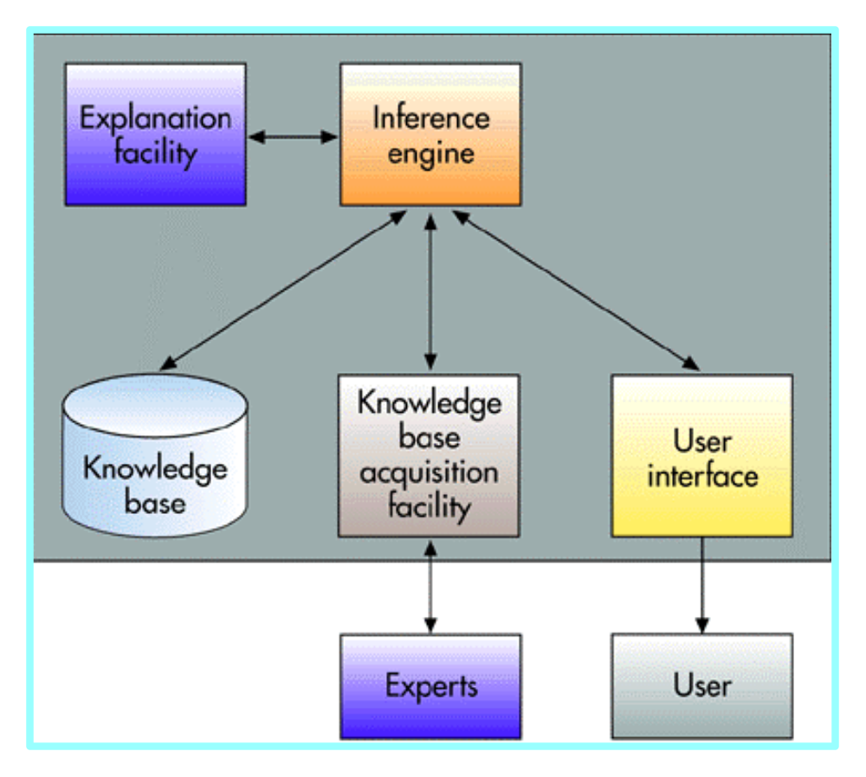
Components of Expert Systems
Knowledge Base
Stores all relevant information, data, rules, cases, and relationships used by the expert system.
Inference Engine
Seeks information and relationships from the knowledge base and provides answers, predictions, and suggestions in the way a human expert would.

Slide 12
Components of Expert Systems
Fuzzy Logic
A specialty research area in computer science that allows shades of gray and does not require everything to be simply yes/no, or true/false.
Rule
A conditional statement that links given conditions to actions or outcomes.

Slide 13

Rules for a Credit Application

Slide 14
Explanation Facility
Explanation Facility
  A part of the expert system that allows a user or decision maker to understand how the expert system arrived at certain conclusions or results.

Slide 15
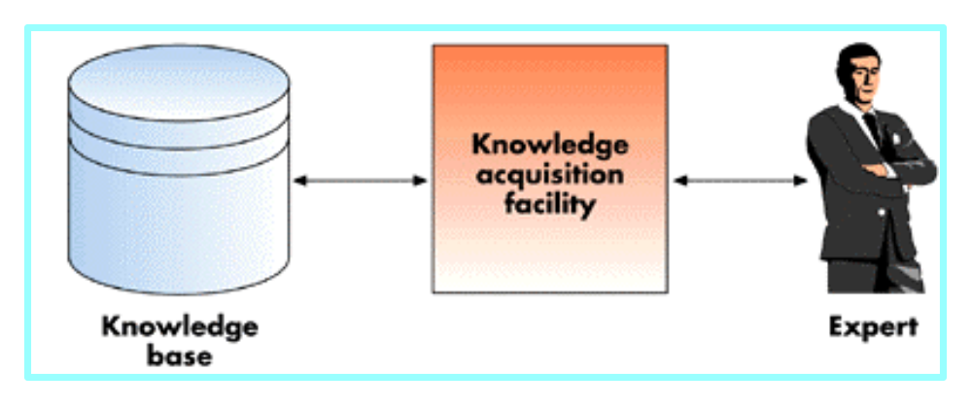
Knowledge Acquisition Facility
Knowledge Acquisition Facility
Provides a convenient and efficient means of capturing and storing all components of the knowledge base.

Slide 16
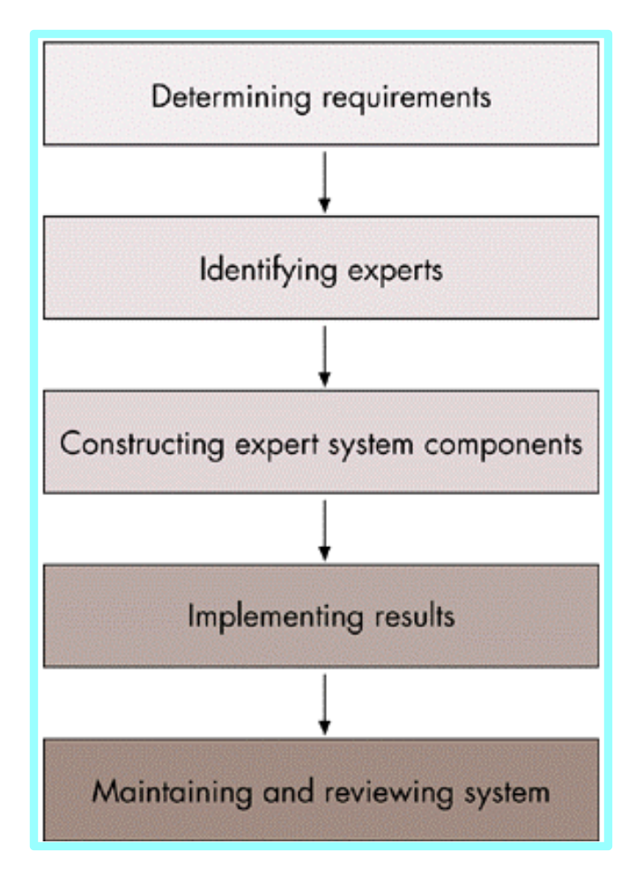
Expert Systems Development
Domain
The area of knowledge addressed by the expert system.

Slide 17
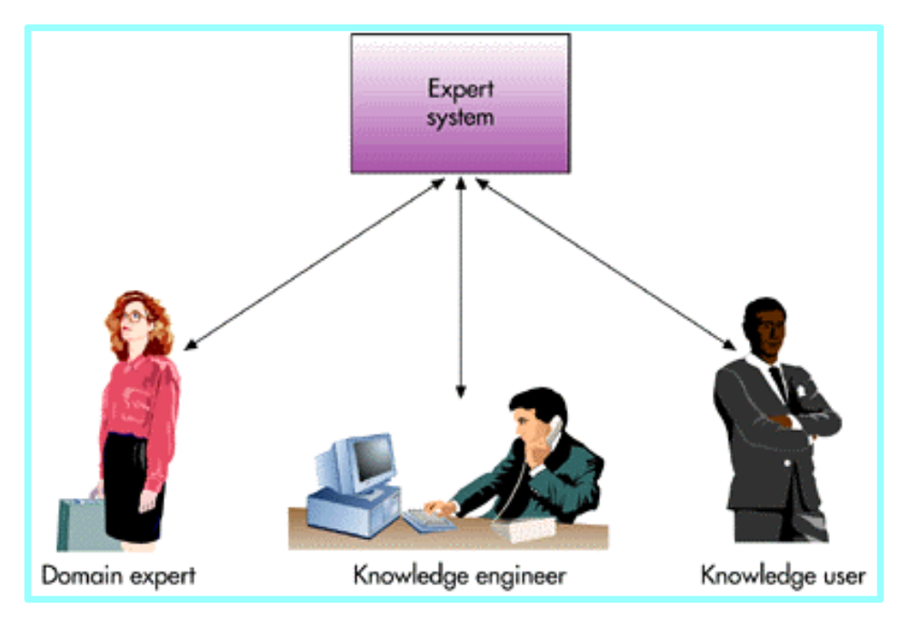
Participants in Expert Systems Development and Use
Domain Expert
The individual or group whose expertise and knowledge is captured for use in an expert system.
Knowledge User
The individual or group who uses and benefits from the expert system.
Knowledge Engineer
Someone trained or experienced in the design, development, implementation, and maintenance of an expert system.

Slide 18
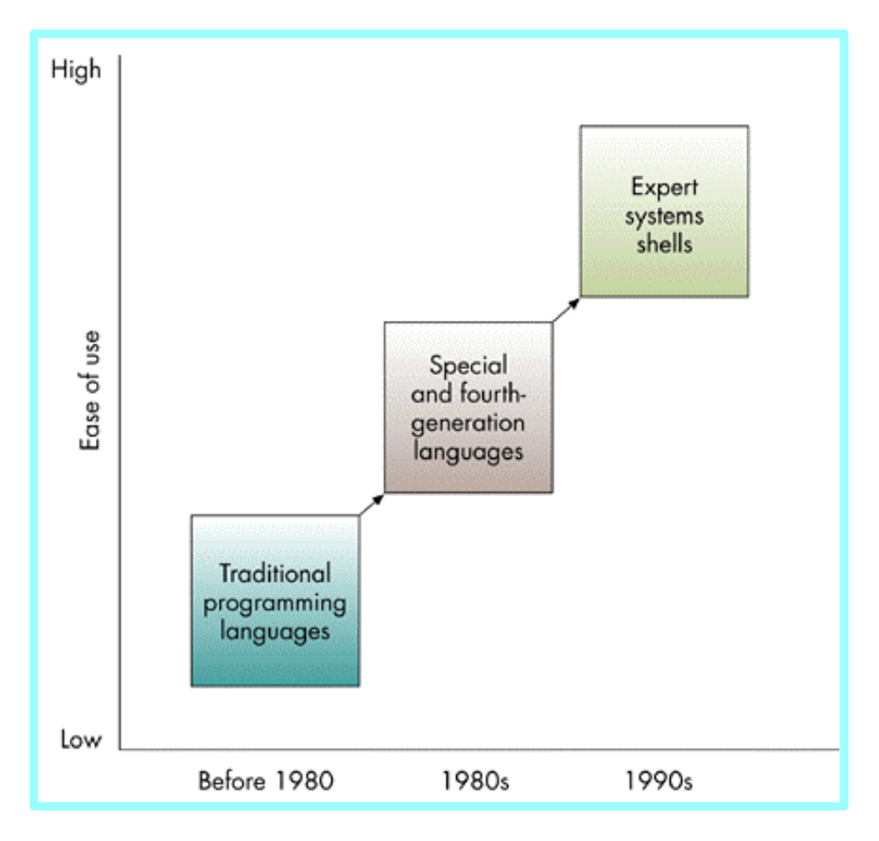
Evolution of Expert Systems Software
Expert System Shells
A shell is a collection of software packages and tools used to design, develop, implement, and maintain expert systems.

Slide 19
Advantages of Expert Systems Shells
Easy to develop and modify
The use of satisficing
The use of heuristics
Development by knowledge engineers and users

Slide 20
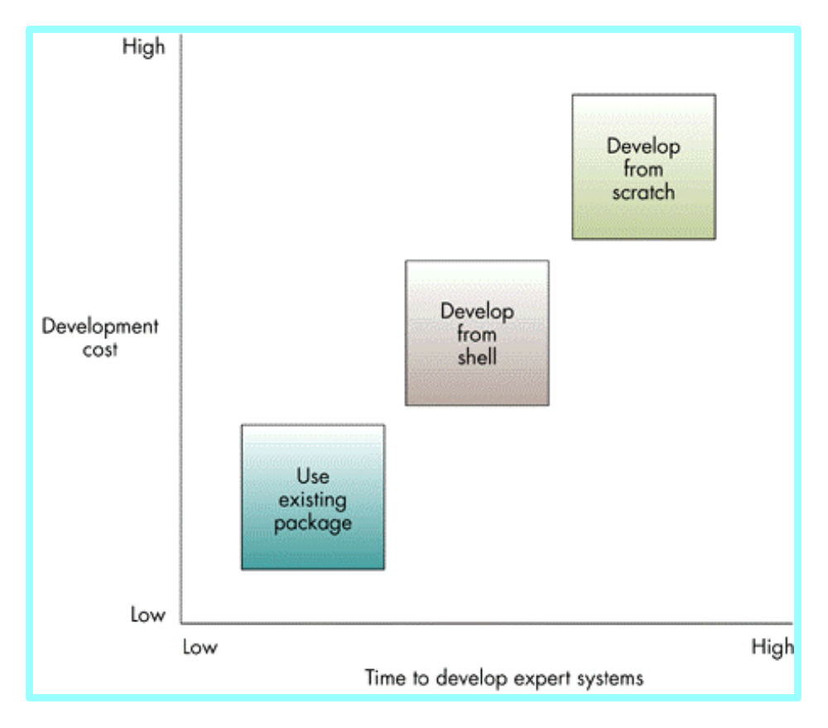
Expert Systems Development Alternatives

Slide 21
Applications of Expert Systems and Artificial Intelligence
Credit granting
Information management and retrieval
AI and expert systems embedded in products
Plant layout
Hospitals and medical facilities
Help desks and assistance
Employee performance evaluation
Loan analysis
Virus detection
Repair and maintenance
Shipping
Marketing
Warehouse optimization

