Slide 1
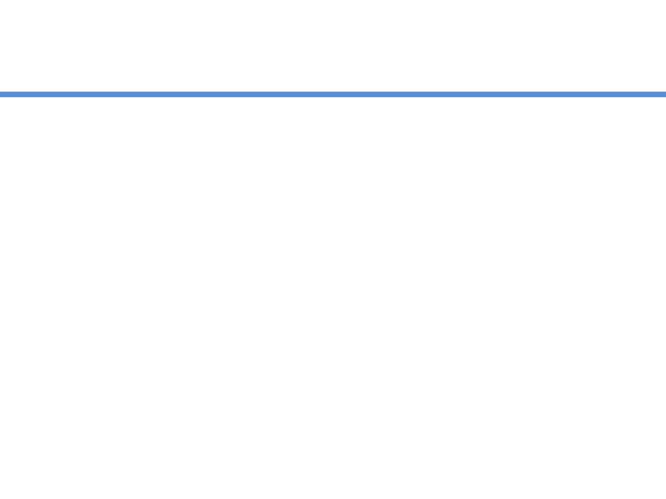
Spring MVC

Slide 2
Servlet WebApplication
Client requests for the URL
Particular servlet is mapped and response generated
Response is sent to the client
Application
request
Servlet
DB
response
Servlet
request
Servlet
POJO
response

Slide 3
JSP WebApplication
Client requests for the URL
Particular JSP is mapped and response generated after processing the request
Response with the data is sent to the client
Application
request
JSP
DB
response
JSP
request
JSP
POJO
response

Slide 4
WebApplication ??
Developers found
Both are not so good
HTML code embedded into Java code
Java code embedded into HTML code
Servlet
JSP
Two responsibilities mixed together, and makes it difficult to work independently

Slide 5
MVC
MVC says we can overcome all such problems
M
V
C
odel
iew
ontroller
Separate out
Presentation
Business Layer
HTML
JSP
Servlet

Slide 6
MVC
M
V
C
odel
Represents data
iew
Represnts UI part
ontroller
Manages the application flow, makes a call to some sort of service producing Model and then passes on the model to view

Slide 7


Example - MVC
Decorates with Fruits
Decorates with Cream
Machine to prepare Vanilla Cake
Machine to prepare Chocolate Cake
Machine to prepare Strawberry Cake
Your Cake Shop

Slide 8
MVC
HTML code
Showing Model
Application
View
Java Object
“Can be DO”
Some Business Service Producing Model (Data)
Model
Some Business Service Producing Model (Data)
Controller
Some Business Service Producing Model (Data)

Slide 9
Spring MVC
Web Application development Framework
Based on MVC guidelines
Let’s move to Spring MVC

Slide 10
Spring MVC Web App
Scans the URL and tell the exact address of the Guy who can generate the data for this web page
Handler Mapping
Prepares data, creates a Java object to hold data
www.webSite/WebPage
Front
Controller
Dispatcher Servlet
Data Generator
Controller
JavaObject holding Data
Final Response
View
View Resolver

Slide 11
Benefits
Spring Web MVC Framework is
Robust
Flexible
Well-designed framework for rapidly developing web applications using the MVC design pattern
IoC
DI

Slide 12
Benefits
Easier testing
Most of Spring’s classes are designed as JavaBeans enables you to inject test data using the setter methods of these classes
Bind directly to business objects
Spring MVC does not require your business (model) classes to extend any special classes; this enables you to reuse your business objects by binding them directly to the HTML forms fields
Clear separation of roles
Spring MVC nicely separates the roles played by the various components that make up this web framework

Slide 13
Benefits
Adaptable controllers
Spring provides several types of controllers, each serving a different purpose
Simple but powerful tag library
Spring’s tag library is small but powerful. Spring uses the JSP expression language (EL)
View technologies and web frameworks
Spring supports other view technologies as well, such as Apache Velocity and FreeMarker
Lighter-weight environment
Spring enables you to build enterprise-ready applications using POJO classes

Slide 14
Spring MVC Java Concepts
Model and View
Many of the methods in the Controller related subclasses return
This object holds the model as a java.util.Map object and view name and makes it possible to return both in one return value from a method
org.springframework.web.servlet.ModelAndView object

Slide 15
Getting Started
Install a Apache Tomcat
You can use any servlet container
Integrate it with IDE
If you are using
Download SpringFramework
Spring uses Common Logging jar
Download it
http://repo.spring.io/release/org/springframework/spring/

Slide 16
Getting Started
To create first demo, need to follow these 4 simple steps:
Modify web.xml
Create servlet-name-servlet.xml
Create the HelloController.java (controller)
Create HelloPage.jsp (View)

Slide 17
web.xml
<?xml version="1.0" encoding="UTF-8"?>
<web-app xmlns:xsi="http://www.w3.org/2001/XMLSchema-instance" xmlns="http://java.sun.com/xml/ns/javaee" xsi:schemaLocation="http://java.sun.com/xml/ns/javaee http://java.sun.com/xml/ns/javaee/web-app_3_0.xsd" id="WebApp_ID" version="3.0">
<display-name>FirstSpringMVCProject</display-name>
<servlet>
<servlet-name>spring-dispatcher</servlet-name>
<servlet-class>org.springframework.web.servlet.DispatcherServlet</servlet-class>
</servlet>
<servlet-mapping>
<servlet-name>spring-dispatcher</servlet-name>
<url-pattern>/mvc/*</url-pattern>
</servlet-mapping>
</web-app>

Slide 18
dispatcher.xml
<?xml version="1.0" encoding="UTF-8"?>
<beans xmlns="http://www.springframework.org/schema/beans"
xmlns:xsi="http://www.w3.org/2001/XMLSchema-instance"
xmlns:p="http://www.springframework.org/schema/p"
xmlns:context="http://www.springframework.org/schema/context"
xsi:schemaLocation="http://www.springframework.org/schema/beans
http://www.springframework.org/schema/beans/spring-beans-3.0.xsd
http://www.springframework.org/schema/context
http://www.springframework.org/schema/context/spring-context-3.0.xsd">
<bean id="handlerMapping" class="org.springframework.web.servlet.handler.BeanNameUrlHandlerMapping"/>
<bean name="/welcome.html" class="com.helloController.HelloController"/>
<bean id="viewSolver" class="org.springframework.web.servlet.view.InternalResourceViewResolver">
<property name="prefix">
<value>/WEB-INF/views/</value>
</property>
<property name="suffix">
<value>.jsp</value>
</property>
</bean>
</beans>

Slide 19
View
<%@ page language="java" contentType="text/html; charset=ISO-8859-1"
pageEncoding="ISO-8859-1"%>
<!DOCTYPE html PUBLIC "-//W3C//DTD HTML 4.01 Transitional//EN" "http://www.w3.org/TR/html4/loose.dtd">
<html>
<head>
<meta http-equiv="Content-Type" content="text/html; charset=ISO-8859-1">
<title>First SpringMVC Demo</title>
</head>
<body>
<h1>First ServletMVC Demo</h1>
<h2>${welcomeMessage}</h2>
</body>
</html>

Slide 20
Controller
package com.tkhts.helloController;
+ import javax.servlet.http.HttpServletRequest;
public class HelloController extends AbstractController {
@Override
protected ModelAndView handleRequestInternal(HttpServletRequest request, HttpServletResponse response) throws Exception {
ModelAndView modelandview = new ModelAndView("HelloPage");
modelandview.addObject("welcomeMessage","Hi Friends, Techknow Heights welcomes you....");
return modelandview;
}
}

Slide 21
Annotations
@Controller
indicates that a particular class serves the role of a controller
@RequestMapping
used to map a URL to either an entire class or a particular handler method
<context: component-scan base-package= "path" />

Slide 22
Annotations
@Controller
@RequestMapping("/greet")
public class HelloController{
@RequestMapping("/welcome")
public ModelAndView helloWorld(){
ModelAndView model = new ModelAndView("hello");
model.addObject("data", “SpringMVC is with annotation");
return model;
}
}

Slide 23
@PathVariable
Use to accept the customized or more dynamic parameters in the request paths
@RequestMapping("/hello/{name}")
public String greet(@PathVariable(value=“name") String name){
// .......
}

Slide 24
@PathVariable
@PathVariable is very useful for dynamic URIs
There is no limit on the number of parameters used in a single method
@PathVariable argument can be of any simple type such as int, long, Date, etc

Slide 25
@RequestParam
@RequestParam is used for accessing the query parameter values from the request
public boolean login(
@RequestParam(value=“id", required=true) String id, @RequestParam(value="pass", required=false) String pass
){
//...
}

Slide 26
@ModelAttribute - method
@ModelAttribute on method level adds common objects in all the models within the controller.
@ModelAttribute
public void setHeader(Model model){
model.addAttribute(“title”, “You are learining SpringMVC”);
}

Slide 27
@ModelAttribute
@ModelAttribute refers to a property of the Model object
The M in MVC
public boolean login( @ModelAttribute(“person”) Person p ){
//...
}

Slide 28
Binding Data
class Employee {
String name;
int id;
Date dob;
Address address;
// ...
}

Slide 29
Binding Data – Invalid Data
class Employee {
String name;
int id; // “sr.18”
Date dob;
Address address;
// ...
}

Slide 30
Binding Data – Invalid Data
public ModelAndView login(
@ModelAttribute(“person”) Person p,
BindingResult result
){
if(result.hasErrors){
return new ModelAndView(“errorPage”);
}
return new ModelAndView(“successPage”);
}

Slide 31
Binding Data – Invalid Data
errorPage.jsp
<%@ taglib prefix=“form” url=http://www.springframework.org/tags/form” %>
<form:errors path=“student”>

