Slide 1
Objectives:
In Today’s Class, you will learn the following:
Working deeper with more HTML
Internet Basics, Keywords and how the Web works
Brief discussion on Web Browsers
The events that occur before a web page appears via the Browser …on the client’s computer screen
From: PROF. ARTHUR U. UME
Notes:
1

Slide 2
Working deeper with more HTML
.
From: PROF. ARTHUR U. UME

Slide 3
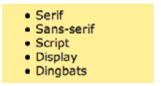
How to Implement an Unordered Listing in HTML
What is an Unordered List?
An unordered list is a collection of related items that have no special order or sequence.
An Unordered list is used to group a set of related items, in no particular order.
Each item in the list is marked with a bullet….
<ul>...</ul> [Tags used for identifying an unordered listing]
<li>...</li> [tags used to individually list the items within an unordered listing]
From: PROF. ARTHUR U. UME

Slide 4
1. Basic HTML Code to display an Unordered list of the courses which your Members are Offering at ADUN…. :
<html>
<body>
<h2>This is an Unordered List of Courses My Team Members are offering at the Admiralty University of Nigeria: </h2>
<ul>
<li>Computer Science</li>
<li>Software Engineering</li>
<li>Cyber Security</li>
<li>Information Systems Analysis</li>
<li>Database Management</li>
<li>Information Technology</li>
</ul>
</body>
</html>
From: PROF. ARTHUR U. UME

Slide 5
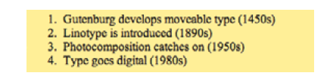
How to Implement an Ordered Listing in HTML
What is an Ordered List?
An Ordered list is a collection of related items that have a special order or sequence.
Ordered lists are used for lists of items for which the order of the items does matter.
Each item in the list is marked with a number…
<ol>...</ol> [tags used for identifying an ordered listing]
<li>...</li> [tags used to list the individual items within an ordered list]
From: PROF. ARTHUR U. UME

Slide 6
2. Basic HTML Code to display an Ordered list of some important Dates in the History of Computing…. :
<html>
<body>
<h3>This is an Ordered List showing the History of Computing with important/significant Dates: </h3>
<ol>
<li>The Pascaline Era of First Mechanical Calculators(1600s)</li>
<li>Jacquard Loom Mechanical Calculator (1800s)</li>
<li>ENIAC Computer (1940s)</li>
<li>John Von Neumann Architecture (1946)</li>
<li>First Minicomputer (1965-1975)</li>
<li>Electronic Emailing(1985)</li>
<li>RFID & Artificial Intelligence (2015)</li>
</ol>
</body>
</html>
From: PROF. ARTHUR U. UME

Slide 7
How to Implement Tables in HTML
What are tables in HTML?
A table is layout mechanism that allows us to arrange content which include text, images, links, forms, and even other tables to be arranged into vertical columns and horizontal rows. Each block of space within a table is called a table data cell.
Tables are heavily used in HTML documents.
<table>….</table> [opening and closing tags to create a table>
<tr>…./tr> [tags for creating table rows within the table]
<td…/td> [tags for creating and inserting data items within the table]
From: PROF. ARTHUR U. UME

Slide 8
3. Basic HTML Code to build a Table to display the Names of the Professors at the Faculty of Science , ADUN…. :
<Html>
<Body>
<table>
<table border="1">
<tr>
<td>SURNAME</td>
<td>FIRST NAME</td>
<td>DESIGNATION</td>
<td>NATIONALITY</td>
</tr>
<tr>
<td>Ume</td>
<td>Arthur</td>
<td>Professor & Dean-Science</td>
<td>Nigerian</td>
</tr>
From: PROF. ARTHUR U. UME

Slide 9
Code for Table to display the Names of the Professors, contd.
<tr>
<td>Shilgba</td>
<td>Leonard</td>
<td>Professor & V/C</td>
<td>Nigerian</td>
</tr>
<tr>
<td>Dioha</td>
<td>Joseph</td>
<td>Professor & Director, Sustainability</td>
<td>Nigerian</td>
</tr>
</table>
</Body>
</Html>
From: PROF. ARTHUR U. UME

Slide 10
How to Implement Combo boxes in HTML
What is a Combo box?
A Combo box is a commonly used graphical user interface widget (control) by the Interaction Designer; the term “Combo box" is referred to as "drop-down list“
The combo box widget/control is normally used by the programmer when he/she wants to collect predetermined listing of data items or information from the Users of the information system or software.
<option> ….</option> [tags used to build up every individual value to be passed on from the drop-down listing for processing.
<select> …. </select> [tags used when we need to allow users to make a choice from a list of items.
<option…value=“0”> this attribute is used to show what will be initially displayed (default) item to the user
From: PROF. ARTHUR U. UME

Slide 11
4. Basic HTML Code to build Combo Box to select your Favorite Colors; Age Bracket and hobby:
<Html>
<Body>
<select name=colorlist id=colorlist>
<option value=0>Please Choose Your Favorite Color</option>
<option value=1>Red</option>
<option value=2>Blue</option>
<option value=3>Green</option>
<option value=4>Orange</option>
</select>
<select name=agelist id=agelist>
<option value=0>Here, Choose Your Age Baracket</option>
<option value= 1>15-20</option>
<option value=2>20-25</option>
<option value=3>25-30</option>
<option value=4>30-35</option>
</select>
From: PROF. ARTHUR U. UME

Slide 12
HTML Code to build Combo Boxes …contd.
<select name=statelist id=statelist>
<option value=0>Lastly, Choose Your favorite Hobby</option>
<option value=1>Reading</option>
<option value=2>Cooking</option>
<option value=3>Travelling</option>
<option value=4>Sleeping</option>
<option value=5>Singing</option>
<option value=6>Swimming</option>
<option value=7>Jogging</option>
</select>
</Body>
</Html>
From: PROF. ARTHUR U. UME

Slide 13
How to Implement Online Forms with HTML
What is an Online Form?
Many times the programmer depends on using an online form to capture/collect information and data items from users.
Users/ Clients are asked to fill forms in order to start many business processes.
We can use HTML to construct the look and feel of such forms.
The <form> tag is used to specify the beginning of a form area on a Web page while the </form> tag is used to specify the end of a form area.
Common attributes used to the <form> tags are name, method, and action. These attributes are important in Server-side scripting!
From: PROF. ARTHUR U. UME

Slide 14
5. Basic HTML Code to build an Online Form to capture Students’ Registration Info:
<html>
<head>
<title>This is a Form to Capture ADUN Students' User Names and Passwords</title>
</head>
<body>
<h2> Students'Registration Page</h2>
<form>
Please Enter Your Username here:<input type="text" name="username" required="required"/><br/>
Then Enter Your Password here:<input type="password" name="password" required="required"/><br/>
What is your Department at ADUN? <Input type="text" name="dept"><br>
From: PROF. ARTHUR U. UME

Slide 15
HTML Code to build an Online Form ….contd.
<h3>Make a Selection of your Gender:</h3>
<Input type="radio" name="gender" value="Male"> Male<br>
<Input type="radio" name="gender" value="Female"> Female<br>
<input type="submit" value="Click this button to Login"/>
</form>
</body>
</html>
From: PROF. ARTHUR U. UME

Slide 16
Browsers & Brief discussion on browsers
Today there are numerous (hundreds) of browsers presently out there in the market for Online applications development. These Browsers are created and supplied by many vendors…other than Netscape and Microsoft.
These browsers ALL work well in rendering Online applications and e-commerce sites.
Today, it is actually becoming a problem for applications developers to deal with the compatibility issues involved with the numerous browsers; it has become a challenge to write applications that can run in ALL the browsers which are out there for ALL your future clients or customers!
The tables below list some of the prominent browsers which an applications developer will most likely encounter in the industry.
From: PROF. ARTHUR U. UME

Slide 17
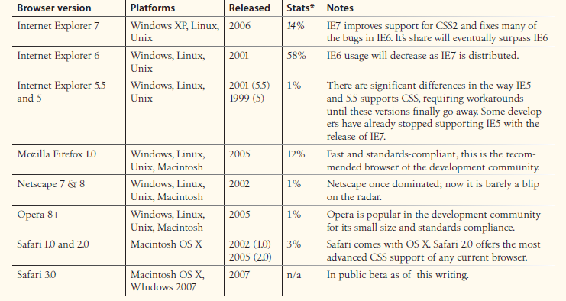
Browser versions, platforms and Use-statistics
From: PROF. ARTHUR U. UME

Slide 18
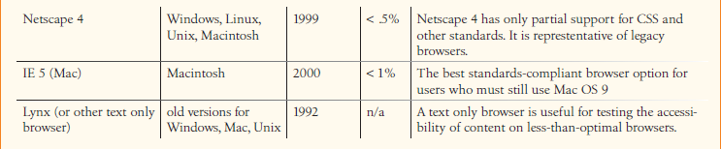
Browser versions, platforms and Use-statistics
From: PROF. ARTHUR U. UME

Slide 19
The Path/Route of the HTML source code
Write the html document in Text Pad; he/she loads the source code and all accompanying graphics image files onto a Web Server.
See example of such html source code below:
19

Slide 20
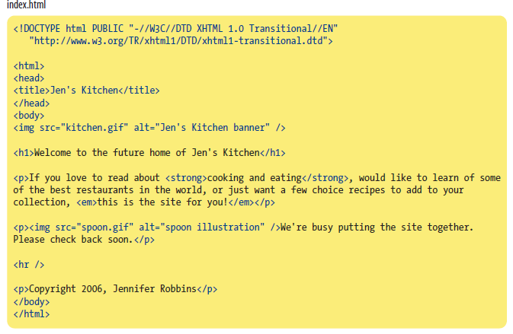
Recap: Example of such HTML source code….
From: PROF. ARTHUR U. UME

Slide 21
How to put Images into your HTML file
2 ) Put/Save the image in the same folder as the .html file
Copy the image you want to display on the webpage to the same folder where your .html file is located.
Add the value to the src= attribute as your image name with its extension.
You may want to give dimension/size to the image using the alt= attribute …to resize it if need be.
For example :
<img src= "Portrait Prof Arthur Ume ADUN -IMG-20190227.jpg" alt= "Image" height="65" width="60"/ >
From: PROF. ARTHUR U. UME

Slide 22
The path/route of the HTML source code
A site visitor makes a request a for the web page by either typing its URL (for example, http://jenskitchensite.com) directly in the browser, or by clicking on a link on the page. (Note: The URL contains all the information needed to target a specific HTML document on a specific web server on the Internet via a browser.)
The browser sends an HTTP Request to the Web server named in the URL and asks for the specific file. If the URL specifies a directory (not a file), it is the same as requesting the default file in that directory.
From: PROF. ARTHUR U. UME

Slide 23
The path/route of the HTML source code
The Web server looks for the requested source code file and issues an HTTP response.
(Two things may happen at this time…:)
If the page cannot be found, the server returns an error message. (The message typically says “404 Not Found,” although more hospitable error messages may be substituted/provided by the web programmer. OR
If the document is found, the server retrieves the requested file and returns it to the browser.
From: PROF. ARTHUR U. UME

Slide 24
The path/route of the HTML source code
The browser parses the HTML document. If the page contains images, (indicated by the HTML img element), the browser contacts the server again to request each image file specified in the markup source code.
The browser inserts each image in the document flow where indicated by the img element.
And voila! The assembled complete web page is displayed for your visitors’’ viewing pleasure.
Below is a diagrammatic illustration of this sequence of steps….
From: PROF. ARTHUR U. UME

Slide 25
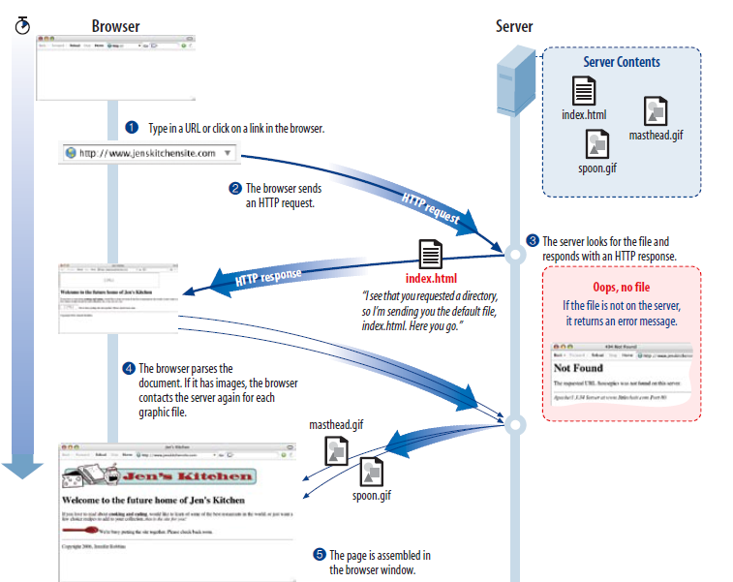
The path/route of the HTML source code…in the Browser!
From: PROF. ARTHUR U. UME

Slide 26
Individual Class Workshop/Assignment
Individually Study, Copy and Run the sample HTML Code written by the Instructor in your TEXTPAD.
Modify the code segments to do the following:
An Unordered list of the States of Nigeria
An Ordered list of FOUR important Dates in the History of Computing.
A Table to display the Names of SIX important towns in your State
Combo Boxes to select your Favorite Books; Height and Sport.
An Online Form to capture age, sex and computer literacy:
Keep your work to show the Instructor for scoring!
Due Date: March 12th
From: PROF. ARTHUR U. UME

