Slide 1
Georgi Kanchev
Gousto Task review
09.02.21

Slide 2
Exploratory analysis and data preparation
Data is primarily made up of nominal data with 2 ordial fields, spice level and time to prepare.
The majority of fields contain brief natural language descriptions of the recipes
There is missing data
There are 2 duplicates in recipe_id
There are recipe_ids in similarity_scores.csv that are not in recipes_info.csv and vice-versa

Slide 3
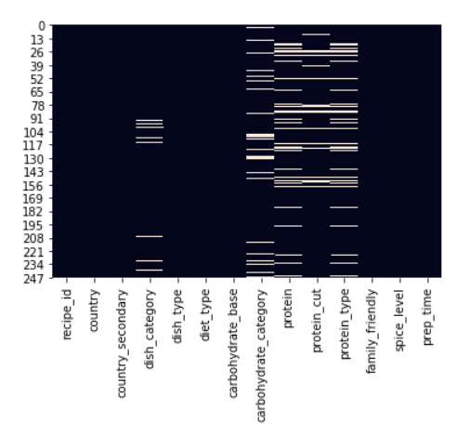
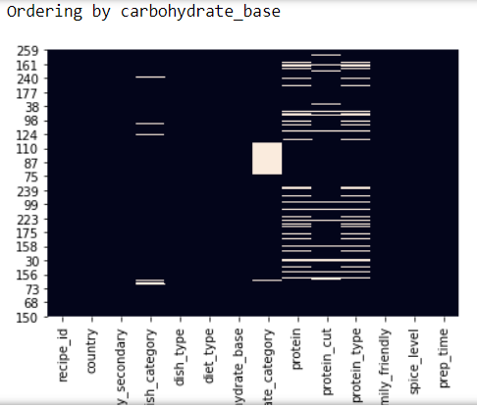
Imputation using manual exploration
Exploration of the dataset showed that there is valuable information that can be leveraged to impute missing values
Grouping by specific fields allowed for information to be inferred about missing fields
Specifically, interrelations between two fields showed signs of being able to explain missing values
In the images on the side we see that sorting the dataframe by carbohydrate base clustered all missing values in carbohydrate category, for example.

Slide 4
Imputation using KNN
Another approach to imputation is to use a naïve form of encoding, such as Ordial encoding in this case, that can preserve the null values
Once we have the data in a machine-readable format with all null values preserved we can apply imputation algorithms
There are drawbacks to this approach. Most notably, the use of an ordial encoder when the majority of data is nominal
Odial encoding of nominal data combined with a knn algorithm for imputation might pick up on patterns introduced into the data completely at random because of the enforced ordering of nominal data

Slide 5
Similarity measure using NLP
A measure of similarity can be derived between the data by encoding it in various ways and measuring what is called the cosine similarity between the data. The metric measures the cosine of the angle between the two vectors, in other words it gives us a measure of whether the vectors are pointing in a similar direction.
There are a number of ways in which we can turn the data into vectors which we can then measure
Simple approach is to use one hot encoding
Another approach is to extract the text from the fields and use NLP approaches, such as TF and TF-IDF
More complex NLP embeddings can also be used, such as Word2Vec, GloVe, BERT or ELMo
Pros: simple, elegant and tested in the document similarity literature. Does not require additional data to be generated.
Cons: simpler and even complicated embedding approaches struggle to capture subtleties in the similarities and differences of the dataset based on text alone

Slide 6
Similarity measure using metric learning
Distance metric learning (or simply, metric learning) aims at automatically constructing task-specific distance metrics from (weakly) supervised data, in a machine learning manner.
Weakly supervised learning: the algorithm has access to a set of data points with supervision only at the tuple level (typically pairs, triplets, or quadruplets of data points). A classic example of such weaker supervision is a set of positive and negative pairs: in this case, the goal is to learn a distance metric that puts positive pairs close together and negative pairs far away.
In this case I used the user-generated similarity ratings to as data sources for the weak supervision of the algorithm. I took rating >2 to be similar (1) and <3 to be unsimilar (-1).
Once the metric was learned I transformed the dataset and measured Mahalanobis distance between the vectors. The metric was scaled and used as similarity.

