Slide 1



HTML 5 and CSS 3 Team work
TEAM : “THORN;
Project :“Thorn Consult Bulgaria Ltd”;
Software University
http://softuni.bg

Slide 2
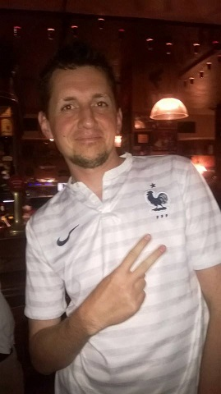
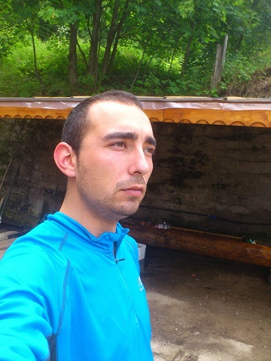
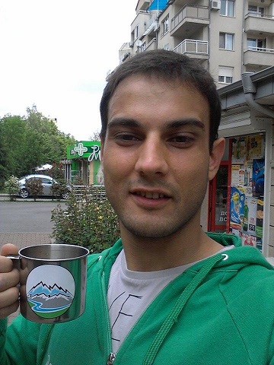
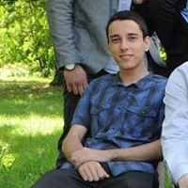
.team-members { display : block }
Dimitar
Velimir
Georgi
Ivan

Slide 3

.team-members { info }
Contribution : everyone was involved;
Organisation : chaotic;
Communication :
via Fake-book;
meetings in SoftUni and at home;
Commits in GitHub : 60+;

Slide 4

“Thorn Consult Bulgaria Ltd”;
Idea : project management company;
Projects :
Software dev.;
Music producers;
$ making;
Advertising : FB 20+ likes and 5 shares in 11 hours;
Slogan : Keep calm and learn to < THORN >;

Slide 5
“Thorn Consult Bulgaria Ltd”;
LIVE DEMO
http://team-thorn.softuni-friends.org

Slide 6
TEAM “THORN”

