Slide 1

Skynet ADS-B Market analysis Intermediate report
Prepared for Mr. Phil Connors
March 2017

Slide 2
Overview
Executive summary
Use case and value proposition refresh
Getting the right data for the job
Methodology and Demo
Key findings
Recommendations
Next steps
Notes:
OVERVIEW
Requirements
Outcomes
Solution
Timeline and deliverables
Team
Pricing
Summary

Slide 3
Executive Summary after week 1
The project progressed as planned.
We have selected and ingested the relevant data, as well as developed a feed ingestion service for future updates.
Explored the data and find a reliable methodology.
Ready for intermediate results and feedback.
Current Results for non ADS-B population show that:
Xxxx $ for the aircrafts x and y (2 * 15.000$ transponders). X % of
Targeting airlines x and y only

Slide 4


Commercial Aircraft Fleet ~8,000
FAA estimates 80% need ADS-B transponders
Use Case Scoring
10% Market
Share
$64
Million

Slide 5


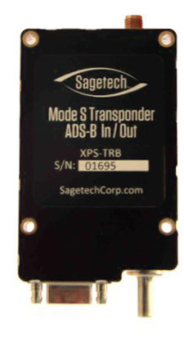


Summary of Requirements
--- USE CASE ---
Identify the two aircraft type constituting the largest proportion of those requiring ADS-B transponders

Slide 6
Getting the right data for the job
Bureau of Transportation Statistics
FAA
ADSB Exchange
List of all aircrafts types (US, International)
List of ADS-B equipped with aircraft
7 days: 14 to 20 March 2017 (20 GB per day)
Feed ingestion services
List of all aircrafts with types and airlines
Data from the last 7 years

Slide 7
Architecture
데이터 원천
Ingest
Data Lake
SOURCE
AIRCRAFT REGISTRATION
(Text)
Batch
(Bash Shell)
SQL
Hive
In-Memory
Spark
Other
Zeppline
Flight Data
(parquet)
YARN : Data Operation System
(Cluster Resource Management)
ADSB
Exchange
(Json)
HDFS
(Hadoop Distributed File System)

Slide 8
The Methodology
All aircrafts
US commercial aircraft
Not ADS-B equipped
Assumptions:
Most of active ADS-B aircrafts are captured in a week of ADS-B exchange data
ADS-B are turned on when installed
All active aircrafts are identified from the delay data

Slide 9
Key findings
Show the key findings

Slide 10
Recommendations
Our business analysis of the current situation

Slide 11
Next steps
Reviews and Project completion
Continuous Market screening

Slide 12
Notes:
Do you have any questions?
My colleague Martin will provide contact details
Thank you for your time

