Slide 1

Skynet ADS-B Market analysis Intermediate report
Prepared for Mr. Phil Connors
March 2017

Slide 2
Overview
Executive summary
Use case and value proposition refresh
Getting the right data for the job
The methodology
Key findings
Recommendations
Next steps
Notes:
OVERVIEW
Requirements
Outcomes
Solution
Timeline and deliverables
Team
Pricing
Summary

Slide 3
Executive Summary after week 1
The project progressed as plan
We have selected and ingested data from FAA, ADS-B exchange,
Explored the data and find a reliable methodology
Ready for intermediate results and discussion
Finalize the project after this review

Slide 4


Commercial Aircraft Fleet ~8,000
FAA estimates 80% need ADS-B transponders
Use Case Scoring
10% Market
Share
$64
Million

Slide 5
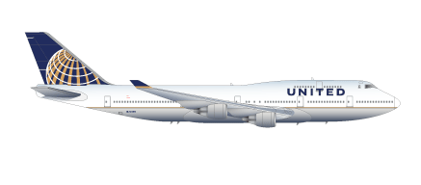

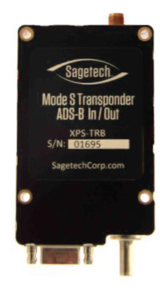


Summary of Requirements
--- USE CASE ---
Identify the two aircraft type constituting the largest proportion of those requiring ADS-B transponders

Slide 6
Getting the right data for the job
ADS-B
Exchange
FAA
To do add the field we use
To do add the field we use
To do add the field we use

Slide 7
The Methodology
Explain how we got the results (show all the data there?)

Slide 8
Key findings
Show the key findings

Slide 9
Recommendations
Our business analysis of the situation

Slide 10
Next steps
Project completion and deliverable
Next project ideas

Slide 11
Notes:
Do you have any questions?
My colleague Martin will provide contact details
Thank you for your time

