Slide 1
efood assignment
Customer segmentation to determine a group to target for breakfast cuisine

Slide 2
Introduction
Ordering breakfast via efood is a new habit, which has the potential to create loyal customers
Existing customers will be segmented in order to identify a valuable target group for a marketing campaign for the breakfast cuisine
The customers will be segmented using the frequency of orders and order value
A clustering algorithm will be implemented to create customer segments (k means algorithm)

Slide 3
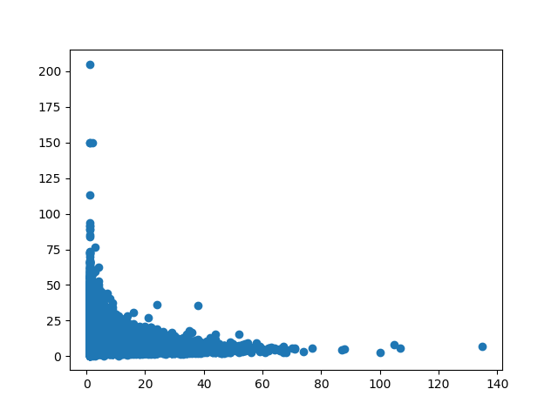
Customer frequency and order value

Slide 4
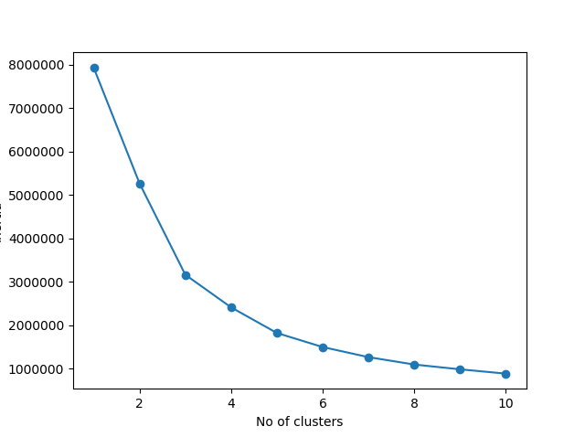
Determining the optimal number of customer clusters

Slide 5
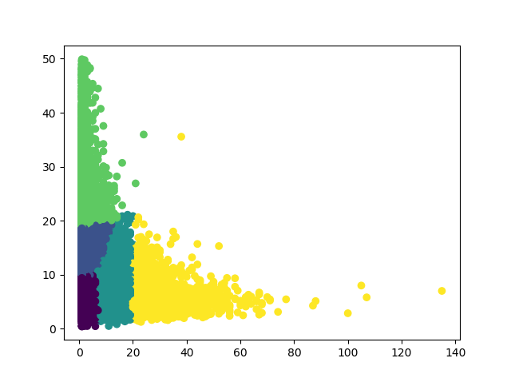
Clustered Customers: 5 segments (1)

Slide 6

5 segmets (2)
The optimal number of segments according to our method (elbow method) is 5
Green: customers with a high basket value and average frequency
Blue: customers with an average basket value and average frequency
Purple: customers with low basket value and low frequency
Cyan: customers with average to high frequency
Yellow: customers with high to very high frequency

Slide 7
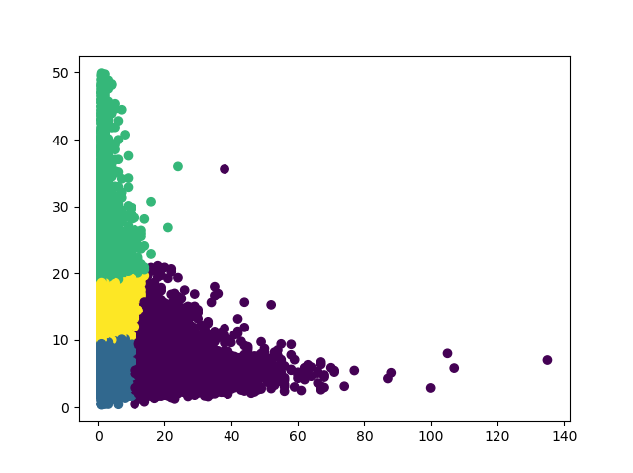
Clustered Customers: 4 segments (1)

Slide 8
4 segmets (2)
In order to simplify our findings, we also tried to segment our customer base into 4 segments
Green: customers with a high basket value and average frequency
Yellow: customers with an average basket value and average frequency
Blue: customers with low basket value and low frequency
Purple: customers with average to very high frequency and low to average basket value

Slide 9
The valuable segment
Customers in the purple segment are already loyal and order frequently via efood
Customers in the green segment order less frequently, but the average order amount is higher, this could be due to only ordering on special occasions or when socializing at home
The customers in the yellow segment order with a similar frequency as the green segment, but with a lower amount per order
These customers could be willing to order more frequently, as they’re not the “budget” segment, thus they could become more loyal when targeted with the right campaign

