Slide 1

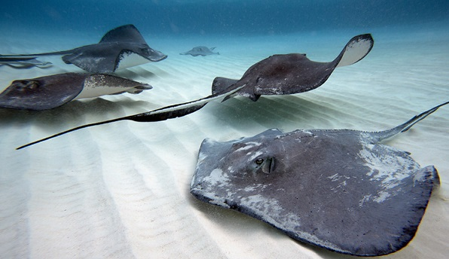
Team
Stingray

Slide 2
Hinka Hineva – hinkah
Lubomir Ganchev – luboganchev
Georgi Yaramov – georgi.yaramov
Diana Pesheva – dpesheva
Roman Peshterski – roman.peshterski
Konstantin Severy – ksevery
Borislava Hinova – arthemida
Team members

Slide 3
Goals
To create a console game
To include several levels
To implement movement controlled by the player
To implement movement controlled by the computer
Make it simple but well done

Slide 4
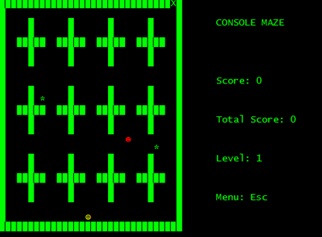
Project: Console Maze
Collect coins and reach the Exit while a bad guy is after you!
You need at least 60 % of all coins at the playground!

Slide 5
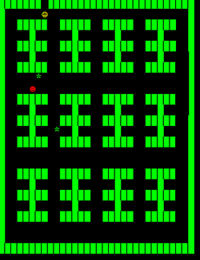
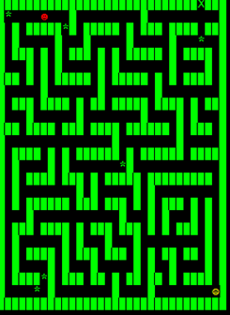
Project: Console Maze
You pass the first level?
There are two more waiting for you!
Level 2
Level 3
and

Slide 6
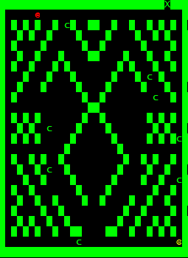
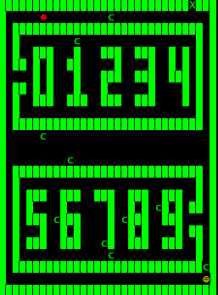
Project: Console Maze
.. and two more
Level 4
Level 5
and

Slide 7
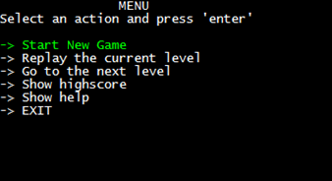
Project: Console Maze
You don’t want to play anymore?
Go to the Menu and use the arrow keys to make your choice!

Slide 8
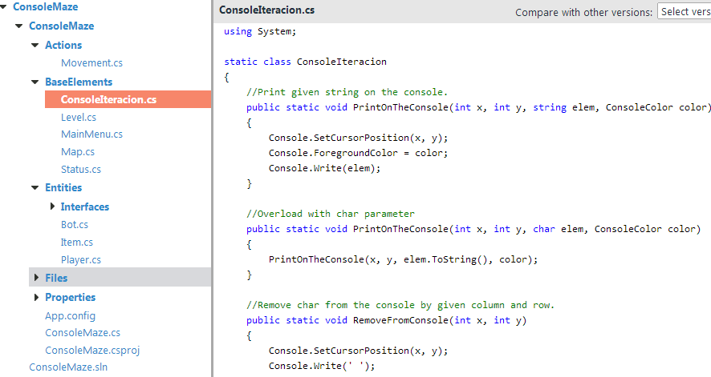
Realization
Class structure
More than 25 methods
Comments in the code
Text files to store maps, help and highscore
~ 75 change sets

Slide 9
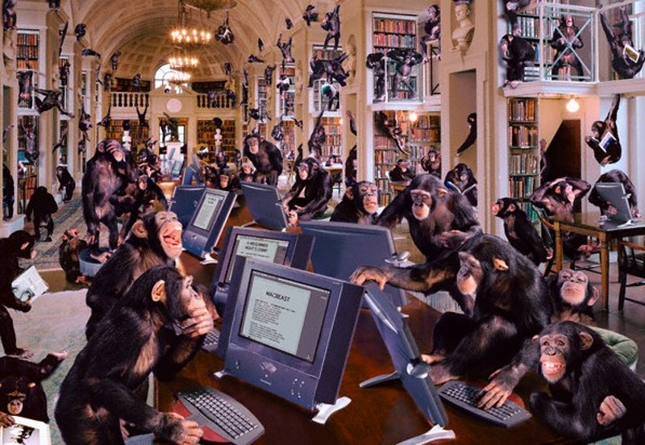
Great contribution
from everybody
We learned a lot from
each other…
and had a lot of fun

Slide 10
Thank you for your attention!

