Slide 1
Top 2000 Spotify songs 2000-2019
Data Challenge FALL SEMESTER 2021/2022, Georgiy Farina & Enkh-Oyu Nomin

Slide 2
Summary
Introduction
Data Source
Cleanup
Preprocessing
Data Visualization
Analysis
Conclusions

Slide 3

Introduction
Top 2000 Spotify songs from 2000 to 2019
Both frequent Spotify users, interested because of that
Expectations:
Pop on top
Hip&Hop and R&B the most spoken and explicit
Duration of songs decreasing over the years

Slide 4
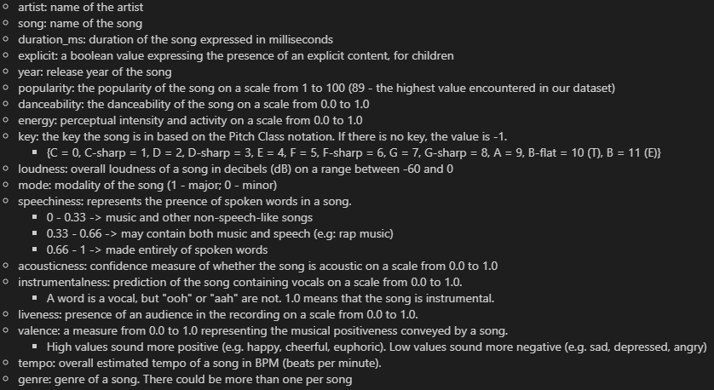
Data Source
Dataset found on Kaggle website
2000 rows, 18 columns
Each row represents a different hit song

Slide 5
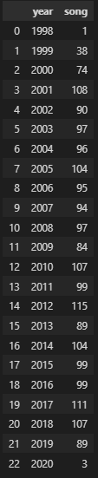
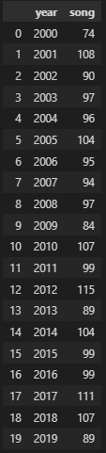
Cleanup
Datatypes checked -> no incoherent datatype w.r.t the column names
Year outliers handling

Slide 6


Preprocessing
Minor mode column changed from 0 & 1 to «minor» and «major»
Duration transformed from miliseconds to minutes

Slide 7
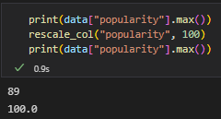


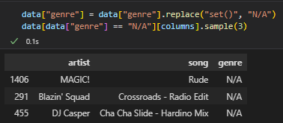

Preprocessing
Rescaled some columns that needed it
set() values in genre column

Slide 8
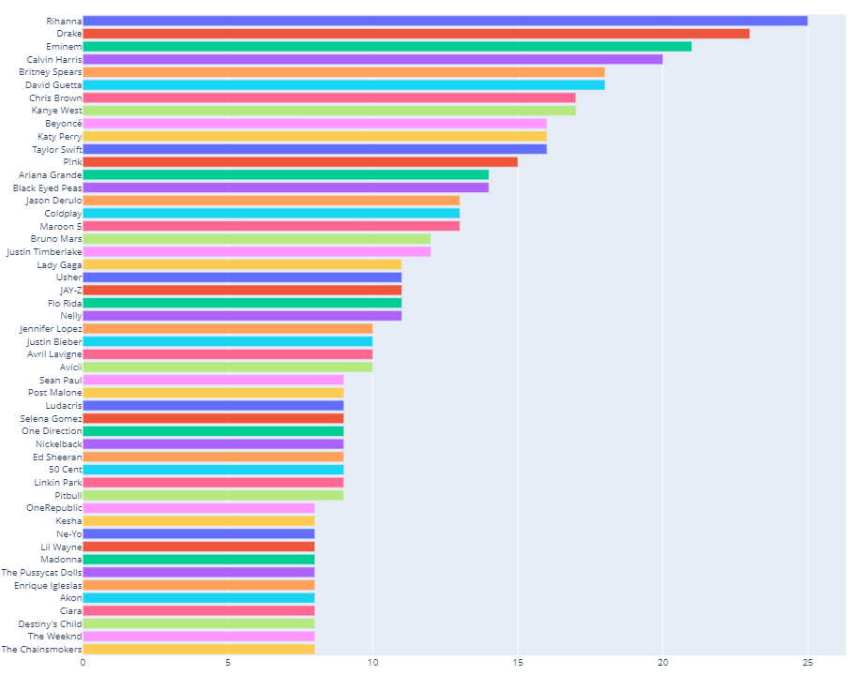

Data visualization: N°of tracks per artist

Slide 9

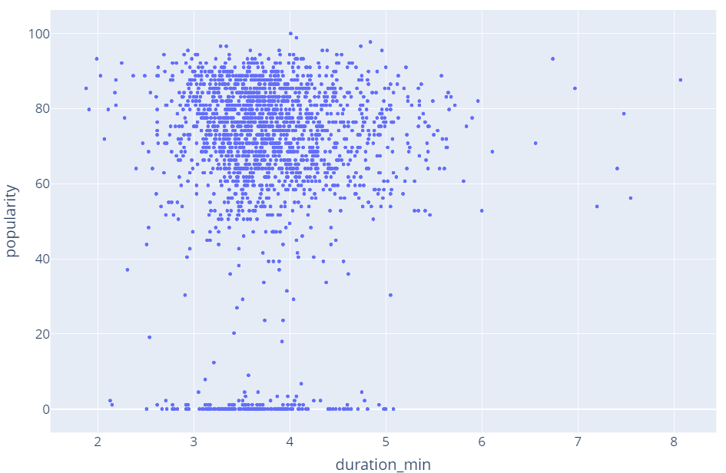
Data visualization: popularity by song durations

Slide 10

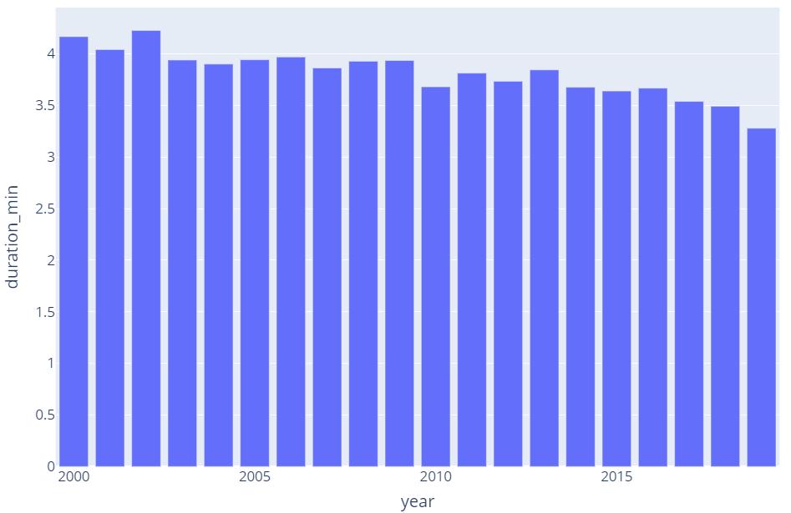
Data visualization: average duration of songs per year

Slide 11
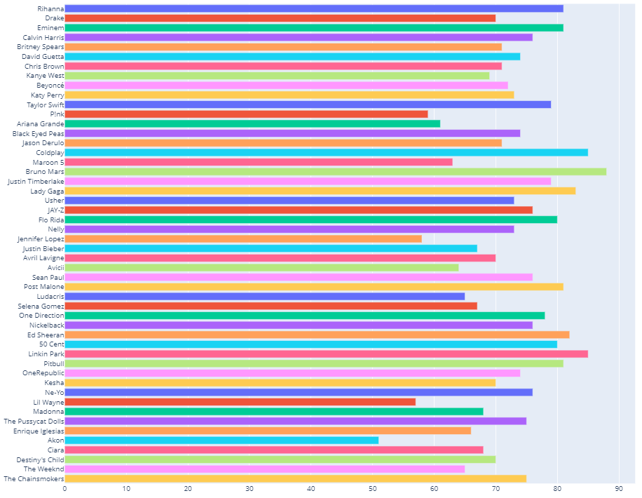
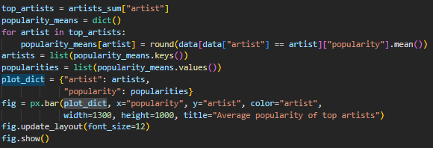
Analysis: average popularity of artists

Slide 12
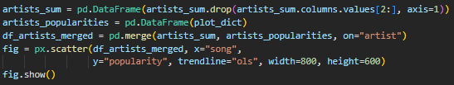
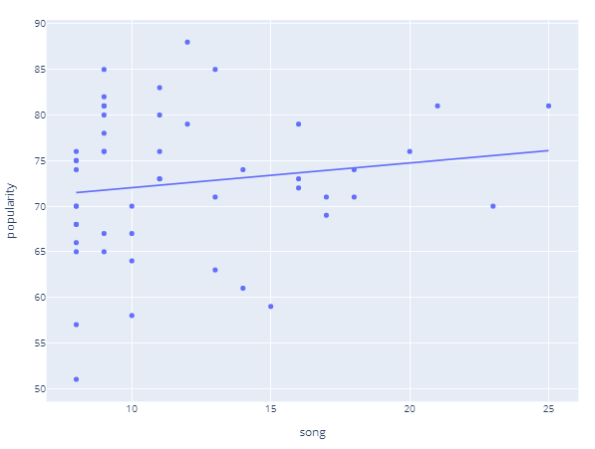
Analysis: Popularity by N°of Songs

Slide 13
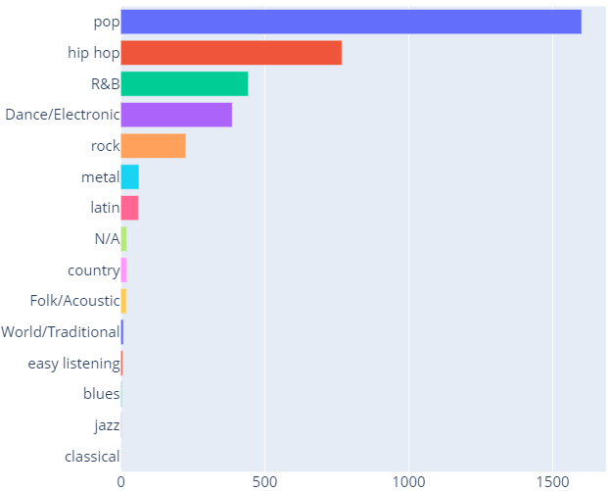
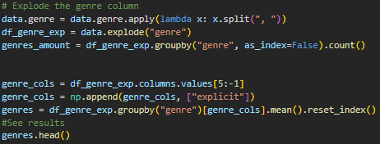

Analysis: top genres

Slide 14

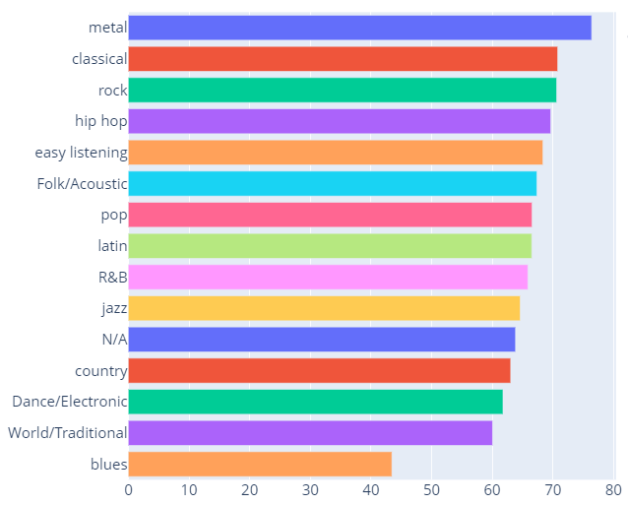
Analysis: top genres

Slide 15
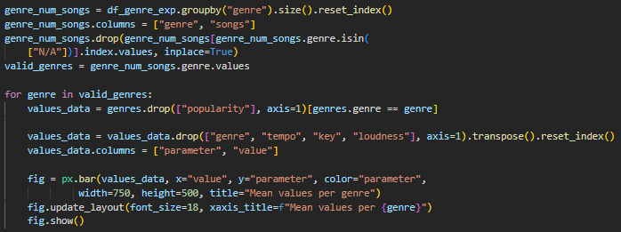
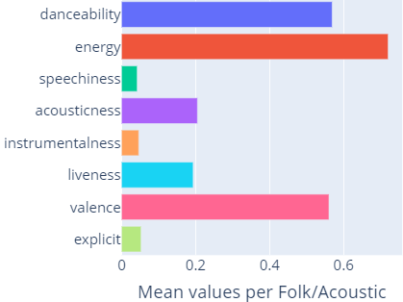
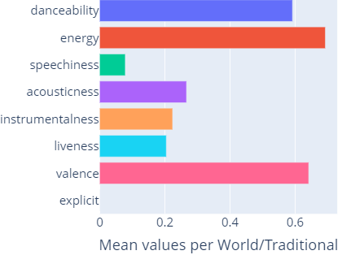
Analysis: mean technical values per genre
Notes:
Until valid_genres = … -> selection of data with valid genres (so without N/A)
then in the loop we drop the columns that we dont want to plot (since there is no meaning in computing those columns means)
First values are like
¨
Param1 param2 param3
Value value value
Then we make it
Param1 value
Param2 value
Param3 value
This way it’s easier to deal with

Slide 16
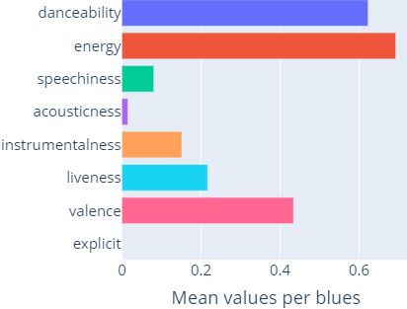
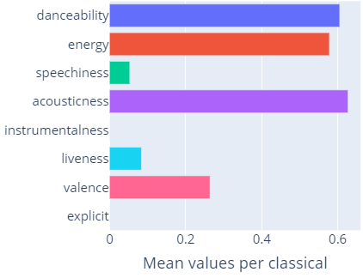
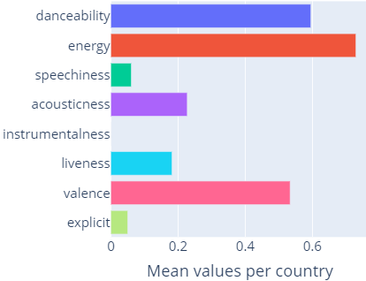
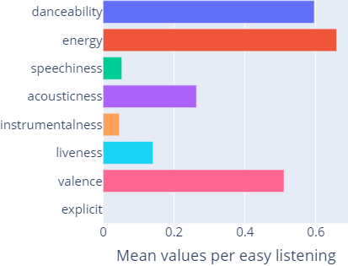
Analysis: mean technical values per genre

Slide 17
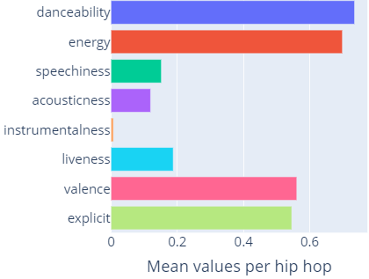
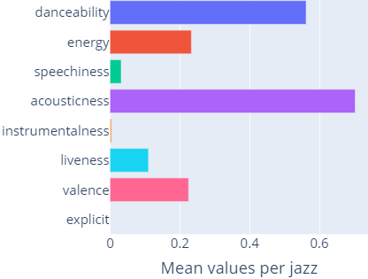
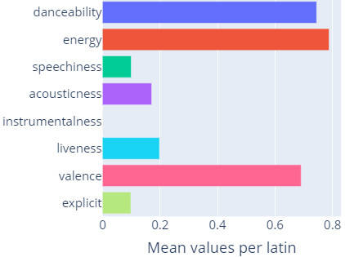
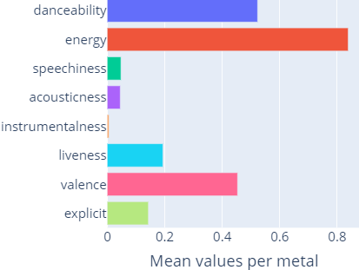
Analysis: mean technical values per genre

Slide 18
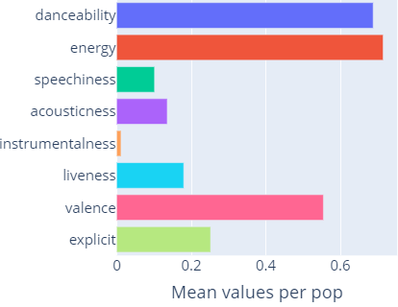
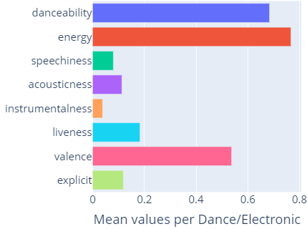
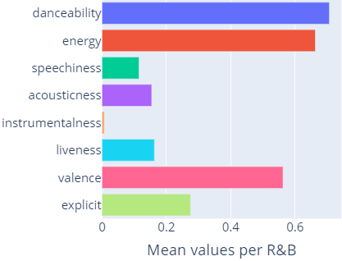
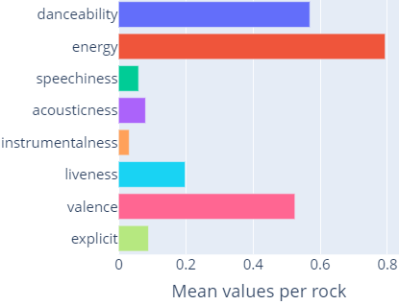
Analysis: mean technical values per genre

Slide 19
Conclusions
Top genres are:
Pop
Hip hop
R&B
Hip hop and R&B - most spoken and explicit genres
Blues and Jazz most instrumental ones
The duration of songs are decreasing
The duration of the most popular songs vary between 2 and 5 minutes
Number of songs is not strictly defined by the average of the popularity

Slide 20
THE END
THANK YOU FOR YOUR ATTENTION!
QUESTIONS ARE WELCOME ☺

