Slide 1
Elixir, Java and What WenТ Wrong with OOP
Georgi Yolovski

Slide 2

About Me
Software Consultant @ Accedia since 2013
Experience with Java, C#, Python, NodeJS and more
Enjoys playing with new languages and frameworks

Slide 3
What is OOP?
A programming paradigm
Based on the concept of objects
Map real-world objects and processes to digital counterparts
Use classes to define objects
… according to Wikipedia

Slide 4
The Original concept of OOP
The term is coined by Alan Kay (a biologist) in the 1960s
Simulating the cells in living organisms
Internal state (data)
Decoupled from each other
Communicate through messages
Proved to be quite useful
Internet
Microservices
…

Slide 5
Where are the classes?
“If I could do Java over again, I would leave out classes.” – James Gosling
“OOP to me means only messaging, local retention and protection and hiding of state-process, and extreme late-binding of all things.” – Alan Kay
It’s about encapsulation and message passing
Not about classes

Slide 6
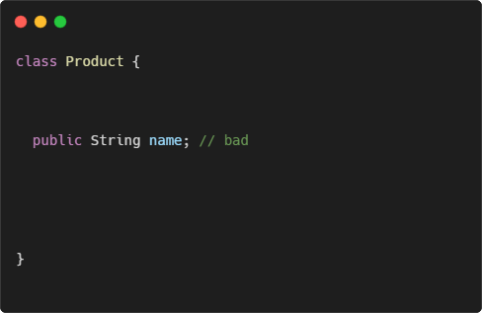
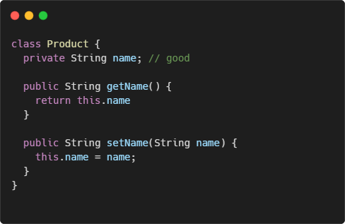
Let’s talk about encapsulation
What’s the difference?

Slide 7
What is encapsulation then?
Avoiding shared mutable state
Reduce side effects
Less bugs
Forget about getters and setters
Records in Java (since JDK 14) are a step in the right direction

Slide 8
True OOP examples
Elixir?

Slide 9

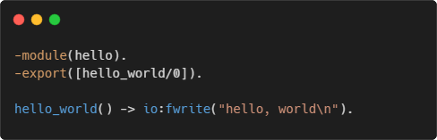
It all started with erlang
Developed in the 1980s by Ericsson
Runs on BEAM virtual machine
Suitable for telecoms
Distributed
Fault-tolerant
High-availability
Used by WhatsApp, RabbitMQ, Motorola

Slide 10

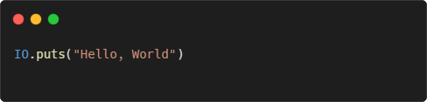
Enter elixir
Created in 2012 by Jose Valim
Runs on BEAM
Used by Discord, Pinterest, Spotify
Main features
Immutable data structures
Functional paradigm
Pattern matching
REPL and documentation as first-class citizen

Slide 11
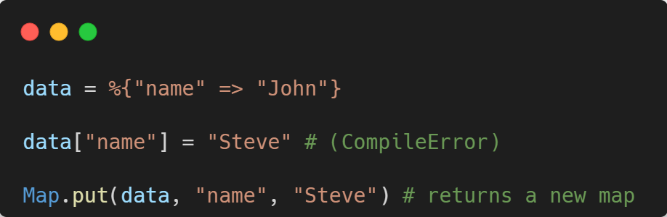
The real encapsulation
In Elixir everything is immutable
A better way to achieve encapsulation

Slide 12
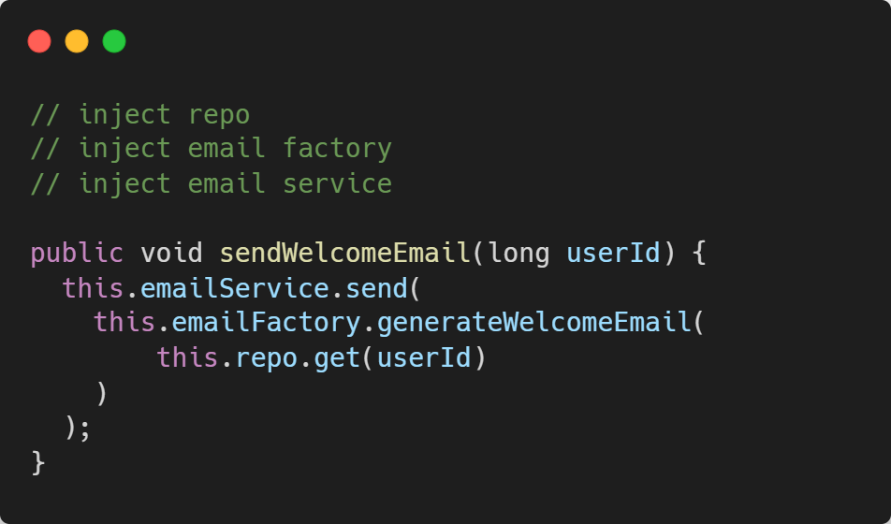
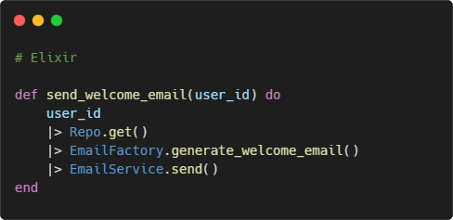
Functional programming
Focus on actions and business logic, not on objects and instances

Slide 13
Pattern matching
Popular in functional languages
Test whether the object matches a given expression
Cleaner control flow statements

Slide 14

Demo

Slide 15
REPL and doctests
Elixir has a built-in REPL (Read–eval–print loop)
Execute simple expressions
Start as part of the app
Attach to a running app
Doctests
Mix between unit tests and documentation
Keeps the documentation up to date

Slide 16
Demo

Slide 17
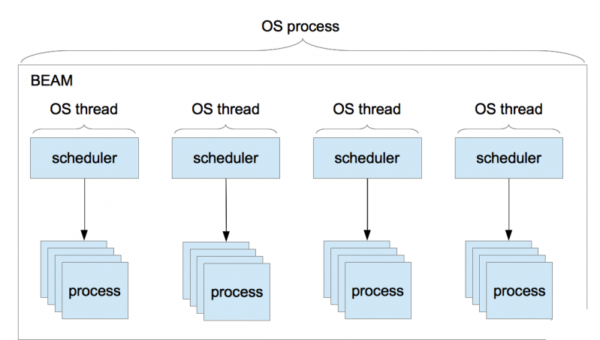
BEAM concurrency model
BEAM VM has its own scheduler
Runs lightweight processes
No shared state
Communication via message passing
… sounds familiar?

Slide 18
Concurrency model benefits
Better performance (no locks)
Fault tolerance
Easier to distribute
Built-in load balancing
Hot deployment
Scalability – up to ~268M running processes
Virtual Threads in Java 19 – a step in the right direction

Slide 19
Demo

Slide 20
Why chose Elixir?
Code clarity
Less bugs
Development experience
Performance

Slide 21
Q & A

Slide 22
Contacts
Personal
Mail: georgi.yolovski@accedia.com
FB: fb.com/georgi.yolovski
LinkedIn: linkedin.com/in/georgi-yolovski
Accedia
Join us: accedia.com/careers
Start your career: accedia.com/grow

Slide 23
Thank you

