Slide 1
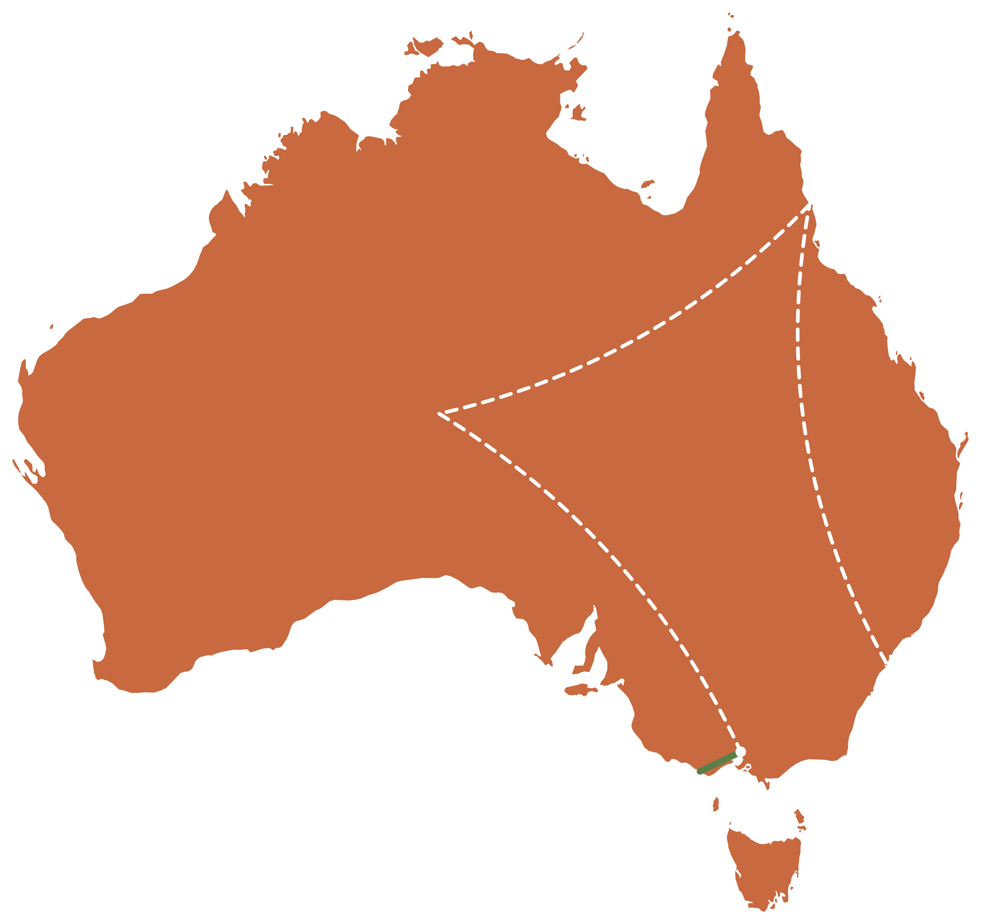
My Dream Trip
Around Australia
ENGLISH PRESENTATION · UNIT 1
2
3
3 weeks · 4 places · 1 big adventure
1
by Name & Name
4
Notes:
SPEAKER 1 · about 0:15
KEYWORDS: hello · [Name] and I · dream trip · 16,500 km from Germany · seatbelts
SCRIPT:
Hello everyone! Today [Name] and I are taking you on our dream trip around Australia. Australia is about 16,500 kilometres away from Germany – so fasten your seatbelts!
(Write your two names on this slide: "by Name & Name".)

Slide 2
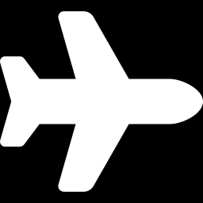

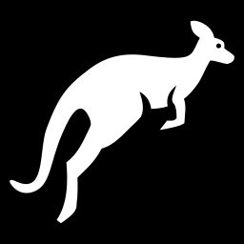
Our Plan
If we had three weeks of holidays, we would travel all around Australia.
21
4
days of travelling
amazing places
If we went in September, it would be warm in the north and mild in the south.
16,500
Sept.
If we saw a kangaroo, we would take a selfie with it!
km away from Germany
spring in Australia!
Conditional type 2: if + simple past → would + infinitive
Notes:
SPEAKER 1 · about 0:25
KEYWORDS: plan · three weeks → travel all around · September → warm north, mild south · kangaroo → selfie
SCRIPT:
Let's start with our plan. If we had three weeks of holidays, we would travel all around Australia. If we went in September, it would be warm in the north and mild in the south – because in September it is spring there! And if we saw a kangaroo, we would take a selfie with it, of course!
(Grammar: three conditional sentences type 2 – "If + simple past, would + infinitive".)

Slide 3
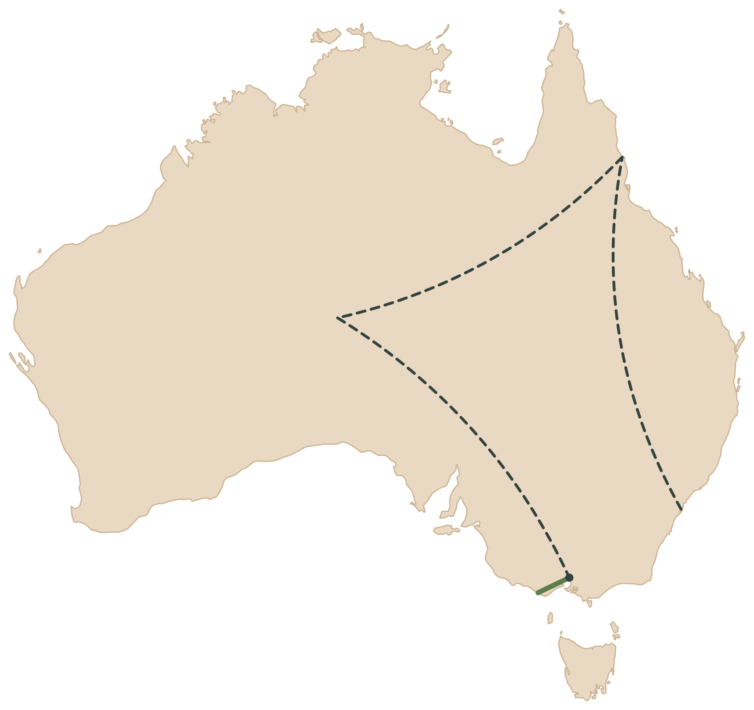
Our Route – 21 Days
1
Days 1–5 · Sydney
land after about 22 hours on the plane
Great Barrier Reef
2
2
Days 6–10 · Great Barrier Reef
fly to Cairns and go snorkelling
3
3
Days 11–14 · Uluru
Uluru
fly into the outback
Sydney
1
4
Days 15–20 · Great Ocean Road
fly to Melbourne, rent a camper van
4
Melbourne
Great Ocean Road
Day 21 · Home
fly back to Germany from Melbourne
plane
camper van
Notes:
SPEAKER 1 · about 0:25
KEYWORDS: route · 4 places · Sydney → reef → Uluru (outback) → Great Ocean Road · dotted = plane, green = camper van · day 21 home
SCRIPT:
Here you can see our route. We would visit four places: Sydney, the Great Barrier Reef, Uluru in the outback and the Great Ocean Road. The dotted lines are flights, and the green line is our trip by camper van. After 21 days we would fly home from Melbourne.

Slide 4
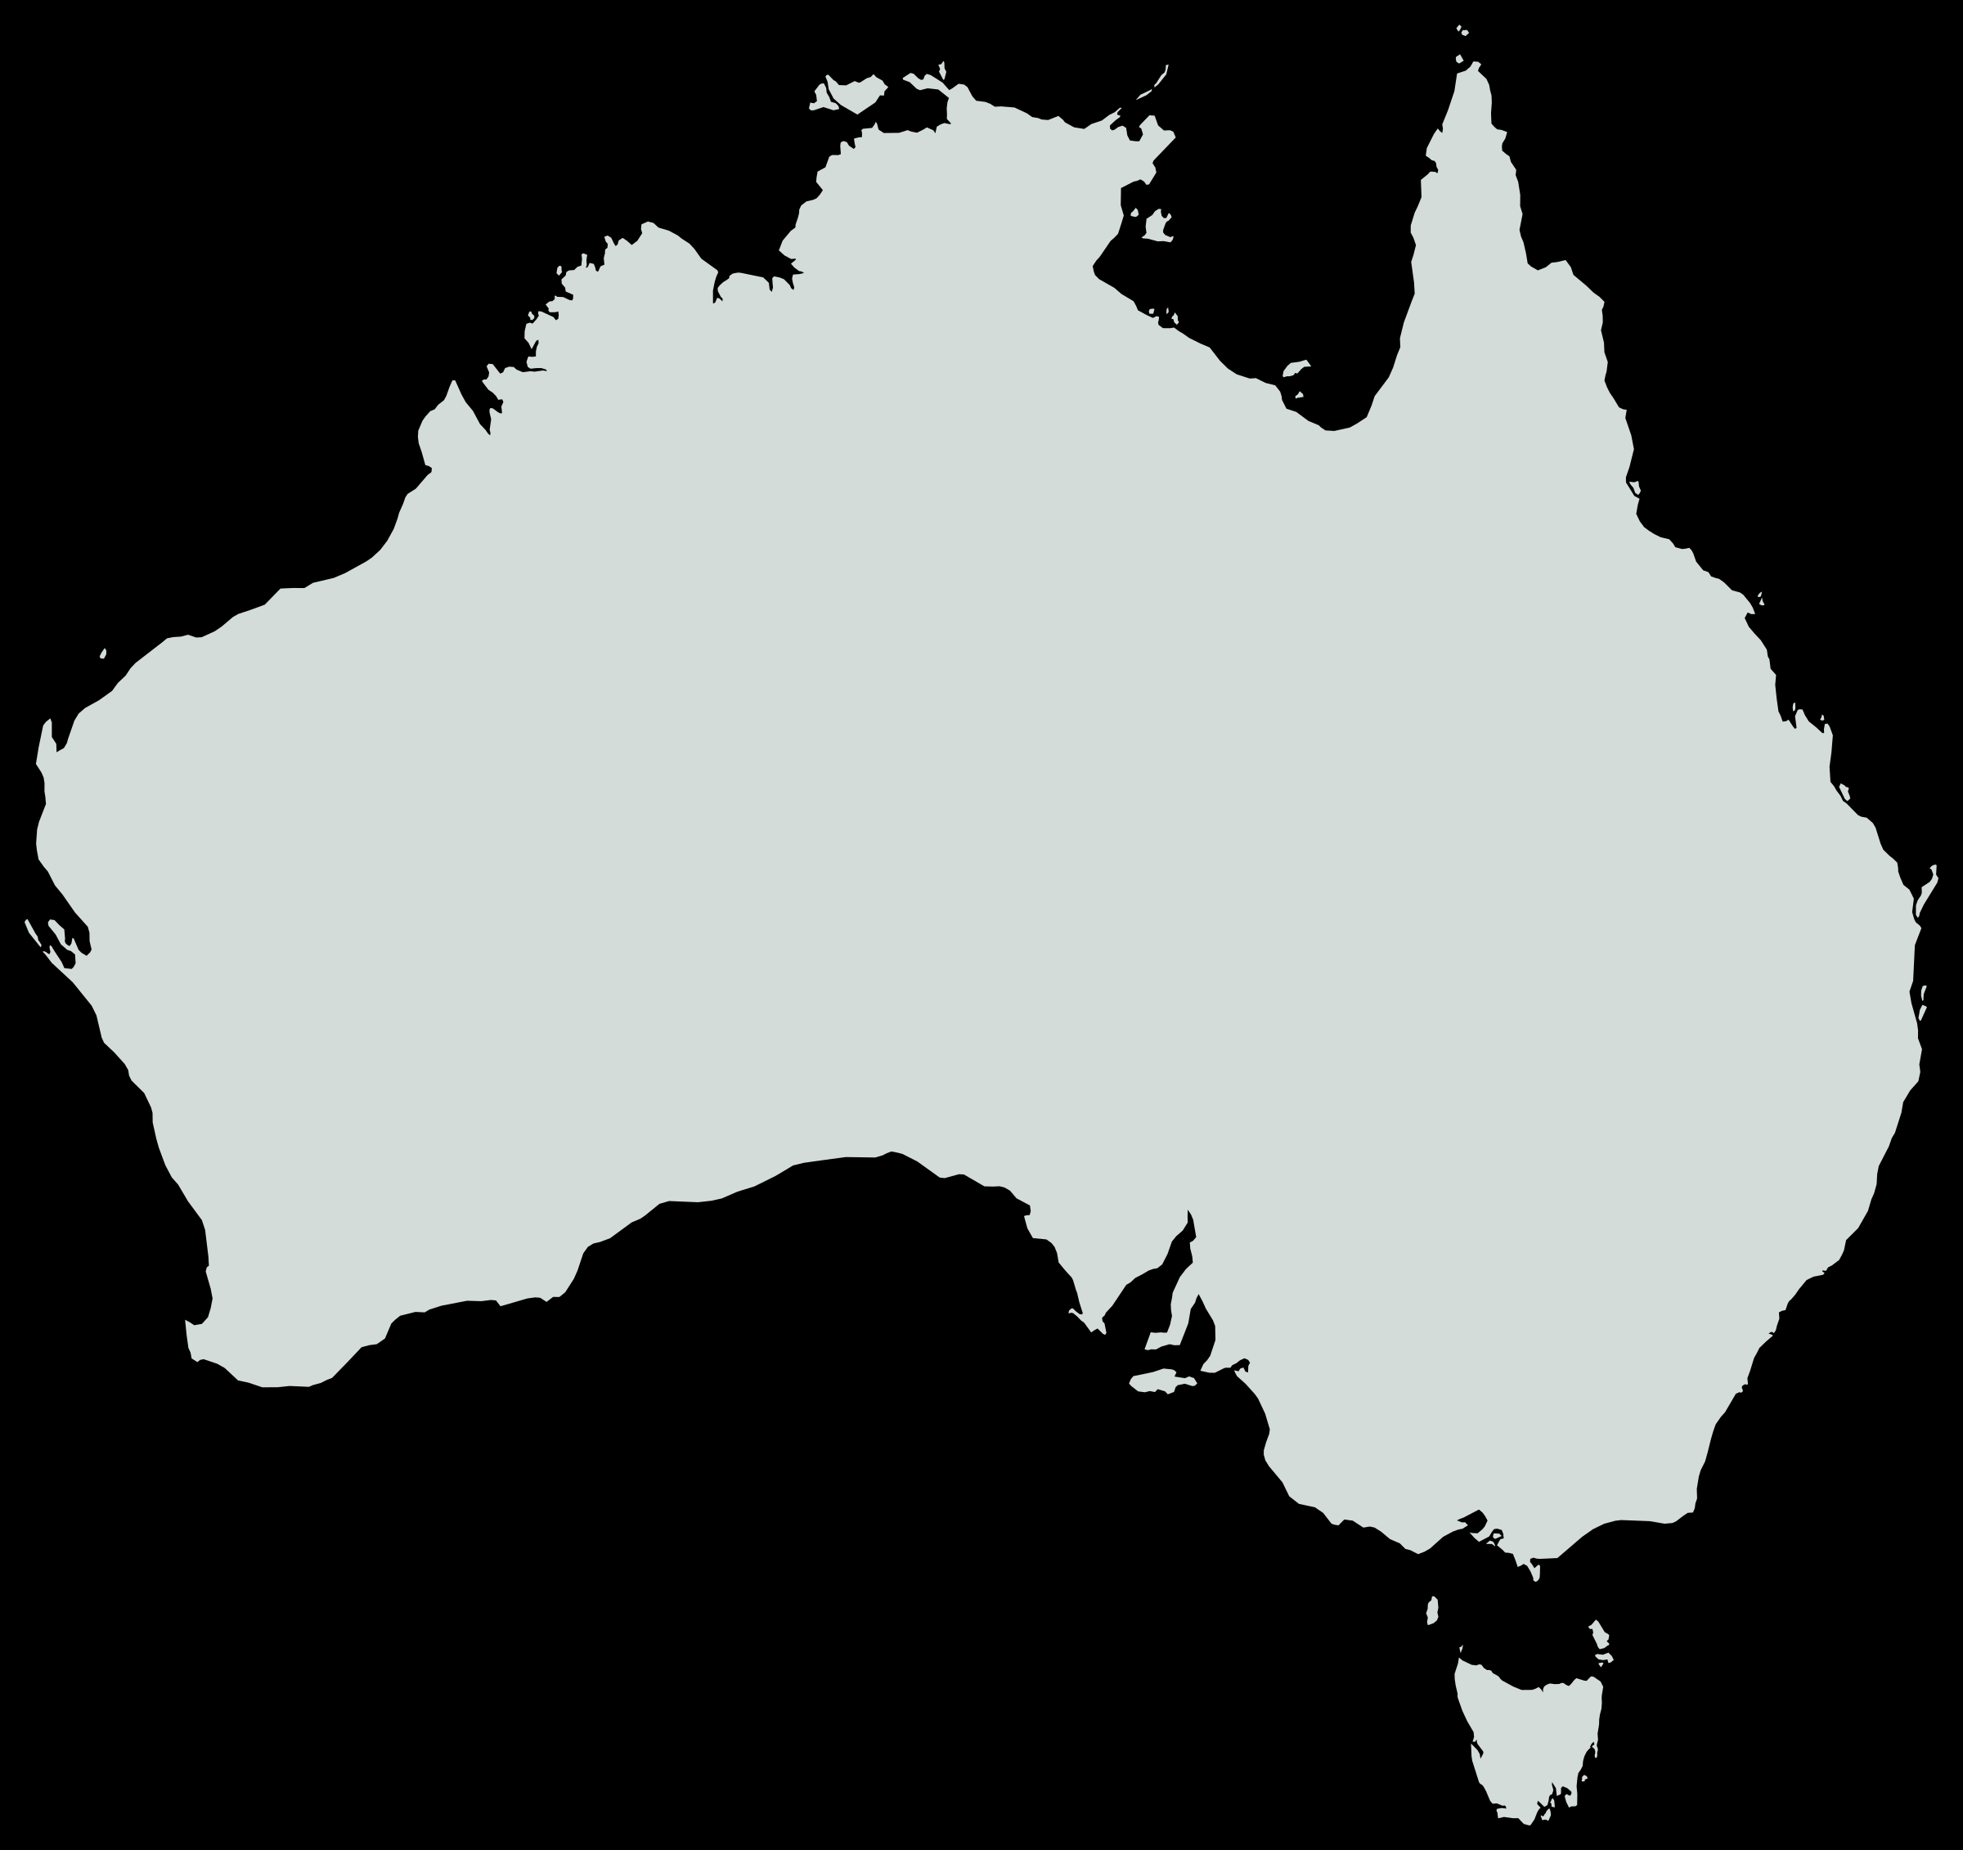
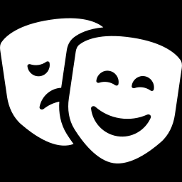
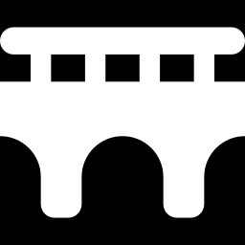

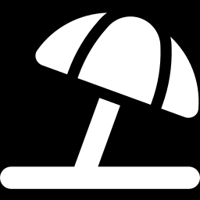
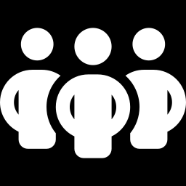
Sydney
1
STOP 1 OF 4 · DAYS 1–5
The harbour city
Opera House
opened in 1973 – a UNESCO World Heritage Site
Harbour Bridge
called “the Coathanger” – you can climb it!
Bondi Beach
Insert photo here
surfing and a famous walk along the coast
About 5.5 million people
the biggest city – but the capital is Canberra
Sydney Opera House & Harbour Bridge
Notes:
SPEAKER 1 · about 0:30
KEYWORDS: biggest city · 5.5 million · capital = Canberra · Opera House 1973, UNESCO · Harbour Bridge "Coathanger", climb · Bondi Beach
SCRIPT:
Our first stop is Sydney, the biggest city in Australia, with about five and a half million people. But it isn't the capital – that's Canberra! The Opera House opened in 1973 and is a UNESCO World Heritage Site. Next to it is the Harbour Bridge. People call it "the Coathanger", and you can even climb it. After that we would relax at Bondi Beach.
(Photo idea: Sydney Opera House with the Harbour Bridge.)

Slide 5

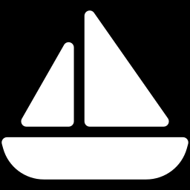
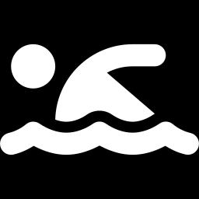
Great Barrier Reef
2
STOP 2 OF 4 · DAYS 6–10
The biggest coral reef in the world
2,300 km
≈ 3,000
1,500+
long
single reefs
kinds of fish
HISTORY
In 1770, Captain James Cook was sailing along the coast when his ship hit the reef.
Insert photo here
We would go snorkelling from Cairns – with a guide.
Coral and fish at the Great Barrier Reef
Notes:
SPEAKER 1 · about 0:35
KEYWORDS: fly to Cairns · biggest coral reef · 2,300 km · 3,000 reefs · 1,500+ kinds of fish · 1770 Captain Cook WAS SAILING … hit the reef · snorkelling with a guide · hand over to [Name]
SCRIPT:
Next we would fly to Cairns to see the Great Barrier Reef. It is the biggest coral reef in the world: about 2,300 kilometres long, with around 3,000 single reefs and more than 1,500 kinds of fish. A bit of history: in 1770, Captain James Cook was sailing along the coast when his ship hit the reef. We would go snorkelling there – with a guide, of course. And now [Name] takes you to the red centre of Australia.
(Grammar: past progressive – "was sailing".)

Slide 6

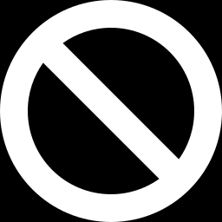
Uluru
3
STOP 3 OF 4 · DAYS 11–14
The red heart of the outback
348 m
9.4 km
high
around the rock
Uluru is sacred to the Anangu, the Aboriginal owners of the land. No climbing since 2019!
Insert photo here
At sunset the rock changes its colour:
Uluru at sunset
Notes:
SPEAKER 2 · about 0:35
KEYWORDS: thank you · middle of Australia, outback · huge rock · 348 m high · 9.4 km around · sacred to the Anangu (Aboriginal people) · no climbing since 2019 · sunset colours
SCRIPT:
Thank you, [Name]! Our third stop is Uluru, right in the middle of Australia, in the outback. Uluru is a huge rock: it is 348 metres high and 9.4 kilometres around. It is sacred to the Anangu, the Aboriginal owners of the land. That's why climbing Uluru has been banned since 2019. The best moment is the sunset, when the rock changes its colour from orange to deep red. If we were there, we would watch it every evening.
(Grammar: one more conditional type 2 – "If we were there, we would watch …")

Slide 7

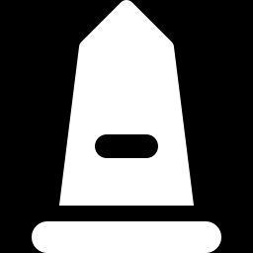
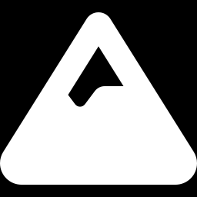
Great Ocean Road
4
STOP 4 OF 4 · DAYS 15–20
243 km along the coast – by camper van
km 0
km 243
Torquay
Kennett River
Twelve Apostles
surf beaches
wild koalas
rocks in the sea
A war memorial
Twelve Apostles?
Insert photo here
Soldiers built the road after World War I (1919–1932).
There were never 12 rocks – today only 7 are left!
The Twelve Apostles
Notes:
SPEAKER 2 · about 0:35
KEYWORDS: fly to Melbourne · camper van · 243 km along the coast · built by soldiers after World War I → biggest war memorial · Kennett River: wild koalas · Twelve Apostles: never 12, only 7 left
SCRIPT:
For our last stop, we would fly to Melbourne and rent a camper van. The Great Ocean Road is 243 kilometres long and goes right along the coast. Soldiers built it after World War One, so it is also the biggest war memorial in the world. At Kennett River you can see wild koalas in the trees. And then there are the Twelve Apostles – huge rocks in the sea. Funny fact: there were never twelve, and today there are only seven!
(Photo idea: the Twelve Apostles.)

Slide 8
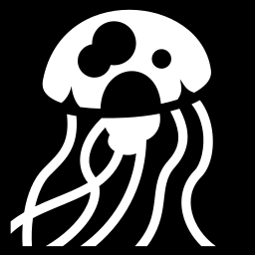
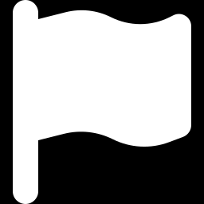
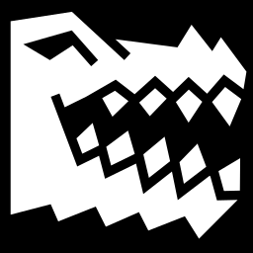
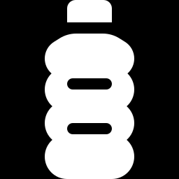
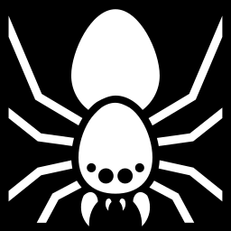

Survival Tips
Slip, slop, slap!
Box jellyfish
shirt, sunscreen and a hat
wear a stinger suit in the tropical north
Stay safe in Australia!
Red and yellow flags
Crocodiles
swim between them – lifeguards watch you
never swim where you see warning signs
In the outback
Snakes & spiders
always carry lots of water
wear closed shoes and shake them out
Emergency? Call 000 (triple zero)
Notes:
SPEAKER 2 · about 0:35
KEYWORDS: beautiful but careful · sun: slip, slop, slap · beach: red and yellow flags · north: box jellyfish, crocodiles · outback: water · spiders: shoes · emergency 000
SCRIPT:
Australia is beautiful, but you have to be careful. Here are our survival tips. The sun is very strong, so remember "Slip, slop, slap": slip on a shirt, slop on sunscreen and slap on a hat. At the beach, always swim between the red and yellow flags. In the north, watch out for box jellyfish, and never swim where you see crocodile signs. In the outback, always carry lots of water. And shake out your shoes because of spiders! In an emergency, call triple zero.

Slide 9
Thanks for listening!
2
If we could go tomorrow, we would pack our bags right now!
3
Do you have any questions?
1 Sydney
2 Great Barrier Reef
1
3 Uluru
4 Great Ocean Road
4
Notes:
SPEAKER 2 · about 0:10
KEYWORDS: dream trip · could go tomorrow → would pack bags · thank you · questions?
SCRIPT:
That was our dream trip around Australia. If we could go tomorrow, we would pack our bags right now! Thank you for listening. Do you have any questions?

Slide 10
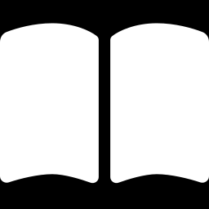
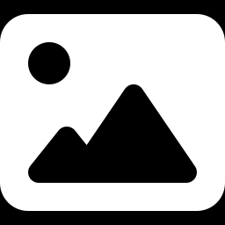
Sources
Facts & information
Photos, map & icons
Tourism Australia – australia.com
Sydney Opera House – sydneyoperahouse.com
UNESCO World Heritage Centre – whc.unesco.org
Great Barrier Reef Marine Park Authority – gbrmpa.gov.au
Parks Australia – Uluru-Kata Tjuta National Park – parksaustralia.gov.au/uluru
Parks Victoria – Twelve Apostles – parks.vic.gov.au
Cancer Council – SunSmart (“Slip, Slop, Slap”) – sunsmart.com.au
Surf Life Saving Australia – Beachsafe – beachsafe.org.au
Australian Bureau of Statistics – abs.gov.au
Photos: add the website and photographer of each photo here
Map: Natural Earth data (public domain)
Icons: Font Awesome (CC BY 4.0) and game-icons.net (CC BY 3.0)
All websites were visited in October 2026.
Notes:
SPEAKER 2 · not spoken (or: "Here are our sources.")
Before presenting: add the source of every photo you inserted (website + photographer).

