Slide 1
Measuring Malaria in Complex Transmission Systems
A Time-at-Risk Based Approach
Alec Georgoff
MMC Meeting, Bangkok, Thailand
November 30, 2018

Slide 2
Introduction

Slide 3
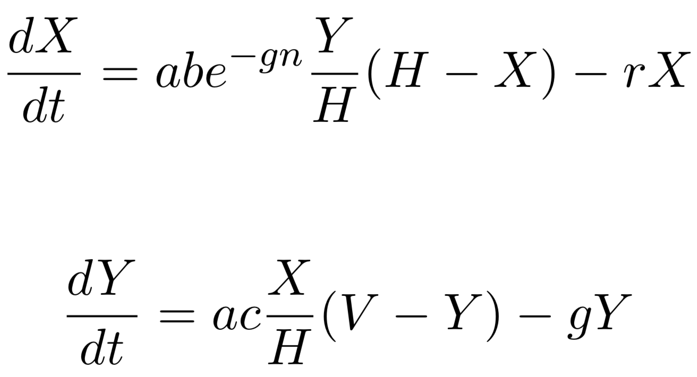
Ross-Macdonald Equations
Infected Humans
Infected Mosquitoes

Slide 4
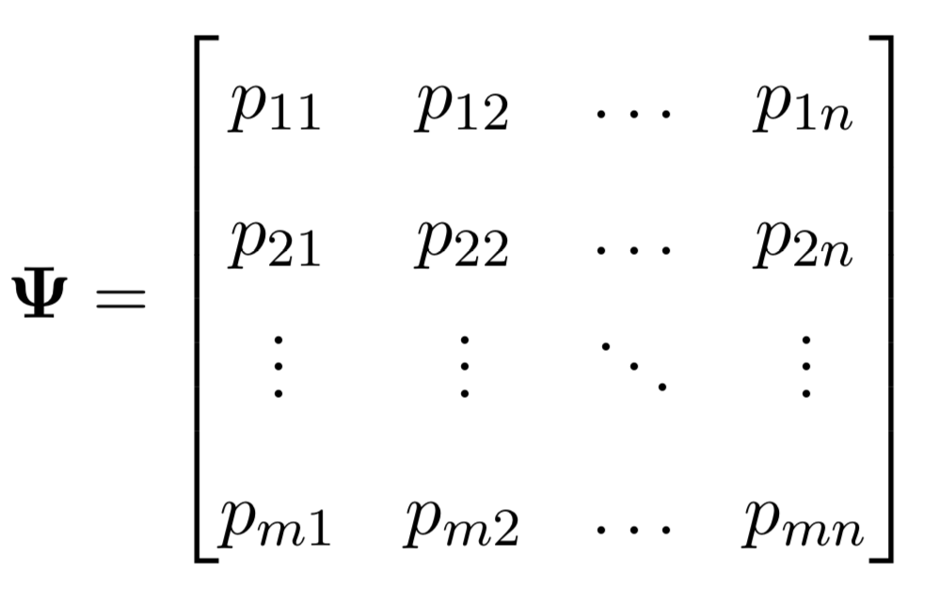
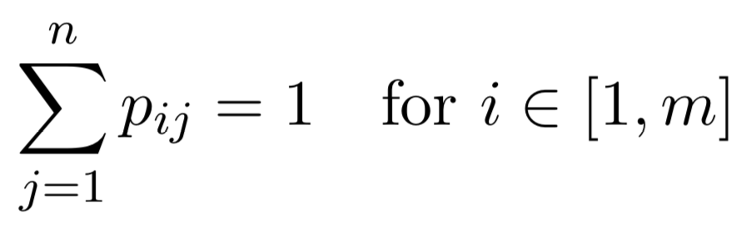
Time-at-Risk (TaR)

Slide 5
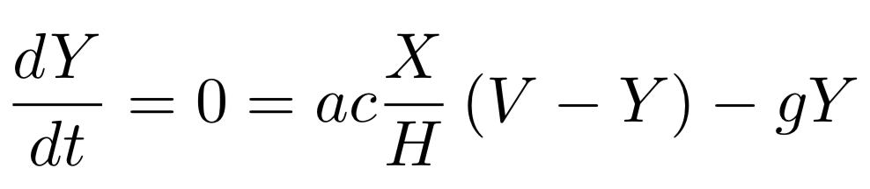
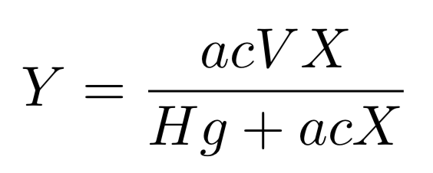
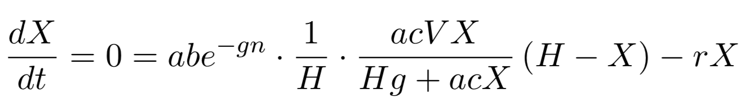
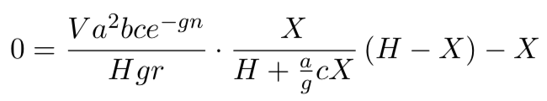
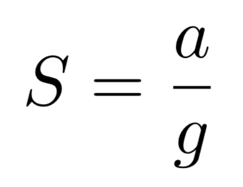
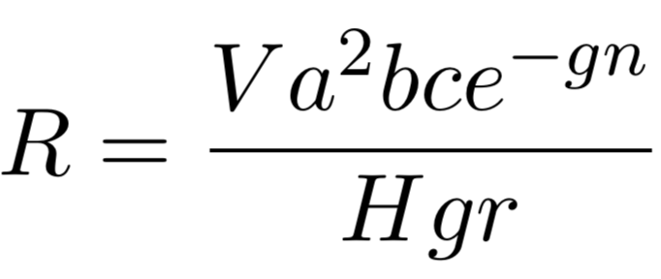
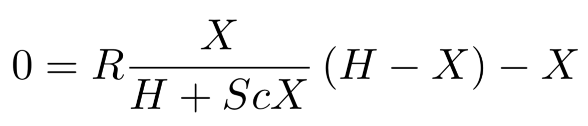
Equilibrium Assumptions

Slide 6
Equilibrium Assumptions

Slide 7
Equilibrium Assumptions

Slide 8
Equilibrium Assumptions

