Slide 1
Measuring Malaria in Complex Transmission Systems
A Time-at-Risk Based Approach
Alec Georgoff
MMC Meeting, Bangkok, Thailand
November 30, 2018

Slide 2
Introduction

Slide 3
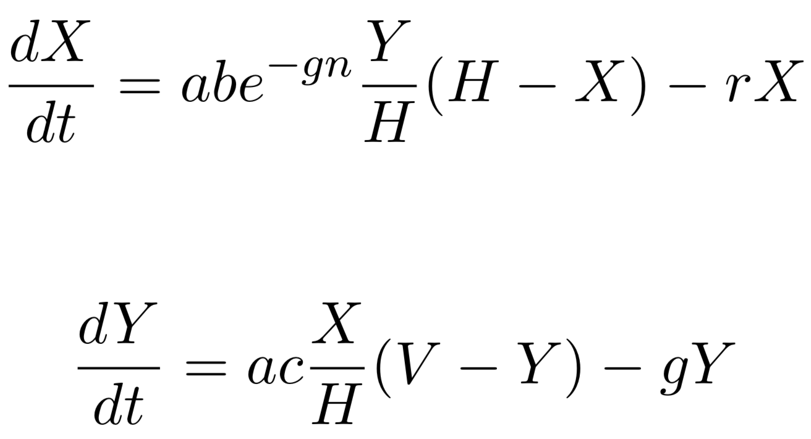
Ross-Macdonald Equations
Infected Humans
Infected Mosquitoes

Slide 4
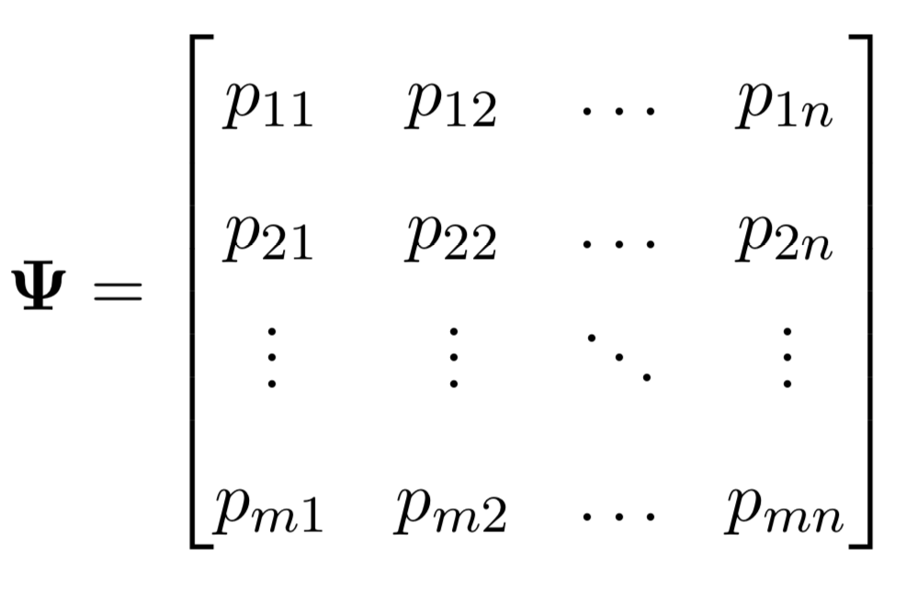

Time-at-Risk (TaR)

Slide 5

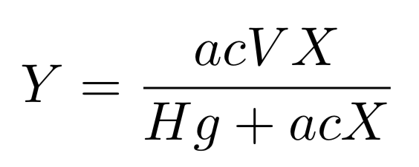


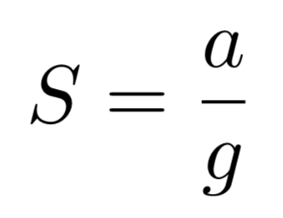
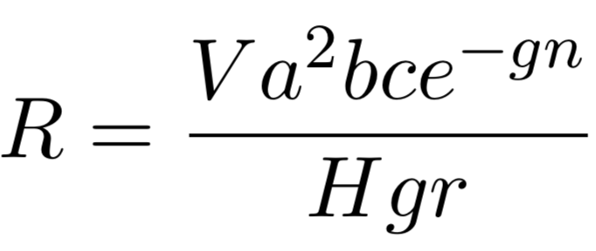

Equilibrium Assumptions

Slide 6
Equilibrium Assumptions

Slide 7
Equilibrium Assumptions

Slide 8
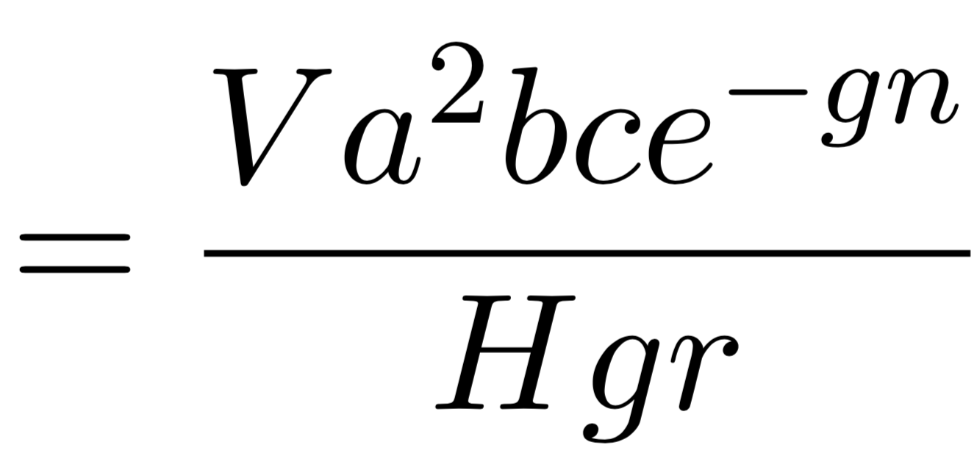

Reproductive Rate

Slide 9

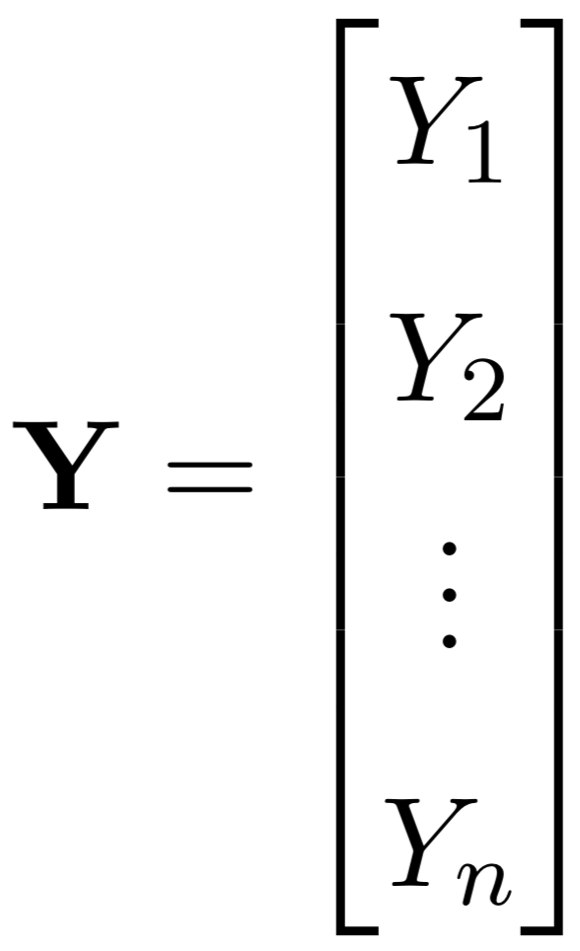
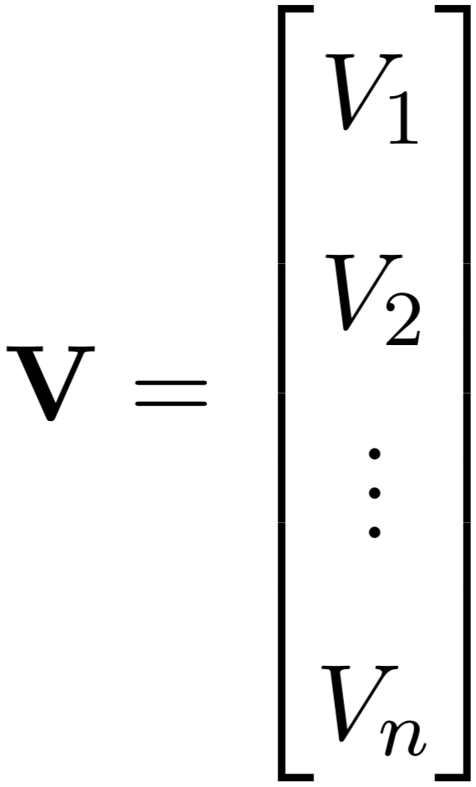
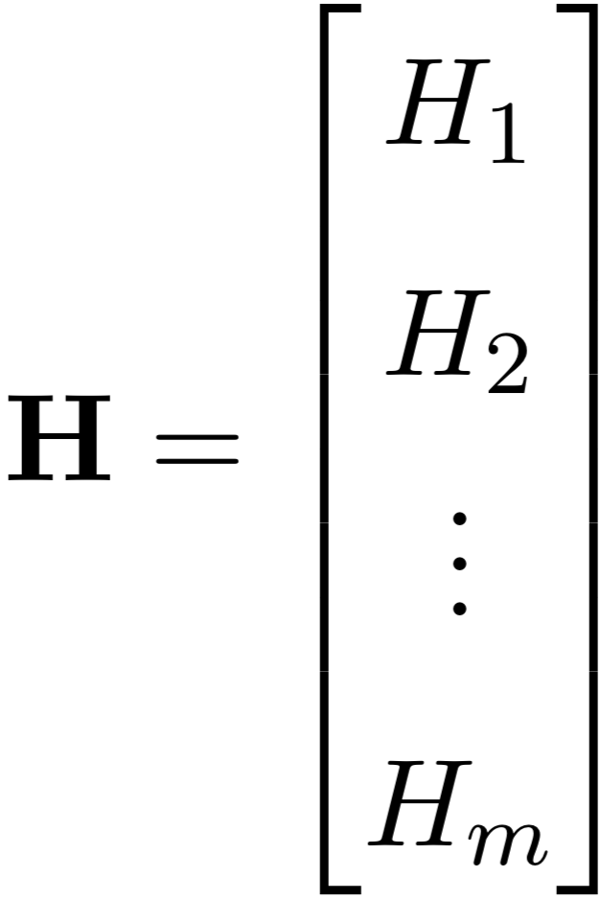
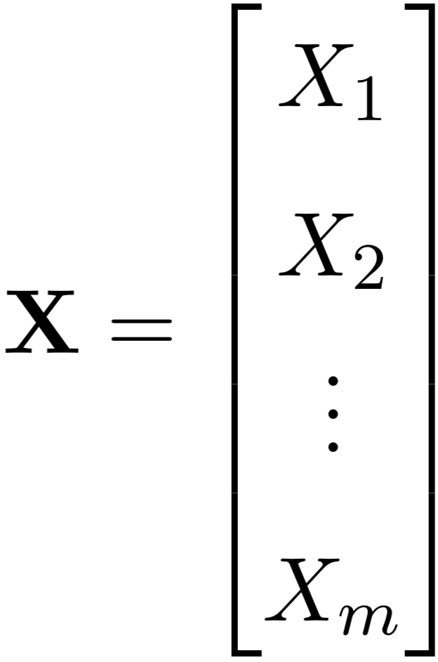
Vectors of Variables

Slide 10


Scaling by Time-at-Risk

Slide 11
Ross-Macdonald Equations

Slide 12


Ross-Macdonald Equations

Slide 13

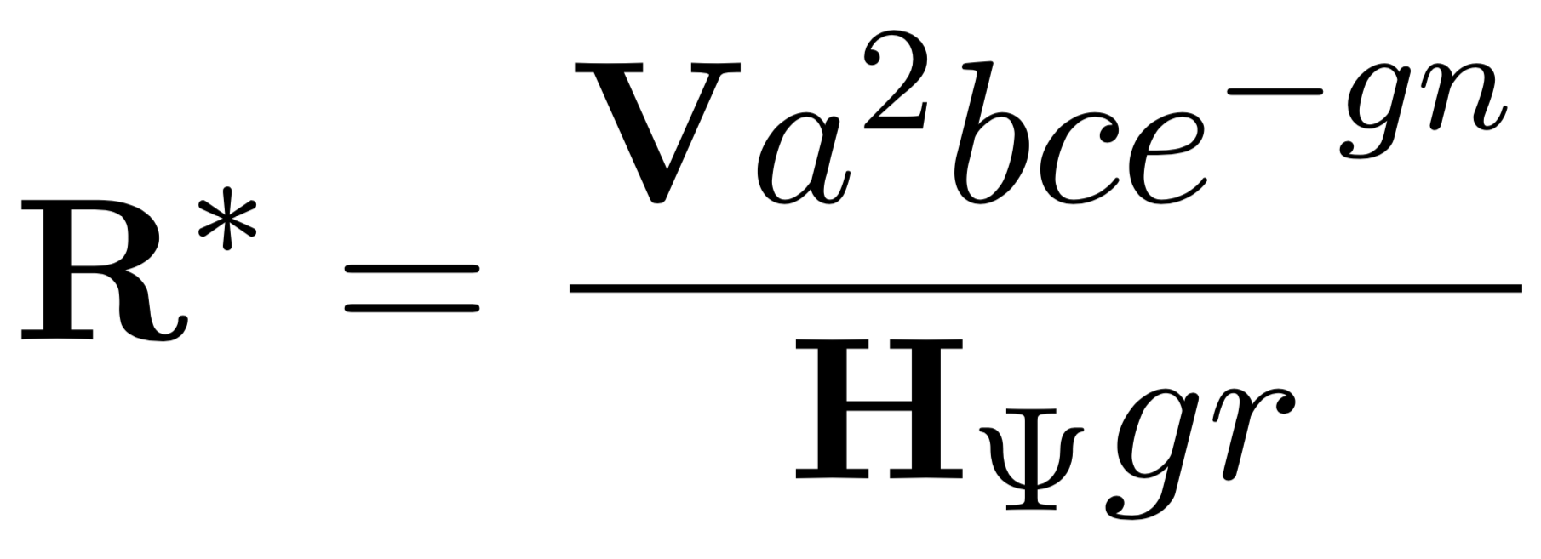
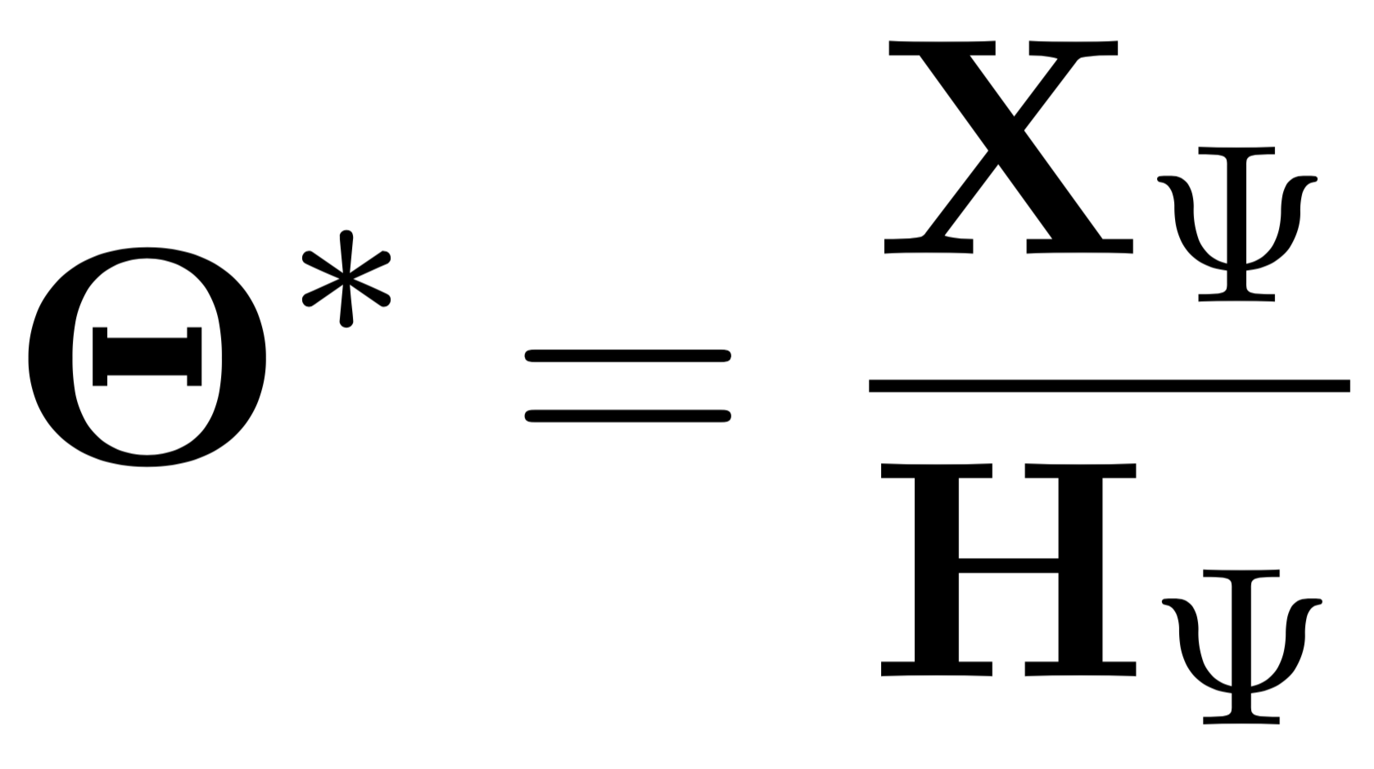
Equilibrium Assumptions

Slide 14
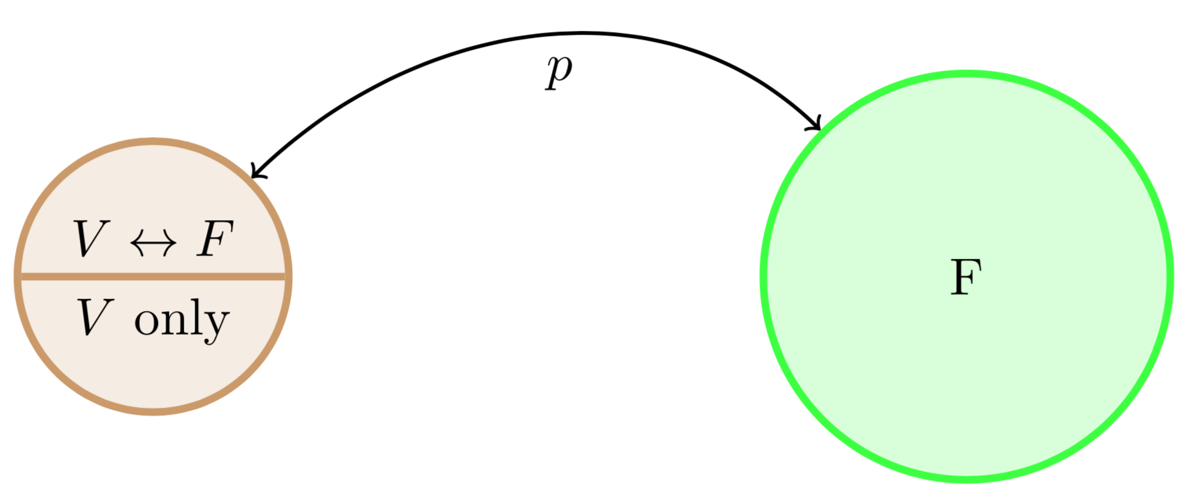
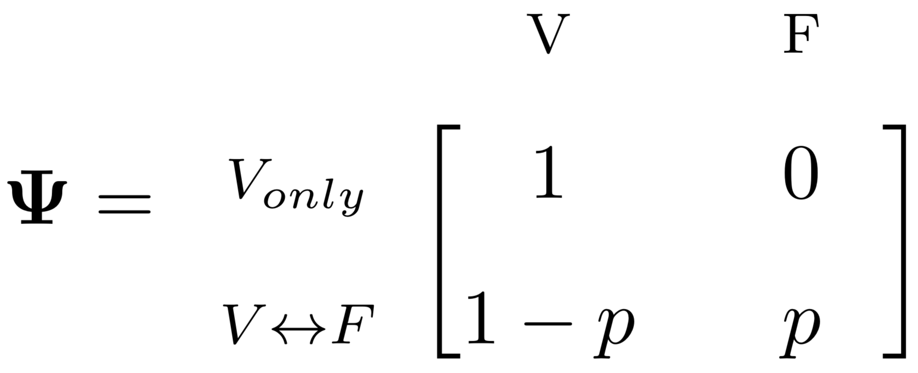
Simple Example: One Village, One Forest

Slide 15

Simple Example: One Village, One Forest

Slide 16
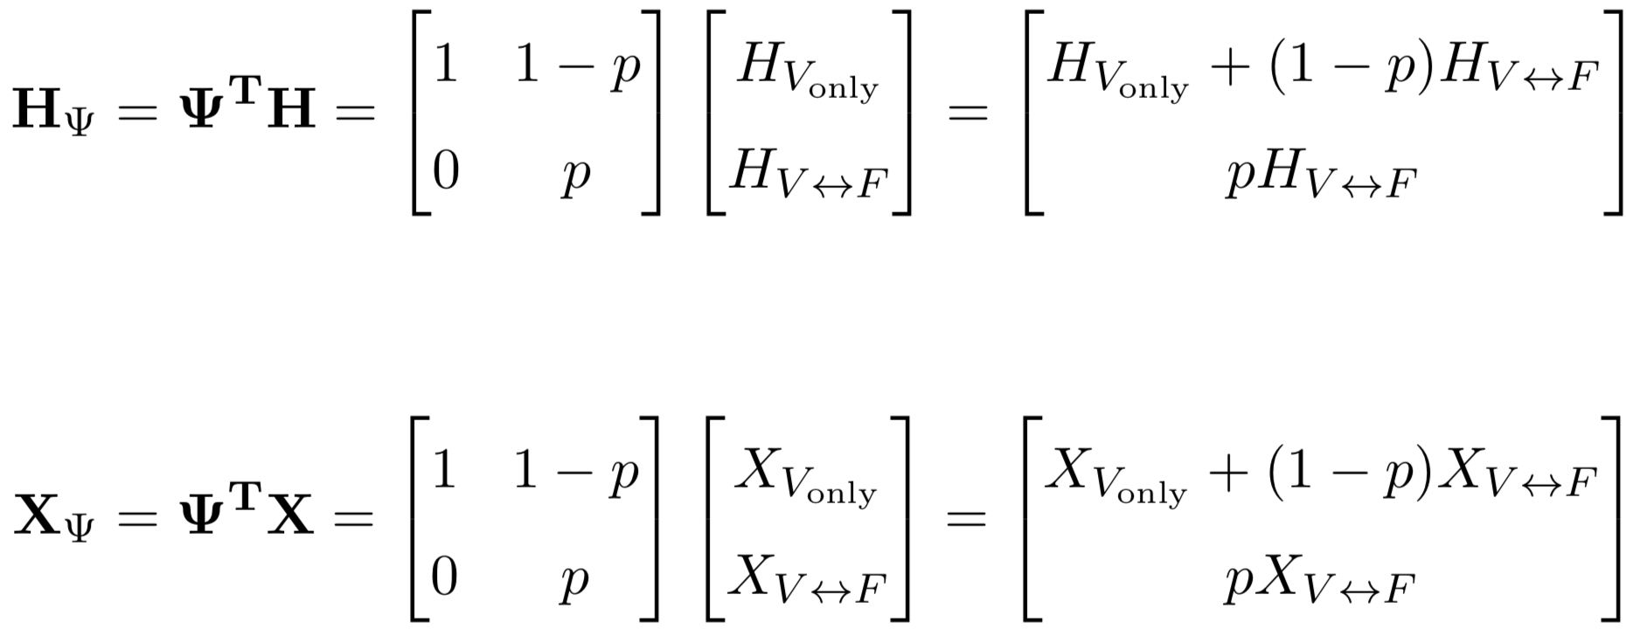

Simple Example: One Village, One Forest

Slide 17

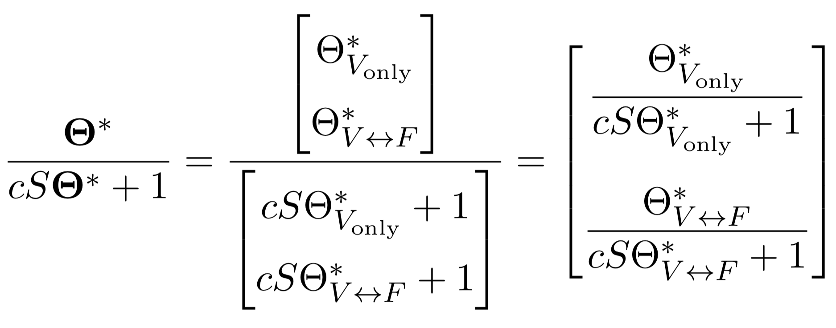
Simple Example: One Village, One Forest

Slide 18
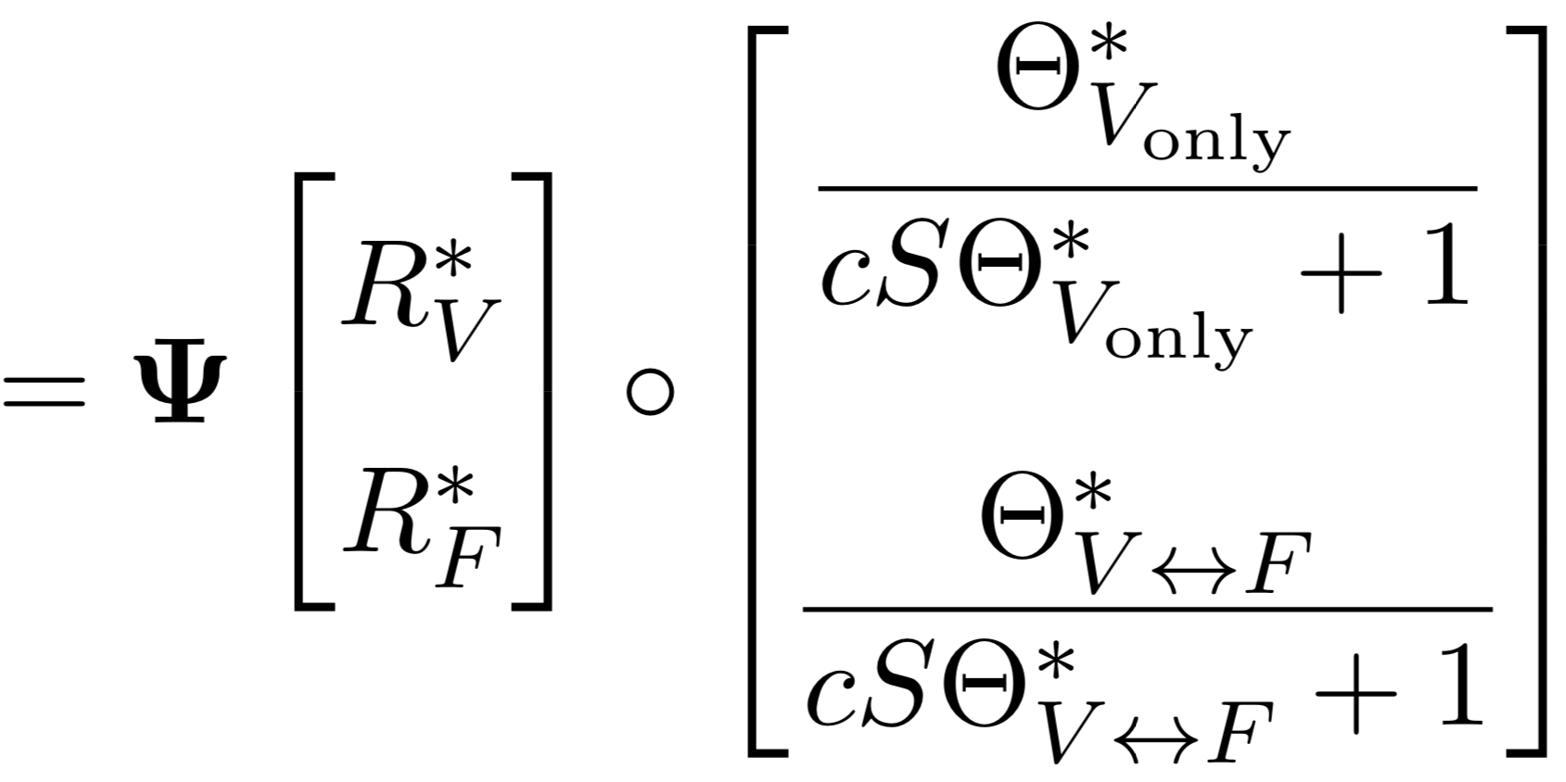

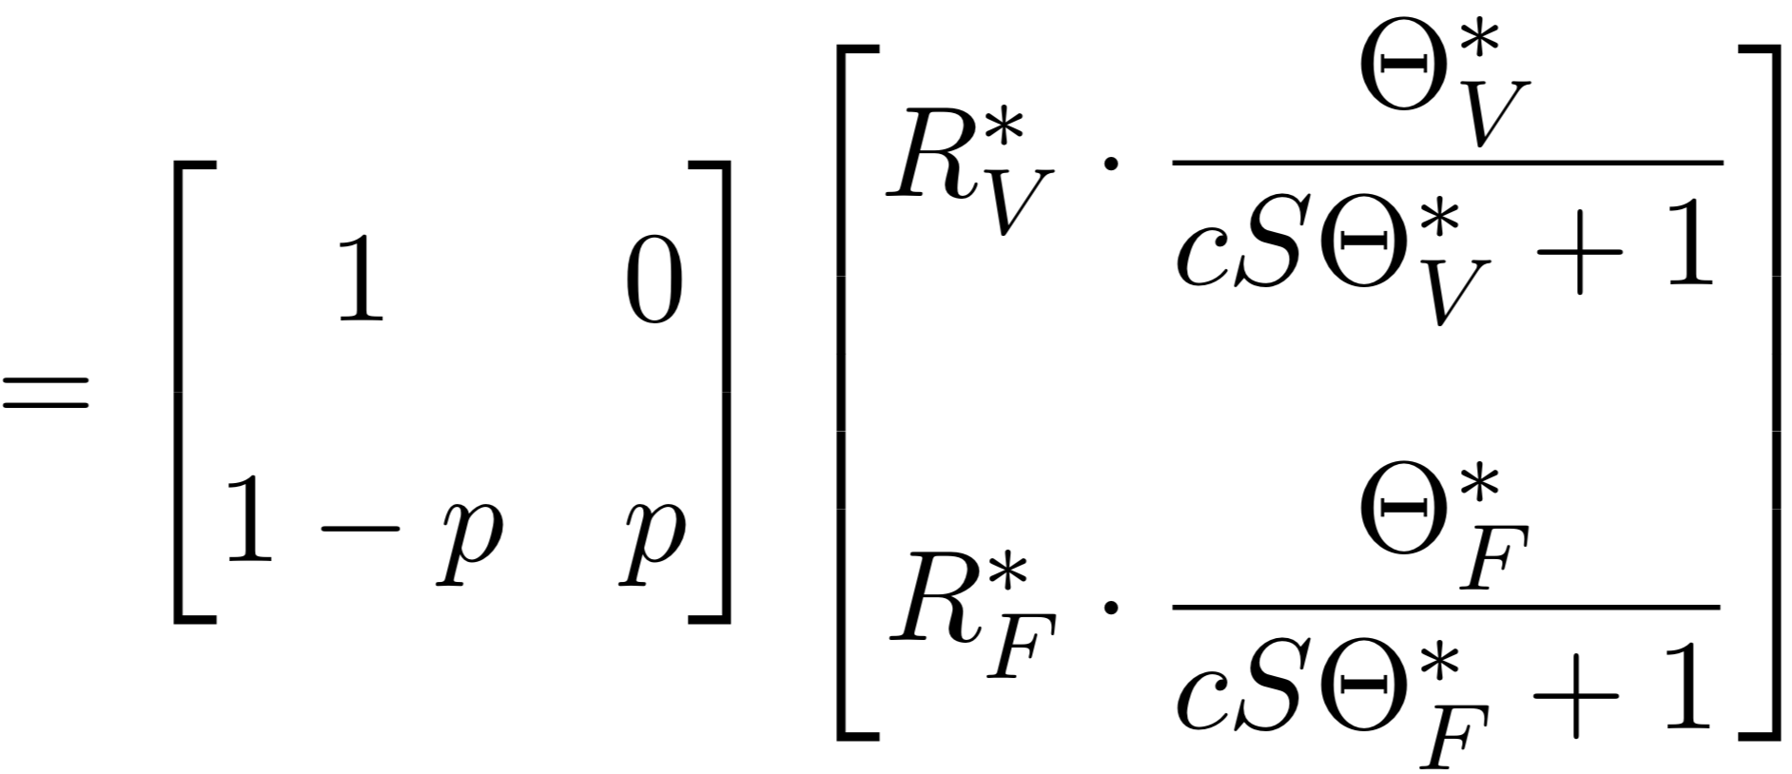

Simple Example: One Village, One Forest

Slide 19



Simple Example: One Village, One Forest

Slide 20
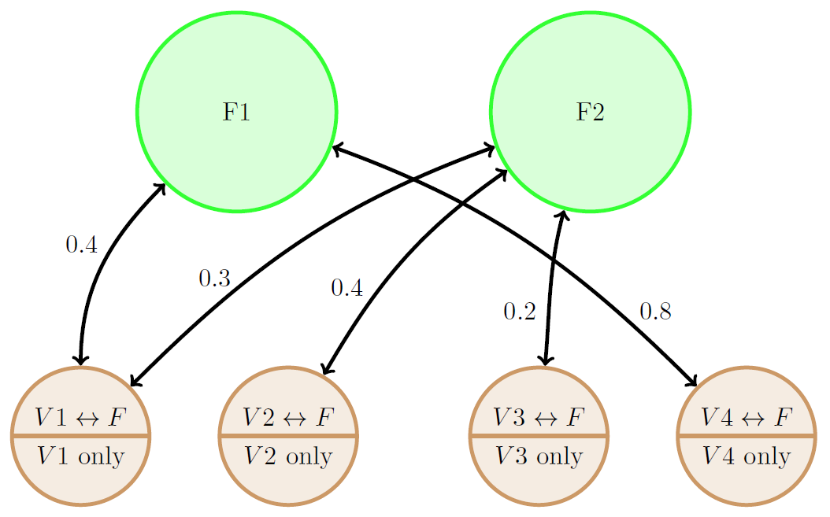
Expand to More Villages and Forests

Slide 21
Expand to More Villages and Forests

Slide 22
Expand to More Villages and Forests

Slide 23
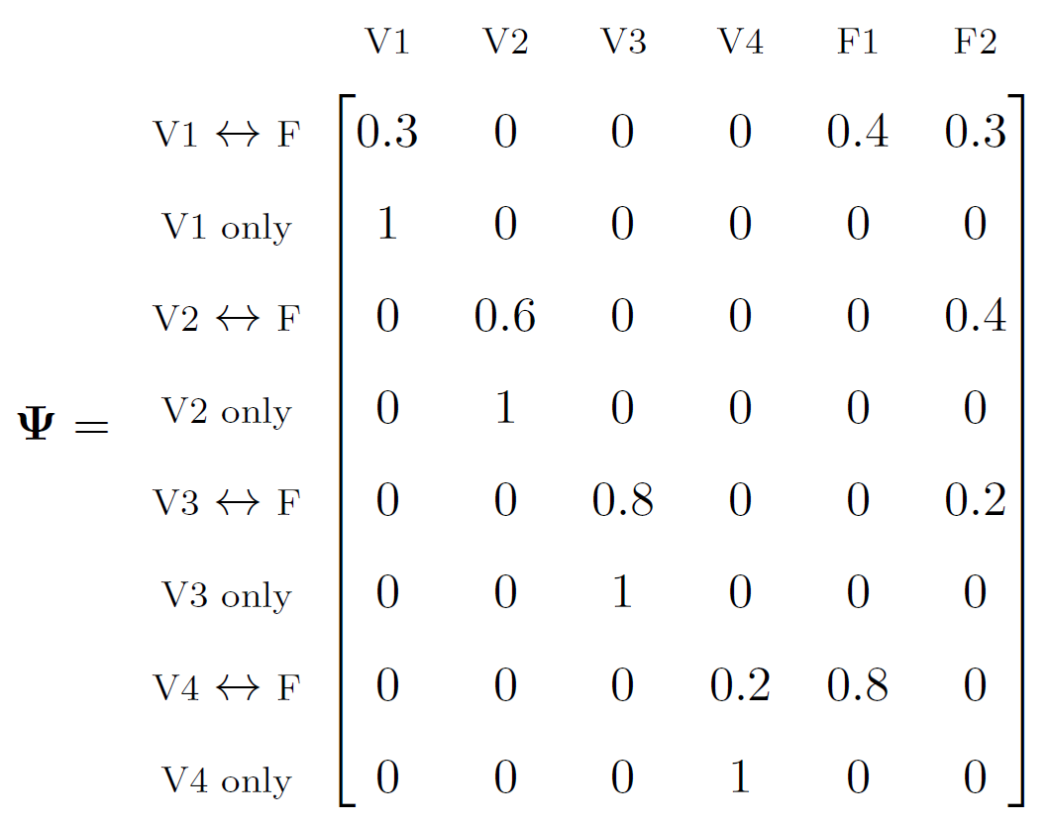
Expand to More Villages and Forests

