Slide 1
Measuring Malaria in Complex Transmission Systems
A Time-at-Risk Based Approach
Alec Georgoff
MMC Meeting, Bangkok, Thailand
November 30, 2018

Slide 2
Introduction

Slide 3
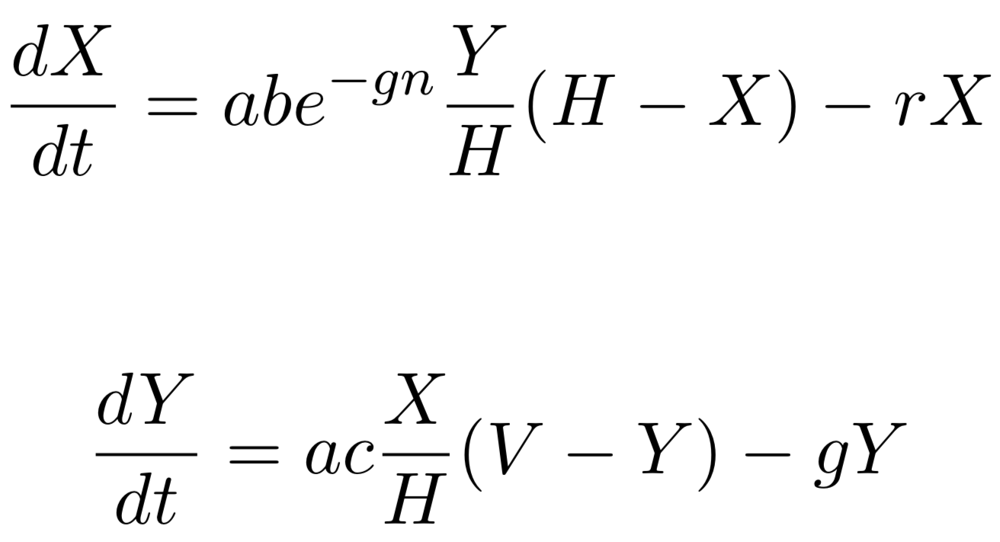
Ross-Macdonald Equations
Infected Humans
Infected Mosquitoes

Slide 4
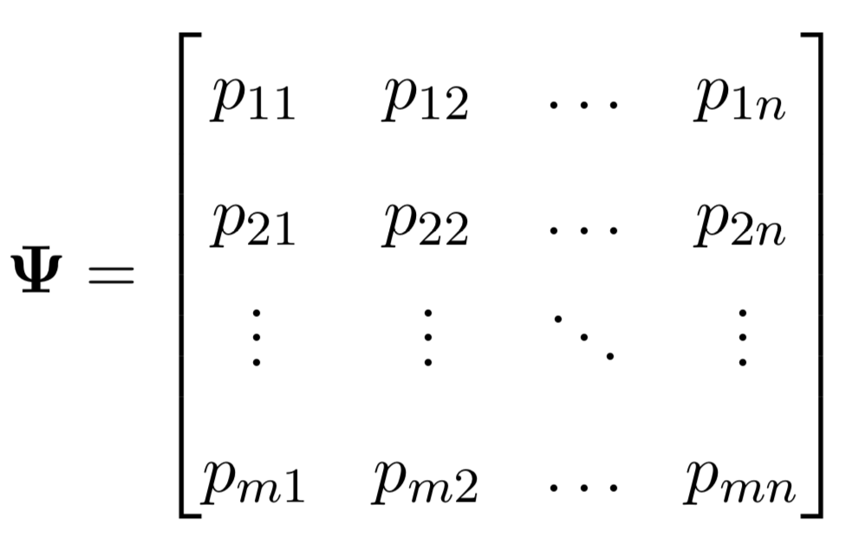

Time-at-Risk (TaR)

Slide 5

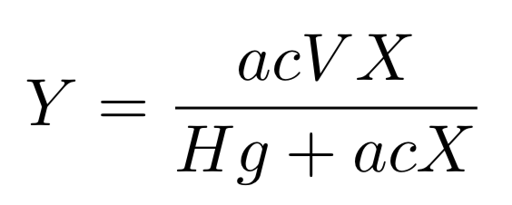


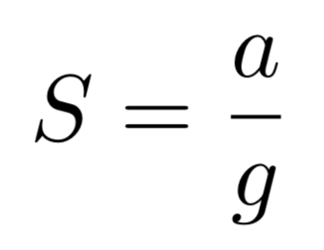
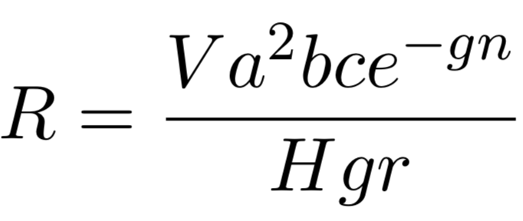

Equilibrium Assumptions

Slide 6
Equilibrium Assumptions

Slide 7
Equilibrium Assumptions

Slide 8
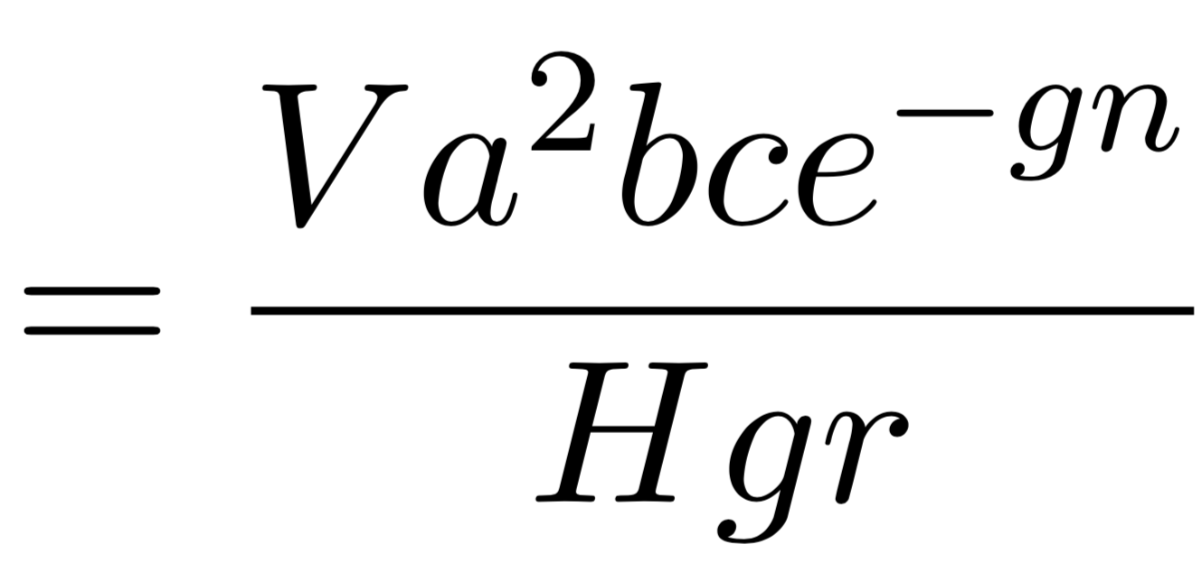

Reproductive Rate

Slide 9

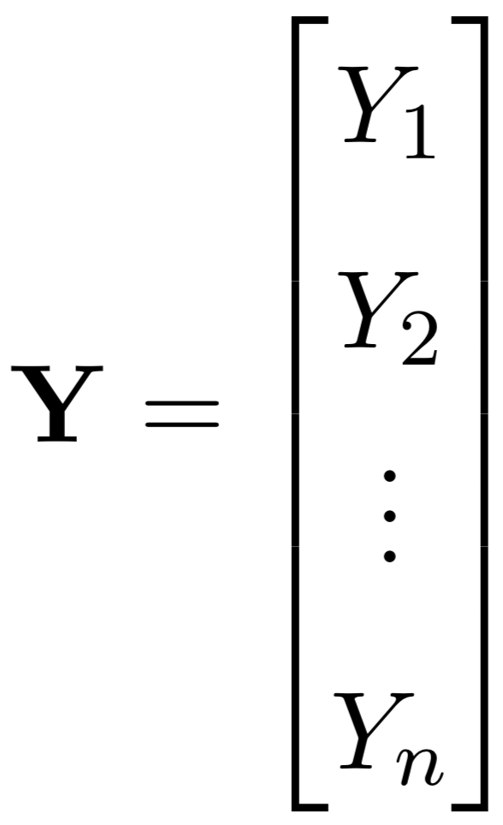
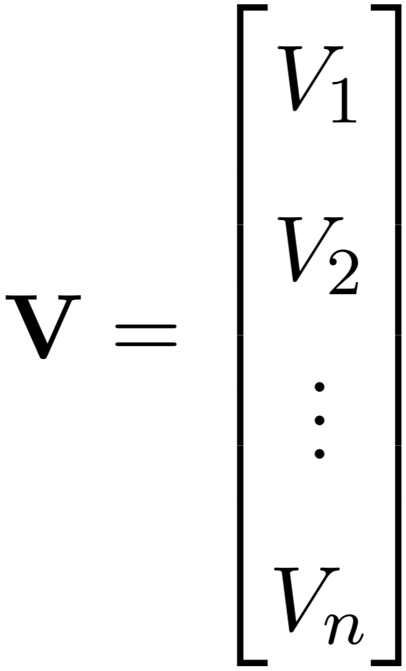
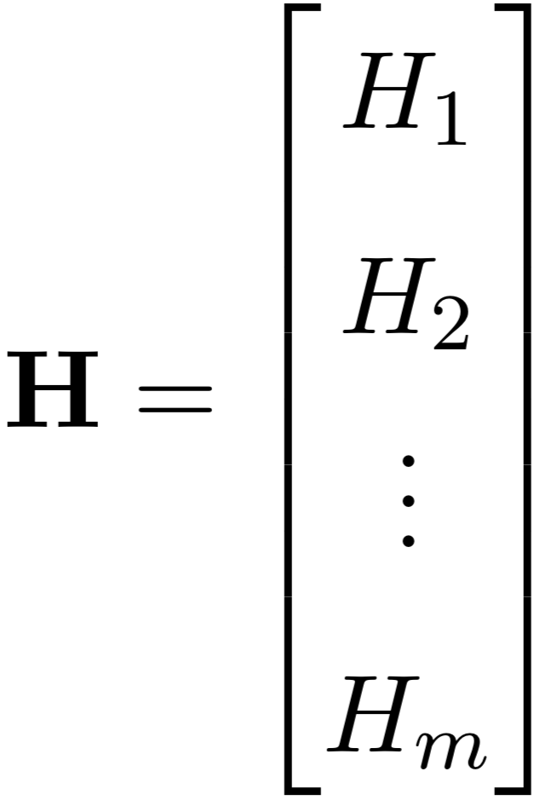
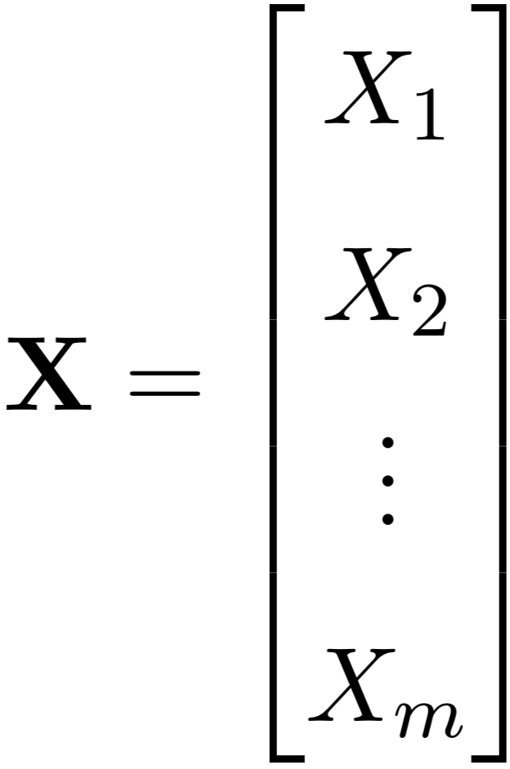
Vectors of Variables

Slide 10


Scaling by Time-at-Risk

Slide 11
Ross-Macdonald Equations

Slide 12


Ross-Macdonald Equations

Slide 13

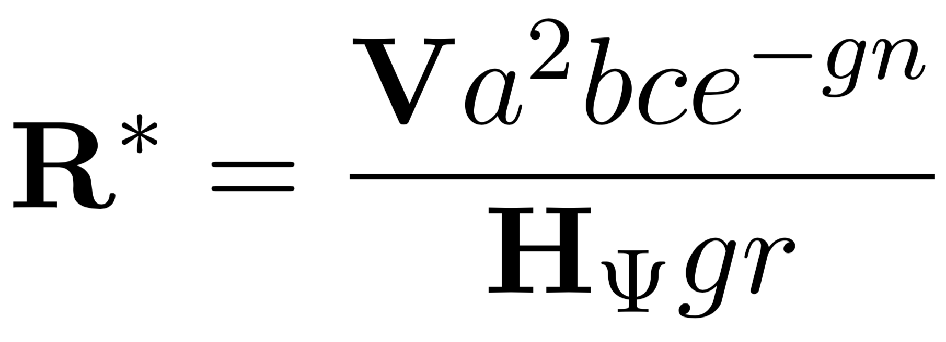
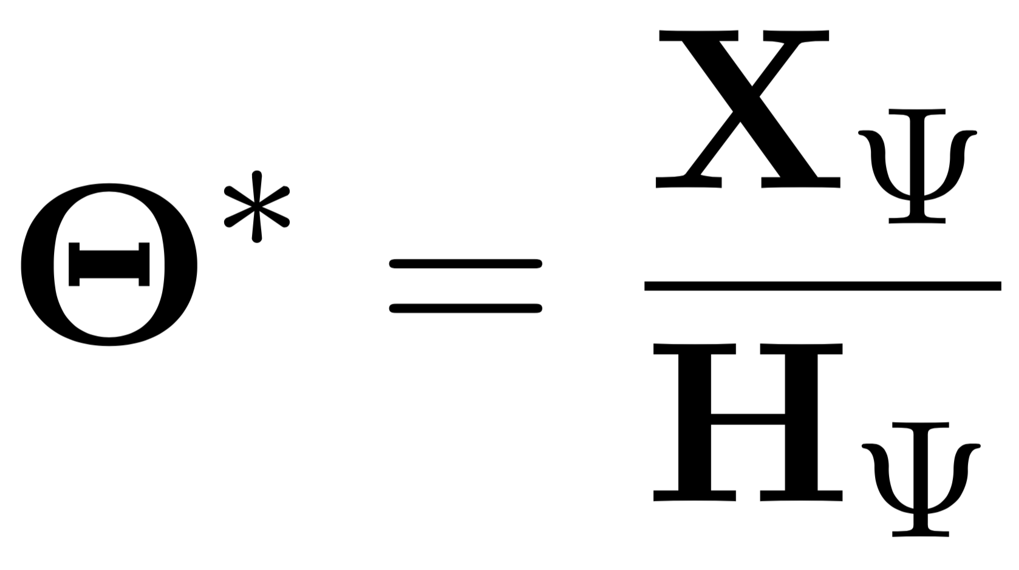
Equilibrium Assumptions

Slide 14
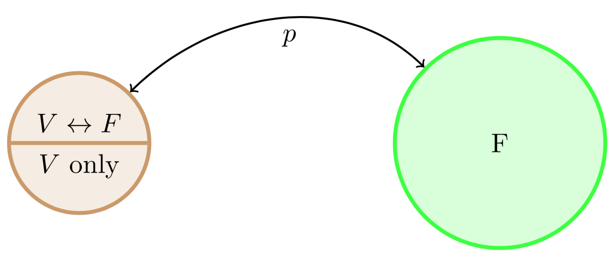
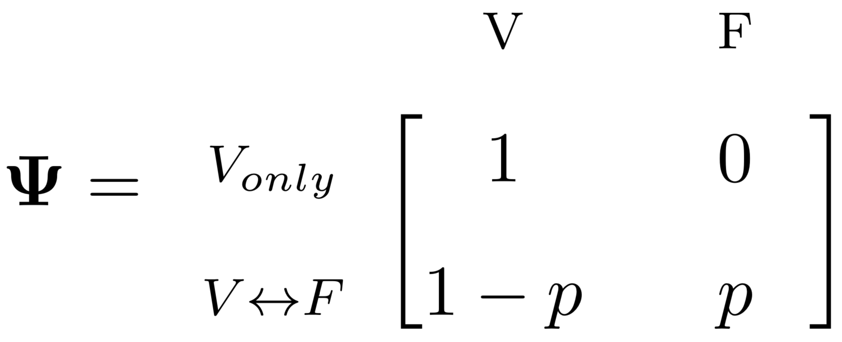
Simple Example: One Village, One Forest

Slide 15

Simple Example: One Village, One Forest

Slide 16
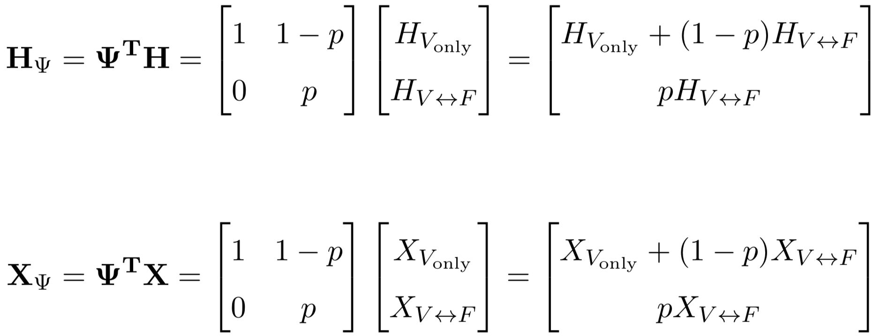

Simple Example: One Village, One Forest

Slide 17

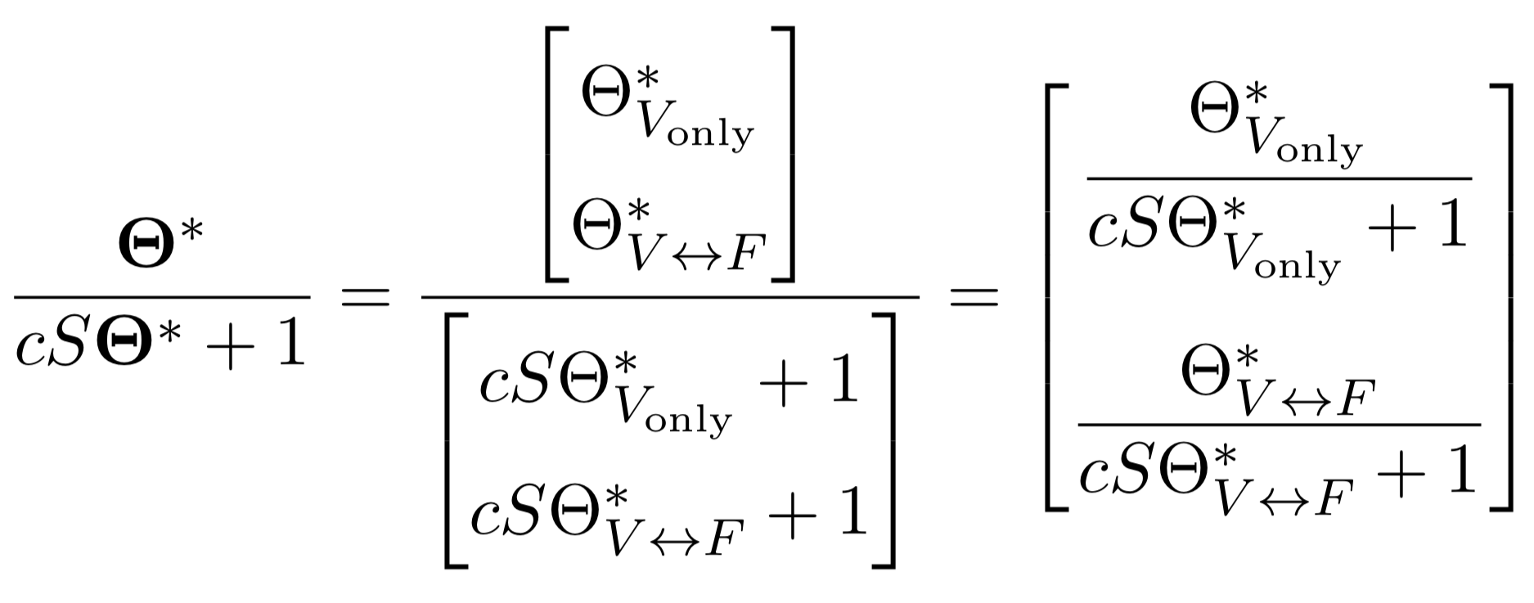
Simple Example: One Village, One Forest

Slide 18
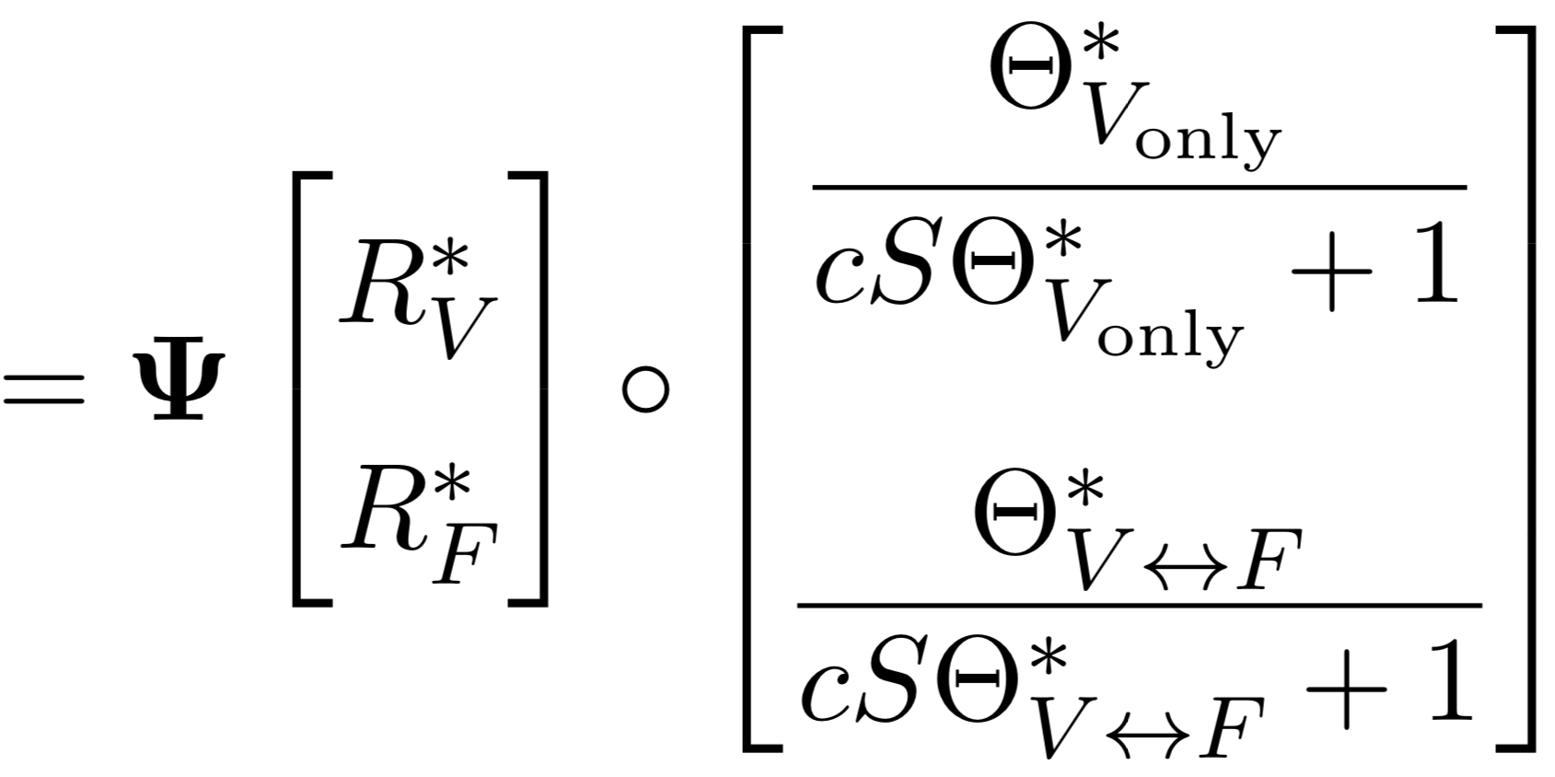

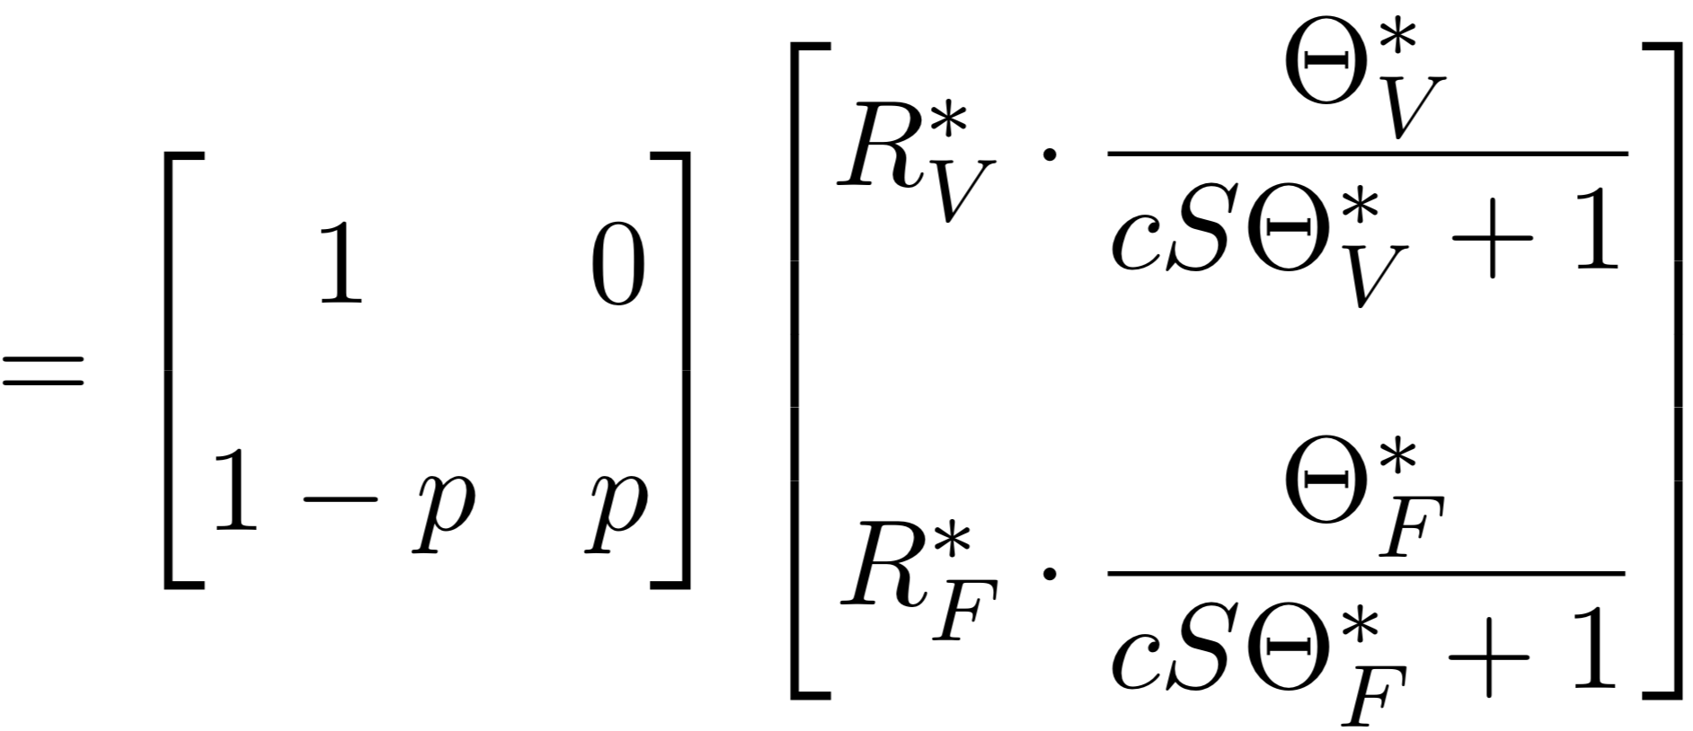

Simple Example: One Village, One Forest

Slide 19



Simple Example: One Village, One Forest

