Slide 1



HYD-R
River
Turbine
Grid

Slide 2



PV
PV
Converter DC-AC
Battery
Converter AC-DC
Grid
Battery

Slide 3

WD-ON/OFF
Wind Turbine
Converter DC-AC
Battery
Converter AC-DC
Grid
Battery

Slide 4

HYD-S
Dam
Turbine
Grid
Battery

Slide 5





THERM
Fuel Tank
Fuel Transport
Pipeline
Ship Transport
Combined Power Plant Cycle
Grid
Battery

Slide 6

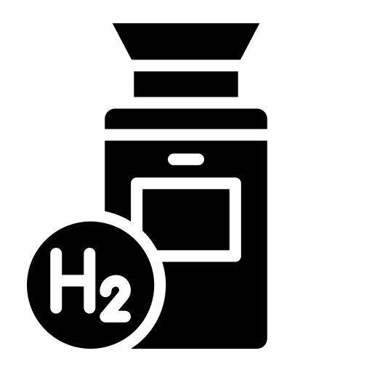
H2P-G
H₂ Storage UG 200bar
Hydrogen Transport
Combined Power Plant Cycle
Grid
H2 Storage UG 200bar
Battery

Slide 7

H2P-L
Liquid Storage
Hydrogen Transport
Combined Power Plant Cycle
Grid
H2 Storage UG 200bar
Battery

Slide 8


SOL-SALT
Solar Concentrator Salt
Steam Generator
Combined Power Plant Cycle
Grid
H2 Storage UG 200bar
Battery

Slide 9

SOL-STEAM
Solar Concentrator Steam
Combined Power Plant Cycle
Grid
H2 Storage UG 200bar
Battery

Slide 10



BIO-OIL-ICE
Bio-oil
Refining
Fuel Tank
ICE
Grid
H2 Storage UG 200bar
Battery

Slide 11


PALM-ICE
Palm-oil
Cracking
Bio-oil
Refining
Fuel Tank
ICE
Grid
H2 Storage UG 200bar
Battery

Slide 12



BIO-WOOD
Wood
Pyrolysis
Bio-oil
Steam Reforming
Combined Power Plant Cycle
Grid
H2 Storage UG 200bar
Battery

Slide 13


IMP-BIOG
Biogas (50% CH₄)
Pipeline
Biogas purification
Combined Power Plant Cycle
Grid
H2 Storage UG 200bar
Battery

Slide 14
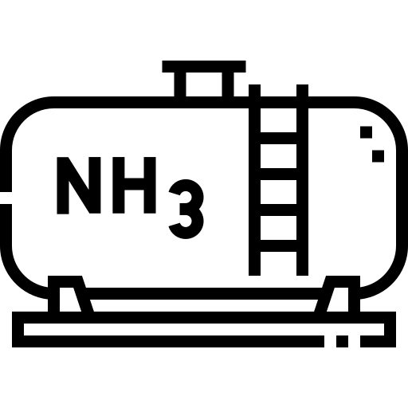
NH3-P
Ammonia cracking
H2 Storage UG 200bar
Hydrogen Transport
Combined Power Plant Cycle
Grid
H2 Storage UG 200bar
Battery

Slide 15



THERM-CH4
CH4 storage 200bar
Methane Compression
Methane Transport
Combined Power Plant Cycle
Grid
H2 Storage UG 200bar
Battery

Slide 16


H2-G
Electrolyzer
Compressor 30-200bar
H₂ Storage UG 200bar
H2 Storage UG 200bar
Battery

Slide 17



H2-GL
Electrolyzer
Liquifaction
Ship Transport
Liquid storage
Liquid to gas
Compressor 30-200bar
H₂ Storage UG 200bar
H2 Storage UG 200bar
Battery

Slide 18
H2-L
Electrolyzer
Liquifaction
Liquid storage
H2 Storage UG 200bar
Battery

Slide 19
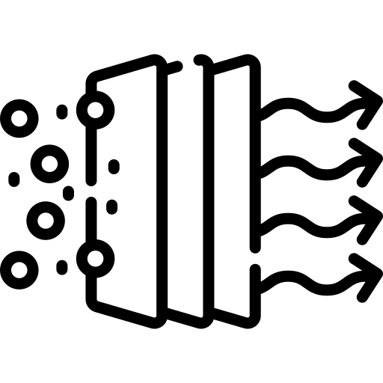


SYN-FT
Electrolyzer
CO₂ Capture
H₂, CO₂ Compression
FT-Synthesis
Refining
Fuel Tank
H2 Storage UG 200bar
Battery

Slide 20

SYN-METH
Electrolyzer
CO₂ Capture
Sabatier Reaction
Methane Compression
CH4 storage 200bar
H2 Storage UG 200bar
Battery

Slide 21




NH3-FULL
Electrolyzer
N₂ Separation
N₂, H₂ Compression
NH₃ Synthesis
Ammonia Liquifaction
Ammonia Liquifaction
H2 Storage UG 200bar
Battery

Slide 22
SYN-CRACK
Electrolyzer
Palm-oil
H₂, CO₂ Compression
Cracking
Refining
Fuel Tank
H2 Storage UG 200bar
Battery

Slide 23
CH4-BIO
Electrolyzer
Biogas purification
Sabatier Reaction
Methane Compression
Biogas (50% CH₄)
H2 Storage UG 200bar
Battery

Slide 24

PHS
Hydro Pump
Dam
H2 Storage UG 200bar
Battery

Slide 25
SOL-SALT-STORE
Solar Concentrator Salt
H2 Storage UG 200bar
Battery

