Slide 1
ShareGrid
Telerik cloud development course project
Georgy Angelov

Slide 2
ShareGrid
Overview
A smart and secure way to distribute files and messages
Allows uploading of files, links and messages
Entities are grouped in channels
Each channel is password protected and its contents are encrypted
User-friendly HTML5 interface
Open API
Built on cloud technologies

Slide 3


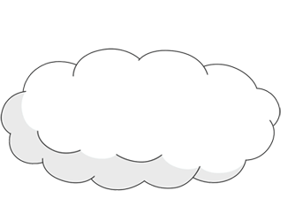









ShareGrid
Architecture

Slide 4
ShareGrid
Middle tier
Built on ASP.NET MVC 4 Web API using C#
Deployed on the Appharbor cloud
RESTful Web API
Support for both xml and json output
Two authorization alternatives:
With channel key
With authenticated user session key

Slide 5
ShareGrid
Users
A user is required to have a name, email and password
Each user can subscribe to channels with the channel’s password. No need to remember the password again.
Each user can register a channel and automatically becomes a channel administrator

Slide 6
ShareGrid
Channels
The channel name is internally processed to be unique. Everything except letters, numbers and dashes is removed and the result is made lowercase.
There are two passwords for each channel:
Standard user password
Administrator password
Only people that subscribed with the administrator password are allowed to modify the channel
Everyone is allowed to post content

Slide 7
ShareGrid
Channel entities
Each entity has an ID and a channel ID
All entity information (text and files) is stored encrypted
There are three types of entities:
Messages (guaranteed to have at least title or message)
Links (has a property named `Link`)
Files (contain download and preview links, file name and size)
Entities are (by default) sorted by date but additional sorting types are available
Entities listing can have offset and limit

Slide 8



ShareGrid
User interface
Live demo

Slide 9

ShareGrid

