Slide 1

Antivibecoding
Foundations of mathematics
Programming language
Proof assistant

Slide 2
A decade long pet project.

Slide 3
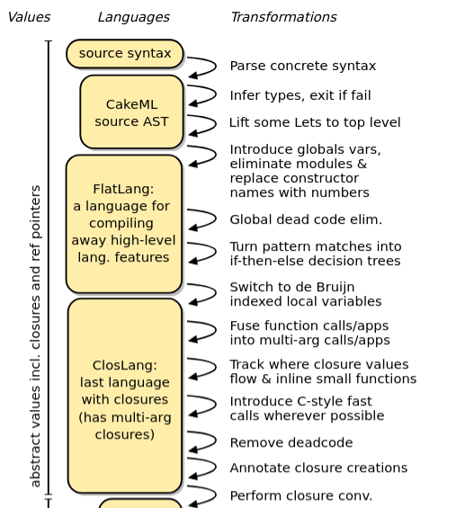
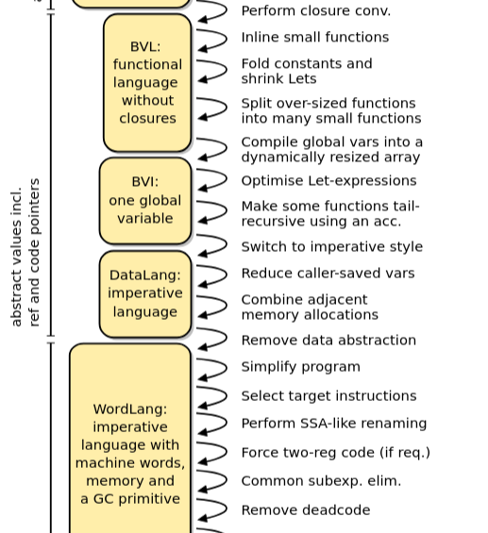
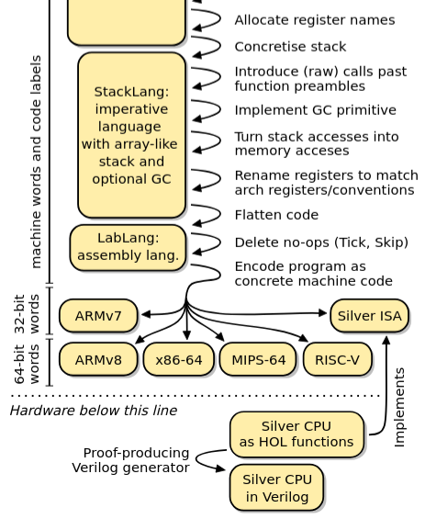
Existing project: CakeML

Slide 4
Parametric polymorphism: types depend on types
Full polymorphism: types depend on values
Problem: CakeML has only parametric polymorphism
Solution: plus one abstraction layer + code generation

Slide 5
Expressivity
Parametric polymorphism: types depend on types
Full polymorphism: types depend on values
Problem: CakeML has only parametric polymorphism
Solution: plus one abstraction layer + code generation

Slide 6
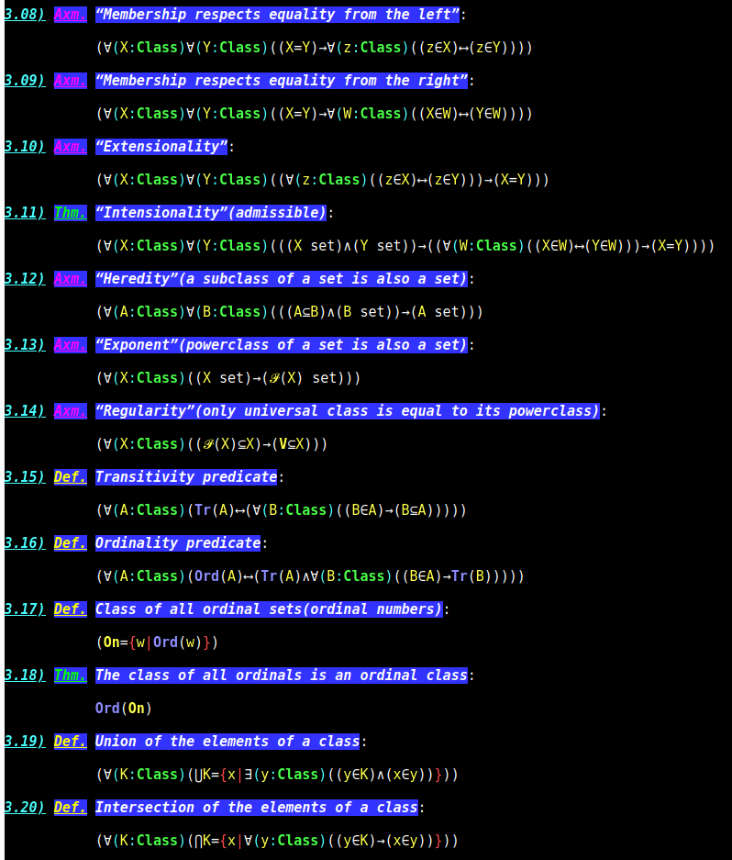
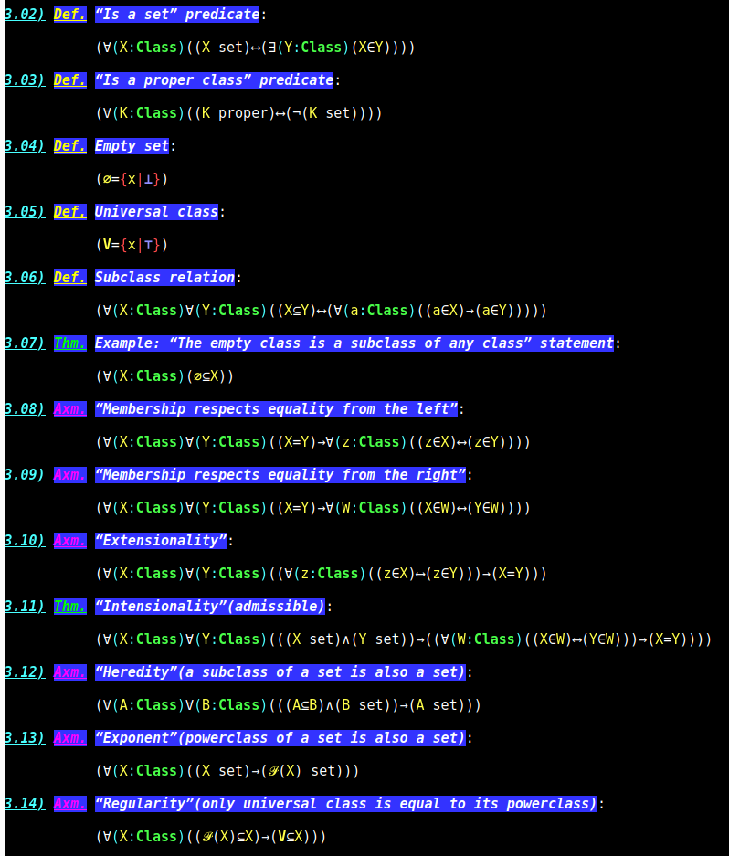
https://ObeliskProofAssistant.github.io/
...

Slide 7
Problem: lack of clarity

Slide 8
Advantages over Coq, Lean, and Isabell
Zero implicit computation: No term normalization or reduction magic in the kernel. Every proof step is an explicit syntactic tree, making it fully transparent and checkable by hand.
Pure declarative syntax: Designed like a mathematical paper, not a functional program. No tactic noise (intro, apply, rewrite) — drastically lowers the learning curve for mathematicians.
Ultra-small trusted kernel: With ~20k LOC and no heavy type-theory engine, the kernel is tiny enough to be manually audited for correctness (unlike their massive C++/OCaml/Lean runtimes).
Stable definitions: Proofs do not break when definitions change, because nothing is computed during verification. This makes it AI-friendly and highly reusable.
Clear error messages: No impossible unification constraints or "failed to synthesize instance" nightmares. Errors map directly to missing logical premises.

Slide 9
Comparison with existing projects
Lean: complexity which can not be adopted by mathematicians
Metamath: glueing unrelated statements, no reflection, no polymorphism
HOL4(CakeML): expressibiity issues
RoqC: has an architecture is built mainly for solving a different set of problems - the automatisation of the low level software verification.
Isabelle: abstraction layers, ...
Mizar: built for a different epoch
Idris / Agda:
Haskell: not a proof assistant

Slide 10
Advantages over Idris (and Agda)
No computational opacity: Idris verifies by evaluating terms (normalisation). Obelisk does not – every equality is proven step‑by‑step. No need to trust an evaluator or wonder why two terms are equal.
Pure mathematics, not programming: Idris is a general‑purpose programming language with effects (IO). Its type system is inconsistent for pure logic (partiality, assert). Obelisk is total and logically sound from the ground up.
Standalone certificates: Idris proof terms die with the compiler. Obelisk exports portable, human‑readable proof objects that can be re‑checked by an independent tiny verifier.
No unification hell: Idris has notoriously obscure error messages due to dependent unification. Obelisk’s explicit syntax avoids this entirely.

Slide 11
Advantages over Mizar
Zero hidden type inference: Mizar has a complex, implicit type‑checking engine that assigns types automatically based on background facts. This often surprises users. Obelisk requires all premises to be explicitly stated – complete transparency.
Modern, minimal kernel: Mizar’s implementation is large, monolithic, and hard to audit or extend. Obelisk’s kernel is deliberately tiny (~20k LOC) and cleanly separated from the parser/pretty‑printer.
Targeted at executables: Mizar is purely for mathematical literature. Obelisk is designed to verify executable specifications (e.g., smart contracts) while retaining mathematical clarity, bridging formal math and production code.

Slide 12
Advantages over HOL Light / ACL2 / PVS (etc.)
Declarative over tactical: HOL Light and PVS rely heavily on computational tactics (rewriting, SMT). The proof script is often unreadable and brittle. Obelisk’s proofs are static lists of logical steps, as readable as the final theorem.
No reliance on external solvers: Many systems (ACL2, PVS) push hard work to external SAT/SMT solvers, adding trust assumptions. Obelisk keeps the core logic entirely self‑contained and solver‑free.
Built for clarity, not speed: While others optimize for automation, Obelisk optimises for explanatory power – essential for formal verification in regulated industries (finance, aerospace) where auditors need to understand why a property holds, not just that it holds.

Slide 13
The lack of clarity in every project
The lack of clarity is the main problem in the existing projects.
Meanwhile there already exist suitable foundational theories.

Slide 14
Why Haskell fails
Haskell is not a proof assistant—it is a programming language with a rich type system.
People rarely use it for smart contract verification (e.g., Solidity, Rust, or Move) because:
Logical inconsistency: Haskell allows general recursion, undefined, and error, which introduce logical contradictions (⊥ :: a). You cannot prove mathematical theorems in Haskell's type system soundly.
Unreliable GHC backend: Type-level computation relies on GHC's complex, ever-changing internals. A verified property today may break with the next compiler update.
No independent proof object: Haskell type-checks are lost after compilation. There is no standalone certificate that can be re-checked without trusting GHC.
How Obelisk beats Haskell:
Totality: Every function is guaranteed total (no loops, no exceptions). Perfect for formal verification.
Certified proofs: Obelisk generates an explicit, portable proof certificate that can be independently validated by a separate tiny checker—essential for high-stakes smart contracts.
Mathematical consistency: Built on solid logical foundations (e.g., HOL or set theory), not on a partial, non-logical programming language.
Haskell is a tool for exotic programming; Obelisk is a foundation for mathematics and unforgeable contracts.

