Slide 1
MAP RXJS Operator
Angular 7 + Material Design
Notes:
Alright Guys It’s Dani here. In this tutorial I will show you how to use the RXJS MAP operator.
Then I will make 2 demo projects from scratch in Angular 7 and we will use material design in order to see the result in the browser.

Slide 2



Explanation
The Map operator applies a function of your choosing to each item emitted by the source Observable, and returns an Observable that emits the results of these function applications.
Source - http://reactivex.io/documentation/operators/map.html
Notes:
If you have ever used the map function from ECMAScript 2015 over arrays you will be very familiar with it. It works exactly the same for Observables as it does for arrays. You can use map operator to transform a collection of items into a collection of different items. Transforms the items emitted by an Observable by applying a function to each item (or converting from one item type into another). This is one of the most commonly used operators.
Lets look at the Marble Diagram. We read the it from left to right.
The source Observable stream contains 3 items with numeric values (1, 2 and 3 in that order). We apply the map() operator which takes numeric value of each item (x) and multiplies it by 10. The result Observable contains items with numeric values 10 (10 * 1), 20 (10 * 2) and 30 (10 * 3).
You can see the official documentation at reactivex.io.

Slide 3
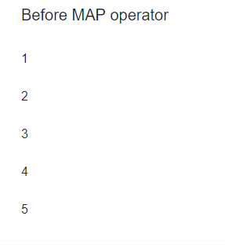
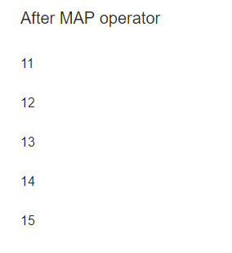
DEMO 01
Add 10 to each number
Notes:
Now let’s see the first demo in Angular application. We will write it from scratch in Angular 7 and we will use Material Design components in order to visualize the result.
As in the Marble diagram we will use map operator in order to multiply each number by 10.

Slide 4
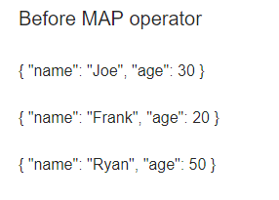
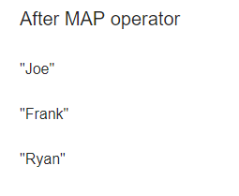
DEMO 02
Map to single property
Notes:
Now lets look at the next demo in which we will transform the source observable from an array of objects to an array of strings. We will take only the name property of the given object.
And then loop threw the result and show it in the browser.

Slide 5
complete solutions A-Z
PLEASE SUBSCRIBE FOR MORE TUTORIALS
THANK YOU!
Notes:
So yeah the MAP operator easy pizi. Thank you guys for watching. If you think it was helpful, please THUMBS UP, SUBSCRIBE and I will see you next time.

