Slide 1
B4P
Beyond Former Performance.
A powerful programming language and analytics engine
enabling rapid transformation of big data into powerful insights
Transforming Big Data into Powerful Insights
Version 8.02 'Edouard Albert Roche' (2021-04-18)
Image source: Amir Hanna, Rush Hour in Dubai / UAE, unsplash.com.
Copyright © 2007: 2021 by Georg zur Bonsen, Baden / Switzerland

Slide 2
Overview
The B4P Data Integration and Analytics Engine
Multiple complex
data sources
B4P Data Integration and Analytics Engine
Integrated analysis
in seconds
data files
B4P
spreadsheets
X
X
databases
web data
>b4p
b4p
interactive
processing
batch
programs
data files
Excel, XLS, CSV, XML, JSON, HTML, Zip, Text (and others)
Data Sources
databases
Database exports (Salesforce, Oracle, SAP, FileMaker, et al)
web data
Internet sources of structured data (websites, web services)
other data
Statistical (R, SAS, SPSS, Stata), PDF (via Tabula)

Slide 3
Table of Contents
1
Problem Statement
2
B4P Solution: Analytics and Execution Engine
3
B4P Real-world Use Cases
4
B4P Language
5
B4P Program Examples

Slide 4
Problem Statement
Manual data integration and analysis is labor-intensive and error-prone
Start your data analysis task
Gather the Data by Hand
from databases, tables, Internet,
manual data collection, etc. Lots of mouse clickes to initiate all downloads
Exported Data: Cumbersome Format
from databases, e.g. poor format, cryptic terminology
Foreign Characters
Lost
M?nchen
Incompatible Data Formats
Excel cannot read it in or use it directly, data alignment needed.
E.g. locality of numbers, dates.
Verify the Data Manually
or semi-automatically on Excel
Errors Introduced
Missing Data, manual corrections and filling gaps
Combine Multiple Info Sources
in order to see the big picture effectively,
do various lookups by hand
Compare New vs Old Data
on Excel. Time-consuming analysis of multiple lists along the timeline. Discovered important issues too late.
Excel too slow with Big Data
loading and processing
(3’000 … > 10 M rows)
waiting ... waiting ...
Clean-Up by Hand
Unlikely to discover all
issues every time
Condense and Align the data, do necessary sorting, build pivot tables, etc.
Do Needed Calculations
in order to come closer to the results and verify them
Add Formatting and Style
on the results, incl. comments, etc. by hand
Work completed: late, inconsistent, error-prone

Slide 5
Problem Statement
Conventional methods of analytics automation are complex and unsustainable
Write Excel Macros
(Visual Basic)
OK for simple tasks, but ...
... coding becomes cumbersome if problems are more complex. Vulnerable if data format changes.
Processing performance drops significantly when working with large data volumes.
Complex, opaque, un-auditable, poorly performing code if tasks are not very small and simple
Write a
Computer Program
(C, Java, Python, etc.)
Runs fast, but takes a lot of time to program, debug and optimize.
Others may have difficulties to understand what you have written.
Such programs end up very large, with many functional details coded by hand.
Good programming know-how, ideally object-oriented programming sklls are needed, as well as obtaining a suitable development environment.
Unreadable, unchangeable, opaque code cannot be created nor adapted by business users.
Hire a Consultant
(or two)
They are happy to solve your problems for cash. Solutions are quite decent, but ...
... if you need further enhancements, they will ask for more cash.
You will depend on them as they expected, and keep convincing your boss to have these expenses approved.
Expensive, external vendor dependency, no long-term sustainability

Slide 6

B4P Solution
Automate your data integration and analysis with a low-code analytics engine
Start Data Analysis Task
1
2
3
4
5
6
7
8
Ingest
Semantic
Alignment
Validate &
Explore
Merge &
Consolidate
Enrichment
Align and
process
Format
Save and
Export
From files,
databases
and the Internet
Excel
JSON
HTML, XML
CSV, TSV, ...
Text files
and many more
Harmonize
keywords
and values
Align headers and overall structure
Align different
number formats
Align deviating terminologies
Identify and extract
data you need
Check all headers
Identify data
Resolve inconsistencies
Interpolate missing values
Identify and resolve duplications
Combine data
from multiple
tables
Eliminate
redundant data
Fill information gaps
Enrich the
information value
Consolidate
Analyze
Calculate
Pivot
Align
Sort
Sort and arrange
rows and columns
Add style, formats and
colors
Excel
HTML, XML
JSON
CSV, TSV
Text files
and many more
B4P
Integrated analysis completed in seconds
Rapid, High Quality Results

Slide 7
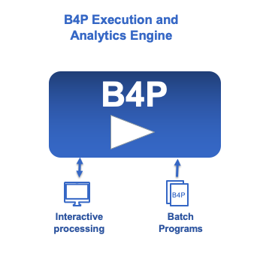
B4P Solution
Based on 14 Years of Experience Solving Problems in a Global Corporation
The Engine
The Language
table load excel file ( football club, Football Membership List.xlsx );
table load ( soccer club, Soccer Membership List.csv ); // Beginners = Novices
table rename column headers ( football club, { Family Name, City }, { Last Name, Town } );
table process selected rows ( soccer club, [Level]==Novice, [Level]=Beginner );
table merge ( football club, soccer club, {Last Name,First Name},
{Level,Town}, append, " or " );
table sort rows ( soccer club, { Level, Last Name, First Name });
table rearrange columns ( soccer club, { Level, First Name, Last Name, Town } );
table save excel file ( soccer club, Soccer Club, New Soccer Club Membership List.xlsx );
echo ("New soccer club has ", table length( soccer club ), " members. Enjoy playing.");
Fast: Runs at full machine performance
Supports many data formats for inputs and outputs (Excel, HTML, XML, JSON, text files, etc., full UNICODE)
Processes and delivers accurate results reliably
High performance even with big data – In seconds, not hours
Styled and formatted output for Excel and HTML
(e.g. Structured tables, colors, multiple Excel sheets per file)
Principle of Low-Code Approach: Few statements suffice
Simple syntax: Easy to read, learn, understand and run
Key strengths on large structured data tables and hierarchically structured variables
Extensive library with very powerful functions and features
Compact methods for powerful processing steps
minimizes coding loops and using variables

Slide 8
B4P Solution
Supported Data Formats
Inputs
Outputs
Excel
XLSX, XSLM, open formats
CSV comma and tab separated files
Database Exports
HTML, MHTML and XML formats (depending what the database is producing). Examples: Salesforce, Oracle, SAP
JSON files (JavaScript Object Notation format)
CSV comma / tab / semicolon / ...symbol separated files
Other Inputs
Files with fixed columns on every row
Any other form of structured text files
ZIP files (B4P does data decompression)
Character Sets (both input and output)
UNICODE UTF-8 and UTF-16; Basic and extended multilingual planes
Legacy formats (like ASCII / Windows West Europe)
Unformatted Output for Excel
CSV comma separated files
Formatted Output for Excel (with colors, formatting and style)
XLSX (Excel 2007 onwards, in use today)
XLS (Excel 2003 XML format)
Unformatted and formatted output for Browsers
HTML (incl. colors, formatting and style)
XML (planned)
Output for other databases
CSV comma / tab / semicolon / ... symbol separated files
JSON files
Plain text files
ZIP files (B4P does data compression)
X
X
Additional data formats can be supported easily through B4P library extensions

Slide 9


Real-world Use Case #1
Integrating Corporate data from branch offices worldwide
Each region manages their own data in different database systems or manually with Excel
B4P
Region 1
Europe
Data
Collection
1. Load Data from all Sources
The data from different sites originate from 20 different database exports or manually prepared Excel files
Region 2
Europe
Data Pre-
Cleanup
The two Excel files are revolving,
i.e. mutually used and updated
by the user and the B4P program
2. Clean-Up and Harmonize
Harmonize data formats to week numbers and years
Excel
Region 3
N America
Align
Products
Vendor +
Product List
3. Align Product Information
The revolving table manages the products to
include and allow for using harmonized product names.
Orientation is by common product identification number.
Excel
Region 4
S America
Excel
Align
Projects
Project
List
4. Align Project Information
Different project names and/or abbreviations are used by the sites. They will be aligned.
Excel
Planning
Table
5. Project Name Alignment
The sequential list of individual demands is transformed
to a horizontal planning table with weekly schedule.
Information consolidation and summing up
Region 19
Asia
Excel
Optional: Import supplier data
Supplier Data
6. Import supplier planning data
If supply info is available, then match demand with their delivery plans
Supplier Data
Excel
Region 20
Asia
Create final
reports
Supplier Data
7. Reports
Detailed internal reports for performance monitoring
Condensed reports for suppliers
Supply Chain
Reports
Excel
More than 20 different files!

Slide 10
Real-world Use Case #2
Information interchange between multiple different databases
Lookup Tables
e.g. exchange rates,
product portfolios
Excel
ERP
Site 1
B4P
Cloud based
CRM database
ERP
Site 2
Example 1:
Information about new orders booked into the ERP system will be reported to the CRM system in order to mark the opportunity as "ordered".
Data Xchg Reports
(e.g. changes,
inconsistencies)
Example 2:
Key dates (e.g. planned order date, delivery dates) for the same opportunity or order are different in the CRM and ERP system.
Report the differences, and, if allowed, use automated rules to resolve the inconsistencies
Excel

Slide 11

Real-world Use Case #3
Enriched Business Intelligence from many data sources
Orders List
from CRM database
1. Load orders list
Load the files and make the numerals
suitable for processing
(e.g. remove thousand separators)
Filter
2. Filter
Delete orders not of interest
Delete orders with 0 EUR values
Treat opportunities of different natures
individually
Expansion
6. Expand
Expand opportunities with multiple
equipment suppliers into multiple rows
and list the suppliers separately
7. Derive Equipment Values
Derive equivalent equipment values
Plausibility checks + adjustments against
upper and lower boundaries.
3. Preparations
Harmonize similar company names
Align product prices so they represent
similar scopes, all converted to EUR
Equipment
Supplier List
short names
Preparations
Excel
Final Cleanup
8. Final cleanup
Keep and rearrange columns of interest,
Discard the rest
Numeric output in commercial format
Xchg Rates
4. Consolidation
Identify multiple rows with same
opportunity numbers (as they cover
different product & aftermarket scopes)
Proper handling of traditional OEM
business, consortia setups, aftermarket,
etc.
Excel
Consolidation
5. Do some corrections
Make corrections if orders given to competitors appear over-/underpriced in order to eliminate distortion
Plausibility check of values of
sub-system scopes vs. the whole.
Ouput: Market
Intelligence Data
Use Excel to visualize
Market development over time
Market development across regions
Market share among suppliers
Identifying market disruptions
etc.
Scaling
Factors
Corrections
Excel
x
✓
ERP = Enterprise Resource Management Databases (e.g. SAP, Oracle, BAAN, Abacus)
CRM = Customer Relationship Database (e.g. Salesforce)

Slide 12
B4P Language
Key Benefits of a Low-Code Language Approach
Simple procedural language
Easy to read and understand the code, therefore very easy to learn programming.
Powerful language semantics keeps your program short to solve complex problems.
Immediately get your code running
Clear, natural language. Give your variables, tables, functions, etc. natural names (spaces are allowed !)
Big Data tables of any size are one of the main data storage models and B4P is optimized for this.
Rich hierarchical data storage model to manage tree-type hierarchical information
No programming complexity such as type definitions, declaring all the variables and doing memory management on your own.
Significantly less need for fine grained programming like formulating loops, using variables, coding detailed algorithms, etc.
B4P understands data formats such as Excel, HTML, XML, JSON, CSV, etc. to retrieve data from Excel, database
and the Internet directly
The execution engine and all library files are very light-weight and lean, very robust and start quickly.
Portability (Windows, Linux, MacOS, etc.), enabling to run the same code on any computer.
Output Excel files with style and formatting like fonts, colors, number formats, row widths, etc.
Rich function library with over 800 functions, including 200 functions for processing tables, and growing.
The B4P Language allows you to express yourself easily in plain English to solve complex problem.
Focus on the what, not the how.

Slide 13
B4P Language
Syntax and Semantics
Overall language block structure similar to C / C++ / Java.
Full and homogeneous UNICODE support.
Tables and structured variables are the two main data storage mechanisms.
Table names, variable names and function names are fully flexible, e.g. multiple words and spaces are allowed.
- Full Excel support, including formatting and style.
Variables organized in a dynamic tree, allowing to build up nested arrays and structures.
- Load / save sophisticated JSON contents to / from the variable structure using 1 statement.
Code pieces can be passed as function parameters which will be executed multiple time or on a on-demand basis:
- Example: table process (...), pick if (...)
- Benefit: Eliminates need to write loops or other details.
Numerous flexible control flow mechanisms, going beyond the common ones like if, while, for, ...
Cross platform compatibility: Windows / Linux / MacOS:
- File names with directory paths are understood and interpreted correctly in other platforms (e.g. Windows vs. Linux).
- Your program does not need to be modified to run on a different system.
Powerful parameter set and matrix operations to process big data.
1. Use the rich B4P function library to process your big data. They deliver naked machine performance.
2. Use deep operations (vector and matrix operations) to process large amount of data inside tables and parameter sets.
3. Think how you can formulate your code in a very compact manner without compromising comprehensibility.
Complete solutions require only 5-20 statements

Slide 14
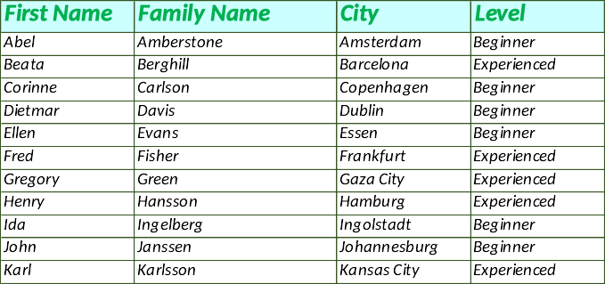
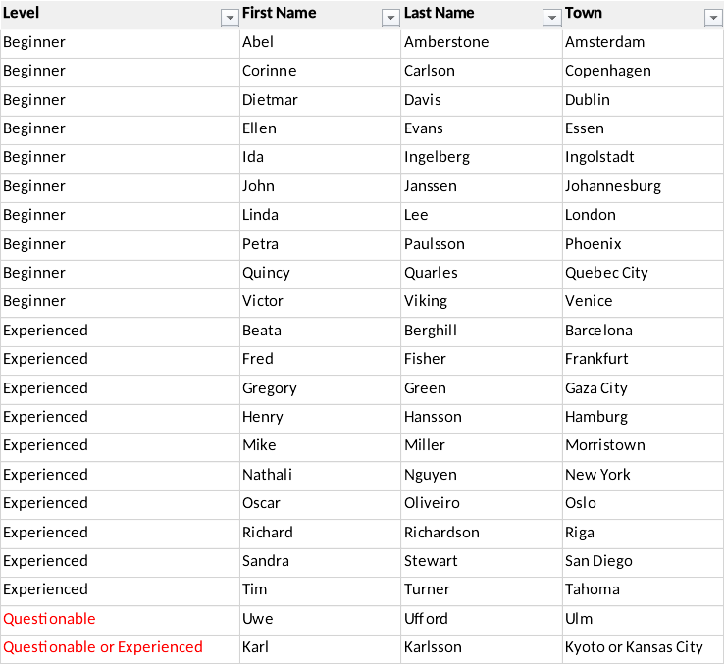
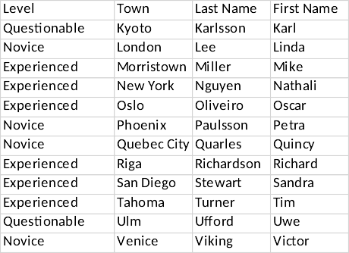
B4P Example #1
Merging Two Tables
Football Membership List
Merged Membership List
4P
B4P
Soccer Membership List
Task: A new football club should be created by merging two existing sports clubs:
The tables of the two clubs are arranged differently and use different naming schemes (e.g. qualification levels)
Some people are members in both clubs and need to be resolved properly.
Highlight possible inconsistencies (red text color)

Slide 15
8 statements: load, clean, align semantics, merge, and save
B4P Example #1
Merging Two Tables
Simple statements
easy to understand
Multiple words for functions, variables, table names, header names, allow for readability and naming flexibility
Excel file loaded with
a single simple statement
table load excel file ( football club, Football Membership List.xlsx );
table load ( soccer club, Soccer Membership List.csv ); // Beginners = Novices
table rename column headers ( football club, { Family Name, City }, { Last Name, Town } );
table process selected rows ( soccer club, [Level]==Novice, [Level]=Beginner );
table merge ( football club,
soccer club, {Last Name,First Name},{Level,Town},append," or " );
table sort rows ( soccer club, { Level, Last Name, First Name });
table rearrange columns ( soccer club, { Level, First Name, Last Name, Town } );
table save excel file ( soccer club, Soccer Club, New Soccer Club Membership List.xlsx );
echo ("New soccer club has ", table length( soccer club ), " members. Enjoy playing.");
No loops. Simple statements
apply for whole tables
One statement merges
two tables as specified
Full Excel support

Slide 16
B4P Example #1
Merging Two Tables
7 additional statements add coloring, formatting, and style to Excel file
Simple statements
easy to understand
Highly comprehensible function names
Simple and target inde-pendent approach to format tables, rows, columns and cells
table style table ( soccer club, sheet, column width, 20, row height, 20,
freeze rows, 1, autofilter, 0, vertical align, center );
table style rows ( soccer club, 0, sheet, boldface, true, fill color, gray 15 );
table style columns ( soccer club, Level, sheet, column width, 30 );
table process selected rows ( soccer club, ([Level] = '*Questionable*'),
table style cells ( soccer club, Level, row(), single, text color, red ) );
translate style attributes for excel( soccer club );
table save excel file ( soccer club, Soccer Club, New Soccer Club Membership List.xlsx );
echo ("New soccer club has ", table length( soccer club ), " members. Enjoy playing.");
Full Excel support

Slide 17
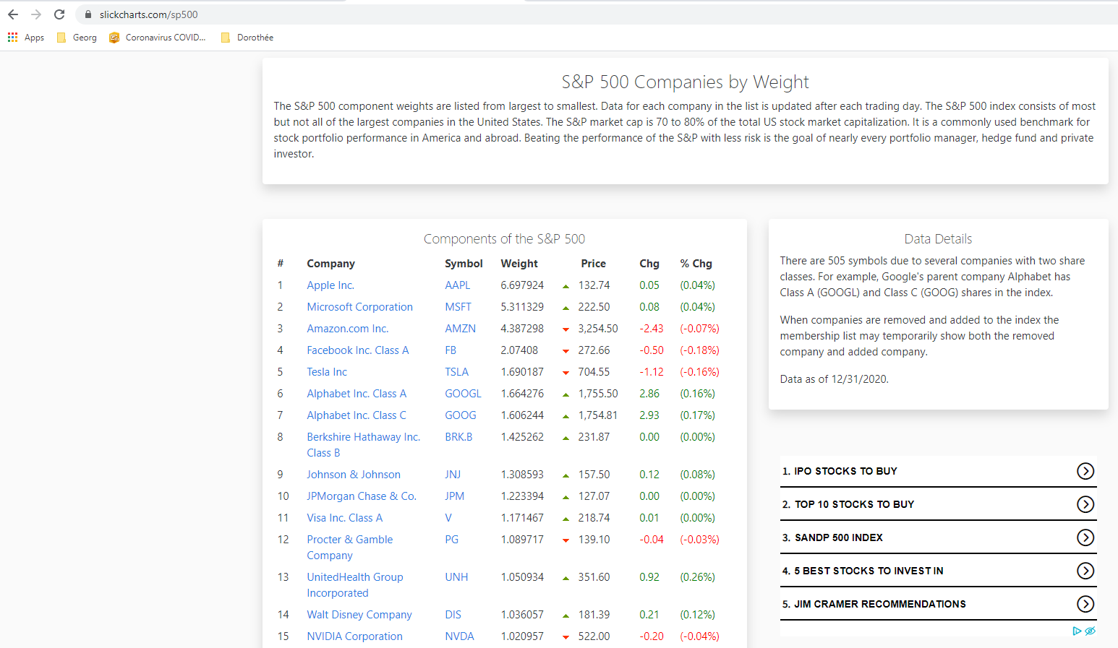
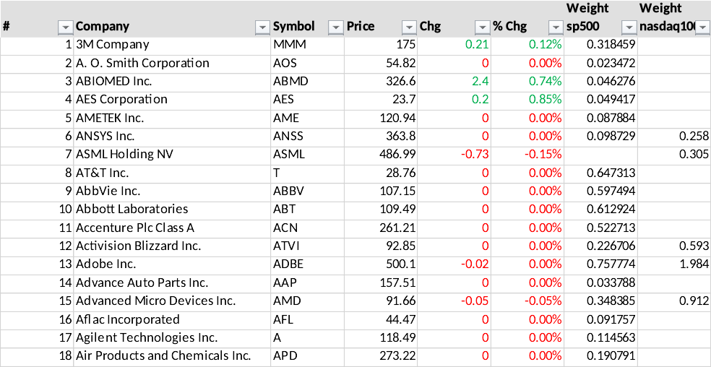
B4P Example #2
Combining Stock Data: SP 500 and NASDAQ 100
4P
B4P
Task: Import the SP 500 and NASDAQ 100 listings and merge them
Data source1: https://www.slickcharts.com/nasdaq100
Data source2: https://www.slickcharts.com/sp500
Some companies are listed in only one of them, others are listed in both.
Combine the information, show the weighting in the two listings and color the stock price developments

Slide 18
B4P Example #2
Combining Stock Data: SP 500 and NASDAQ 100
13 Statements, 1 loop and 1 variable do the complete job
// Download two web pages.
for all parameters ( {nasdaq100, sp500} , listing[] )
{
file download overwrite ( "https://www.slickcharts.com/" + listing[], listing[] + .html);
table load ( listing[] ,listing[] + .html, HTML, "Components of the" );
table rename column headers ( listing[], "Weight", "Weight " + listing[] );
// Weight info is specific to SP and Nasdaq, so add the listing name
table save ( listing[], listing[] + " as loaded.csv" );
}
// Combine the two tables
table merge extend columns ( nasdaq100, sp500, Symbol );
table rename ( sp500, stocks );
// Cleanup
table correct headers ( stocks, '*Price*', Price );
table rearrange columns ( stocks, { '#', Company, Symbol, Price, Chg, '% Chg' } ); // Weightings follow afterwards
// Percent value gets converted to regular number, price value is cleaned up
table process ( stocks, ['% Chg'] = smart numeral( middle( ['% Chg'], '(', ')' )); [Price] = clean numeral([Price]) );
table sort rows ( stocks, Company );
table process ( stocks, ['#'] = row() );
// Save the work
table save excel file ( stocks, "NASDAQ and SP500", Stocks.xlsx );
Download 2 files
and align header names
Merge the 2 tables
and assign common name
Clean Up
Save as Excel File

Slide 19
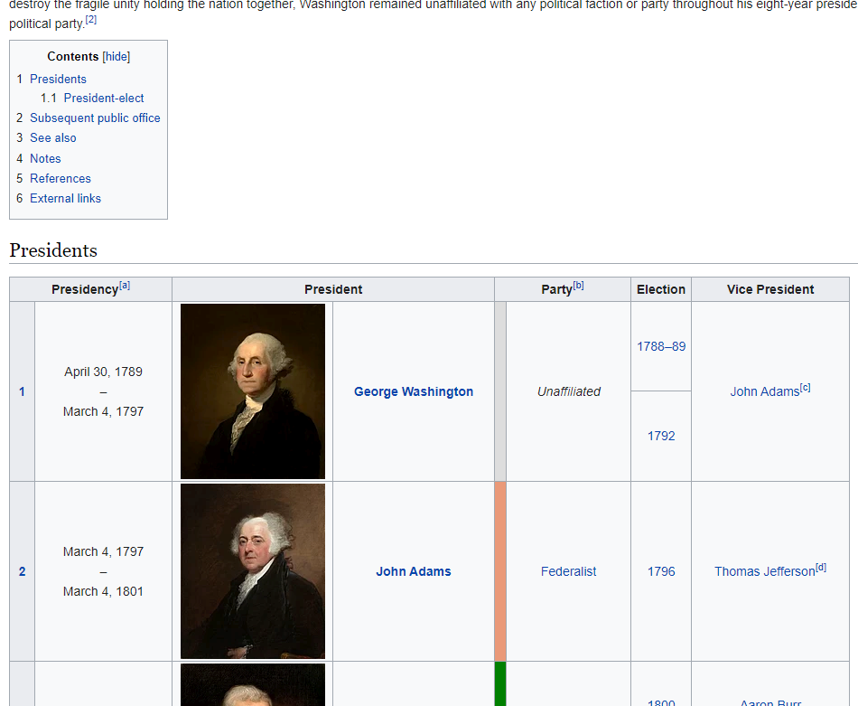
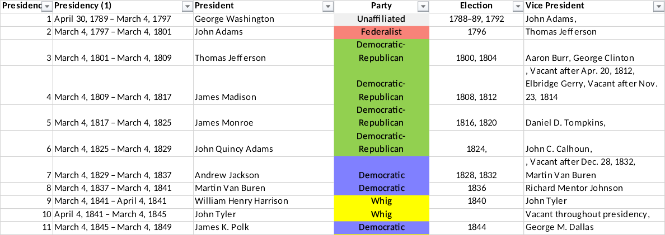
B4P Example #3
Web Data: Analyzing all Presidents in Wikipedia
4P
B4P
Task: Download the list of Presidents and generate Excel table with one president per row
Data source: https://en.wikipedia.org/wiki/List_of_presidents_of_the_United_States
Some Presidents had multiple terms
Ignore the portraits
Some vice presidents had deviating terms
Remove redundant artefacts, e.g. cross-referencing symbols
Generate a nice table with parties colored differently

Slide 20
B4P Example #3
Web Data: Analyzing all Presidents in Wikipedia
16 Statements, 0 Loops and 0 Variables to organize all the Presidents
include ( Style Library ); // This library needs to be included if you want to add style and formatting to the table
file download overwrite ( "https://en.wikipedia.org/wiki/List_of_presidents_of_the_United_States", presidents.html );
table load ( presidents, presidents.html, HTML, 'id="Presidents"' );
// Clean up and strip out all footnote references and new lines in the fields
table delete rows ( presidents, table length( presidents ) -1 ); // Remove last row with redundant footnote info
table process all cells ( presidents, [.] = replace all( literal([.]), { "[a]" .. "[z]", new line}, '' ) );
// Remove the blank column originally containing portraits and put president name into all rows
table delete columns ( presidents, {President, Party } );
table rename column headers ( presidents, {"President (1)","Party (1)"}, {President, Party} );
table fill vertically ( presidents, President );
table consolidate ( presidents, President, { Election, Vice President }, append, ", " );
table initialize ( party colors, // Define party colors
{{ Party Name, Colors },
{ Democratic, "#8080FF" }, // Light blue
{ Republican, "#FF8080" }, // Light red
{ Federalist, coral },
{ "Democratic- Republican", excel light green },
{ "Democratic-Republican", excel light green },
{ Whig, yellow },
{ National Union, ocre },
{ Unaffiliated, gray 15 } } );
// Add some colors and styles
table process ( presidents, table style cells( presidents, Party, row(), single,
fill color, [ party colors : Party Name, [Party], Colors ] ) );
table style columns ( presidents, { "Presidency (1)", "President", "Vice President" }, sheet, column width, 30 );
table style columns ( presidents, { Party, Election }, sheet, column width, 20, horizontal align, middle );
table style rows ( presidents, 0, table, boldface, true );
table style table ( presidents, sheet, wrap text, true, autofilter, 0, freeze rows, 1 );
translate style attributes for excel ( presidents );
table save excel file ( presidents, All U.S. Presidents, presidents.xlsx );
Internet Download
in 1 statement
Cleanups
with minimum effort
Align the data.
Contents done!
Define colors
affiliated to the parties
Color and Style the results
Save as Excel File

Slide 21
B4P
Beyond Former Performance.
Information
www.b4p.app
Europe
Georg zur Bonsen
+41 56 221 82 00
zur-bonsen (at) bluewin .ch
North America
Rafael M Richards
+1 202 469 15 27
rmrich5 (at) gmail .com
Contact
Presentation: Updated 2021-01-07

Slide 22
Table of Contents
1
The Problem Statement
2
The Analytics and Execution Engine
3
Typical Use Cases
4
The B4P Language
5
Programming Examples
6
Backup Slides

Slide 23
B4P
New in Release 8.00
100% Excel Support
Overall Clean-up
Help and Documentation
B4P loads and saves the latest
Microsoft Excel file format (.xlsx)
Formatting and styles are supported
B4P also supporting the old
Excel XML 2003 file format
Round trip: Generated excel files can be loaded again with out losing data.
Thorough functional tests and stress tests have been carried out to make B4P become even more reliable.
The start-up behavior has been streamlined.
Moved from PDF to 100% online
www.b4p.app
Online help available inside B4P on
your fingertips, i.e. by typing "docs"
Lots of reproducible program examples
Various new help features are available
Excel files are actually ZIP files containing various files describing workbooks, tables, styles and shared strings.
The functions
table load excel file and
table save excel file
are implemented in B4P.
A small number of new functions have been added which include the following:
Processing table columns
Processing table cells
Advance table search and update functions
Improved visualization of tables
Improved listing of tables, functions and variables
The document generation has been automated using a B4P program. It fishes all raw contents from source code comments and supplementary text files, generates a master file (JSON) and finally produces all web document contents automatically.
Almost all programming examples are tested automatically with every new update and the outputs are included in the documentation.

Slide 24
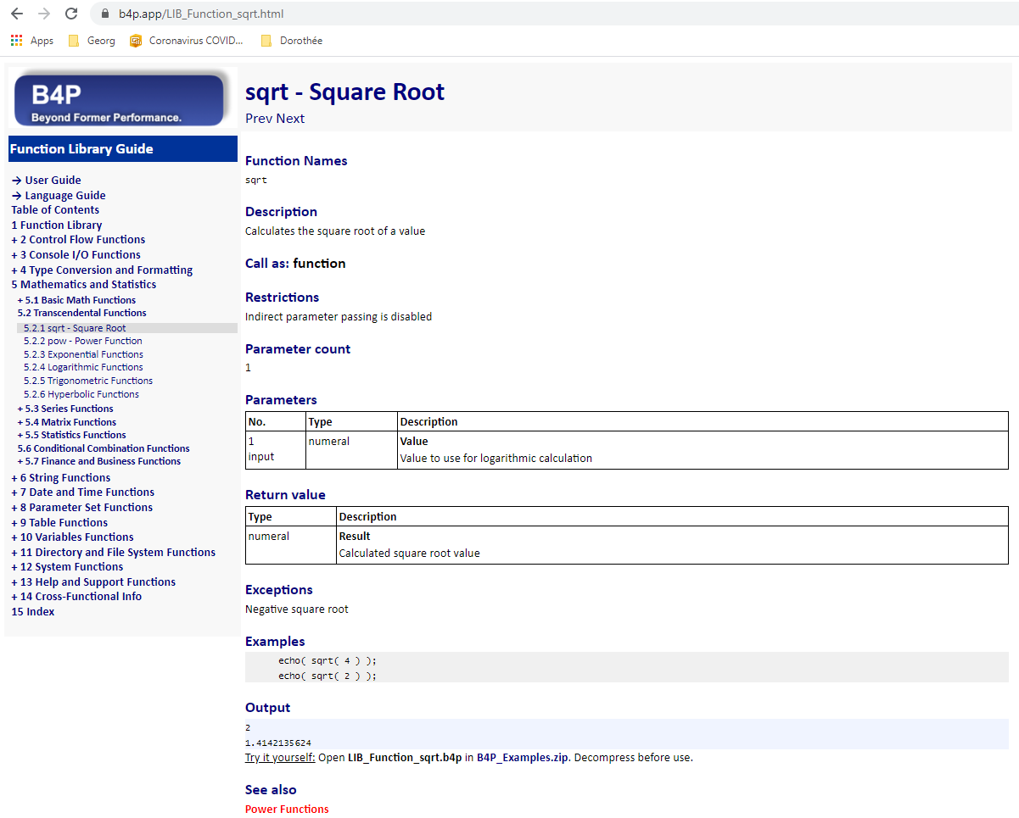
B4P Use Case
Automatic documentation generation for website www.b4p.app
Inputs: Source Text (inside C program)
Output: Web contents
// sqrt
// ___________________________________________________________________________
/* B4PDOCU.START
"sqrt - Square Root" :
{
"Function Names": "sqrt",
"Keywords": "Square Root",
"Documentation": "Function Description",
"Description"::
Calculates the square root of a value
+++,
"Call as": "function",
"Parameter count": "1",
"Restrictions": "Indirect parameter passing is disabled",
"Parameters":
[
{ "Number": "1",
"Name": "Value",
"Direction": "input",
"Types": "numeral",
"Description": "Value to use for logarithmic calculation"
} ],
"Return value":
[
{ "Name": "Result",
"Types": "numeral",
"Description": "Calculated square root value"
}
],
"Exceptions": "Negative square root",
"Examples"::
echo( sqrt( 4 ) );
echo( sqrt( 2 ) );
+++,
"Output": "automatic",
"See also": "Power Functions"
}
B4PDOCU.STOP */
void function__sqrt(int bias, Token_List& p, Token_Entry& ret_val)
{
...
return;
}
Consistent structure
Clean tables
4P
B4P
Program examples
executed automatically
Smart cross-
referencing

Slide 25
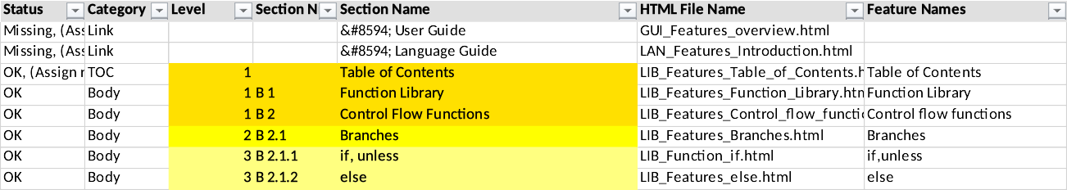
B4P Use Case
Automatic Document Generation for www.b4p.app using B4P
Catalog of Books
Short Excel File
Specifies all manuals to
generate
Specifies location of source
text for the different manuals
Catalogue
of Books
Preparation
Preparation
Load catalogue of books
User selects the book to generate
Excel
Text Collection
Scan all files in specified subdirectories for
relevant contents for B4P documentation
C / C++
C / C++
Collecting all
raw texts
Raw Inputs
Descriptions of B4P functions are documented in the C/C++ files in comments, using an enhanced JSON format.
Other contents such as introductory parts are described in additional text files, also using enhanced JSON format
C / C++
C / C++ Source Code
/* ... Raw Docu inputs */
Master File
JSON
Verification
C / C++
✓
C / C++
Verification
Ensures that contents provided fulfill the structural guidelines
C / C++
Text Files
... Raw Docu inputs
Collect all
keywords
Collect all Keywords
Structured handling of all keywords and function names allowing convenient cross referencing and index pages
Revolving Table of Contents
It puts all individual raw document sections into a given order and hierarchy level in the document
Both user and B4P program update this table mutually
Revolving
ToC
Load & process
Revolving ToC
Process Revolving ToC
Add titles of new contents into placeholders or at the bottom
Add further info (links, keywords)
Do chapter/section renumbering
Excel
Create HTML
Navigator Bar
Generate HTML Navigation Bar
Left-hand menu to select section to see
Generate HTML contents
Formatted text and tables
Pictures included
Execute all B4P program examples automatically and add their outputs into the doc contents
Generate HTML
Contents
www
@
Place all web
contents in
staging area
Staging Area
All files (HTML, JPG, style.css, PDF, etc.) are moved to the staging area, ready for one-mouseclick publication on the Internet: www.b4p.app
www

Slide 26
Program Example #3
Combining Stock Data: SP 500 and NASDAQ 100
8 additional statements provide coloring and formatting
include ( Style Library );
// Download two web pages.
for all parameters ( {nasdaq100, sp500} , listing[] )
{
file download overwrite ( "https://www.slickcharts.com/" + listing[], listing[] + .html);
table load ( listing[] ,listing[] + .html, HTML, "Components of the" );
table rename column headers ( listing[], "Weight", "Weight " + listing[] );
// Weight info is specific to SP and Nasdaq, so add the listing name
table save ( listing[], listing[] + " as loaded.csv" );
}
// Combine the two tables
table merge extend columns ( nasdaq100, sp500, Symbol );
table rename ( sp500, stocks );
// Cleanup
table correct headers ( stocks, '*Price*', Price );
table rearrange columns ( stocks, { '#', Company, Symbol, Price, Chg, '% Chg' } ); // Weightings follow afterwards
// Percent value gets converted to regular number, price value is cleaned up
table process ( stocks, ['% Chg'] = smart numeral( middle( ['% Chg'], '(', ')' )); [Price] = clean numeral([Price]) );
table sort rows ( stocks, Company );
table process ( stocks, ['#'] = row() );
// Add some color and formatting
table process ( stocks,
table style cells ( stocks, {'Chg','% Chg'}, {2:row()}, single, text color, select if ( [Chg]>0, excel green, red ) ) );
table style rows ( stocks, 0, table, fill color, gray 14, boldface, true, wrap text, true );
table style columns ( stocks, Company, sheet, column width, 30 );
table style columns ( stocks, '% Chg', sheet, number format, "0.00%" ); // Value to show as percent.
table style table ( stocks, sheet, freeze rows, 1, autofilter, 0);
// Save the artwork
translate style attributes for excel ( stocks );
table save excel file ( stocks, "NASDAQ and SP500", Stocks.xlsx );
Download Files
and align header names
Merge the Tables
and assign common name
Clean Up
Add style and color
Save as Excel File

Slide 27
Table of Contents
1
Problem Statement
2
B4P Analytics and Execution Engine
3
Real-world Use Cases
4
The B4P Language
5
Programming Examples

Slide 28
Table of Contents
1
Problem Statement
2
B4P Analytics and Execution Engine
3
Real-world Use Cases
4
The B4P Language
5
Programming Examples

Slide 29
Table of Contents
1
Problem Statement
2
B4P Analytics and Execution Engine
3
Real-world Use Cases
4
The B4P Language
5
Programming Examples

Slide 30
Table of Contents
1
Problem Statement
2
B4P Analytics and Execution Engine
3
Real-world Use Cases
4
The B4P Language
5
Programming Examples

