Slide 1
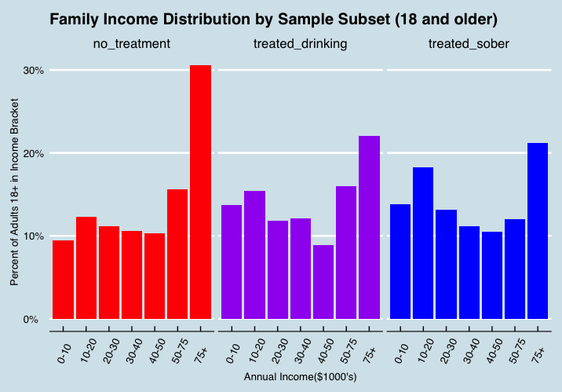
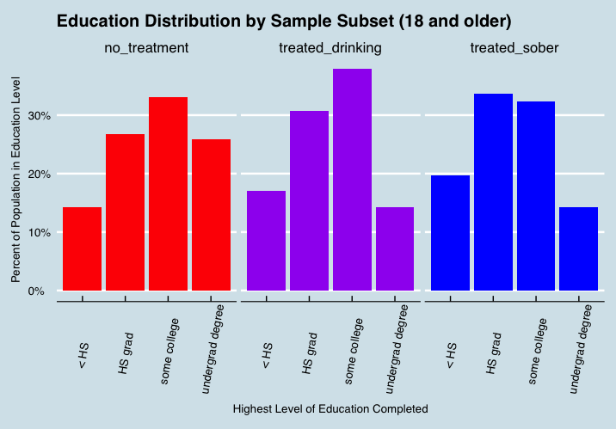
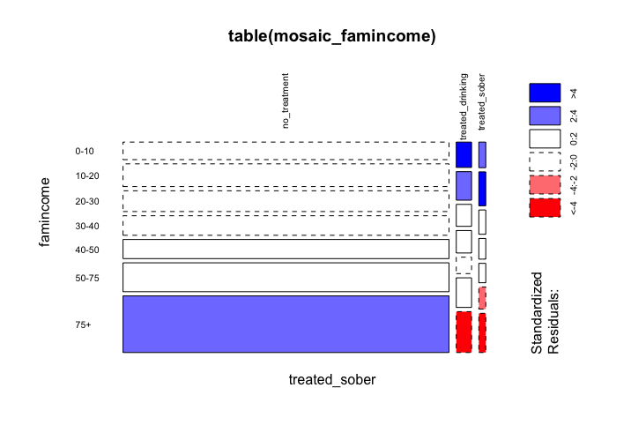
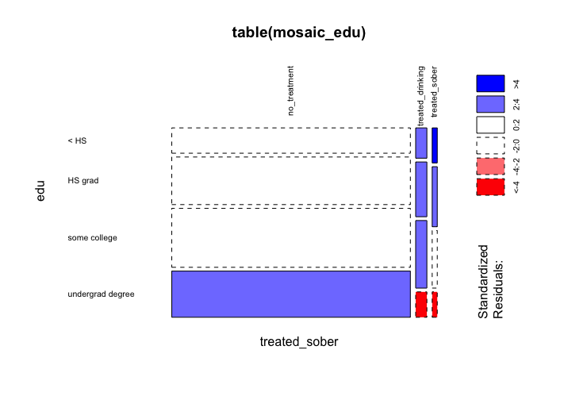
Exploring the Relationship Between Socioeconomic Status and Long Term Treatment Outcomes in the 2015 National Survey on Drug Use and Health
George Rhodes
Background:
The Substance Abuse and Mental Health Services Administration (SAMHSA) claims that 21.6 million Americans age 12 and over struggled with a substance use disorder (SUD) in 2013. Since health disparities across socioeconomic statuses (SES) influence the availability, utilization, and impact of health services, attempts to treat the addicted population must take SES into account. But what role does SES play on the ability to recover from addiction?
Data:
Public use data from the 2015 National Survey on Drug Use and Health (NSDUH) downloaded from the SAMHSA.
Research Question:
Does SES impact treatment outcomes among respondents to the 2015 NSDUH age 18 and older?
Methods:
Used R and RStudio to clean and recode relevant variables.
Chose Family Income and Level of Education as SES measures.
Created a new nominal variable named “treated_sober” to form three subgroups of sample.
no_treatment = has not received addiction treatment.
treated_drinking = received treatment and has drank in the past year.
treated_sober = received treatment and has not drank in past year.
Calculated the proportions based off of the population within each subgroup to compare SES profiles across the three subgroups.
Ran chi-squared test and created mosaic plots to understand and display the differences between the expected and observed frequencies.
Findings:
Treated_sober and family income:
X-squared = 172.07, df = 12, p-value < 2.2e-16
Treated_sober education level:
X-squared = 206.56, df = 6, p-value < 2.2e-16
Higher measures of SES are overrepresented in the no_treatment group.
Lower measures of SES are overrepresented and higher measures of SES are underrepresented in both the treated_drinking and treated_sober groups.
Limitations:
Fails to answer research question.
Positive treatment outcome defined as abstaining from alcohol for 12 months which fails to capture reduction in either consumption or consequences.
Treatment could be for drugs or alcohol while the outcome is measured by abstinence from alcohol.
Household makeup omitted and measures of SES have upper limits of $75k and undergraduate degree.
Type of treatment not yet explored.
Sources: 2015 National Survey on Drug Use and Health, public use data set from SAMHDA
Pampel, F. C., Krueger, P. M., & Denney, J. T. (2010). Socioeconomic Disparities in Health Behaviors. Annual Review of Sociology, 36, 349–370.
Phelan, J. C., Link, B. G., & Tehranifar, P. (2010). Social conditions as fundamental causes of health inequalities: theory, evidence, and policy implications. Journal of Health and Social Behavior, 51 Suppl, S28-40

