Slide 1
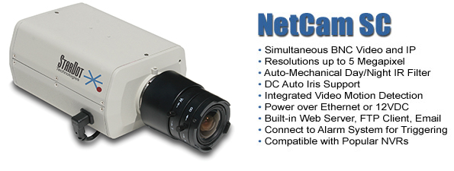



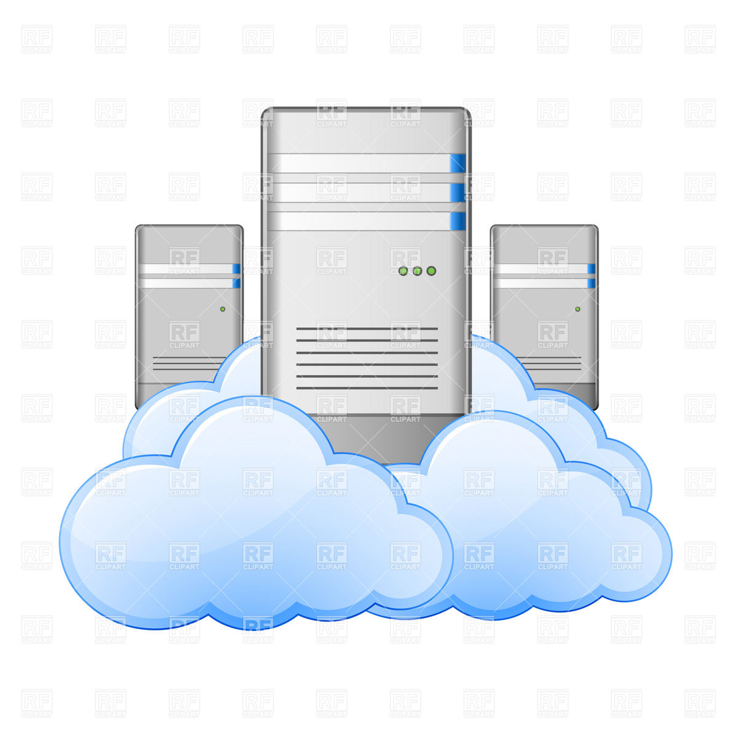

Setup 1
R
Field
Data Storage @ University
Desktop
Notes:
http://images.google.de/imgres?imgurl=https://thetomatos.com/wp-content/uploads/2016/02/hiker-clipart-1.gif&imgrefurl=https://thetomatos.com/free-clipart-14643/&h=284&w=490&tbnid=9oqiGb3OeSuRdM:&docid=69TjXdHTW3KDKM&ei=45CSWMq8IuyLgAaxwKiADw&tbm=isch&iact=rc&uact=3&page=0&start=0&ved=0ahUKEwiKutHapvDRAhXsBcAKHTEgCvAQMwg4KBgwGA&bih=989&biw=1877
http://images.google.de/imgres?imgurl=http://vignette3.wikia.nocookie.net/clubpenguin/images/8/82/Student_Desk.PNG/revision/latest%3Fcb%3D20140411234122&imgrefurl=http://clubpenguin.wikia.com/wiki/Student_Desk&h=1345&w=1832&tbnid=mbRQm9AqbHB0dM:&docid=jEJSZ0Aqg2IcbM&ei=w5KSWPqTOdPwgAaYnY2wCg&tbm=isch&iact=rc&uact=3&page=0&start=0&ved=0ahUKEwi6gdm_qPDRAhVTOMAKHZhOA6YQMwhGKCYwJg&bih=989&biw=1877
https://www.honeycombcreative.com/wp-content/uploads/2016/01/website-seo-page.svg

Slide 2
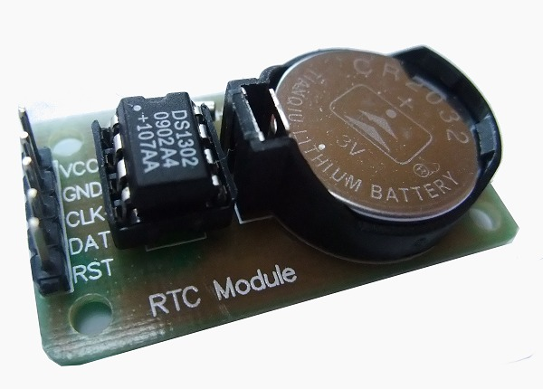

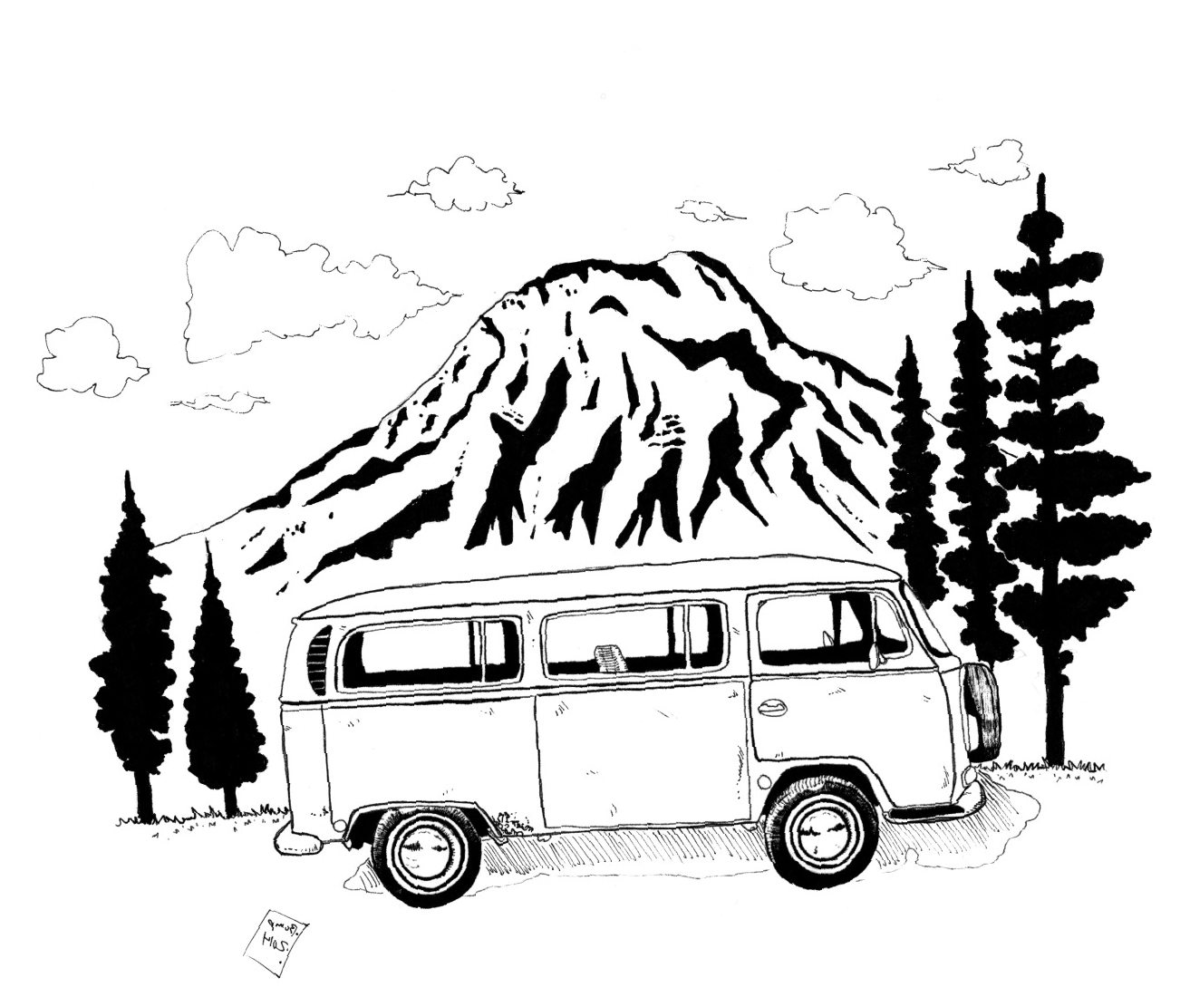
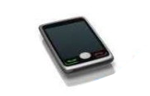

Setup 2
RTC
(Timeserver)
R
SSH
(Mobile Hotspot)
Manually
(external storage)
Field
Desktop
Notes:
http://images.google.de/imgres?imgurl=https://thetomatos.com/wp-content/uploads/2016/02/hiker-clipart-1.gif&imgrefurl=https://thetomatos.com/free-clipart-14643/&h=284&w=490&tbnid=9oqiGb3OeSuRdM:&docid=69TjXdHTW3KDKM&ei=45CSWMq8IuyLgAaxwKiADw&tbm=isch&iact=rc&uact=3&page=0&start=0&ved=0ahUKEwiKutHapvDRAhXsBcAKHTEgCvAQMwg4KBgwGA&bih=989&biw=1877
http://images.google.de/imgres?imgurl=http://vignette3.wikia.nocookie.net/clubpenguin/images/8/82/Student_Desk.PNG/revision/latest%3Fcb%3D20140411234122&imgrefurl=http://clubpenguin.wikia.com/wiki/Student_Desk&h=1345&w=1832&tbnid=mbRQm9AqbHB0dM:&docid=jEJSZ0Aqg2IcbM&ei=w5KSWPqTOdPwgAaYnY2wCg&tbm=isch&iact=rc&uact=3&page=0&start=0&ved=0ahUKEwi6gdm_qPDRAhVTOMAKHZhOA6YQMwhGKCYwJg&bih=989&biw=1877
https://www.honeycombcreative.com/wp-content/uploads/2016/01/website-seo-page.svg

