Slide 1
WELCOME

Slide 2
INTRODUCTION

Slide 3
GROUP MEMBERS:
Georshan .G
Surya .A
Cherin .K
Henlin .SJ

Slide 4
E-COMMERCE

Slide 5

Introduction of E-commerce:
Definition of E-Commerce:
E-commerce is the activity of electronically buying or selling of products on online services or over the Internet.
About our Project:
Admin Monitors the Activity of the user’s and checks the transaction

Slide 6

ADVANTAGES:
Fast Buying and Selling Products
24/7 (Buying & Selling)
No need of Physical Company Setup
Easy to Start and maintain Business

Slide 7

Disadvantages:
Lack of Security

Slide 8
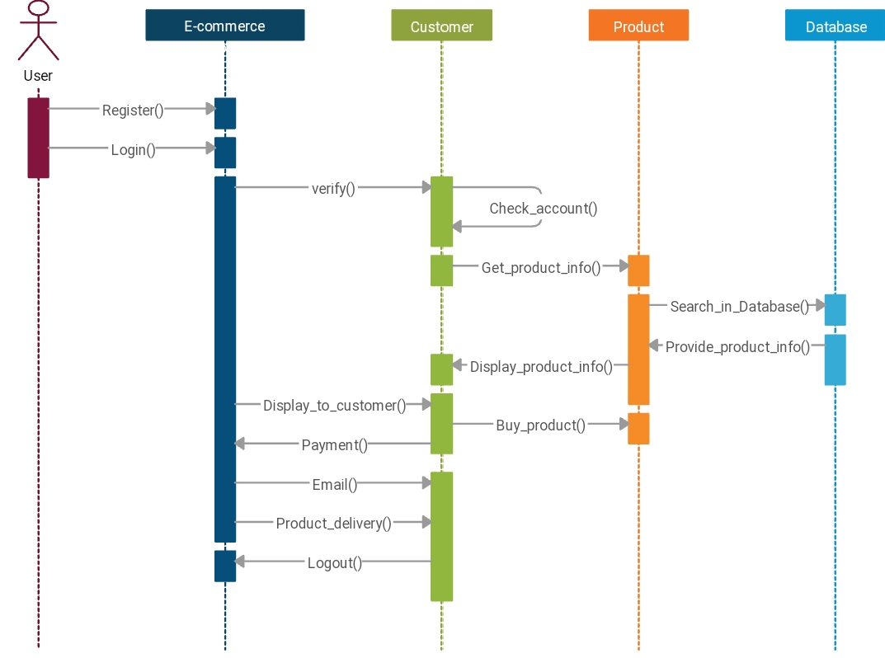
Interaction Diagram:

Slide 9

Features:
Customer Related Access
Category List
Product List
Cart Items
Product Items
Check out Products
Payment Gateway
Track Items
Seller Related Access
Adding Products
Ordered Items
Related to Particular Seller
Product Status Update
Admin Related Access
Adding Products
Ordered Items
Products Status Update
Checking other User Product

Slide 10

Languages And tools:
CLIENT SIDE
HTML 5
CSS
Javascript
SERVER SIDE
Php
MySql

Slide 11
Project Review:

Slide 12


