Slide 1
C-Shell with Functions
Arlindo da Silva
Arlindo.daSilva@nasa.gov
November 2006

Slide 2
Overview
Motivation
Basic Functionality
Implementation Overview
Available Keywords
Style Guide
  Passing arguments by reference
Examples
Summary

Slide 3
Motivation
Modern Unix shells such as bash and ksh permit definition of user defined functions at the top of the file, e.g.,
Both csh and tcsh lack this feature which makes any kind of encapsulation very difficult.
However, one can simulate this functionality within the csh by a combination of the alias and source commands.
#!/bin/bash
hello() {
echo "Hello, $1!"
}
hello World

Slide 4
Basic Functionality
A sourceable file Functions.csh defines the relevant aliases and must be included at the top of the user code
As in bash/ksh functions are defined at the top of the file with the keywords Sub and /end:
#!/bin/csh
Use Functions.csh
Sub hello
echo "Hello, $1!"
\end
Call hello World

Slide 5
Implementation Overview
For each function, all code between Sub and \end are written to a temporary script file with the function name as part of the file name
Functions are invoked with the keyword Call which in turn sources this temporary file passing the specified parameters
  In addition to the usual $1, $2. … arguments one can also define named arguments
  Functions can also be Run, in which case the corresponding script is executed instead of being sourced.
    Useful to avoid clobbering local variables

Slide 6
Available Keywords
Use module
  Sources the first occurrence of file “module.csm” on your path
  Module files usually contain function definitions
  Module files must have extension .csm
Sub name ( arg1, arg2,…)
  Defines a new function named name
  The named argument arg1, arg2, etc., are optional
    One call always use $1, $2…
    When present, code fragment is automatically generated with the assignments
      Set arg1 = $1
      Set arg2 = $2, etc.
    Notice that when using Call there is only one name space

Slide 7
Keywords, cont…
Call name ( arg1, arg2, …)
  Invokes a function by sourcing the corresponding temporary script file
  Parenthesis and commas are optional and stripped out when present
    Current implementation is dumb
    The arguments must be simple words with no spaces
    All arguments are passed by value, but one can simulate references by passing the name of a csh variable
Call_ name arg1 arg2 …
  Like Call but without parenthesis and commas
  Arguments can be strings

Slide 8
Keywords, cont…
Run name arg1 arg2 …
  Like Call_ but in this case the temporary script file is run as an external script
  There is no good way to return variables in this case
  Since the script runs on its own name space, there is not danger of clobbering shell variables
Clean
  Cleans up temporary script files
  Can be used to erase the internal “function table”
  It is a good idea to execute this alias at the end of your main script
  This alias is automatically run when the shell variable Verify is set and the function returns a non-zero status.

Slide 9
Error trapping
Verify
  Set this variable for automatic error handling
  When a function is called or run, and returns a non-zero error code, your calling script will exit with the same error code when this variable is set
    Alias Clear will be executed prior to an abnormal exit
  You can go back to the default behavior by unsetting Verify

Slide 10
Shell echo and verbose
The verbose and echo variables and the related -v and -x command line options can be used to help trace the actions of the shell.
Since the source command does not recognize lines of the form
One will need to explicit set the echo and verbose shell variables to obtain the desired echoing of csh commands as they are executed
#!/bin/csh -fx

Slide 11
Reserved variables
The following variables are used internally and should be considered as reserved
  ARG___
  ARGV___
  ARGC___
  FILE___
  NAME___
  RC___

Slide 12
Style Guide
Because the source command works on the same name space as the calling script, care should be taken to avoid clobbering shell variables
In particular, the implementation of named arguments creates variables with the same name as the arguments, for example
Will create variable $name which will be set to “World” after this function invocation
#!/bin/csh
Use Functions.csh
Sub hello ( name )
echo "Hello, $name!"
\end
Call hello World

Slide 13
Style Guide, cont…
To avoid this side effect, add underscore to the end of input variables
Variable $name_ will still be created but if one reserves this name convention for argument variables no conflict will arise.
#!/bin/csh
Use Functions.csh
Sub hello ( name_ )
echo "Hello, $name_!"
\end
Call hello World

Slide 14
Style Guide, cont…
All arguments are passed by value, in the sense that a function argument variable is never modified
However, one can pass a variable name and have the script set this variable with the desired result
As a convention we prefix the output argument expected to contain a variable name with an underscore.
#!/bin/csh
Use Functions.csh
Sub add ( first_, second_, _result )
@ result_ = $first_ + $second_
set $_result = $result_
\end
Call add(3,5,result)
echo “Result is $result”

Slide 15
Examples
Along with the main sourceable file
  Functions.csh
you will find a some example/test code
  utFunctions.csm: module file with function definitions
  utFunctions.csh: driver
The next slides reproduce some of these examples

Slide 16
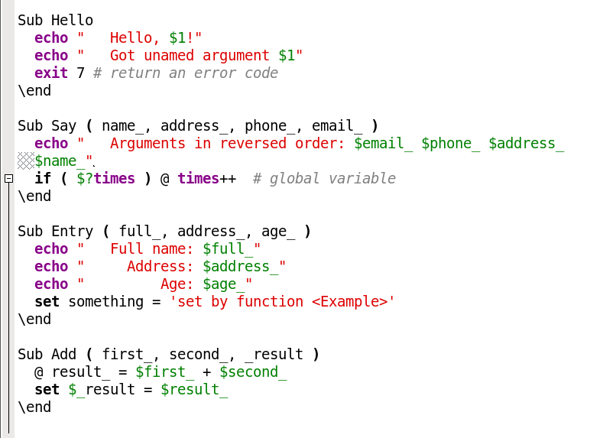
Example 1
Simple function passing unnamed arguments; there is no automatic exiting since Verify is not set by default.
% Call Hello 'World'
% if ( $status ) \
echo "Function <Hello> returned $status“
Hello, World!
Got unamed argument World
Function <Hello> returned 7

Slide 17
Example 2
Regular Call; arguments must be simple words, no strings
% set first = "arlindo"
% set times = 7
% Call Say ( $first, maryland, 301-592-0303, dasilva )
% echo "Variable times now has value $times“
Arguments in reversed order: dasilva 301-592-0303 maryland arlindo
Variable times now has value 8

Slide 18
Example 3
Naked Call_; arguments can be strings, global variable something reset
% set something = "set in <main>"
% Call_ Entry 'Arlindo Moraes da Silva' \
'212 Whitmoor Terrace' '29'
% echo "Variable 'something' $something"
Full name: Arlindo Moraes da Silva
Address: 212 Whitmoor Terrace
Age: 29
Variable 'something' set by function <Example>

Slide 19
Example 4
Run function as script; global variable something is not reset in this case
% set something = "set in <main>"
% Run Entry 'Arlindo Moraes da Silva' \
'212 Whitmoor Terrace' '29'
% echo "Variable 'something' $something"
Full name: Arlindo Moraes da Silva
Address: 212 Whitmoor Terrace
Age: 29
Variable 'something' set by function <main>

Slide 20
Example 5
Passing arguments by reference
% Call Add ( 3, 5, result )
% echo "Result is $result“
Result is 8

Slide 21
Example 6
Simulating error condition with Verify set
% set Verify
% Call Aloha
error: function <Aloha> not defined
error: aborting <Aloha> with rc = 1

Slide 22
Summary
A simple mechanism has been presented for introducing user defined functions in the C-Shell
Although encapsulation is now possible, there are still serious limitations in the csh that makes it not recommended for medium to high complexity scripts
  Perl, python or even bash/ksh are much better choices
However, the encapsulation afforded here can be the first step towards conversion of a large script to another language.

Slide 23
Functions.csh
Source code on 11/28/2006 follows…

Slide 24
Function.csh
# Short-hand to make fortran/perl programmers happy
# Syntax: Use module_name
# Example: Use utFunctions
# Module files are required to have extension ".csm",
# but the extension is not required in the module name.
# ----------------------------------------------------
alias Use \
'set FILE___ = "\!*"\
if ( "$FILE___:e" != "csm" ) set FILE___ = $FILE___.csm\
set ARG___ = `which $FILE___`\
set RC___ = $status\
if ( $RC___ ) then\
echo "error: cannot find module $FILE___"\
else\
source $ARG___[1]\
set RC___ = $status\
endif\
if ( $?Verify && $RC___ ) then\
echo "error: aborting <Use> with rc = $RC___"\
exit $RC___\
endif\
set status = $RC___'

Slide 25
Function.csh, cont…
# Sub declaration: un-quoted here documents save to tmp file
# ---------------------------------------------------
alias Sub \
'set ARGV___ = (`echo "\!*"|sed -e "s/(//g" -e "s/)//g" -e "s/,/ /g"`)\
set NAME___=$ARGV___[1]\
shift ARGV___\
echo "# Auto-generated by Functions.csh" > $TMPDIR/.cshFunctions.$$.$NAME___\
chmod +x $TMPDIR/.cshFunctions.$$.$NAME___\
echo "shift" >> $TMPDIR/.cshFunctions.$$.$NAME___\
set ARGC___ = 1\
foreach ARG___ ( $ARGV___ )\
echo "set $ARG___ =" \"{\$}argv\[$ARGC___\]\" >> $TMPDIR/.cshFunctions.$$.$NAME___\
@ ARGC___++\
end\
cat <<\end>>$TMPDIR/.cshFunctions.$$.$NAME___'

Slide 26
Function.csh, cont…
## Function call of the form: Call function ( arg1, arg2, ... )
# ---------------------------------------------------
alias Call \
'set ARGV___ = (`echo "\!*"|sed -e "s/(//g" -e "s/)//g" -e "s/,/ /g"`)\
set NAME___=$ARGV___[1]; set FILE___ = "$TMPDIR/.cshFunctions.$$.$NAME___"\
if ( $?Trace ) echo "---------------> Entering <$NAME___>"\
if ( -e $FILE___ ) then\
source $FILE___ $ARGV___\
set RC___ = $status\
else\
echo "error: function <$NAME___> not defined"\
set RC___ = 1\
endif\
if ( $?Verify && $RC___ ) then\
echo "error: aborting <$NAME___> with rc = $RC___"\
/bin/rm -rf $TMPDIR/.cshFunctions.$$.*\
exit $RC___\
endif\
set status = $RC___'

Slide 27
Function.csh, cont…
# Naked function call: Call_ function arg1 arg2 ... argn
# -----------------------------------------------------------
alias Call_ \
'set ARGV___ = ( \!* ); set NAME___ = "$ARGV___[1]"; set FILE___ = "$TMPDIR/.cshFunctions.$$.$NAME___"; if ( -e $FILE___ ) source $FILE___ \!*\
set RC___ = $status\
if ( $?Trace ) echo "---------------> Entering <$NAME___>"\
if ( ! -e $FILE___ ) then\
echo "error: function <$NAME___> not defined"\
set RC___ = 1\
endif\
if ( $?Verify && $RC___ ) then\
echo "error: aborting <$NAME___> with rc = $RC___"\
/bin/rm -rf $TMPDIR/.cshFunctions.$$.*\
exit $RC___\
endif\
set status = $RC___'

Slide 28
Function.csh, cont…
# Run: Like Call_ but run function as a separate shell script
# This is useful to preserve your name space.
# -----------------------------------------------------------
alias Run \
'set ARGV___ = ( \!* ); set NAME___ = "$ARGV___[1]"; set FILE___ = "$TMPDIR/.cshFunctions.$$.$NAME___"; if ( -e $FILE___ ) $FILE___ \!*\
set RC___ = $status\
if ( $?Trace ) echo "---------------> Entering <$NAME___>"\
if ( ! -e $FILE___ ) then\
echo "error: function <$NAME___> not defined"\
set RC___ = 1\
endif\
if ( $?Verify && $RC___ ) then\
echo "error: aborting <$NAME___> with rc = $RC___"\
/bin/rm -rf $TMPDIR/.cshFunctions.$$.*\
exit $RC___\
endif\
set status = $RC___'
# Verify status, sort of like GEOS-5
# ----------------------------------
alias Verify_ 'if ( $status ) exit $status'
# Delete temp files: Clean [all]
# ------------------------------
alias Clean \
'if ( "\!*" == "all" ) then\
/bin/rm -rf $TMPDIR/.cshFunctions.*\
else\
/bin/rm -rf $TMPDIR/.cshFunctions.$$.*\
endif'

