Slide 1
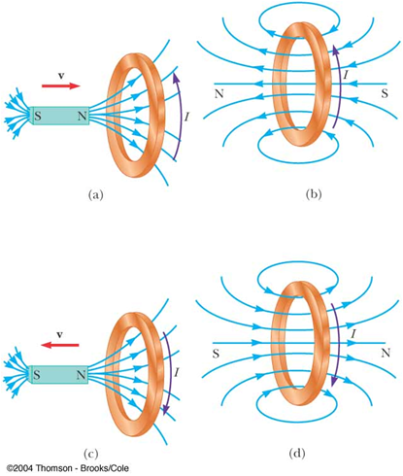

Slide 2
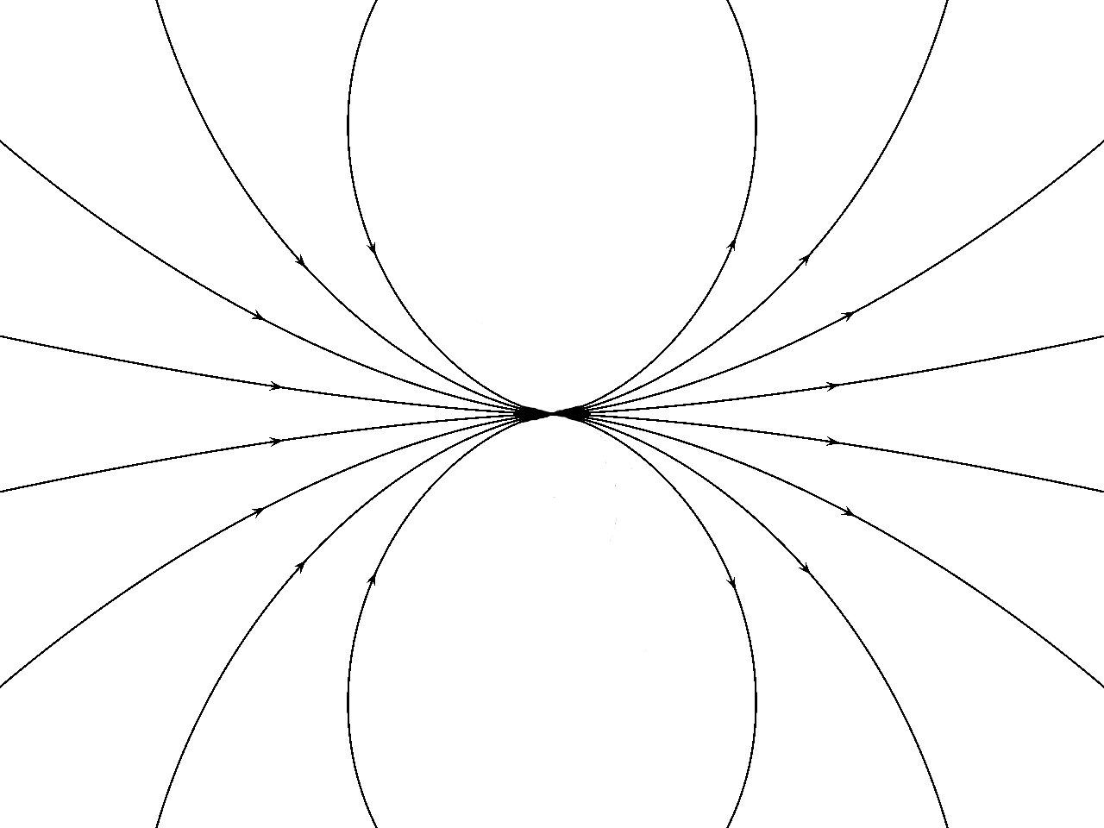

S
N
I

Slide 3
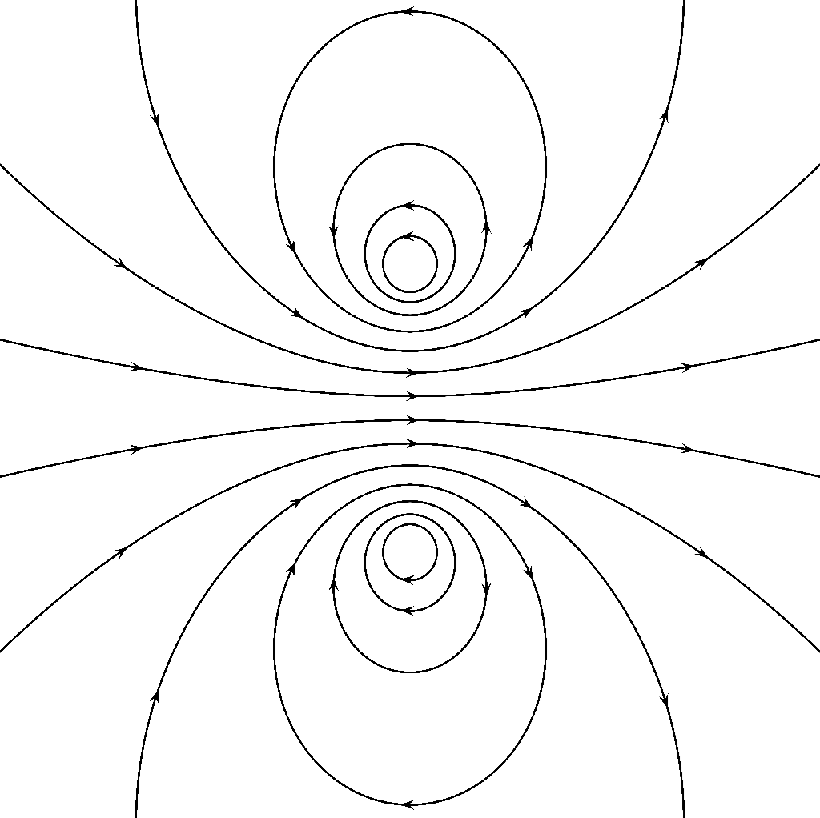
I

Slide 4
S
N
I

Slide 5
I

Slide 6
Increasing Magnetic Flux
I
I
S
N
(a)
(b)
Decreasing Magnetic Flux
S
N
I
I
(c)
(d)

