Slide 1
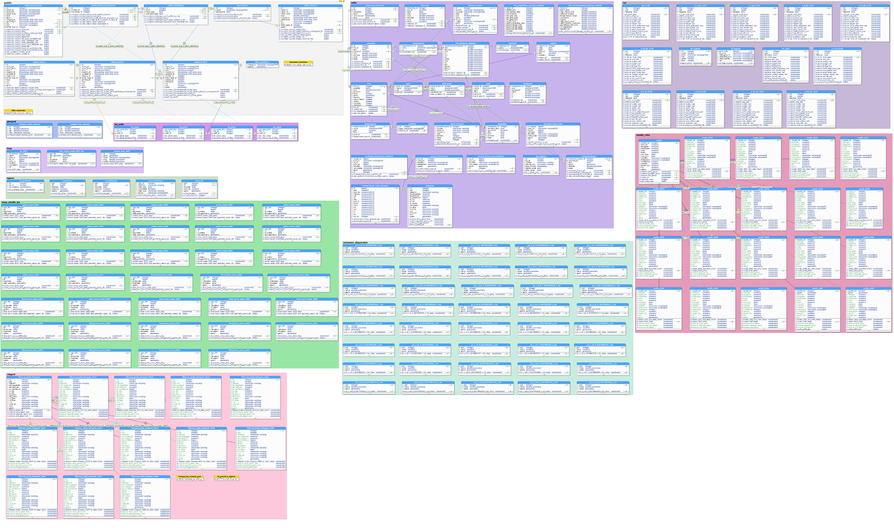
Administrative Boundaries
Land Cover
GlobCover and Corine
Oracle Mapped Tables (emissions)
e-geos new burnt areas
Effis / Gwis
Unfiltered FIRMS hotspots global
Final and active burnt areas (Tomas)
Modeled Emissions and Dispersion (Bruno)
Oracle Mapped Tables (current ba and evolution)

Slide 2
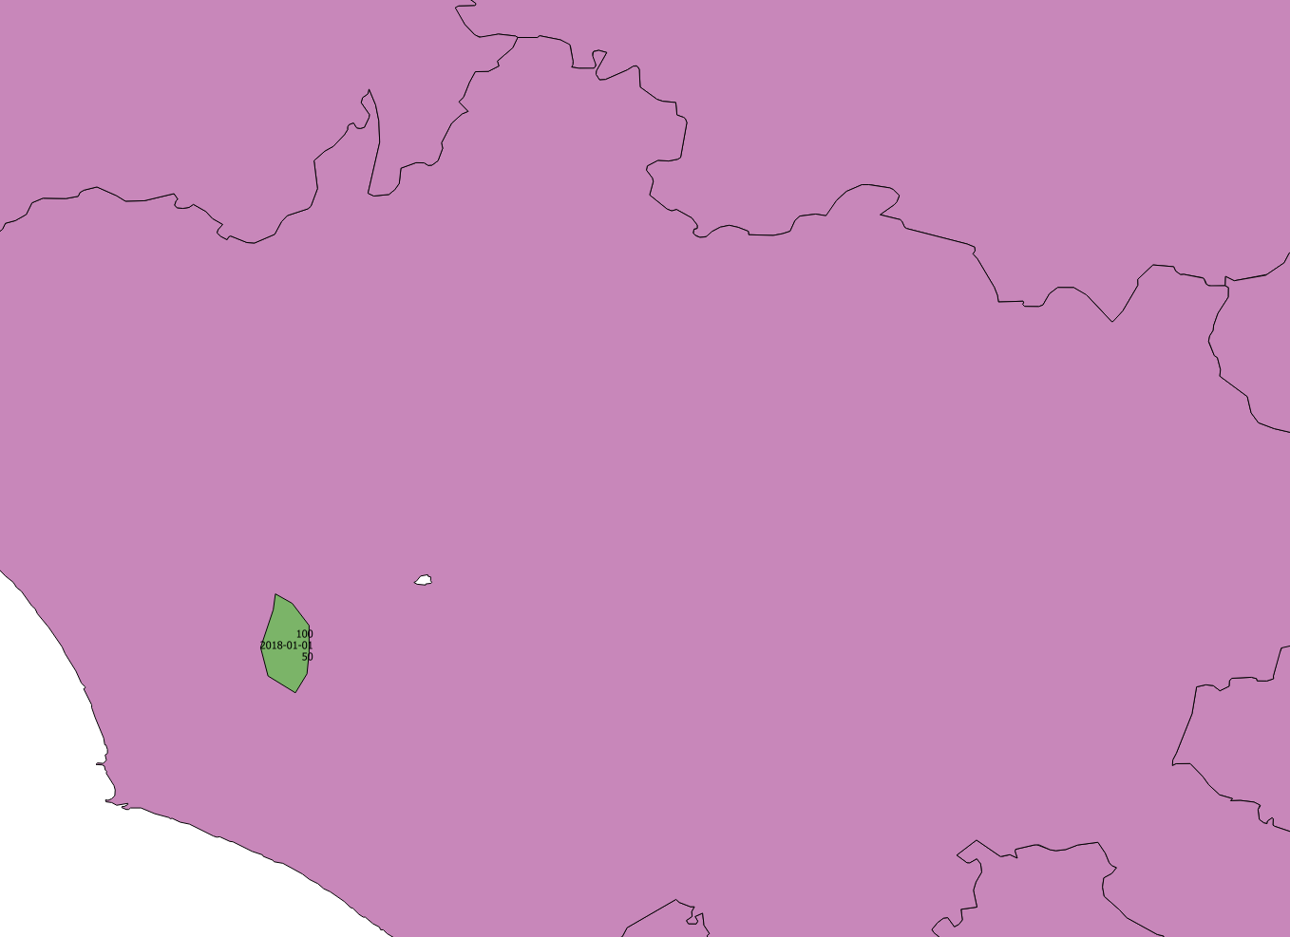

Slide 3
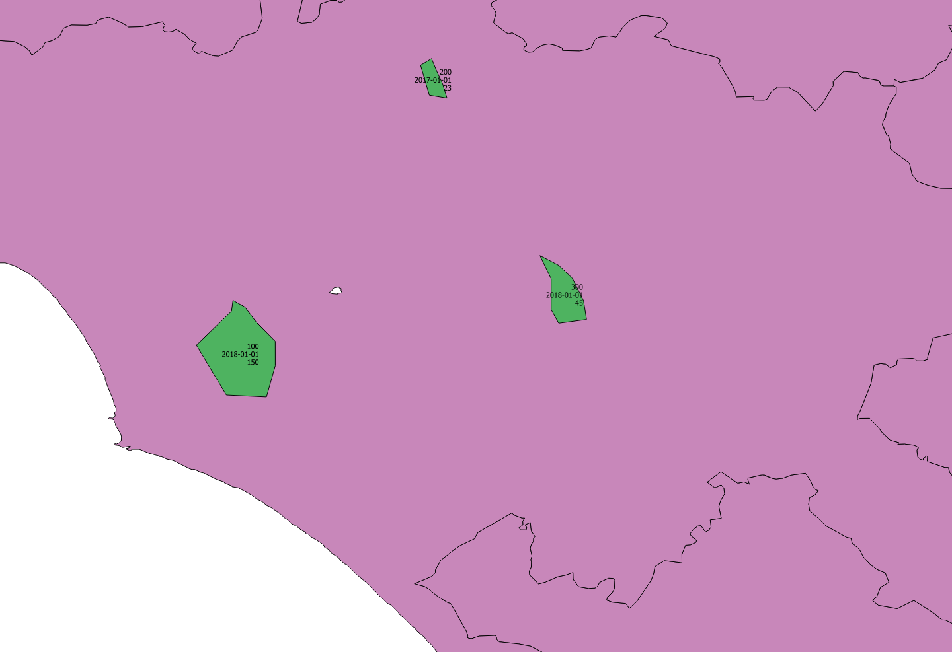

Slide 4


Slide 5
