Slide 1

Task 1
Performance Loss Detection
Applied Industrial AI for Manufacturing
M.Sc. Industrial AI · HS Albstadt-Sigmaringen · plus10 GmbH
Group Members
111048
Ephraim Neke Kamalu
110989
Pratiksha Satish Ramane
110770
Abeera Biju
Geo Shajan
110730
05 May 2026 · Lecturer: Felix Georg Müller

Slide 2
MINI-PROJECT 1 OF 3
What we're covering today
1.
OEE refresher
4.
Modelling
A quick look at Availability, Performance, and Quality
A rule-based filter combined with K-Means clustering (K = 4)
2.
Dataset
5.
Results
Two PLCs logging a small model factory for 8.4 minutes
5 stops found, 41 s lost, Performance = 91.8 %
3.
Approach
Six steps of CRISP-DM, applied to this problem
Task from the lecturer: "There are several performance losses (somewhere between 1 and 10) in the recorded production window — find them and link each one to a physical station."
Applied Industrial AI for Manufacturing · Mini-Project 1 · HS Albstadt-Sigmaringen / plus10 GmbH
2 / 12

Slide 3
BUSINESS UNDERSTANDING
Where does performance loss sit in OEE?
OEE = Availability (A) × Performance (P) × Quality (Q)
A
P
Q
Availability
Performance
Quality
Run time vs. net operating time
Time lost to micro-stops and slow cycles
Good parts vs. total parts produced
Losses from breakdowns and setup delays
Anything that reduces throughput without a full stop
Losses from scrap and defects
Covered in Mini-Project 2
This is what we're investigating here
Covered in Mini-Project 3
← Our focus
Applied Industrial AI for Manufacturing · Mini-Project 1 · HS Albstadt-Sigmaringen / plus10 GmbH
3 / 12

Slide 4
DATA UNDERSTANDING
Two PLCs, one shared timeline
How we prepared the data
Siemens S7 CSV
6,283 rows × 144 columns, ~13 Hz
1
Parsed timestamps from epoch milliseconds
Beckhoff CSV
5,197 rows × 55 columns, ~10 Hz
2
Converted True/False strings to Python booleans
Recording length
505 seconds (8 min 25 s)
3
Resampled both PLCs onto a 20 ms grid (Nyquist-justified)
Variable map
Variablenerklärung.xlsx
4
Forward-filled gaps between samples
5
Dropped constant signals — kept 72 of 195
Physical stations
Sorting, Drilling, Robot, Warehouse, Conveyor
6
Engineered 21 features as input to the ML model
Why 20 ms? The fastest signal in the raw data switches every 73 ms. Nyquist says we need to sample at least twice as fast — so 20 ms gives us a safe margin.
Applied Industrial AI for Manufacturing · Mini-Project 1 · HS Albstadt-Sigmaringen / plus10 GmbH
4 / 12

Slide 5
MODELLING ·
A two-layer approach: rules set the boundary, K-Means scores it
The rule
Any time the whole line freezes for 3 or more seconds during production, we flag it as a stop.
K-Means (K = 4)
Unsupervised clustering on 21 features. The cluster with the least activity is the 'idle' cluster.
Idle cluster
Automatically identified as the centroid with the lowest activity score — no manual labelling needed.
Scoring each stop
We measure how much of each stop falls in the idle cluster, and how far points stray from their centroid.
Station assignment
Each stop is attributed to whichever station was active just before the freeze began.
idle = argmin(centroid activity) · events = group(rule, duration ≥ 3 s) · e.station = last_active_station
Applied Industrial AI for Manufacturing · Mini-Project 1 · HS Albstadt-Sigmaringen / plus10 GmbH
5 / 12

Slide 6
MODELLING ·
WHY K = 4
The MPS 500 cycles through four physically distinct regimes within a shift:
Idle / stopped — no station active
Single-station running — e.g., warehouse handover only
Steady multi-station running
Burst / handover spike
Features used:
Station activity pulses
Rolling edge counts
Time-since-last-edge
Scaled numerics
Line-running mask
Line-wide activity flag
Applied Industrial AI for Manufacturing · Mini-Project 1 · HS Albstadt-Sigmaringen / plus10 GmbH
5 / 12

Slide 7
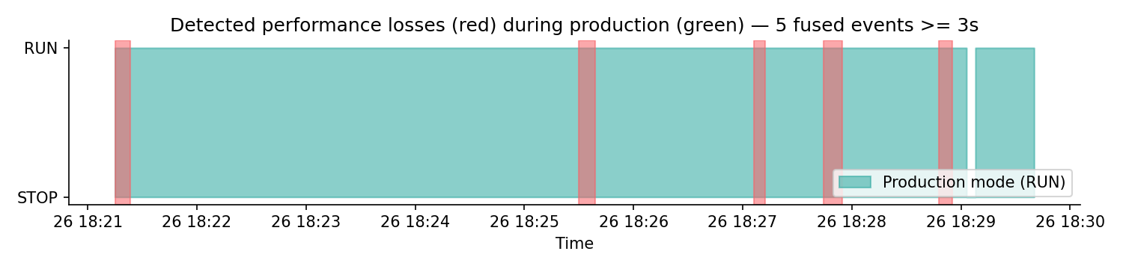
EVALUATION · TIMELINE
We found 5 stops — here's where they sit in the recording
5
41.0 s
500.4 s
91.8 %
86.8 %
stops
total stop time
production run
Performance (P)
K-Means agrees
Applied Industrial AI for Manufacturing · Mini-Project 1 · HS Albstadt-Sigmaringen / plus10 GmbH
6 / 12

Slide 8
Which station caused each stop?
EVALUATION · ATTRIBUTION
Warehouse
2 stops · 17.8 s
Robot
2 stops · 14.7 s
Unknown
1 stop · 8.5 s
* 'Unknown' = the stop happened right at the start of the recording, so there was no prior activity to link it to.
Warehouse and Robot together account for 4 of the 5 stops and 32.5 s of the 41 s total — those two stations are the clear focus for any follow-up investigation.
Applied Industrial AI for Manufacturing · Mini-Project 1 · HS Albstadt-Sigmaringen / plus10 GmbH
7 / 12

Slide 9
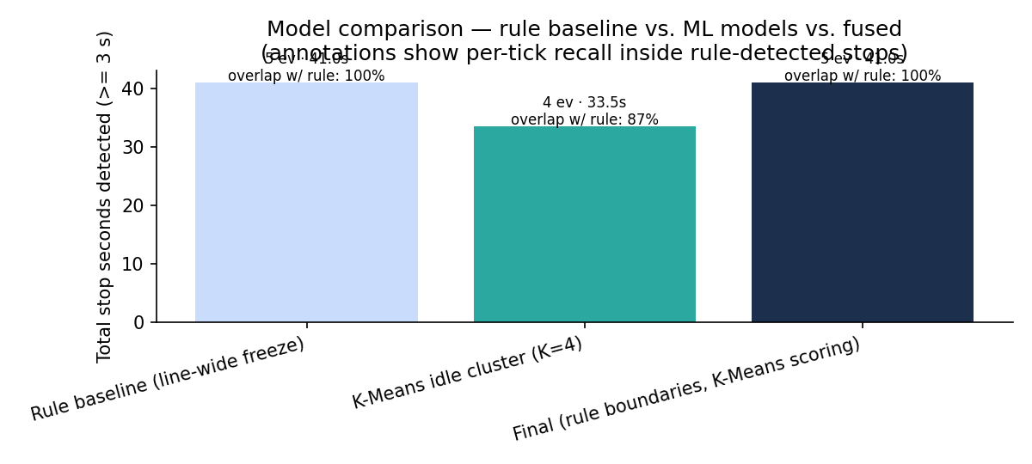
EVALUATION · MODEL COMPARISON
What does K-Means actually add on top of the rule?
Honest read:
The rule finds 5 stops totalling 41 s — that's our headline result.
K-Means on its own finds fewer ticks (it misses parts of some stops), so we don't use it as the primary detector.
Where it adds value: it confirms 86.8 % of the rule's stop ticks and gives a 'surprise score' per stop, which is useful for prioritising.
"The rule draws the boundary. K-Means tells us how unusual each stop really was."
Applied Industrial AI for Manufacturing · Mini-Project 1 · HS Albstadt-Sigmaringen / plus10 GmbH
8 / 12

Slide 10
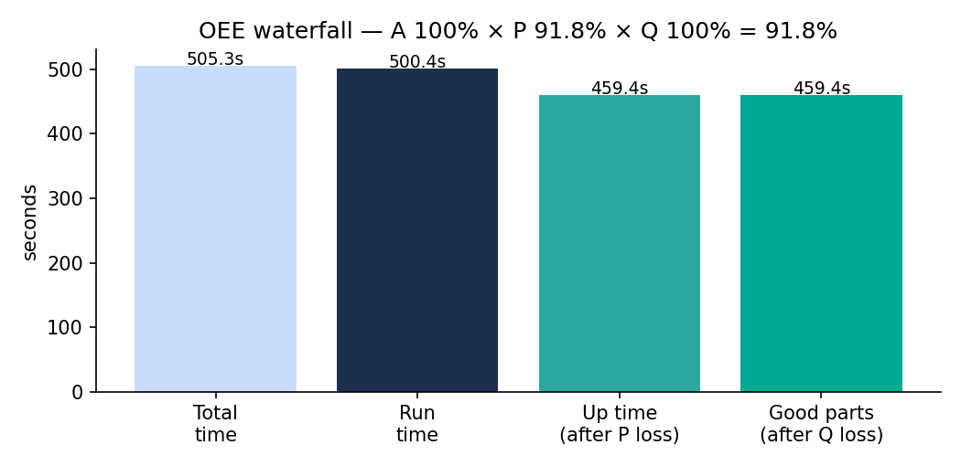
KEY PERFORMANCE INDICATORS
OEE for this recording window
A
100 %
no breakdowns in window
P
91.8 %
41.0 s lost / 500.4 s run
Q
100 %
no scrap data in this snippet
⇒ OEE = 91.8 % (based on this 8-minute slice, assuming A and Q = 100 %)
Applied Industrial AI for Manufacturing · Mini-Project 1 · HS Albstadt-Sigmaringen / plus10 GmbH
9 / 12

Slide 11
INDIVIDUAL CONTRIBUTIONS
Who did what
Ephraim Neke Kamalu
Abeera Biju
Business & Data Understanding
Data Preparation
Aligned timestamps across both PLCs, built the variable-to-station map from Variablenerklärung.xlsx.
Cleaned the raw CSVs, ran the 20 ms Nyquist-justified resampling, and engineered the 21 features.
Pratiksha Satish Ramane
Geo Shajan
Modelling & Evaluation
Deployment & Reporting
Built the K-Means model (K = 4), identified the idle cluster, scored each stop, ran the attribution analysis and model comparison.
Assembled the engineer table, wrote the project report.
Applied Industrial AI for Manufacturing · Mini-Project 1 · HS Albstadt-Sigmaringen / plus10 GmbH
10 / 12

Slide 12
Thank you
Applied Industrial AI for Manufacturing · Mini-Project 1
Ephraim Neke Kamalu · Pratiksha Satish Ramane · Abeera Biju · Geo Shajan

