Slide 1
UAVware based VTOL Apps
dRehmFlight
OpenAeroVTOL
Mixer
PID
Config
Mixer
PID
Config
Application Layer
UAVWare – Unmanned Vehicle Services
UAV Services Layer
Sched
MPU
RC Rx
Telem
Logging
Storage
Servo
dShot
UVOS – Unmanned Vehicle OS
Hardware Driver Layer
Flight Controller
Hardware

Slide 2

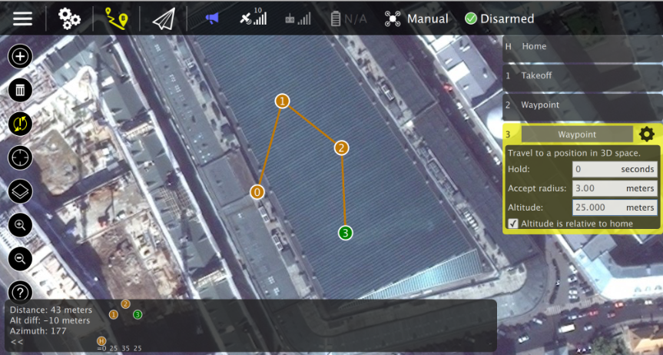
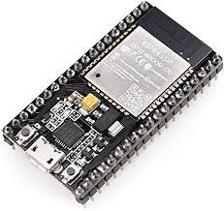


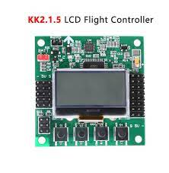
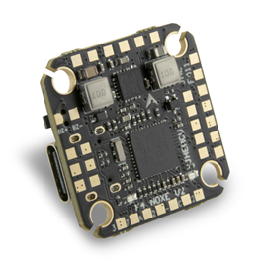
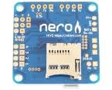
UAVWare with MAVLink Telemetry Based Interface
QGroundControl GCS
ESP32 or ESP8266 Serial to Wi-Fi Bridge
Flight Controller App
UAVWare
KK 2.1.5 with Arduino as MAVLink Input Device

